Slide 1
Purdue CS555: Cryptography Lecture 1
Instructor: Hanshen Xiao
Teaching Assistant: Justin He
course website: https://cs55500.github.io/ (under construction)

Slide 2
Course Staff Information
Instructor: Hanshen Xiao
Email: hsxiao@purdue.edu
Office: 2142 E, Lawson Building
Office hour: 10:30 – 11:30 Tue
Teaching Assistant: Justin He
Email: he924@purdue.edu
Office hour and location: TBD

Slide 3
Useful Books and Lecture Notes
Lecture Notes on Cryptography, by Shafi Goldwasser and Mihir Bellare
Introduction to Modern Cryptography, by Jonathan Katz and Yehuda Lindell
Additional recommended materials/papers for each lecture will be added on our website

Slide 4
Administrivia
Piazza for questions
Gradescope for Psets
Homework (40%)
4 problem sets in total, 2 weeks for each
Mid-term Exam (25%)
Class participation (5%)
Final Project (30%)
Group (2 people) presentation (20 min) on a cryptography application
Bonus (5% + 5%)
lecture notes (4 weeks)
bonus problems in each pset

Slide 5




Purdue CS555: Cryptography Primitives, Toolkits, Applications and Methodology

Slide 6

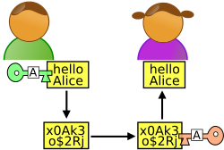
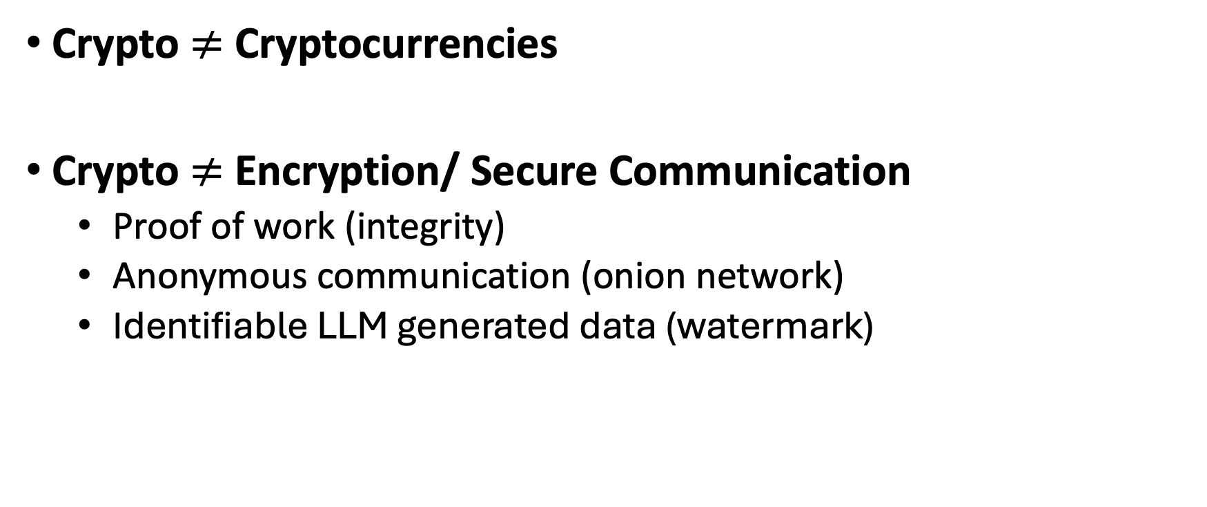
False Impression of Crypto
Crypto $≠$ Cryptocurrencies
Crypto $≠$ Encryption/ Secure Communication
Proof of work (integrity)
Anonymous communication (onion network)
Identifiable LLM generated data (watermark)
m
Alice
Bob
Eavesdropper “Eve”

Slide 7
Syllabus
Background of Information Security (2 weeks)
Privacy and types of leakage
Threat model
Indistinguishability – semantic security risk language
Computational hardness
Pseudorandomness and One-way Function (2.5 weeks)
Pseudorandom generator
Pseudorandom function and Goldreich-Goldwasser-Micali (GGM) construction
Authentication and message-authentication codes (MAC)
Hardcore bit and Goldreich-Levin theorem

Slide 8
Syllabus
Public-key Encryption (2 weeks)
Diffie-Hellman key exchange
RSA
Quadratic residuosity
Learning with errors
Digital Signature and Hash Function (1 week)
Secret Sharing (1 week)

Slide 9
Syllabus
Homomorphic Encryption (1 week)
Zero Knowledge Proof (1 week)
Private Information Retrieval (1 week)
Applications (3 weeks, final presentation)
Anonymous commutation
LLM watermark
Multi-party computation and federal machine learning
Side-channel leakage mitigation
Trusted execution environment & cryptography

Slide 10
High Level Picture of Crypto Research
CRYPTO
Theoretical Computer Science
& Math
System & Hardware

Slide 11


High Level Picture of Crypto Research
CRYPTO
Theoretical Computer Science
& Math
System & Hardware
Assumptions
Performance

Slide 12
High Level Picture of Crypto Research
CS 35500 - Introduction To Cryptography
CS 65500 - Advanced Cryptology
ECET 53600 - Embedded Systems Security
ECE 62700 - Introduction To Cryptography And Secure Communication
CRYPTO
Theoretical Computer Science
& Math
Security proof via reduction
System & Hardware
Accelerating cryptography related computation
Assumptions
Performance

Slide 13
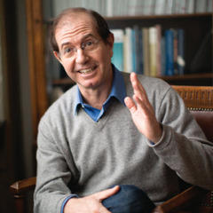
High Level Picture of Crypto Research
If there is an (efficient) adversary that breaks scheme A w.r.t. definition D, then there is an (efficient) adversary that factors large numbers
CRYPTO
Theoretical Computer Science
& Math
Security proof via reduction
Science wins either way
System & Hardware
Accelerating cryptography related computation
Assumptions
Performance

Slide 14
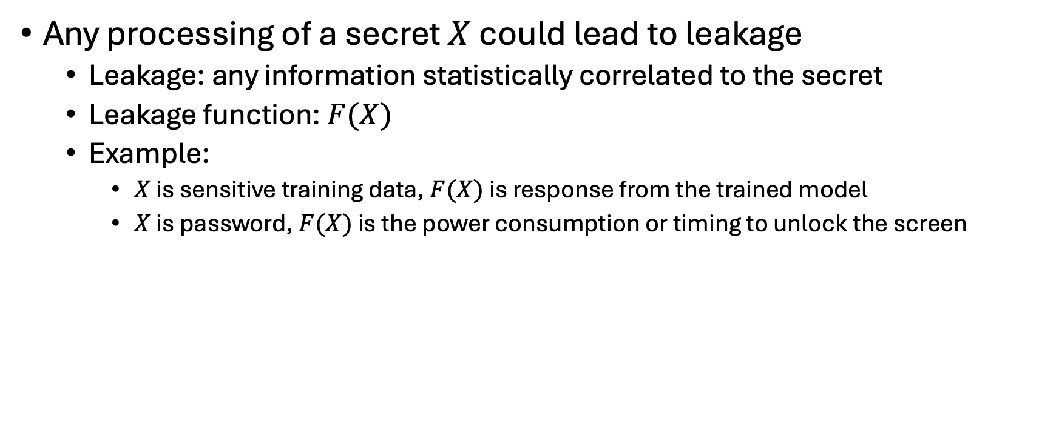
Information Leakage
Any processing of a secret $X$ could lead to leakage
Leakage: any information statistically correlated to the secret
Leakage function: $F(X)$
Example:
$X$ is sensitive training data, $F(X)$ is response from the trained model
$X$ is password, $F(X)$ is the power consumption or timing to unlock the screen

Slide 15

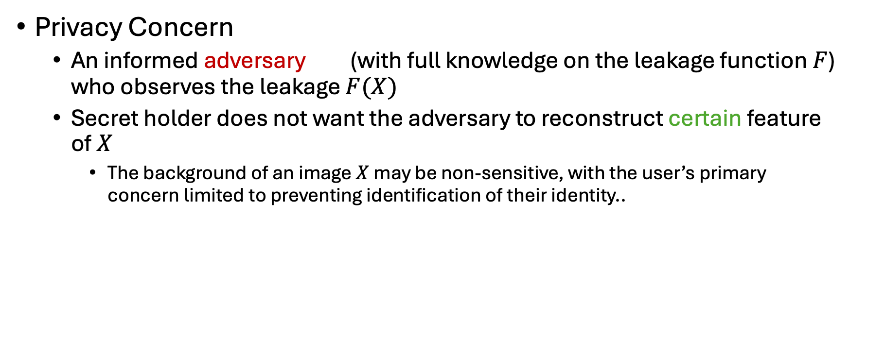
Privacy Concern
Privacy Concern
An informed adversary (with full knowledge on the leakage function $F$) who observes the leakage $F(X)$
Secret holder does not want the adversary to reconstruct certain feature of $X$
The background of an image $X$ may be non-sensitive, with the user’s primary concern limited to preventing identification of their identity..

Slide 16
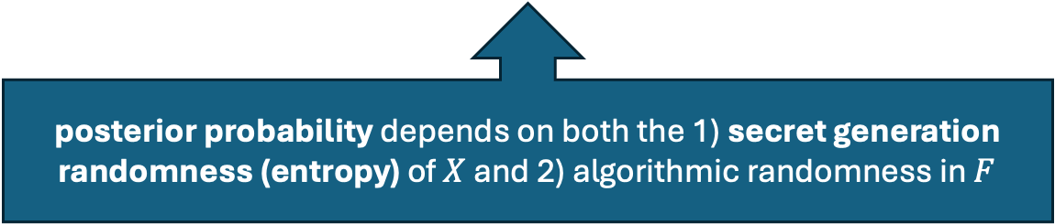
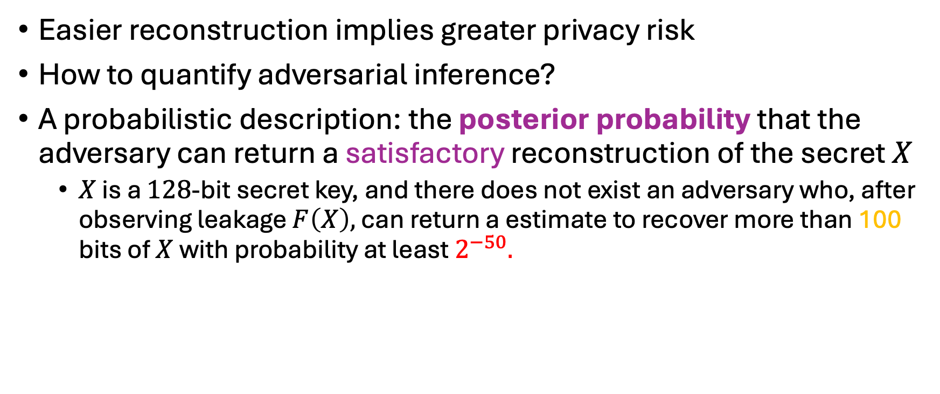
Privacy Risk Quantification and Guarantees
Easier reconstruction implies greater privacy risk
How to quantify adversarial inference?
A probabilistic description: the posterior probability that the adversary can return a satisfactory reconstruction of the secret $X$
$X$ is a $128$-bit secret key, and there does not exist an adversary who, after observing leakage $F\left(X\right),$ can return a estimate to recover more than 100 bits of $X$ with probability at least $2^{−50}.$
posterior probability depends on both the 1) secret generation randomness (entropy) of $X$ and 2) algorithmic randomness in $F$

Slide 17
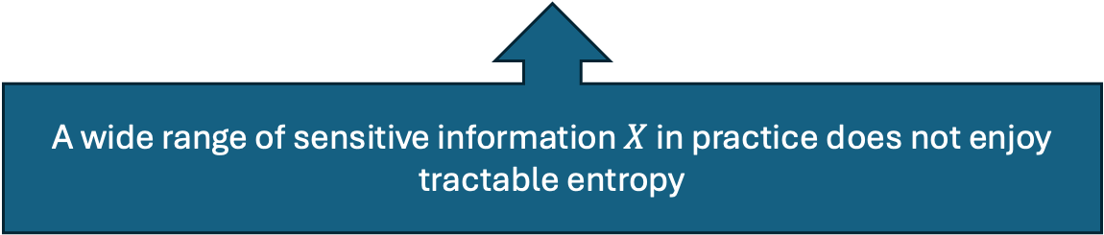
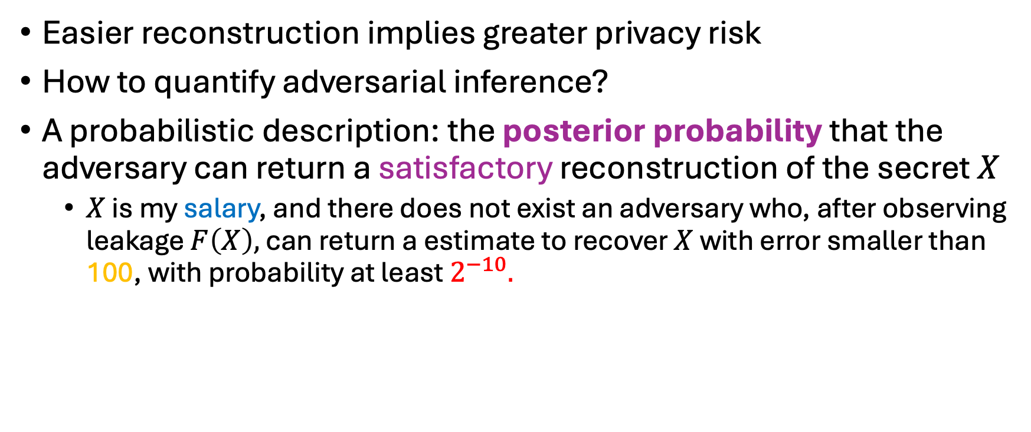
Privacy Risk Quantification and Guarantees
Easier reconstruction implies greater privacy risk
How to quantify adversarial inference?
A probabilistic description: the posterior probability that the adversary can return a satisfactory reconstruction of the secret $X$
$X$ is my salary, and there does not exist an adversary who, after observing leakage $F\left(X\right),$ can return a estimate to recover $X$ with error smaller than 100, with probability at least $2^{−10}.$
A wide range of sensitive information $X$ in practice does not enjoy tractable entropy

Slide 18


Privacy Risk Quantification and Guarantees
Removing assumptions on secret distribution with worst-case analysis
-- guarantees hold for arbitrary distribution of $X$
Easier reconstruction implies greater privacy risk
How to quantify adversarial inference?
A probabilistic description: the posterior probability that the adversary can return a satisfactory reconstruction of the secret $X$
$X$ is my salary, and there does not exist an adversary who, after observing leakage $F\left(X\right),$ can return a estimate to recover $X$ with error smaller than 100, with probability at least $2^{−10}.$
A wide range of sensitive information $X$ in practice does not enjoy tractable entropy

Slide 19
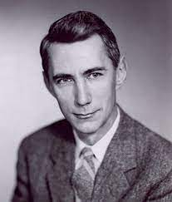
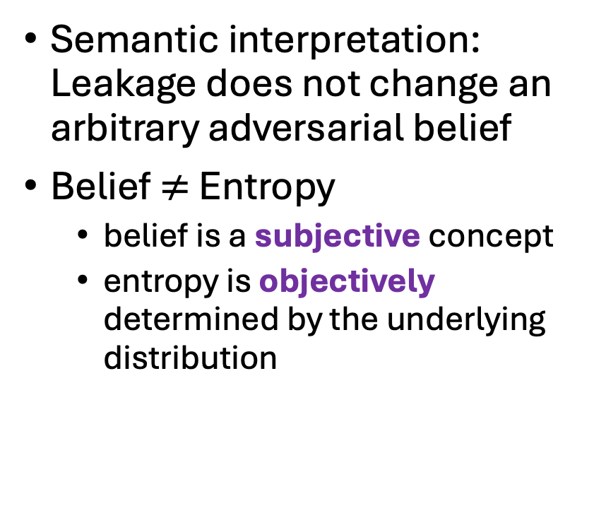
From Probability to Belief
Semantic interpretation: Leakage does not change an arbitrary adversarial belief
Belief $≠$ Entropy
belief is a subjective concept
entropy is objectively determined by the underlying distribution
Claude E. Shannon
“Communication Theory of Secrecy Systems” (1945)
founded information security
“A Mathematical Theory of Communication” (1948)
founded information theory

Slide 20
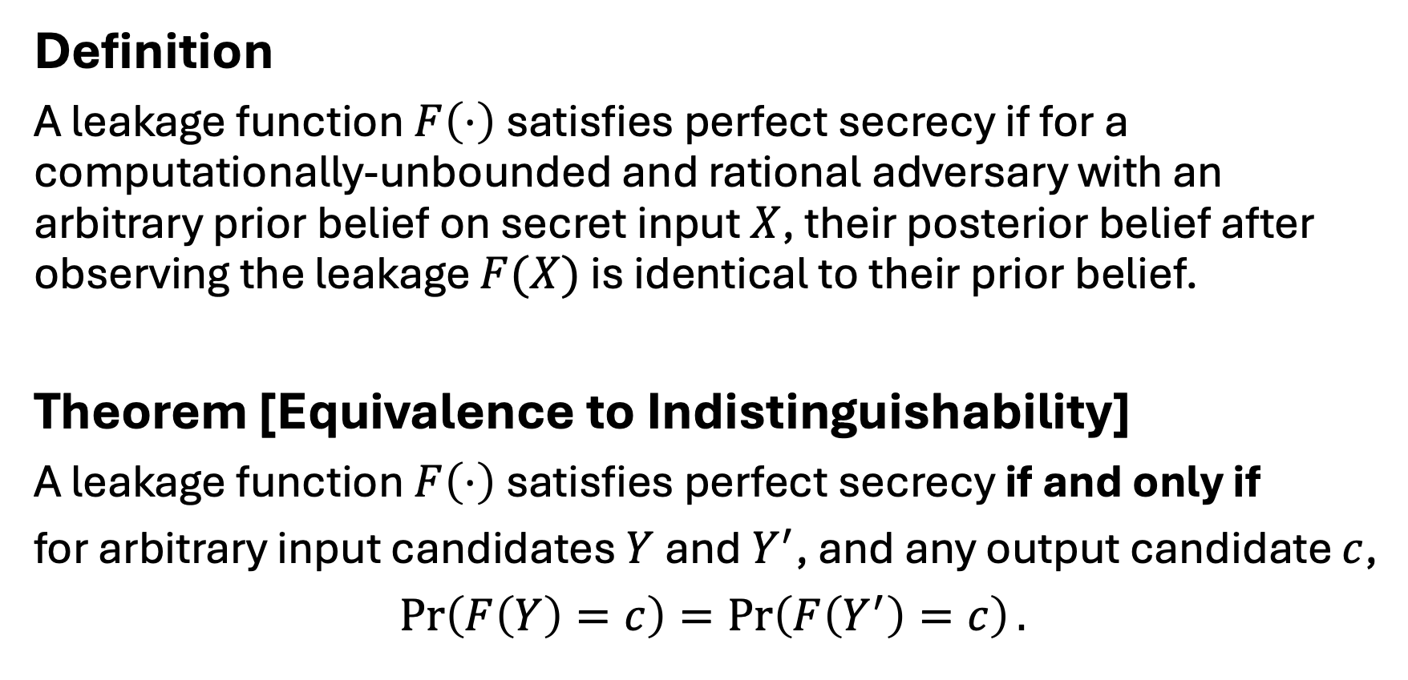
Perfect Secrecy
Definition
A leakage function $F\left(⋅\right)$ satisfies perfect secrecy if for a computationally-unbounded and rational adversary with an arbitrary prior belief on secret input $X$, their posterior belief after observing the leakage $F(X)$ is identical to their prior belief.
Theorem [Equivalence to Indistinguishability]
A leakage function $F\left(⋅\right)$ satisfies perfect secrecy if and only if
for arbitrary input candidates $Y$ and $Y^{′}$, and any output candidate $c$,
$\operatorname{Pr}\left(F\left(Y\right)=c\right)=\operatorname{Pr}\left(F\left(Y^{′}\right)=c\right).$
identical likelihoods

Slide 21
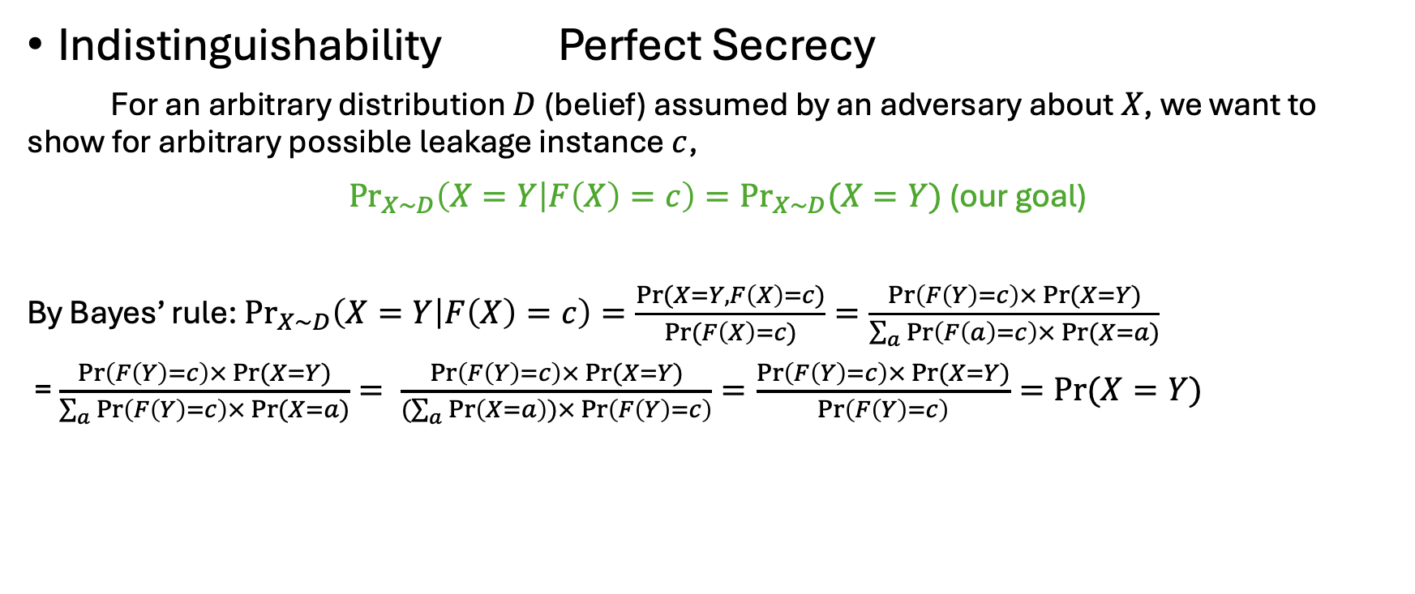
Proof
Indistinguishability Perfect Secrecy
For an arbitrary distribution $D$ (belief) assumed by an adversary about $X$, we want to show for arbitrary possible leakage instance $c$,
${Pr}_{X∼D}\left(X=Y | F\left(X\right)=c\right)={Pr}_{X∼D}{(X=Y)}$ (our goal)
By Bayes’ rule: ${Pr}_{X∼D}\left(X=Y | F\left(X\right)=c\right)=\frac{\operatorname{Pr}{(X=Y, F\left(X\right)=c)}}{\operatorname{Pr}{(F\left(X\right)=c)}}=\frac{\operatorname{Pr}\left(F\left(Y\right)=c\right)×\operatorname{Pr}{(X=Y)}}{\sum_{a}{\operatorname{Pr}\left(F\left(a\right)=c\right)×\operatorname{Pr}{(X=a)}}}$
= $\frac{\operatorname{Pr}\left(F\left(Y\right)=c\right)×\operatorname{Pr}{(X=Y)}}{\sum_{a}{\operatorname{Pr}\left(F\left(Y\right)=c\right)×\operatorname{Pr}{(X=a)}}}= \frac{\operatorname{Pr}\left(F\left(Y\right)=c\right)×\operatorname{Pr}{(X=Y)}}{(\sum_{a}{\operatorname{Pr}\left(X=a\right)})×\operatorname{Pr}\left(F\left(Y\right)=c\right)}=\frac{\operatorname{Pr}\left(F\left(Y\right)=c\right)×\operatorname{Pr}{(X=Y)}}{\operatorname{Pr}\left(F\left(Y\right)=c\right)}=\operatorname{Pr}{(X=Y)}$
total probability

Slide 22
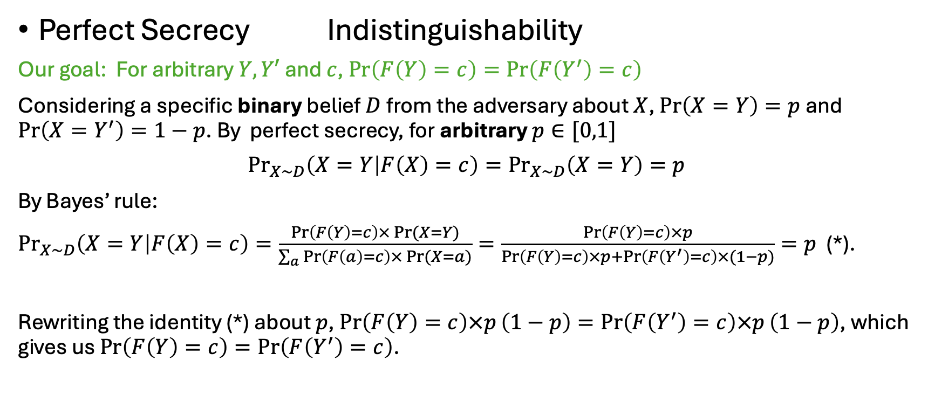
Proof
Perfect Secrecy Indistinguishability
Our goal: For arbitrary $Y,Y′$ and $c$, $\operatorname{Pr}\left(F\left(Y\right)=c\right)=\operatorname{Pr}\left(F\left(Y^{′}\right)=c\right)$
Considering a specific binary belief $D$ from the adversary about $X$, $\operatorname{Pr}\left(X=Y\right)=p$ and $\operatorname{Pr}\left(X=Y^{′}\right)=1−p$. By perfect secrecy, for arbitrary $p∈[0,1]$
${Pr}_{X∼D}\left(X=Y | F\left(X\right)=c\right)={Pr}_{X∼D}\left(X=Y\right)=p$
By Bayes’ rule:
${Pr}_{X∼D}\left(X=Y | F\left(X\right)=c\right)=\frac{\operatorname{Pr}\left(F\left(Y\right)=c\right)×\operatorname{Pr}{(X=Y)}}{\sum_{a}{\operatorname{Pr}\left(F\left(a\right)=c\right)×\operatorname{Pr}{(X=a)}}}=\frac{\operatorname{Pr}\left(F\left(Y\right)=c\right)×p}{\operatorname{Pr}\left(F\left(Y\right)=c\right)×p+\operatorname{Pr}\left(F\left(Y^{′}\right)=c\right)×(1−p)}=p$ (*).
Rewriting the identity (*) about $p$, $\operatorname{Pr}\left(F\left(Y\right)=c\right)×p\left(1−p\right)=\operatorname{Pr}\left(F\left(Y^{′}\right)=c\right)×p\left(1−p\right)$, which gives us $\operatorname{Pr}\left(F\left(Y\right)=c\right)=\operatorname{Pr}\left(F\left(Y^{′}\right)=c\right)$.

Slide 23
Comments
Perfect secrecy initializes the privacy risk measurement from the worst-case posterior advantage angle, i.e., difference between the prior and posterior, rather than absolute measure of the posterior itself
Invariant belief input-independent indistinguishability
Operationally, indistinguishability (binary hypothesis testing) is a special adversarial inference.
No additional advantage for any adversarial inference
input-independent indistinguishability

Slide 24



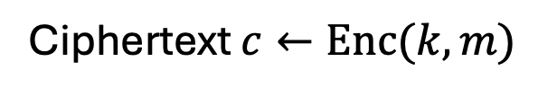
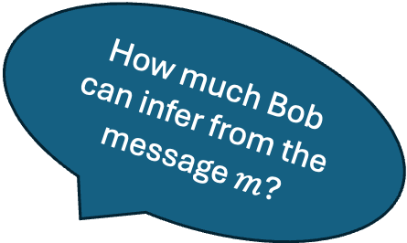
Two Types of Leakage
Private Communication against outside adversary
How much Bob can infer from the message $m$?
$m$
Ciphertext $c←Enc(k,m)$
$$m←Dec(k,c)$$
Key k
Key k
Alice
Bob

Slide 25
Two Types of Leakage
Private Communication against outside adversary
-- intermediate secrecy
Public Release
-- output secrecy
-- tradeoff between information propagation and obfuscation
U.S. Census releases average salaries and population ages in Indiana
ChatGPT responses
Side-channel leakage

Slide 26
Intermediate Secrecy
(Cryptography)
Free lunch in terms of accuracy/utility is possible under additional assumptions
Two main research problems
Weaker assumptions: reduction to more fundamental hard problems
Computational efficiency: efficient primitives and protocols
Perfect indistinguishability
Output Secrecy
(Information Theory and Statistic)
No free lunch in terms of accuracy/utility
Key research problem: optimal utility-privacy tradeoff (e.g., minimal noise/randomization for required privacy guarantees)
Non-zero posterior advantage

