Slide 1
Causality and ML
CS5785 Fall 2019
Xiaojie Mao

Slide 2
Feed your man to keep him faithful
From match.com:
“Ladies, you probably think that it’s just in his nature. He can’t help it – he HAS to cheat. But here’s the sad truth: you’re not feeding him enough. If you’re worried your guy might cheat, try checking out his waistline. A new study says the size of his belly may reveal whether he’ll stray.”
Can also be subtler and less ridiculous:
Smokers have more lung cancer. Stop smoking!
Democracies have higher GDPs overall. To improve the economy of your country, democratize.
People who have master degrees overall have higher income. Go for master education to earn more.
Notes:
Often we make causal statements without realizing them
Ask students what is the cause and what is the consequence.
Intervention and prescription

Slide 3
What is causality?
Did A (outcome or consequence) happen because of B (cause, treatment or intervention)?
Perhaps easier to understand as: How different would A be under B₁ vs B₀, keeping everything else constant?
Key problem: We only know A under B_{realized}; A under B_{not realized} is an unknown counterfactual
AKA “The Fundamental Problem of Causal Inference”
“What if” counterfactual question.
Correlation/association is not causation
Notes:
All of the statements there have a common feature. They are about whether one event A happened because of another event B. Here we call A as outcome; B as cause. In most cases, we consider cause that can be intervened, so we may also call B as intervention or treatment.
But what do we really talk about when we think causally? Actually, when we make causal statements like this, we usually Implicitly compare the outcomes under different scenarios in terms of the causes.
Read the sentence.
So when we investigate the effect of smoking, A might be the health status, and B1 is smoking, and B0 is no smoking.
Disclaimer: here we only consider very well defined binary cause: the cause either happens, or it doesn’t happen. Of course, in practice, things can be a lot more complicated. For example, in smoking, what really matters is not whether a person smokes or not, but how often this person smokes.
We’d like to compare the health status of a person if this person smoked, and the health status of this person if he/she didn’t smoke, with everything else keeps fixed.
In other words, we can think of two parallel universes, and this person smokes in one universe, and doesn’t smoke in the other, and other than smoking, this person is the same in two universes. Suppose we have the magic to peek into both universes, then the causal effect of smoking for this person is exactly the difference of the health status of this person in these two universes.
For example, if the person has higher chance of dying from lung cancer in the universe where he/she smokes, then this means that smoking indeed causes lung cancer. On the contrary, if the person has equal chance of dying from lung cancer in both universes, then smoking doesn’t have causal effect on lung cancer. After all, the chance of dying from cancer is the same, whether this person smokes or not.
Correlation/association is not causation: keeping everything else constant.

Slide 4
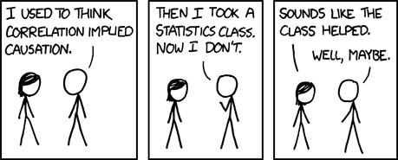
Association and Causation
Notes:
Which one is correlation statement and which one is a causal statement?

Slide 5
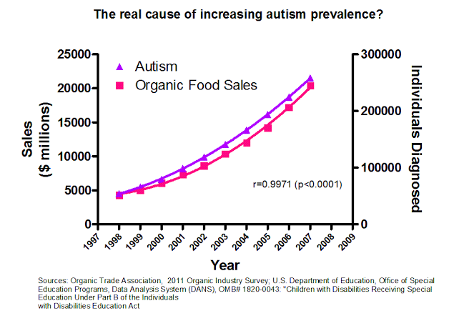
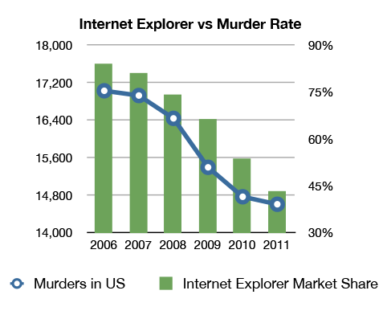
Can you provide any non-causal alternative explanation to the observed association?
Notes:
Do you think this really implies causality? Does this mean in order to reduce autism prevalence, we should abandon organic food?
Why this is not causality? Can you think any non-causal explanation for such association?
What if you fit a machine learning model to this? It probably simply picks some spurious correlation.
We human beings have common sense, so we are better at making causal conclusions. This also reveals that Domain knowledge really helps. Also the existence of alternative explanations is really an important way to refute causal statements.

Slide 6
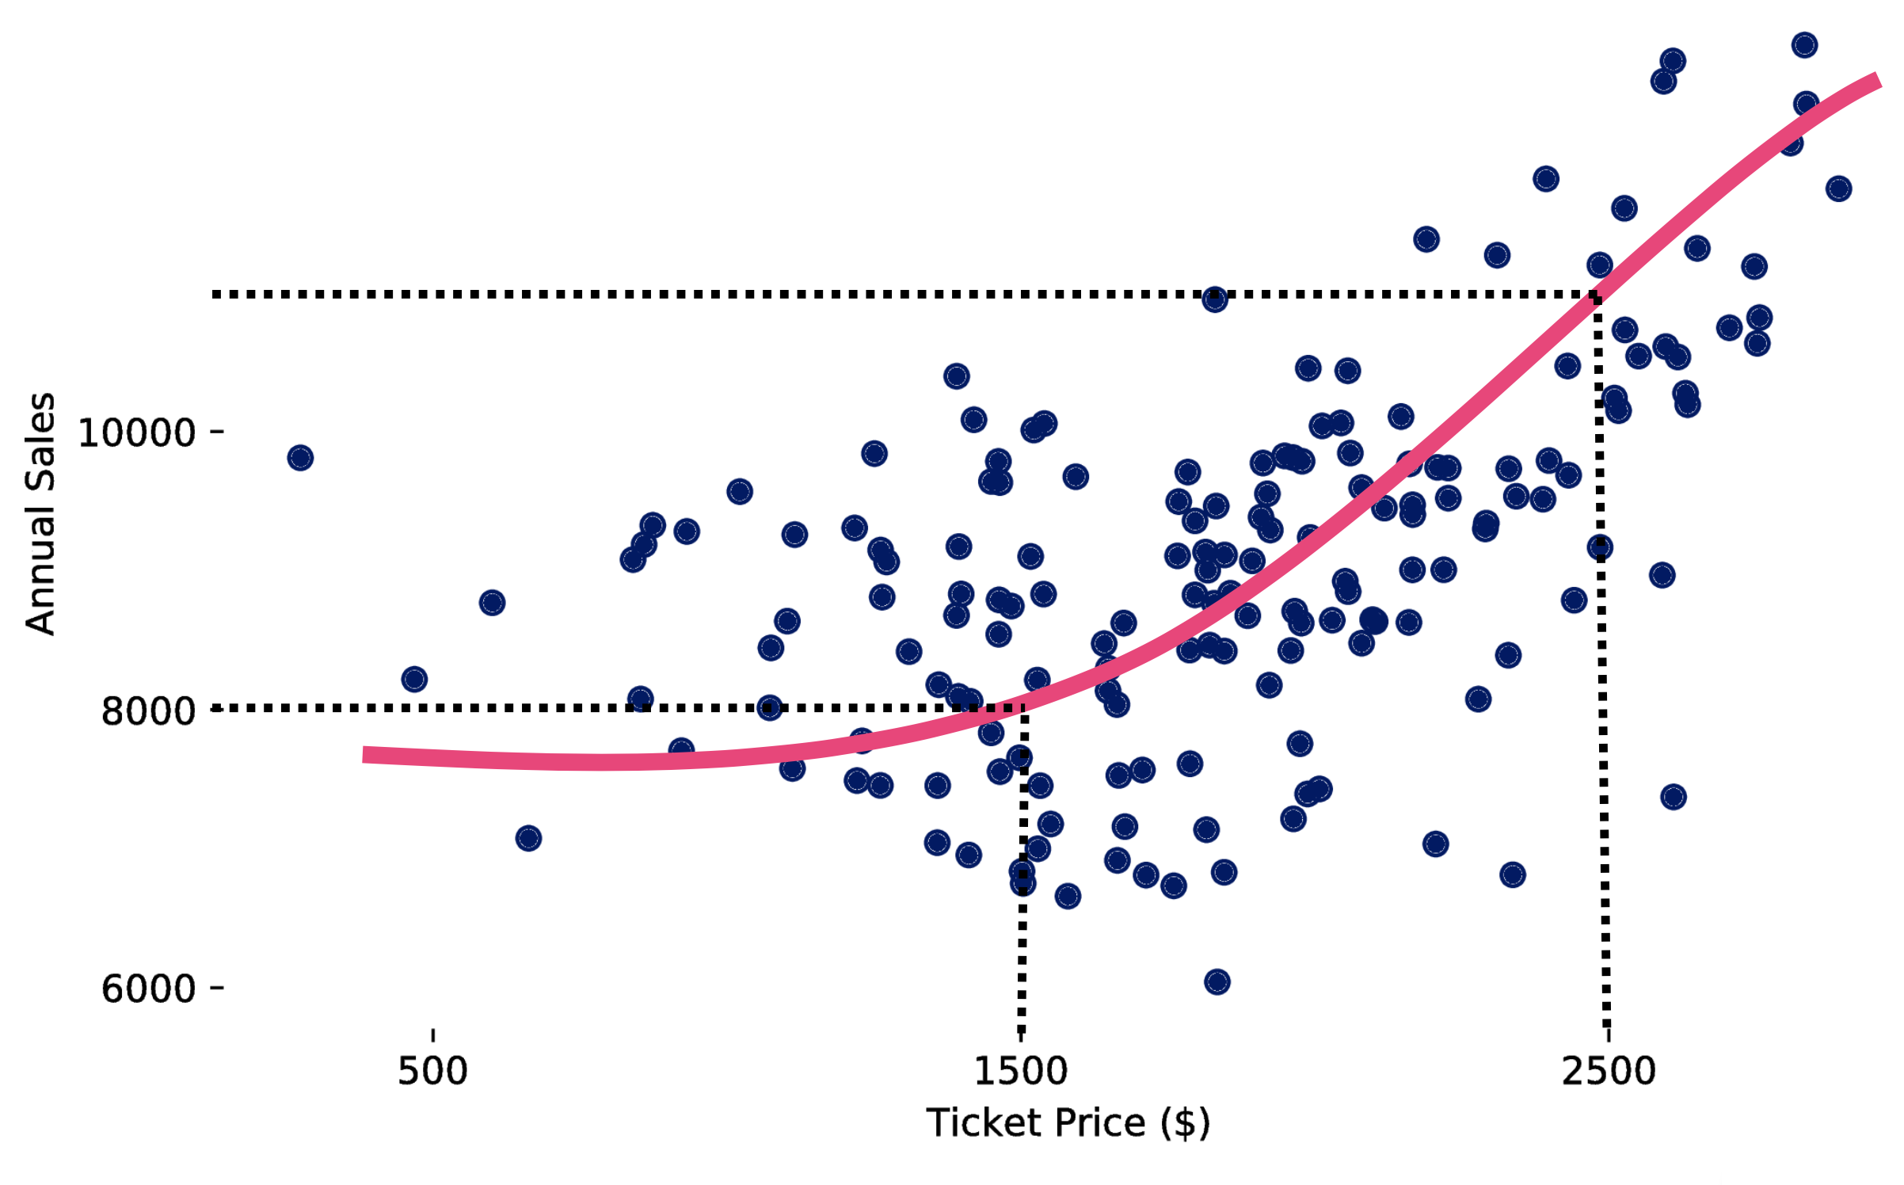
Does the positive correlation mean the increase in ticket prices causes the increase in annual sales?
Notes:
There are many reasons why we observe certain correlations other than causal explanation.

Slide 7

Supervised Learning + Causality
Plan to sell my house
Want to know if changing the exterior siding from vinyl to wood will increase the eventual sale price
Luckily House Prices Kaggle has feature “Exterior”
What causal question would you ask?
Notes:
If you are a data scientist for a real estate company and you want to answer this question. Do you need to think causality? If so, what is the causal question that you’d like to ask?

Slide 8
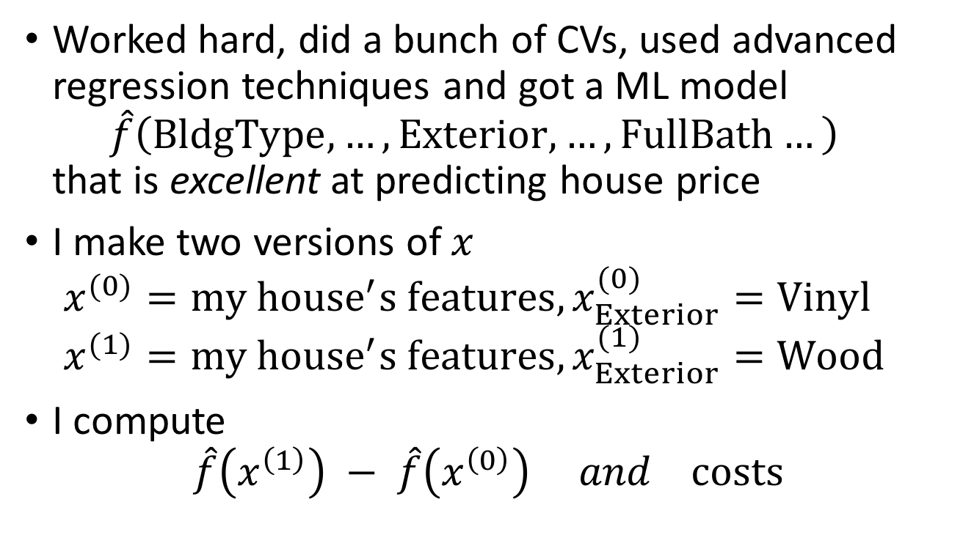
Supervised Learning + Causality
Worked hard, did a bunch of CVs, used advanced regression techniques and got a ML model $\hat{f}\left(BldgType,…,Exterior,…,FullBath…\right)$ that is excellent at predicting house price
I make two versions of $x$ $x^{(0)}=my {house}^{′}s features, x_{Exterior}^{(0)}=Vinyl$ $x^{(1)}=my {house}^{′}s features, x_{Exterior}^{(1)}=Wood$
I compute $\hat{f}\left(x^{\left(1\right)}\right) − \hat{f}\left(x^{\left(0\right)}\right) and costs$

Slide 9
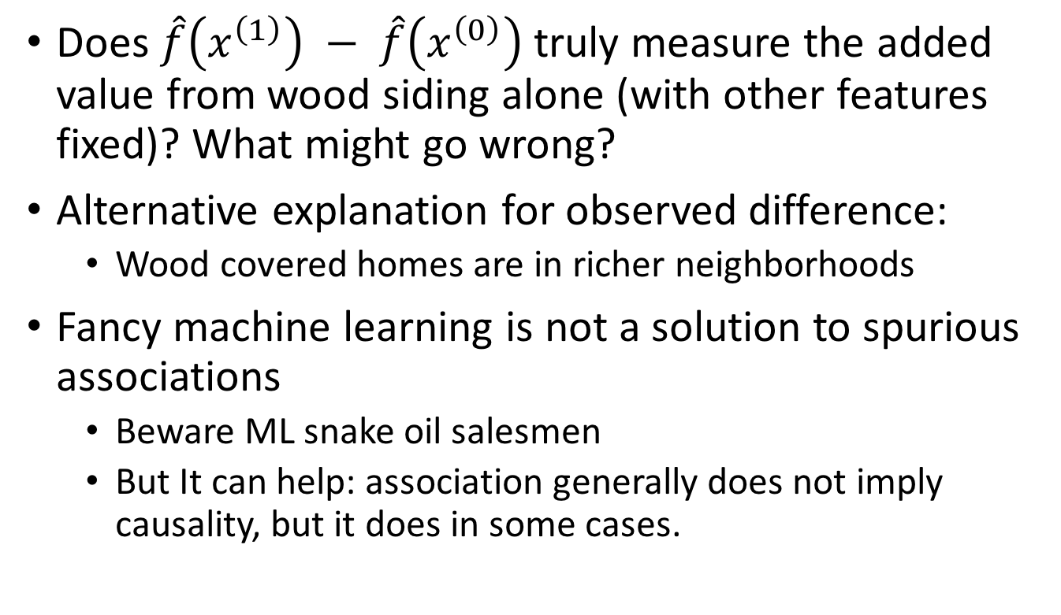
Supervised Learning + Causality
Does $\hat{f}\left(x^{\left(1\right)}\right) − \hat{f}\left(x^{\left(0\right)}\right)$ truly measure the added value from wood siding alone (with other features fixed)? What might go wrong?
Alternative explanation for observed difference:
Wood covered homes are in richer neighborhoods
Fancy machine learning is not a solution to spurious associations
Beware ML snake oil salesmen
But It can help: association generally does not imply causality, but it does in some cases.
Notes:
Why things can go wrong?
Associations do not imply causality; ML only captures associations; Association analysis under a certain condition is helpful for drawing causal conclusion.

Slide 10
Confounder and alternative explanation
Rich Neighborhood?
Wood or Vinly Siding
？
House Value
Confounder: variables that influence both the treatment
choice and the outcome.

Slide 11
Controlled Experiments vs Observational Studies
Controlled experiment: a situation where researcher controls assignment to “treatment”
Controlled experiment examples
Clinical trial for effect of new drug
A/B test for webpage ad placement
Change house siding materials at random
Eliminate all possible alternative explanations
Any observed difference must be due to the “treatment” alone or chance alone
Hypothesis tests: assuming treatment does nothing, how likely is an observed difference of the magnitude observed
Reject “treatment does nothing” if very unlikely (p<0.05)
Notes:
Use the house sales example to introduce the idea of confounder

Slide 12
Controlled experiments rule out alternative explanation
Rich Neighborhood?
Wood or Vinly Siding
？
House Value

Slide 13
Controlled experiments rule out alternative explanation
Rich Neighborhood?
Wood or Vinly Siding
House Value
Notes:
Rich neighborhood is unobserved so that we cannot adjust for its effect

Slide 14
Controlled Experiments vs Observational Studies
Observational study: we passively observe treatment identities and outcomes
Why this matters?
Observational study examples
What’s the effect of smoking on lung cancer incidence?
What’s the effect of lead in kid’s home on his/her performance in school?
What’s the effect of a Cornell degree on future income?
No way to construct a controlled experiment: unethical, expensive, etc.
Notes:
Can we construct controlled experiment here?

Slide 15
A More ML-ish Example: Personalized Medicine
Patient “Anna” comes in with hypertenstion
Asian, 54, history of diabetes, blood pressure 150/95, has genotype features X, …
Will a specific type of medication lower her blood pressure? E.g., ACE inhibitor.
EHR data from 100s of millions of other patients
Find similar patients who received ACE inhabitor and those who didn’t
Build fancy regression model
Same problem as in house prices: confounders or alternative explanations (any example?) are possible for lack of control over treatment choice.
Notes:
Why same problem as in house prices can occur? Anybody can think of alternative explanation?
It’s too expensive to do experiments here.

Slide 16
Simpson’s paradox
UC Berkeley admissions for 1973:
Even harder to design experiments.
Does this mean gender causally affect the admission result? Any alternative explanation?
 | Applied | Admitted
Men | 8442 | 44%
Women | 4321 | 35%
Notes:
This must be observational study

Slide 17
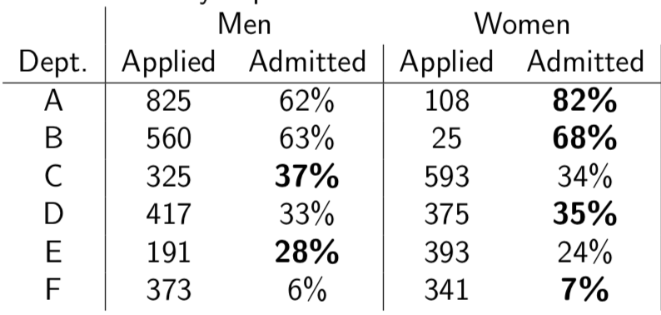
Simpson’s paradox
UC Berkeley admissions for 1973:
In fact, small gender bias in favor of women
Women just happen to apply to more competitive departments
Totally wrong conclusion when we ignore possible alternative explanations.
Notes:
What can you find from this table?

Slide 18
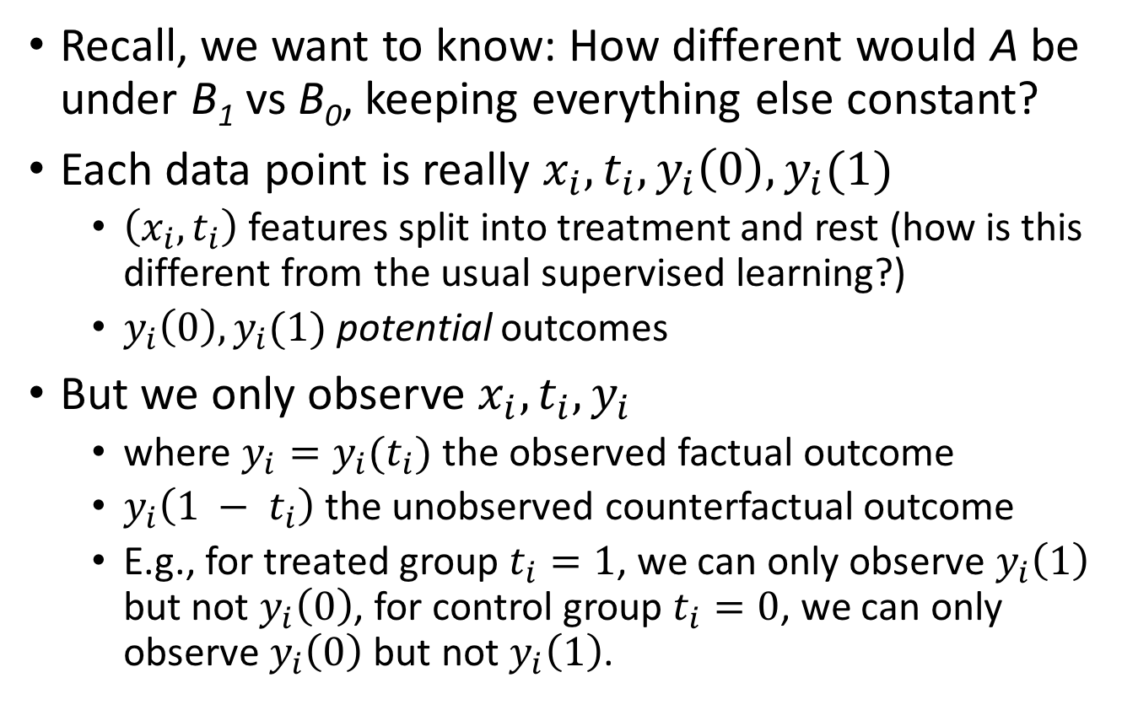
Formulations
Recall, we want to know: How different would A be under B₁ vs B₀, keeping everything else constant?
Each data point is really $x_{i},t_{i},y_{i}\left(0\right),y_{i}(1)$
$\left(x_{i},t_{i}\right)$ features split into treatment and rest (how is this different from the usual supervised learning?)
$y_{i}\left(0\right),y_{i}(1)$ potential outcomes
But we only observe $x_{i},t_{i},y_{i}$
where $y_{i}=y_{i}(t_{i})$ the observed factual outcome
$y_{i}\left({1 − t}_{i}\right)$ the unobserved counterfactual outcome
E.g., for treated group $t_{i}=1$, we can only observe $y_{i}\left(1\right)$ but not $y_{i}\left(0\right)$, for control group $t_{i}=0$, we can only observe $y_{i}\left(0\right)$ but not $y_{i}\left(1\right)$.
Notes:
Causal effect estimands

Slide 19
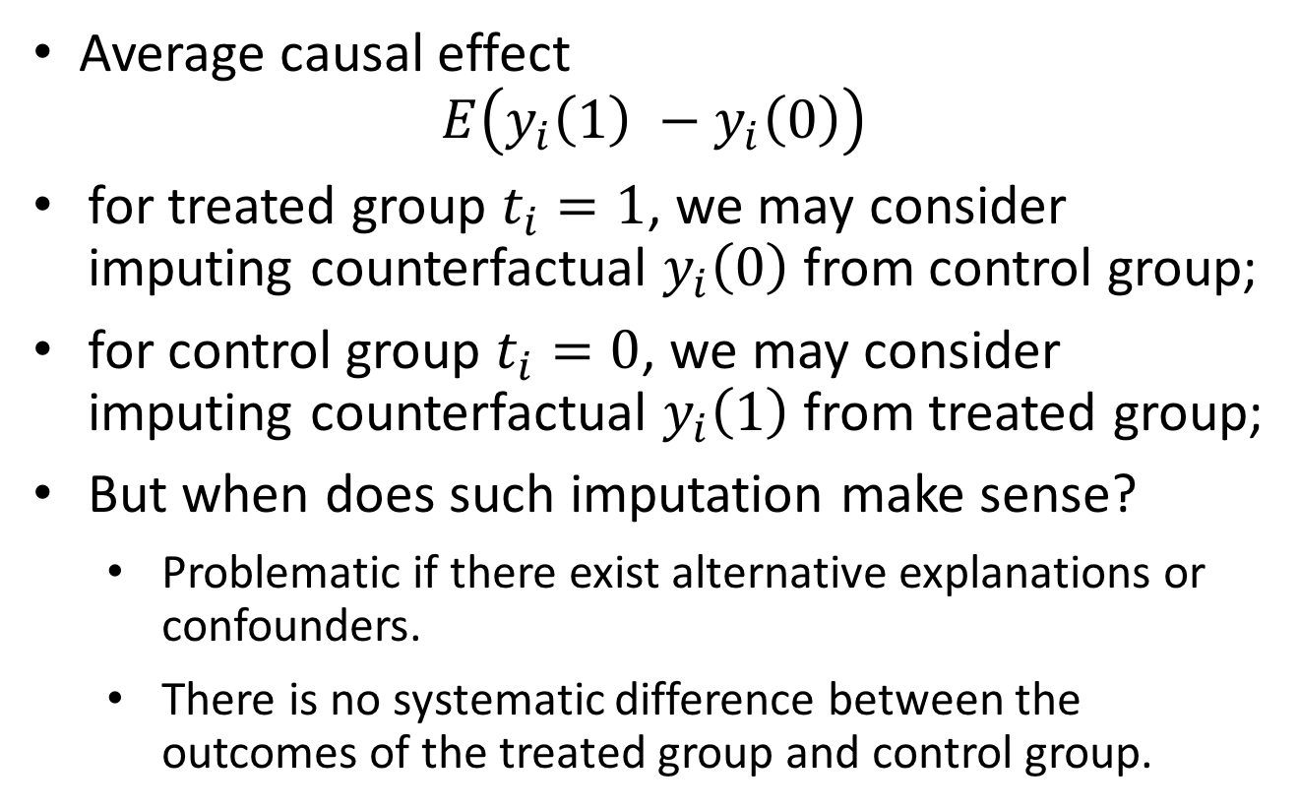
Formulations
Average causal effect
$$E\left(y_{i}\left(1\right) −y_{i}\left(0\right)\right)$$
for treated group $t_{i}=1$, we may consider imputing counterfactual $y_{i}\left(0\right)$ from control group;
for control group $t_{i}=0$, we may consider imputing counterfactual $y_{i}\left(1\right)$ from treated group;
But when does such imputation make sense?
Problematic if there exist alternative explanations or confounders.
There is no systematic difference between the outcomes of the treated group and control group.

Slide 20
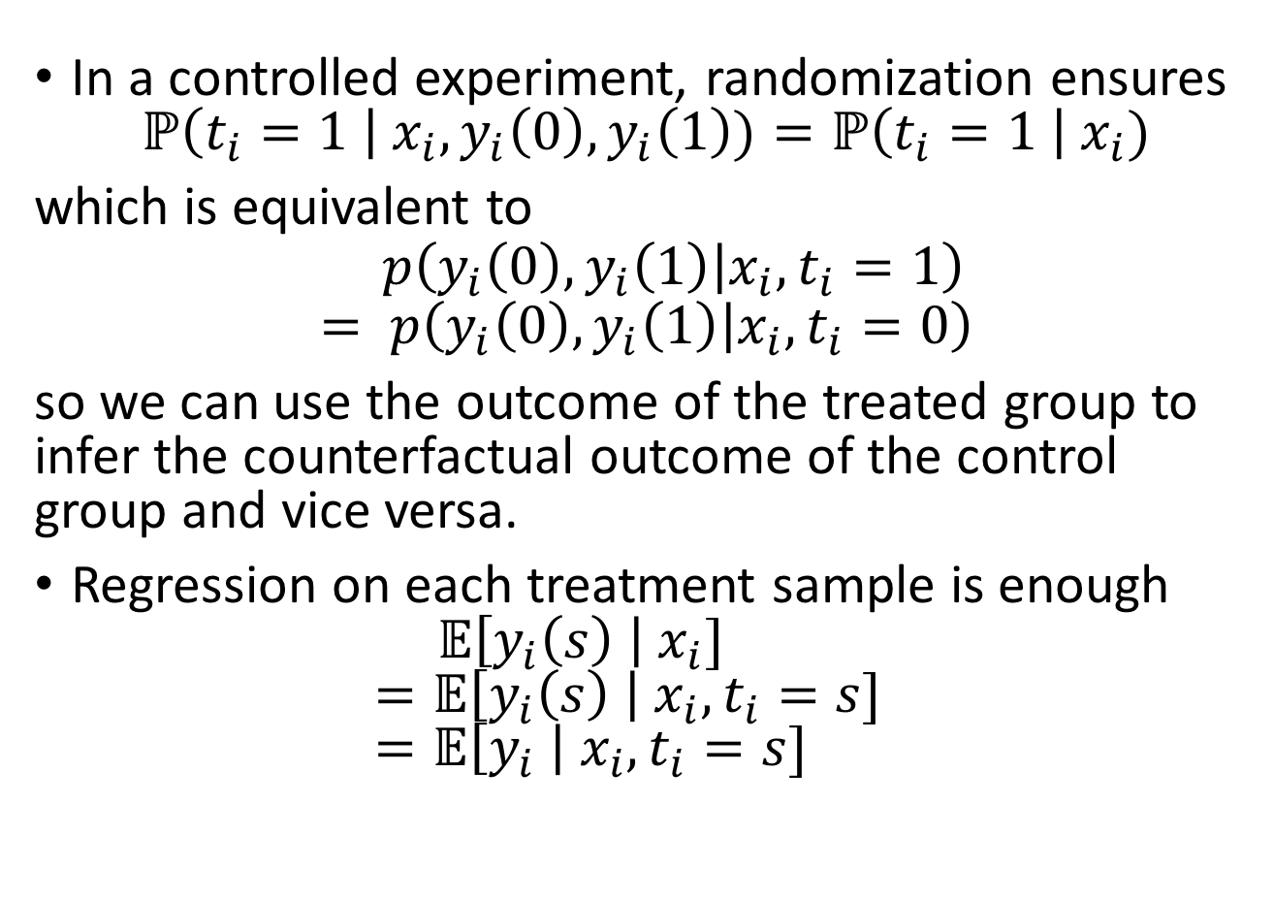
Causal effect estimation in experiments
In a controlled experiment, randomization ensures $ℙ\left(t_{i}=1 \right| x_{i},y_{i}\left(0\right),y_{i}\left(1\right))=ℙ\left(t_{i}=1 \right| x_{i})$
which is equivalent to
$$p\left(y_{i}\left(0\right),y_{i}\left(1\right) | x_{i}, t_{i}=1\right)= p\left(y_{i}\left(0\right),y_{i}\left(1\right) | x_{i}, t_{i}=0\right)$$
so we can use the outcome of the treated group to infer the counterfactual outcome of the control group and vice versa.
Regression on each treatment sample is enough $𝔼\left[y_{i}\left(s\right) \right|{ x}_{i}]$ $=𝔼\left[y_{i}\left(s\right) \right|{ x}_{i},t_{i}=s]$ $=𝔼\left[y_{i} \right|{ x}_{i},t_{i}=s]$

Slide 21
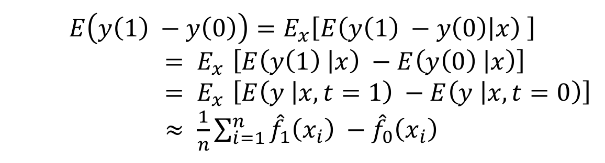
Causal effect estimation in experiments
Machine learning works!! Just make sure to have a good regression model
Usually, train two different models, each on each treatment sample
$$E\left(y\left(1\right) −y\left(0\right)\right)=E_{x}\left[E\left(y\left(1\right) −y\left(0\right) | x\right) \right]$$
${= E}_{x}\left[E\left(y\left(1\right) | x\right) −E\left(y\left(0\right) | x\right)\right]$
${= E}_{x}\left[E\left(y | x, t=1\right) −E\left(y | x, t=0\right)\right]$
$≈ \frac{1}{n}\sum_{i=1}^{n}{{\hat{f}}_{1}\left(x_{i}\right) −{\hat{f}}_{0}\left(x_{i}\right)}$
This is only one way to use machine learning to analyze experimental data. Other methods are available.

Slide 22
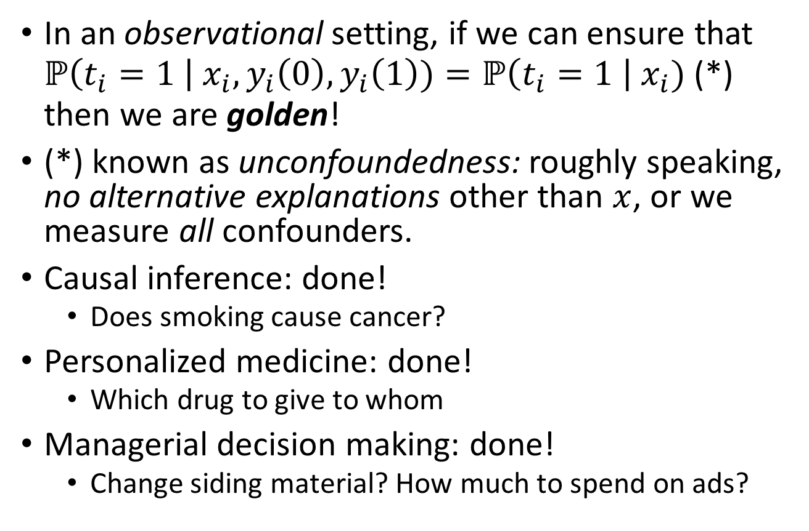
Mimicking Experiments in observational study
In an observational setting, if we can ensure that $ℙ\left(t_{i}=1 \right| x_{i},y_{i}\left(0\right),y_{i}\left(1\right))=ℙ\left(t_{i}=1 \right| x_{i})$ (*) then we are golden!
(*) known as unconfoundedness: roughly speaking, no alternative explanations other than $x$, or we measure all confounders.
Causal inference: done!
Does smoking cause cancer?
Personalized medicine: done!
Which drug to give to whom
Managerial decision making: done!
Change siding material? How much to spend on ads?

Slide 23
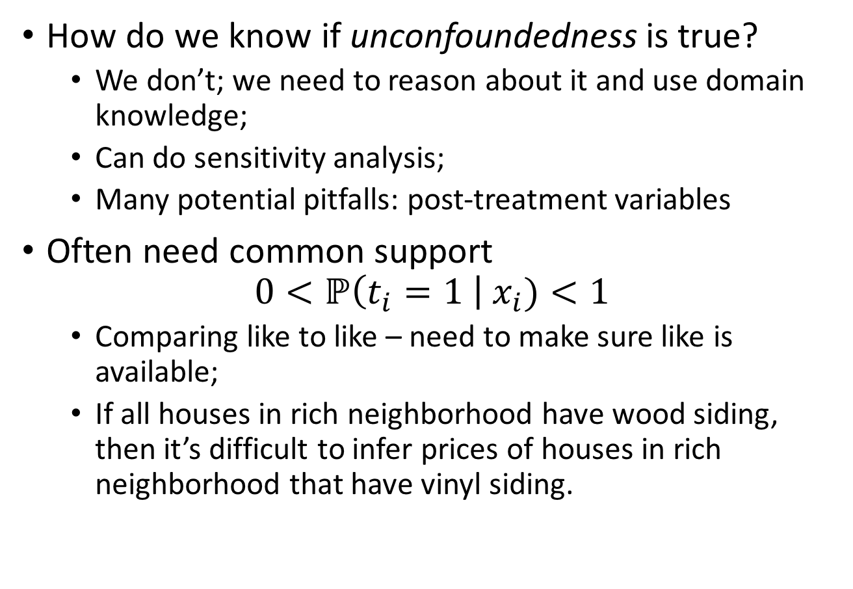
But …
How do we know if unconfoundedness is true?
We don’t; we need to reason about it and use domain knowledge;
Can do sensitivity analysis;
Many potential pitfalls: post-treatment variables
Often need common support
$$0<ℙ\left(t_{i}=1 \right| x_{i})<1$$
Comparing like to like – need to make sure like is available;
If all houses in rich neighborhood have wood siding, then it’s difficult to infer prices of houses in rich neighborhood that have vinyl siding.
Notes:
Maybe remove post-treatment variables; model specification and model extrapolation

Slide 24
But …
The curse of covariate shift: Samples for each treatment choice can be quite different.
Wood siding
House
price
Vinyl siding
Neighborhood
wealth

Slide 25


The curse of covariate shift
$${\hat{f}}_{wood}$$
Wood siding
House
price
Vinyl siding
$${\hat{f}}_{vinyl}$$
Neighborhood
wealth
Model specification is an issue: hard to validate our models on the data to which they will eventually be applied.

Slide 26
This was only a very particular kind of (statistical) causality
Explanations: Why?
Mechanisms: How?
Common situation in physical sciences: Perfect unit homogeneity, temporal stability, and causal transience
E.g.: determine freezing point and boiling point of water molecules contained in a closed box.
(we created statistical homogeneity)

Slide 27
Main takeaways
Most important: be careful!
ML = prediction = associations
Not always causation but sometimes in rare occasions
Don’t be fooled by fancy ML
Fancy ML (boosting, nets) by itself doesn’t fix anything
Fancy ML can neither give nor test unconfoundedness
If you really want to say something causal
Try to think about alternative explanations and argue about unconfoundedness
(Other ways too, e.g., instrumental variables)
Be really careful about model selection and validation

