Slide 1
Q-Learning
Q-value: the value of taking action in state under a policy.
HOW IT WORKS:
Choose a action base on learned data(policy).
Take the action and observe the reward.
Update Q-value for the state using the observed reward
Go to Step 1.

Slide 2
Sarsa

Slide 3
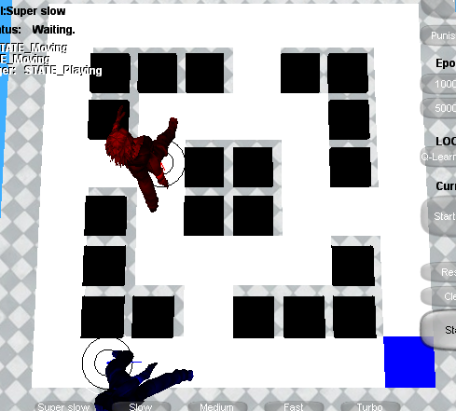
Rules of the game
The mouse scores a point for getting the cheese. Then replace cheese randomly.
The cat scores a point for catching the mouse. Then game is over!

Slide 4
Q-Learning in this game
Q-value: the evaluated value of moving mouse to 8 directions.
State: positions of mouse, cat and cheese.
Choose an action(move direction) base on learned data(policy).
Take the action and observe the reward. Got cheese, Reward= +50 . Caught by cat, Reward=-100.
Update Q-value for the state using the observed reward
Go to Step 1.

Slide 5
Technique and Implementation
Rabin’s framework and c++
Rlearner: run learning algorithm and update policy.
RLPolicy: a database to store Q-value
Rlworld: a presentation of a game environment.
RLGame: control the game overflow and maintain all setting.
Update UI
RLGame
run training
RLearner
RLWorld
query action
RLPolicy
Update policy

Slide 6
Experiment 1: greedy and smart
Cat: always goes for the mouse, if blocked moves randomly
Greedy mouse: always goes for the cheese.
Smart mouse: choose action from learned data.

Slide 7
Experiment 2: Before and after training

Slide 8
Experiment 3:learning iteration.
The more iterations you run, the smarter mouse you will get.

Slide 9
Experiment 4: reward and penalty
Reward=50 penalty=100
Reward=50 penalty=10
When reward is larger than penalty, mouse will go for the cheese no matter what.

Slide 10
Experiment 5: different terrains
Open terrain

Slide 11
Other factors

