Slide 1
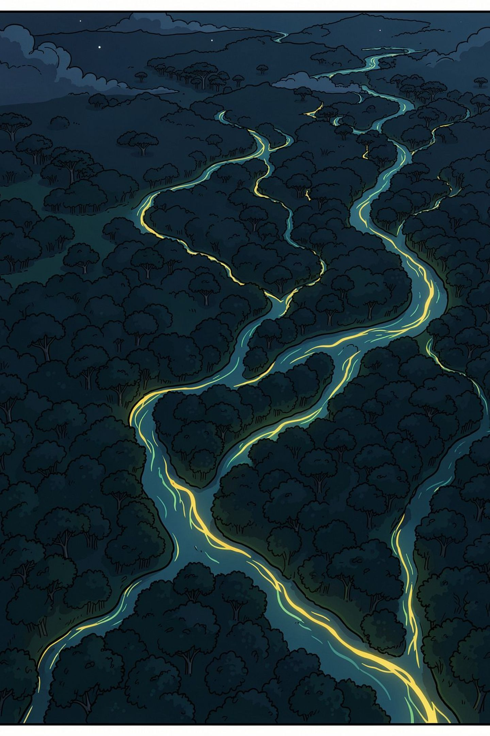
CS 59300 · APPLICATION OF DEEP LEARNING · RESEARCH-BASED COURSE PROJECT
Do Flood Models Transfer
Across Satellites?
The first deep-learning flood evaluation on NISAR L-band radar — measuring whether Sentinel-1-trained models survive the jump, and what it costs to close the gap.
Varun Teja Chundru · Nidhi Musale · Yashada Ajit Tembe · Pushan Verma
Instructor: Dr. Zesheng Chen · September 2026
Notes:
Hook: NISAR's first public data is eight weeks old. Nobody in the world has run a deep learning flood model on it. Our question: do the models the community already built for Sentinel-1 still work on this new satellite — and if not, how cheaply can we fix them?

Slide 2




WHY THIS TOPIC
Floods blind the satellites meant to watch them
Floods are among the most destructive natural disasters — and the hardest to observe when it matters, because optical sensors fail in exactly the conditions that accompany them.
Cloud obstruction
Storm systems block optical imagery precisely when flood monitoring is most critical.
Night blindness
Optical sensors cannot operate at night, missing crucial temporal coverage.
The radar advantage
SAR penetrates cloud and works day or night — uninterrupted coverage through the storm.
Storm clouds — exactly what blocks optical satellites during a flood. Radar passes straight through.
Radar is the only way to map a flood while it is happening. The question is whether our existing AI can read the new radar.
CS 59300 · NISAR Flood Mapping — 2
Notes:
Rubric: why useful. Optical satellites need daylight and clear sky — floods come with storms and clouds. Radar makes its own signal and passes through cloud. So radar is the only real-time flood observation tool; the open question is whether existing AI transfers to the newest radar.

Slide 3

WHY NOW — AND WHY IT'S EXCITING
An eight-week-old dataset nobody has modeled
Jul 2025
Jul 20, 2026
~8 weeks
0 papers
NISAR launches — first joint NASA–ISRO satellite, first-of-its-kind L-band system
First calibrated data released to the public — the archive is filling during our semester
Age of the usable public record when we selected this topic
Published deep-learning models on real NISAR data (verified against the literature, Sept 2026)
Famous benchmark datasets are crowded because they are convenient — the dataset is what draws the crowd. Data this new is the one honest route to novelty: no crowd has had time to form.
Why it's fun: we get to run an experiment that has literally never been run — on a satellite the whole flood-mapping community is waiting to use. Whatever number we measure is new knowledge.
CS 59300 · NISAR Flood Mapping — 3
Notes:
Rubric: why important/fun. NISAR just became real — first calibrated public data July 20, 2026. We verified no published DL models exist on it. Standard benchmarks are crowded precisely because they're convenient; brand-new data is the honest path to novelty. Whatever we measure is a first measurement.

Slide 4

THE PHYSICS IN ONE SLIDE
Same flood, opposite radar signatures
OPEN WATER
→ DARK
FLOODED FOREST
→ BRIGHT
reflected away
double bounce
Smooth water is a mirror: the pulse bounces off at an angle and never returns. The sensor records almost nothing.
Under trees, the pulse hits the water, then a trunk — a bank shot — and returns strongly. L-band's 24 cm waves reach through the canopy; C-band's 5.6 cm mostly cannot.
Consequence: a “find the dark pixels” rule finds rivers — and misses flooded forest entirely. That blind spot is exactly where our study lives.
CS 59300 · NISAR Flood Mapping — 4
Notes:
Teach the one idea everything rests on. Open water reflects the pulse away — dark. Flooded forest double-bounces it back — bright, often brighter than dry forest. Only long L-band waves get through the canopy to do this. So Sentinel-1 (C-band) is nearly blind to flooded forest — and that's precisely the class where transfer should break.

Slide 5
WHAT ALREADY EXISTS
Prior work — and the gap it leaves open
Sen1Floods11 — Bonafilia et al., CVPR-W 2020
446 hand-labeled Sentinel-1 chips across 11 flood events — the training benchmark we build on.
FOUNDATION
Deep-learning floods on L-band — ALOS-2 / PALSAR-2
U-Net / UNet++ flood segmentation on L-band already exists — so DL on L-band works. We cannot claim that first.
DONE
Cross-band transfer — “Beyond Backscatter,” Jun 2026
A Sentinel-1-trained deep model tested on ALOS L-band degrades moderately, not catastrophically — but for InSAR coherence, not floods.
DIFFERENT TASK
DeepSARFlood — 2025
States outright that Sentinel-1 models cannot transfer directly to other bands and “will require domain adaptation” — naming NISAR. Asserted, never measured.
THE GAP
Checked against the 430 papers citing Sen1Floods11 (as our instructor requested) plus a 300-source literature sweep.
CS 59300 · NISAR Flood Mapping — 5
Notes:
Be precise about prior art — this is what Dr. Chen probed. DL flood mapping on L-band exists (PALSAR-2). Cross-band transfer of a deep model exists, but for coherence estimation, not floods — and it found moderate, not catastrophic, degradation, which supports feasibility. DeepSARFlood names our exact gap but never measures it: the data didn't exist until July.

Slide 6




WHAT'S NEW
Our claim — built to survive review
“The first empirical study to quantify zero-shot transfer of a Sentinel-1-trained flood-segmentation model to real NISAR L-band imagery — and the first to measure how small-sample fine-tuning closes the gap, stratified by inundation regime and polarization.”
Every qualifier is load-bearing — drop one and prior art exists:
Real NISAR data
Flood segmentation
Transfer + fine-tuning curve
Stratified by regime & polarization
Not a proxy sensor — the actual mission data, eight weeks old
Not coherence or land cover — the flood task itself
Not just “does it work” — how many labels close the gap
Open water vs. flooded forest; VV/VH vs. HH/HV
Either result is a contribution: a large gap quantifies the adaptation the field predicted — no gap means existing models are NISAR-ready today.
CS 59300 · NISAR Flood Mapping — 6
Notes:
The claim is deliberately narrow — each qualifier defends against a specific paper. And the experiment can't fail: a big gap measures what the field only predicted; a small gap means the community's models are NISAR-ready now. Both are useful, publishable-quality findings.

Slide 7
END GOAL FOR THE RESEARCH
Three questions, three measurable answers
RQ1
RQ2
RQ3
How large is the zero-shot gap — and where?
How many NISAR labels close it?
What causes the gap — wavelength or polarization?
Run the Sentinel-1-trained model on NISAR untouched. Measure the IoU drop separately for open water and flooded forest.
Fine-tune on 0 / 10 / 25 / all hand-labeled chips and trace the recovery curve.
Ablation: swap input-channel mappings (VV/VH → HH/HV) with the architecture held fixed.
H1: open water transfers; flooded forest breaks — the physics predicts exactly this split.
H2: a small labeled set recovers most of the loss — the practical number every NISAR adopter needs.
H3: the polarization substitution explains a large share — separable from the band change.
The end product of the research: three measured numbers the community can cite — the gap, the cost to close it, and its cause.
CS 59300 · NISAR Flood Mapping — 7
Notes:
Rubric: end goal. Not a yes/no — three quantities with falsifiable hypotheses. RQ1 the size and location of the gap; RQ2 the label budget to close it (the practically useful number); RQ3 the mechanism, via a polarization ablation with the architecture fixed.

Slide 8
EXPERIMENTAL DESIGN
Train on Sentinel-1 — break and repair on NISAR
PHASE 1 — PRETRAIN
PHASE 2 — ZERO-SHOT
PHASE 3 — FINE-TUNE
U-Net on Sen1Floods11
Evaluate on NISAR, untouched
Small NISAR label sets
446 hand-labeled Sentinel-1 chips, 11 flood events. Establishes the C-band baseline IoU.
Amazon floodplain scenes. IoU scored separately for open water and flooded forest.
0 / 10 / 25 / all chips → the recovery curve. How much data buys how much performance.
Model U-Net — the standard, interpretable choice; any gap we see comes from the data, not an exotic architecture
Metric IoU per class — predicted vs. true water overlap, 0 to 1
Region Central Amazon floodplain — Solimões–Negro confluence: open water, flooded forest, and dry forest in one frame
CS 59300 · NISAR Flood Mapping — 8
Notes:
Three phases, each producing a number. We deliberately use a plain U-Net: the model is not the contribution — the measured gap between satellites is. An exotic architecture would confound the comparison. One Amazon frame contains all three land classes, so the regime comparison needs no second region.

Slide 9
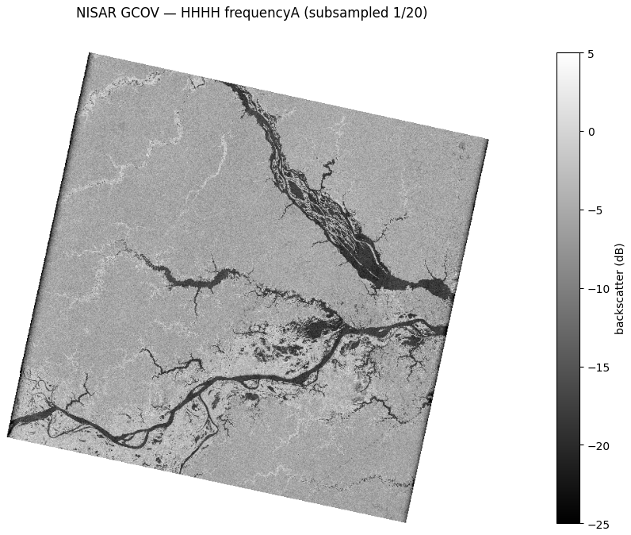
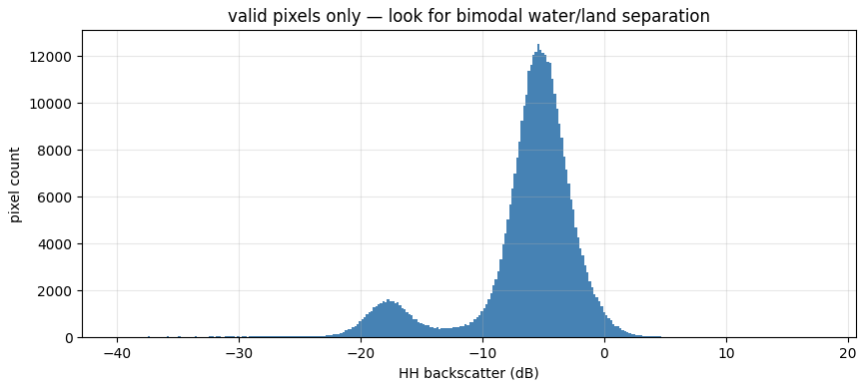
NOT JUST A PLAN
We've already run it on real NISAR data
Bimodal, as predicted: a water tail near −18 dB, land clustered near −5 dB.
89
1.93 GB
9.1%
3 dates
granules over our AOI
scene downloaded & read
water at −15 dB threshold
12-day repeats (Jun–Jul)
NISAR GCOV scene 023_068_D_090 (18 Jun 2026), HH backscatter — our own analysis. Rivers dark, forest bright: the separation the whole project rests on, confirmed.
Auth → download → HDF5 read → dual-pol HH/HV → water separability: the entire data pipeline is de-risked.
CS 59300 · NISAR Flood Mapping — 9
Notes:
Differentiator slide: this is our own analysis, run this week in Colab — not a mock-up. 89 granules over the Amazon AOI; we downloaded one, read the HDF5, found clean bimodal water/land separation, and confirmed the same frame repeats every 12 days across the falling flood pulse. Feasibility is closed, not assumed.

Slide 10



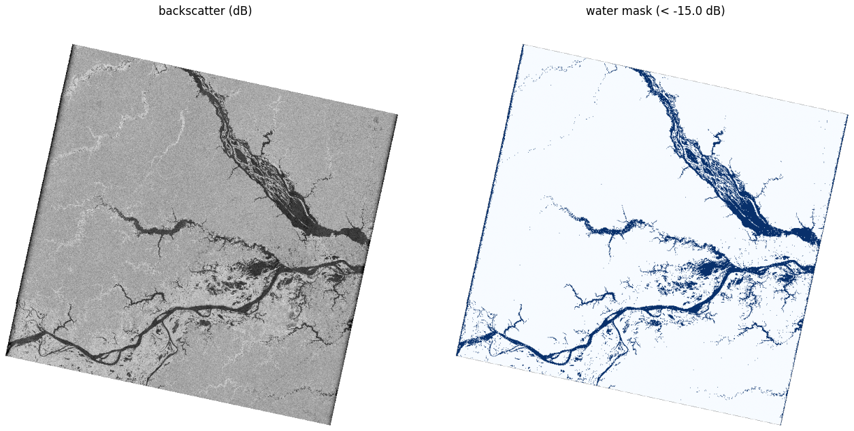
THE HARD PART
Ground truth where no camera can see
Optical satellites cannot see under the canopy — so the answer key must come from elsewhere. Three independent sources, ranked:
The trap we designed out
1 · Hydrology (primary)
Daily river stage at Manaus + canopy-corrected terrain (HAND): everything below the water line is flooded. Never looks at radar — immune to circularity.
Never grade against Sentinel-1. C-band can't see under trees, so its map calls flooded forest “dry.” Score NISAR against it and NISAR is marked wrong for being right — in exactly the regime it should win.
2 · Expert wetland maps
The canonical dual-season JERS-1 Amazon inundation masks — built by the researchers who defined the problem. Our cross-check.
S1 maps = comparison baseline only.
3 · Temporal change (silver only)
Low-water vs. high-water brightening marks flooded forest — direct, but partly circular, so used for training labels, never for final scoring.
Our first water mask from NISAR (threshold baseline)
CS 59300 · NISAR Flood Mapping — 10
Notes:
Ground truth is the make-or-break. Primary: hydrology — gauge stage plus canopy-corrected HAND terrain; it never looks at radar, so it cannot be circular. Cross-check: the classic JERS-1 wetland masks. Change detection only produces silver training labels. And the red card: grading against Sentinel-1 would penalize NISAR exactly where it's right — that trap, caught early, is itself a finding.

Slide 11
EXPECTED CHALLENGES
Named now — with the mitigation pre-registered
Canopy ground truth is irreducibly noisy
Gold vs. silver label split; solid metrics for open water, explicitly uncertainty-flagged treatment for flooded forest. Stated up front, not discovered late.
Dry-season baseline arrives Oct–Nov — deadline collision
Pre-registered fallback ladder: NISAR dry frame → prior-year ALOS-2 → JERS-1 low-water mask → never-flooded uplands in frames we already hold. The headline result depends on none of them.
NISAR data is provisional — calibration still maturing
Stay within one product generation; report artifacts. Characterizing early-mission data quality is itself a contribution.
Polarization mismatch (VV/VH → HH/HV)
Not a bug — promoted to the RQ3 ablation. The confound becomes the experiment.
A pre-registered fallback reads as rigor; the same fallback discovered in week nine reads as a scramble.
CS 59300 · NISAR Flood Mapping — 11
Notes:
Rubric: challenges. Four real ones, each with a mitigation already designed: noisy canopy truth (gold/silver split), the Oct–Nov dry-season timing (four-rung fallback ladder — and the headline result doesn't depend on it), provisional calibration (stay in one product generation), and the polarization mismatch — which we turned into RQ3 rather than treating as a bug.

Slide 12


WHAT WE HAND OVER
Benchmarks ready before NISAR's operational era
Measured numbers
A dataset that doesn't exist
Code + working demo
Report & presentations
Baseline IoU, the zero-shot gap by class, and the fine-tuning recovery curve
The first hand-labeled NISAR flood set — released openly for future benchmarking
Full pipeline and an interactive flood-map tool, built with peer-reviewed pull requests
Methodology, findings, and honest limitations — pre-registered where it counts
Wks 1–2
3–5
5–7
7–9
9–10
Data + label pipeline
S1 baseline
Zero-shot + fine-tune
Analysis + demo
Report + rehearse
Whatever we measure is a first measurement. — Thank you · Questions?
Notes:
Close on deliverables: the three measured numbers, the first labeled NISAR flood dataset (released openly), code plus a working demo built with real PR review, and the report. Ten-week timeline with buffer. Closing line: whatever we measure is a first measurement.

