Slide 1
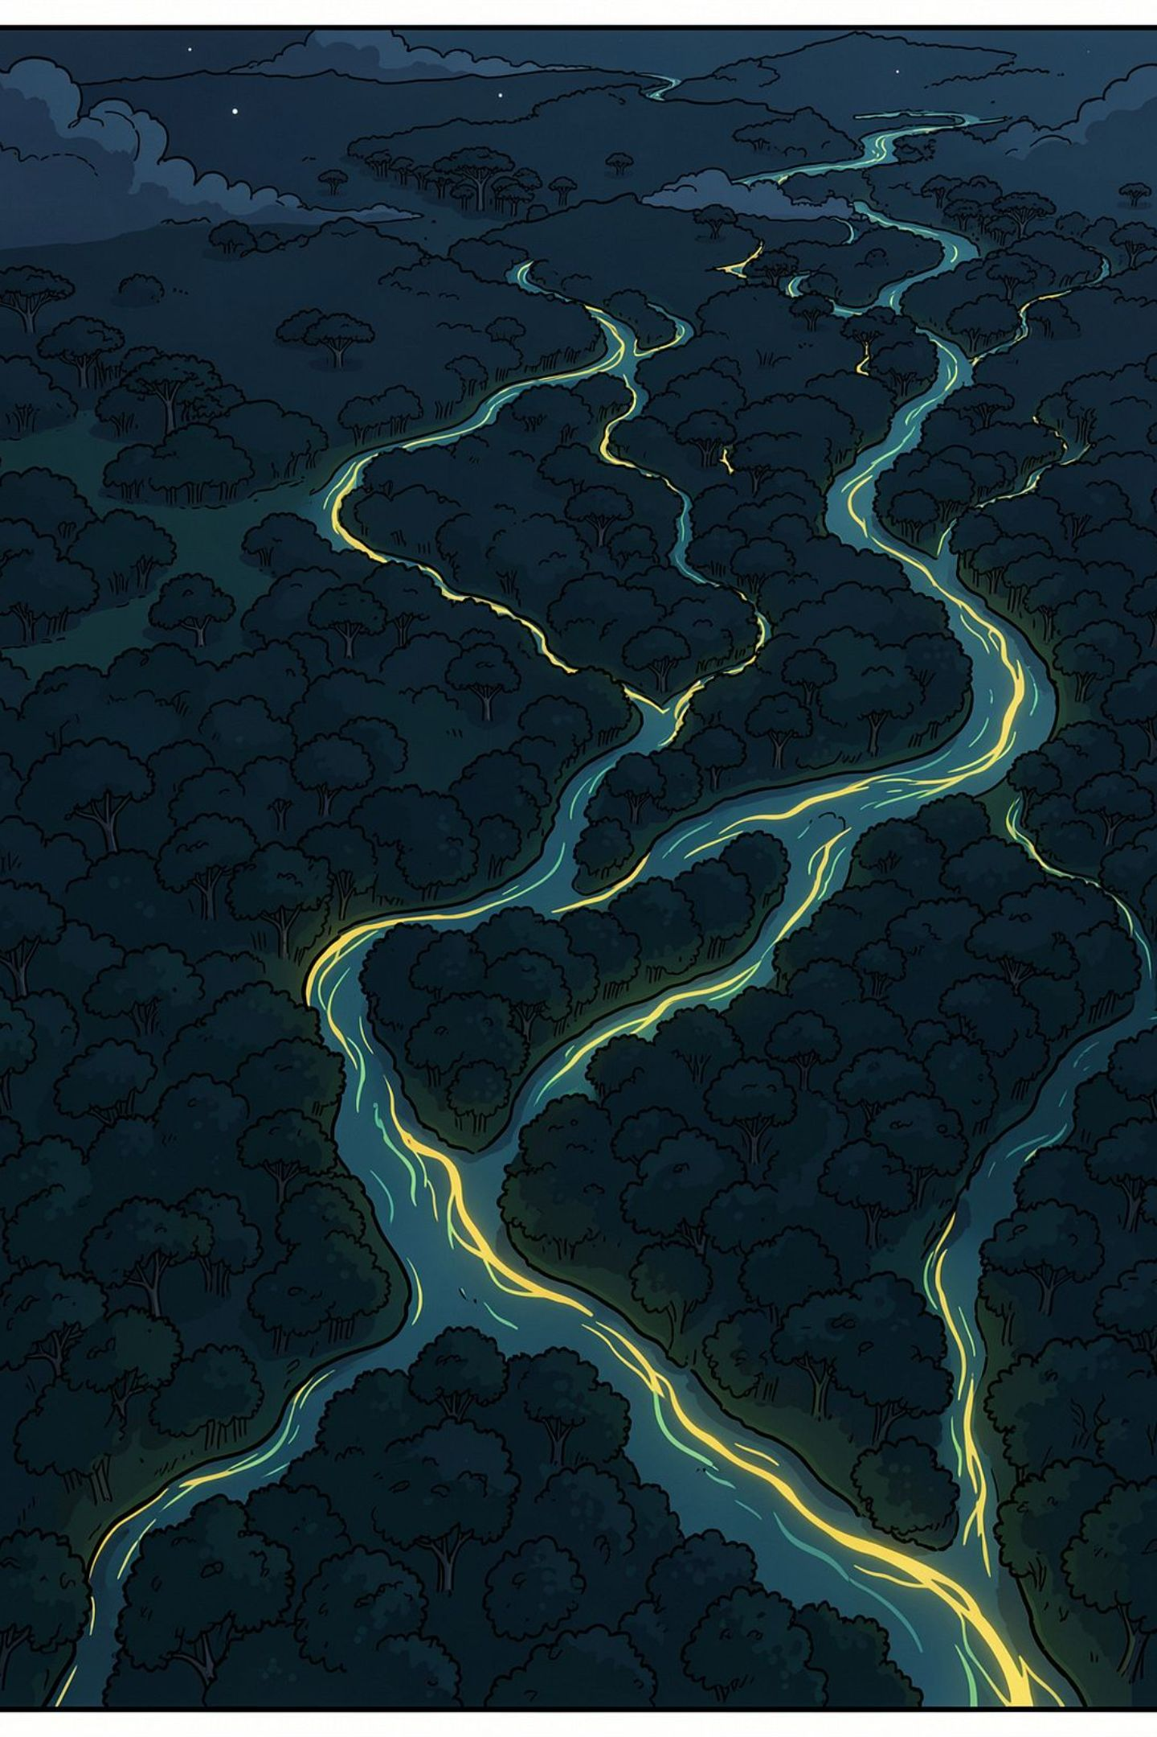
Does a Sentinel-1 flood model work on NISAR?
Requirements Presentation · CS 59300-02 · Dr. Zesheng Chen
Varun Teja Chundru · Nidhi Musale · Yashada Ajit Tembe · Pushan Verma
Literature survey · Most relevant work · Effort estimates · Tasks and owners
Notes:
One line: we test whether flood models trained on the old radar satellite still work on NASA’s new one. This deck covers the papers we read, the two closest to us, how long each piece of work takes, and who does what by midterm.

Slide 2
The study in one picture
Train on the old satellite · test on the new one · measure what it costs to fix
1
TRAIN
2
TEST
3
FIX
Flood model on
Sentinel-1 (C-band)
Sen1Floods11
Run it on real
NISAR (L-band)
without retraining
Fine-tune on
0 / 5 / 10 / 20 / 40
labelled NISAR chips
The output is two numbers
The gap — how much accuracy (IoU) is lost when the model meets a new wavelength.
The recovery curve — how many hand-labelled NISAR chips buy that accuracy back.
Notes:
Three phases. Train a flood model on the Sentinel-1 benchmark, run it untouched on real NISAR data, then fine-tune with small labelled sets. Two deliverable numbers: the size of the gap, and the label cost to close it. Study region is the central Amazon floodplain near Manaus.

Slide 3
Literature survey — where the field stands
Four works define the space. Each one is close to us on one axis, and none covers both.
Sen1Floods11
The labelled benchmark we train on. C-band only.
Bonafilia et al., 2020
ALOS-2 / PALSAR-2 flood segmentation
Deep flood mapping on L-band exists — but a different satellite, no transfer.
IGARSS, 2023
Beyond Backscatter
C-band → L-band transfer of a deep model — but not for floods.
Sica et al., 2026
DeepSARFlood
State of the art. Positions itself for NISAR — assumed, never tested.
Sharma & Saharia, 2025
Our gap sits where the last two meet: real L-band data, for floods, with the transfer actually measured.
Notes:
Four papers. The benchmark we train on; L-band flood mapping on a different satellite; cross-band transfer for a different task; and the state of the art, which names NISAR as a future beneficiary without ever testing it. Also worth citing: a separate 2026 paper, "DeepSAR Flood Mapper", which uses HAND data close to our label pipeline.

Slide 4
Most relevant work 1 — Sen1Floods11
Bonafilia et al., CVPRW 2020 · our training foundation and the baseline we reproduce
Contributions
Weaknesses
How we differ
4,831 Sentinel-1 chips, 11 flood events, 6 continents
446 hand-labelled chips; permanent water vs flood water
Deep models beat backscatter thresholding on radar
Code and data are public
One sensor, one band — all C-band VV/VH
Never shown whether it learned water or C-band statistics
Only 446 hand labels; weak labels inherit optical errors
Optical-derived labels miss flooded vegetation
We take their trained model somewhere it has never been: L-band
We hand-label NISAR chips — a second sensor they never had
We label flooded forest explicitly, where optical labels fail
Their FCNN is our baseline, not our model (Dr. Chen: not U-Net)
Notes:
Sen1Floods11 gives us labelled training data and a published baseline. Its blind spot is that every chip is C-band VV/VH, so nothing in the paper tells us whether the model learned water or learned C-band. That is exactly what we test.

Slide 5
Most relevant work 2 — DeepSARFlood
Sharma & Saharia, 2025 · the state of the art, and the source of our gap
Contributions
Large-scale, near-real-time flood mapping from Sentinel-1 with a deep model; strong operational framing and validation.
Weaknesses
Still single-band C-band. Urban double-bounce left as an open problem. Its NISAR claim is forward-looking — an expectation, never an experiment.
How we differ
The field’s best tool is positioned for NISAR on an untested assumption. We test it — with real L-band data, non-SAR ground truth, and a quantified fine-tuning curve.
Our claim, precisely: the first measurement of how a Sentinel-1-trained flood model performs on real NISAR L-band data — and how much fine-tuning closes the gap.
Notes:
Be precise here. DeepSARFlood does not say cross-band transfer is unvalidated — it assumes it and moves on. That is a stronger framing than "they named our gap", and it survives someone reading the paper afterwards.

Slide 6
Why we expect a gap — the physics in one picture
Short C-band waves bounce off the canopy. Long L-band waves reach the water under it.
C-band (Sentinel-1, ~5.6 cm)
L-band (NISAR, ~24 cm)
bounces off the canopy
“bank shot”: water → trunk → back up
water
water
Signal never reaches the water → flooded forest looks like dry forest.
Water + trunk = double bounce → flooded forest looks bright.
So we predict the biggest accuracy drop on flooded forest — not on open water. Research question 1 tests exactly that.
Second confound we must separate: NISAR is HH/HV, Sentinel-1 is VV/VH — the channels do not map one-to-one. A band-swap ablation on Sentinel-1 bounds how much of the gap is polarization alone.
Notes:
Open water is a mirror — the pulse bounces away and water looks dark. Water under trees does the opposite: the pulse hits the water then a trunk, like a bank shot in pool, and comes back strong. Only the long L-band waves get through the canopy to do this. So the gap should concentrate in flooded forest.

Slide 7
Effort estimate 1 — re-implementing the most relevant work
Sen1Floods11 baseline, hand-labelled split only (446 chips, ~1 GB)
Data access, GeoTIFF loading, nodata handling
4–6 h
< 5
Dataloader, dB conversion, normalisation, splits
3–4 h
GPU-hours — free Kaggle T4
(30 GPU-h/week is plenty)
FCNN / U-Net + training loop + matching IoU definition
4–6 h
Debugging to first sane run
4–8 h
Three gotchas
Convergence runs + results table
3–5 (6–10 wall) h
−1 means no-data — mask it out of loss and IoU
The 2020 repo is TensorFlow-era and bit-rotted — rewrite in PyTorch
Expect IoU 0.55–0.65, not their exact number — we report it as a reproduction gap
Write-up
2–3 h
Total
25–35 person-hours
Notes:
We scope the reproduction to the hand-labelled split only — reproducing all four of their models is three to four times the work for no extra insight. Compute is trivial; the risk is entirely in data handling.

Slide 8
Effort estimate 2 — our own study
Four people · ten weeks to end of November · 6–8 h/week each
NISAR GCOV → analysis-ready chips
25–40 h
High
Budget vs estimate
Labelling protocol + tooling
6–8 h
Low
Available: 260–300 h
Hand-labelling 50 chips + agreement stats
40–50 h
Medium
Sen1Floods11 baseline (estimate 1)
25–35 h
Low
Needed: 200–275 h
Our ViT / SegFormer source model
15–20 h
Low
Zero-shot evaluation + error analysis
8–12 h
Low
It fits — but with almost no slack.
Fine-tuning curve (5 sizes × 3 seeds)
15–20 h
Medium
HAND + Manaus gauge ground truth
20–30 h
Medium
If week 5 slips
Cut the baseline to one model instead of four
Storage, not GPU, is the constraint: chip locally, upload only chips (~100 MB)
Demo app
15–20 h
Low
Integration, report, slides, meetings
30–40 h
—
Total estimate
200–275 person-hours
Notes:
Ten weeks, four people, six to eight hours a week each gives roughly 260 to 300 hours. Our estimate is 200 to 275, so it fits with little slack. The riskiest package by far is the NISAR data pipeline, so it starts first and goes to the most experienced engineer.

Slide 9
Main tasks before the midterm review — and who owns each
Weeks of Sep 23 → late October. Every task has one named owner.
W1
W2
W3
W4
W5
Varun Teja Chundru
NISAR pipeline: granule selection, γ⁰, chipping; repo + PR review
Pushan Verma
Sen1Floods11 baseline reproduced + ViT/SegFormer source model
Nidhi Musale
Labelling protocol, tooling, first 25 hand-labelled chips
Yashada Ajit Tembe
HAND + Manaus gauge ground truth; evaluation + IoU harness
Shared: 50 chips hand-labelled with a double-labelled subset · Midterm deliverable: zero-shot gap measured on at least one NISAR scene
Notes:
Four owners, four workstreams. Varun takes the NISAR pipeline because it is the highest-risk package. Pushan runs the model track, Nidhi the labels, Yashada the ground truth and evaluation. Labelling is shared because inter-annotator agreement needs more than one person. By midterm we aim to have the zero-shot number on at least one scene.

Slide 10
Risks we already know about — and the planned fix
Each risk was designed around before it could bite
1
Labels under the canopy are noisy
2
Polarization confound (HH/HV vs VV/VH)
Separate careful "gold" labels from automatic "silver" ones; report agreement.
Band-swap ablation on Sentinel-1 bounds how much of the gap is polarization.
3
NISAR data is still provisional
4
Small-n fine-tuning is noisy
Lock granule dates from the 2026 high-water season; stay inside one product version.
Repeated random splits, three seeds, report variance not a single curve.
Notes:
Four honest risks, each with a mitigation already decided. The one to emphasise is the polarization confound — we turned it from a weakness into research question three.

Slide 11
Where we are
Data access
Verified — 89 NISAR scenes over the Amazon, one granule read end to end
Literature
4 papers surveyed, 2 nominated, gap defensible against each
Effort
25–35 h to reproduce the baseline; 200–275 h for the full study
Team
4 workstreams, 4 named owners, repo live with PR review
Whatever we measure is a first measurement.
Notes:
Close on the one line: whatever we measure is a first measurement. Then take questions.

