Slide 1
Deep Learning
CS60050
Abir Das and Ayan Chaudhury
Computer Science and Engineering Department
Indian Institute of Technology Kharagpur

Slide 2
Agenda
The Building Blocks of Convolutional Neural Networks/CNNs/ConvNets
Notes:
Today our goal is to cover the sort of basics of convolutional neural networks building on the ideas of neural networks that we discussed earlier.

Slide 3
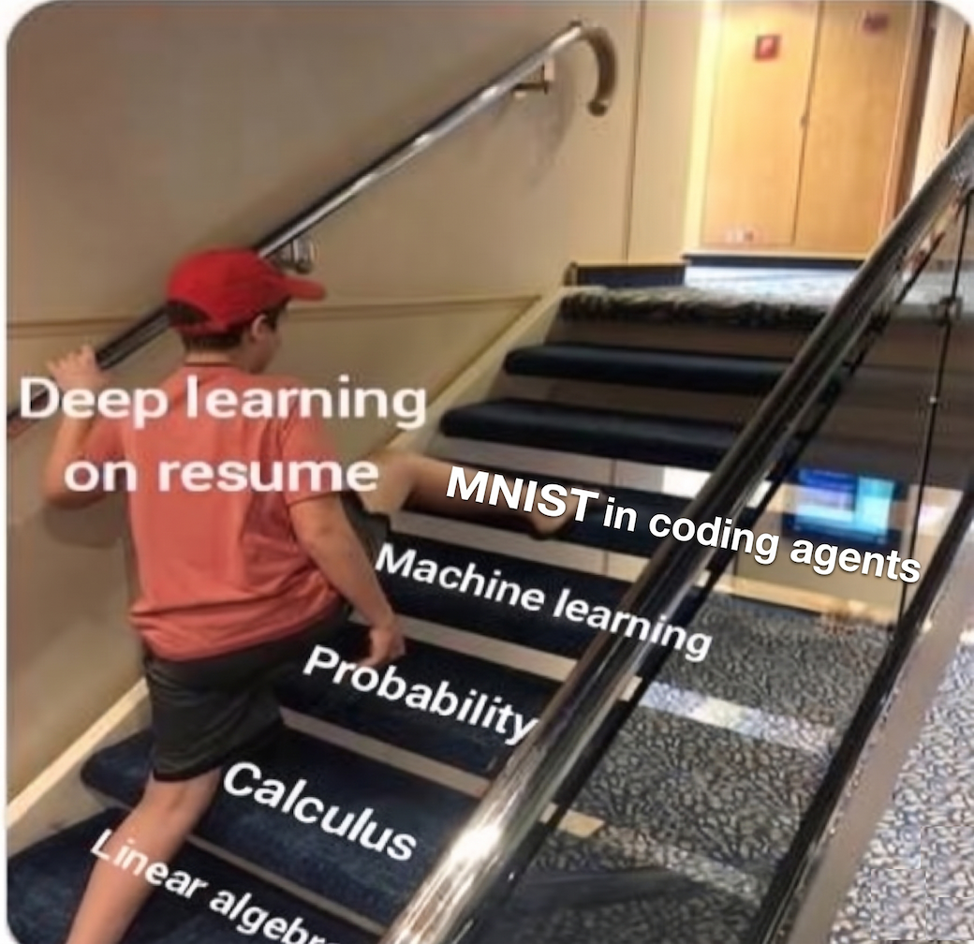
Importance of MNIST

Slide 4
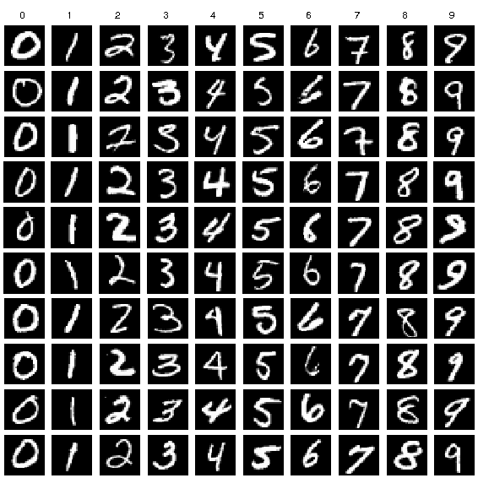
MNIST
database of handwritten digits
10 classes
  Training set 60,000 images
  Test set of 10,000 images
Greyscale images of size 28x28
Often treated as `Hello World’ for any ML/DL practitioner
Image taken from Researchgate

Slide 5
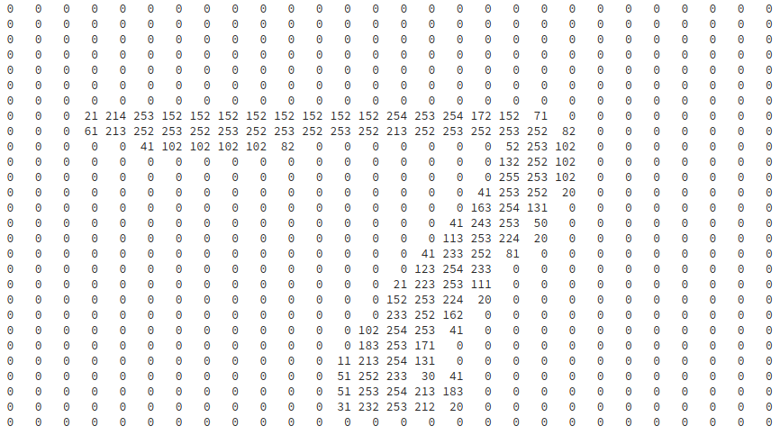
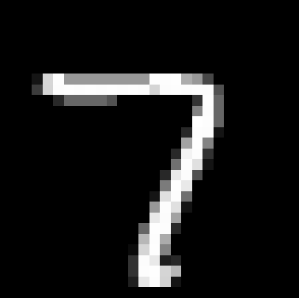
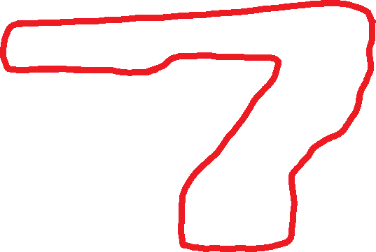
Example from MNIST
Notes:
We have seen the MNIST data, at least some digits. Here is a 7 from that. The left hand side is the image and the right hand side shows the intensity values at each pixel. It’s a 28 by 28 image. So, 28*28 = 784 integer values are there.
We see most of them are 0. But can you discover a patter in the intensity values, the way it is arranged?
If you just focus on the non-zero values, does it look like something.
See – there is a 7 there.

Slide 6
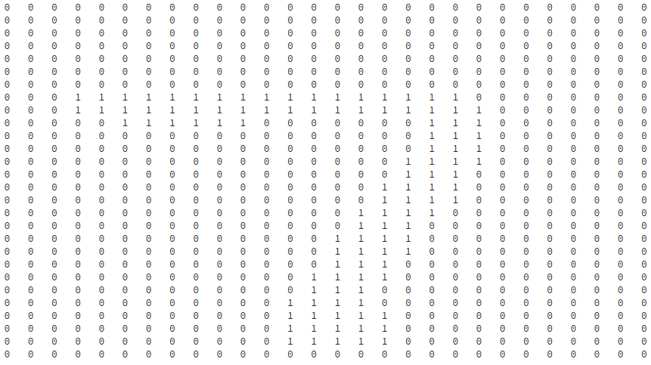

7 Like Window?
Notes:
This motivates us to use some sort of a window – a window which looks like a 7. Can we look through such a window and see if we can find a 7 in an image?
I just prepared a window out of the previous digit itself. Wherever, there is a non-zero value, my window there is open. The other places it is blocked. I denoted this by a value 1 for open/transparent places and 0 for closed places.
This is a weird sort of window, where you can only see what is directly behind an open space. You can think it as a blinder or blinkers that horses in horse-carts are often provided with so that it can see only what is in front of it and not anything else.
Let us see how we can use this window to classify stuffs.

Slide 7
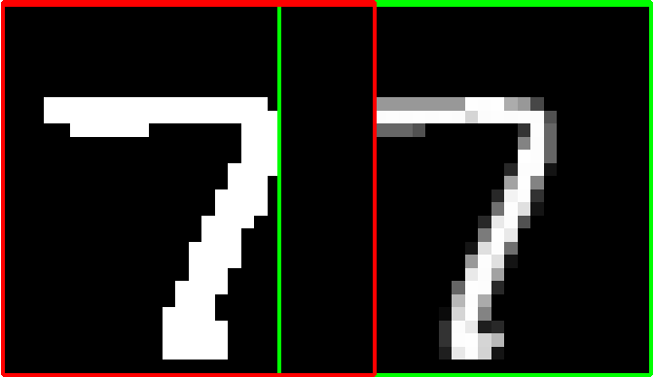
Filtering
0
Notes:
The left figure on the top is the window or filter and the right one is the image which we want to recognize. What we do is – we start at the very left of the image in the right and slide the window or filter slowly over it. For each position we see what we can see.
One way to measure what we can see is sum up the intensity values, that we can see through the window. So at a certain sliding position, we see that, we actually see the background pixel, we see nothing of the foreground, actual 7. So the sum is 0.

Slide 8
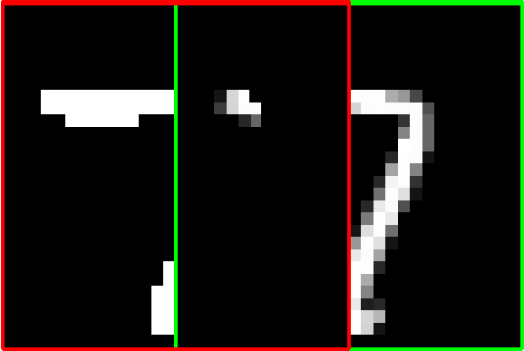
Filtering
1410
Notes:
So, we slide the filter a little more. Look at the overlapping part. We, now, see some part of it. If we sum the intensity values, we get 1410.

Slide 9
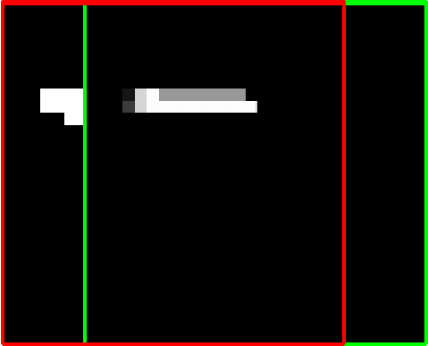
Filtering
4098

Slide 10
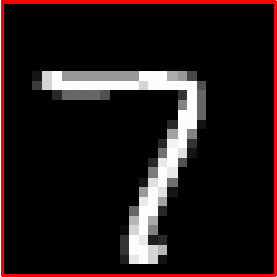
Filtering
18604

Slide 11
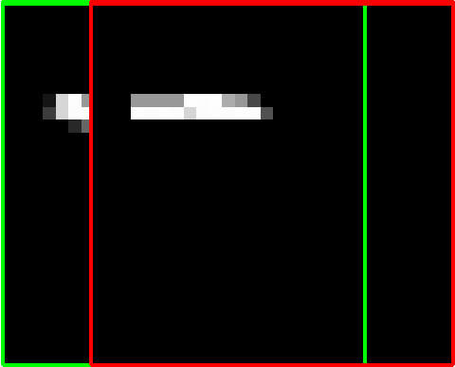
Filtering
4331

Slide 12
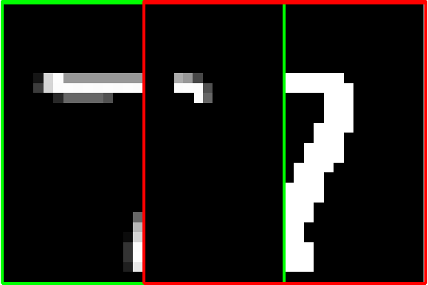
Filtering
1589

Slide 13
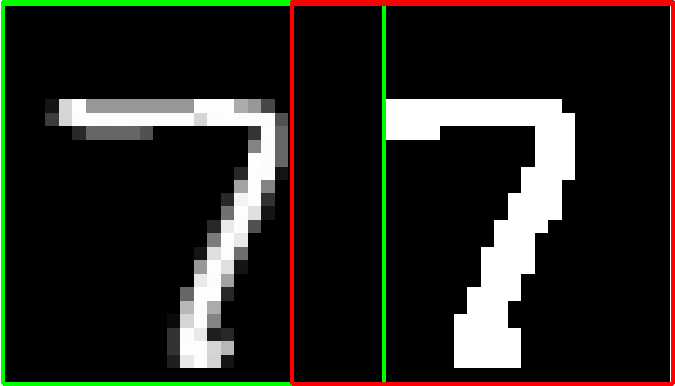
Filtering
0

Slide 14






Filters
Classification by Matching Filters
Test Images
But what if the test image is a little
Rotated (or)
Skewed (or)
Zoomed out and so on

Slide 15
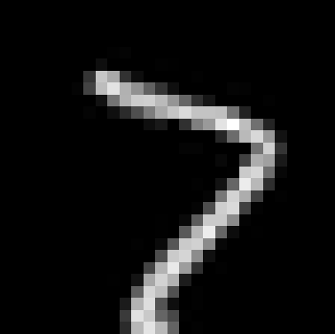

Effect of Slight Rotation
18604
18 degrees
rotation
9974
10278
Notes:
In this slide, we are trying to see what will happen if we slightly rotate the same image where we were searching for 7 earlier. Earlier, we found a high score of 7 when we slided the 7 filter on the non-rotated 7 image. But as shown, in the middle row, the same 7 filter gives very low score on the slightly rotated 7 image. In fact, the 7 filter is giving a high score when it is slided over a slightly rotated 1. So, in principle, the image of 1 is getting classified as 7 by the 7 filter and not the image of 7.
So we see that a simple sliding filter is not very robust as it can easily break with some natural variations of images that we generally get to see in images. Before going to see how we address such issues, one thing I want to mention – though we are just saying this operation as ‘sliding a filter’, it is also known as ‘convolution operation’ or ‘convolving an image with the filter’. The name comes from the fact that convolution operation also does a similar thing where a filter is slided over an input and the sum of elementwise products of the elements of the filter and the portion of the image beneath it is calculated. The two names – filtering and convolution operation are used interchangeably.
Next let us go and see what we can do to address such issues.

Slide 16
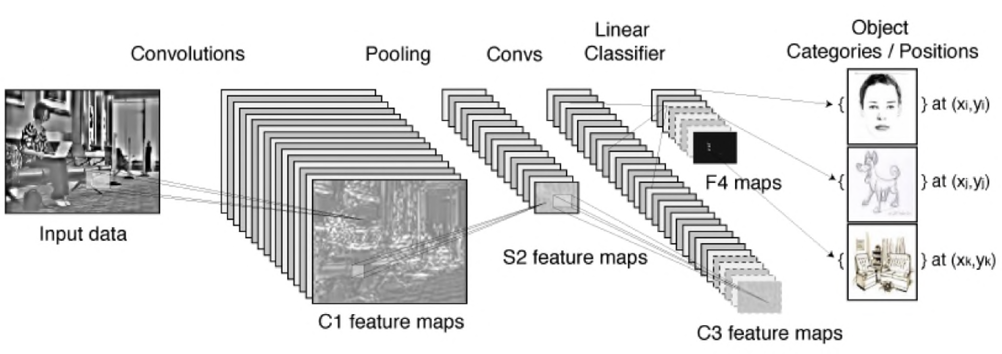
Convnets (Fukushima, LeCun, Hinton)
Slide courtesy: Nando de Freitas, University of Oxford
Notes:
So, one naive way to address this issue is - why don't we go for a lot of such filters which considers all possible such variations. For example, let us have a few such 7 like windows each with different rotations, different skewness, different stretch etc.
Believe it or not, ConvNets try to come up with such filters - it is not only some rotated or twisted versions of such filters, but they are much more complex. This slide shows a convnet in operation. We will go into much more details, but this is just an overview.
Images are really volumes. Here it is a greyscale image. We apply filters which are very small. Say the image is 100x100 pixels. The filters can be 3x3 or 5x5 in size. Now, think of these filters as search. You move the filters over your image and if your filter is a vertical line you are looking for vertical edge in the image, if your filter is a dog, when you are moving it over the image you are looking for a similar dog. Remember that the filters are small and you can move both vertically and horizontally - not like just horizontally which we performed a few slides ago.

Slide 17
Convnets (Fukushima, LeCun, Hinton)
Slide courtesy: Nando de Freitas, University of Oxford
Notes:
Like the previous slide we get a single number, a scalar for each of the positions of the filter. So we get a 2-d array of values where each value is the corresponding output for one position on the image. This array is called a feature map in DL terminology. Now, you can have many such filters and each filter gives rise to one such 2-d array of numbers or feature maps. Each feature map is called a channel in DL terminology.
Generally a filtering or convolution operation is followed by a subsampling operation or what is also known as ‘pooling’ operation. Pooling can be of different types. One such simple pooling operation is called max-pooling. Here only a small patch on the feature map is chosen and in that patch the maximum value of the pixels is taken. So it downsamples. One another way to get a single value from a patch is to average the intensity values inside the patch. Note that, in pooling we generally do not have overlapping patches and thus the 2-D array that we get after pooling is of smaller size compared to the input feature map size on which pooling is applied.

Slide 18
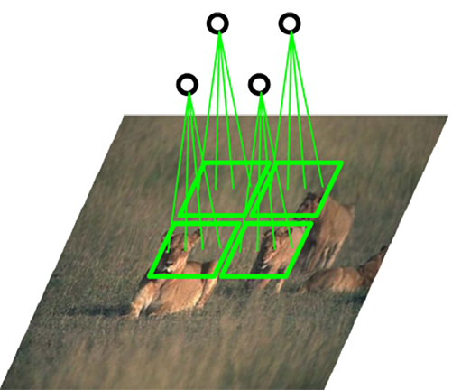
Convnets (Fukushima, LeCun, Hinton)
Slide courtesy: Nando de Freitas, University of Oxford
Notes:
NOW TELL ABOUT ANALOGY TO FULLY CONNECTED NEURAL NETWORKS. DRAW ON BOARD.
ADVANTAGE – 1ST - PARMAETRS ARE SHARED. LESS NUMBER OF PARAMETERS TO BE LEARNED. LESS COMPUTATIONS AND STORAGE. 2ND – INVARIANCE TO LOCATION. IF AN OBJECT IS SOMEWHERE IN THE IMAGE IT WILL FIRE.
TELL ABOUT HEIGHT, WIDTH ETC.
THEN ACTIVATION FUNCTION – ReLU MAINLY.
THEN POOLING. TELL WHAT IS MAX POOLING. POOLING MAINLY 3 REASONS – STORAGE, INVARIANCE [EINSTEIN IMAGE], HUMAN ANALOGY.
YOU CAN USE AS MANY OF THESE LAYERS AS YOU CAN TRAIN. FINALLY FC LAYER – PEOPLE ALSO ARGUE AGAINST IT – FCN.

Slide 19
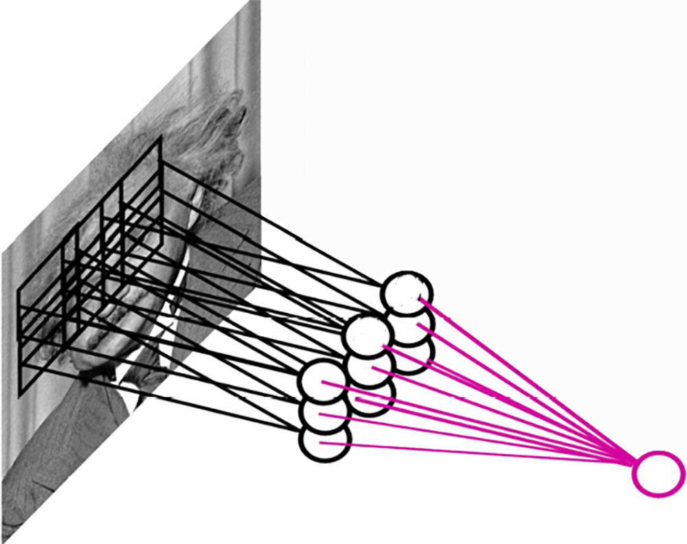
Pooling
By "pooling" (e.g., max or average) filter responses, we gain robustness to the exact spatial location of features.
Image courtesy: Nando de Freitas, University of Oxford

Slide 20
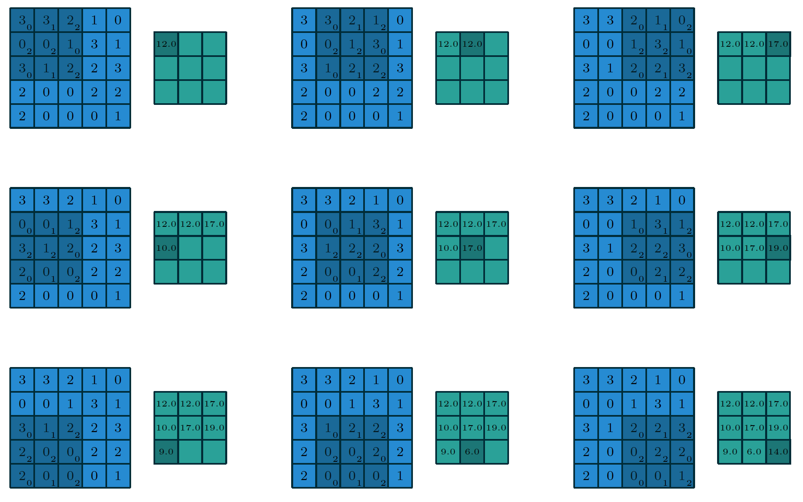
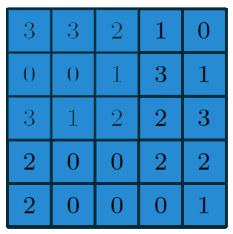
Convolution
Filter
Image
Image courtesy:Vincent Dumoulin

Slide 21
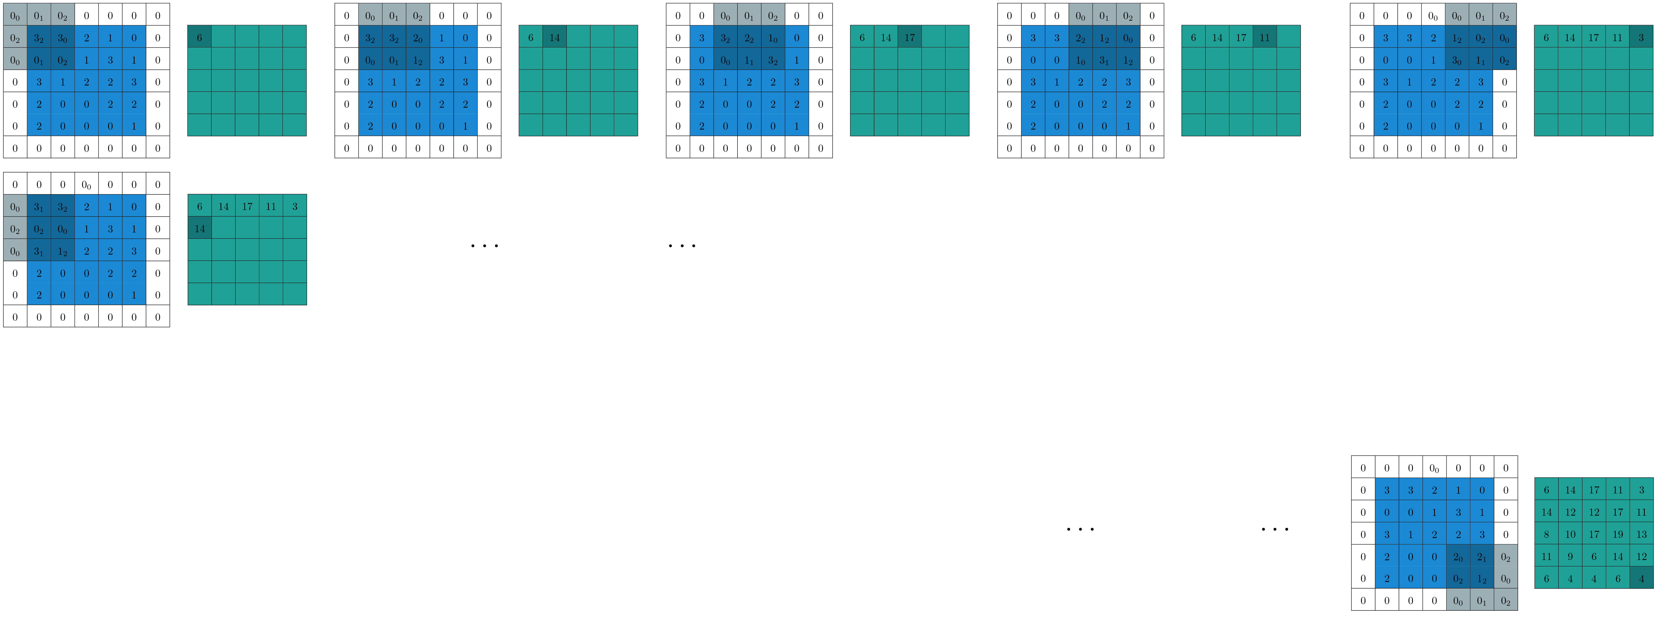
Convolution with Zero Padding
Filter
Image

Slide 22
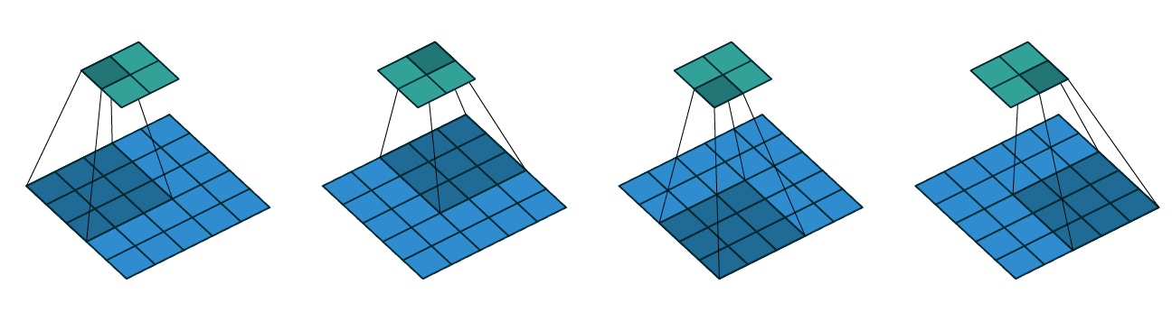
Convolution with Strides
Convolving a 3x3 kernel over a 5x5 input using 2x2 strides
Image courtesy:Vincent Dumoulin

Slide 23
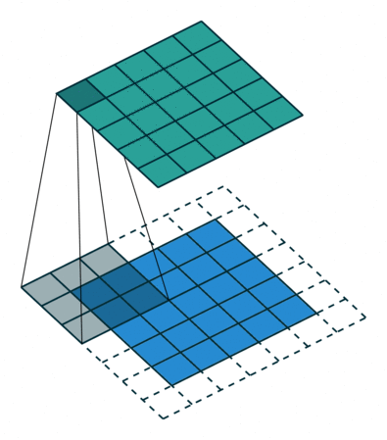
Convolution with Strides and Zero Padding
Convolving a 3x3 kernel over a 5 x5 input using 1 x1 strides and half padding
Image courtesy:Vincent Dumoulin

Slide 24
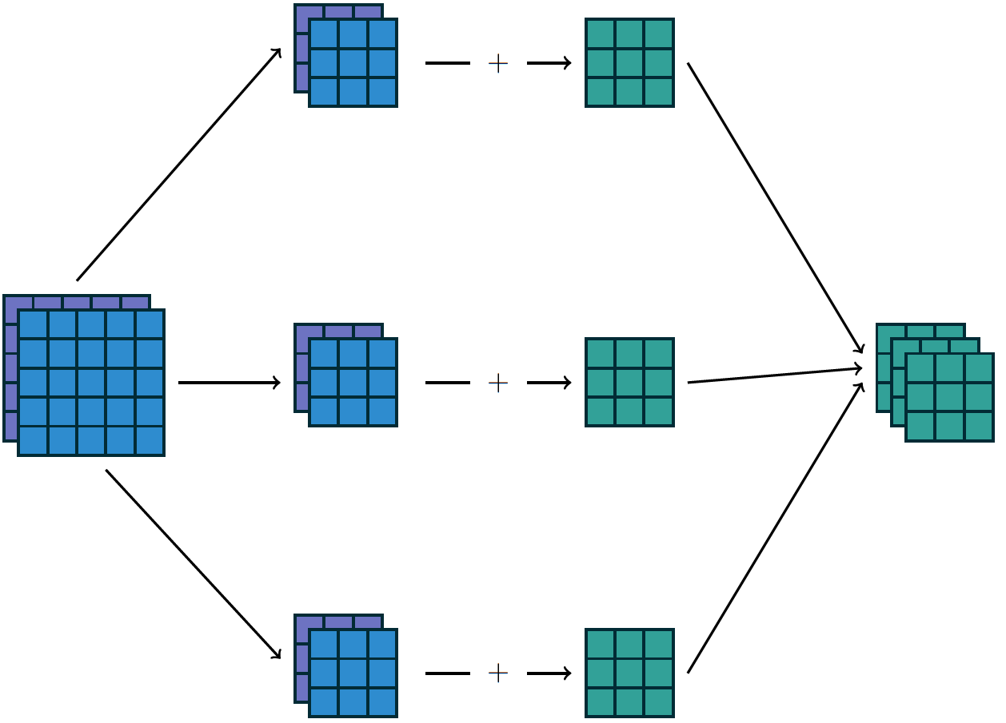
Inputs Generally have Multiple Channels
Image courtesy:Vincent Dumoulin

Slide 25
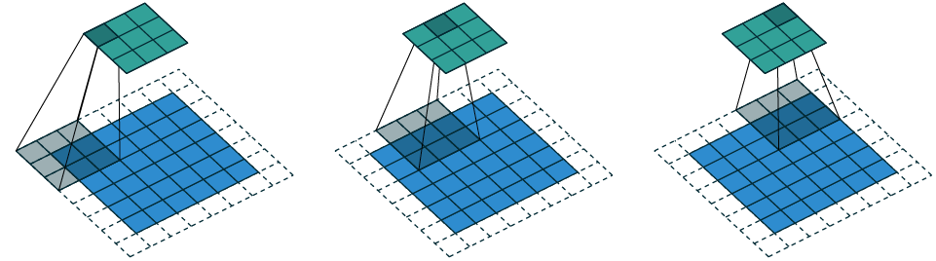
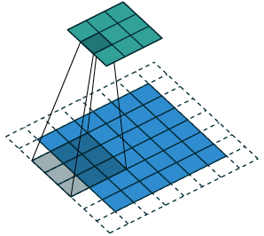
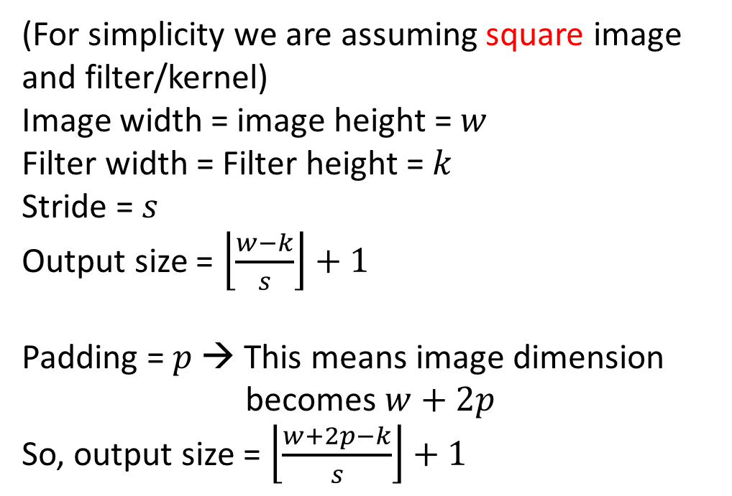

Convolution Arithmetic
(For simplicity we are assuming square image
and filter/kernel)
Image width = image height = $w$
Filter width = Filter height = $k$
Stride = $s$
Output size = $\left\lfloor \frac{w−k}{s}\right\rfloor +1$
Padding = $p$ → This means image dimension
becomes $w+2p$
So, output size = $\left\lfloor \frac{w+2p−k}{s}\right\rfloor +1$
Note the box function
$$w=6, p=1,k=3, s=2$$
Image courtesy:Vincent Dumoulin

Slide 26
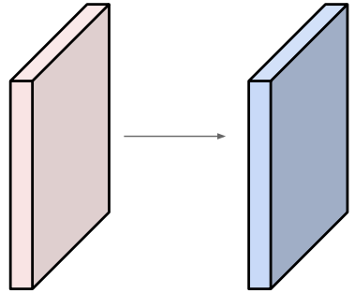
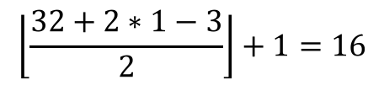
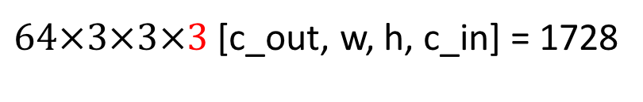
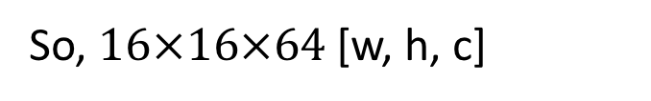
Convolution Arithmetic
Input volume: 32x32x3 [w, h, c].
64 filters of size 3x3 [k, k] with
stride 2 [s], pad 1 [p]
What is the output feature map size?
And What is the number of parameters in this convolution layer?
$$\left\lfloor \frac{32+2∗1−3}{2}\right\rfloor +1=16$$
So, $16×16×64$ [w, h, c]
$64×3×3×3$ [c_out, w, h, c_in] = 1728
Image courtesy: Andrej Karpathy

Slide 27
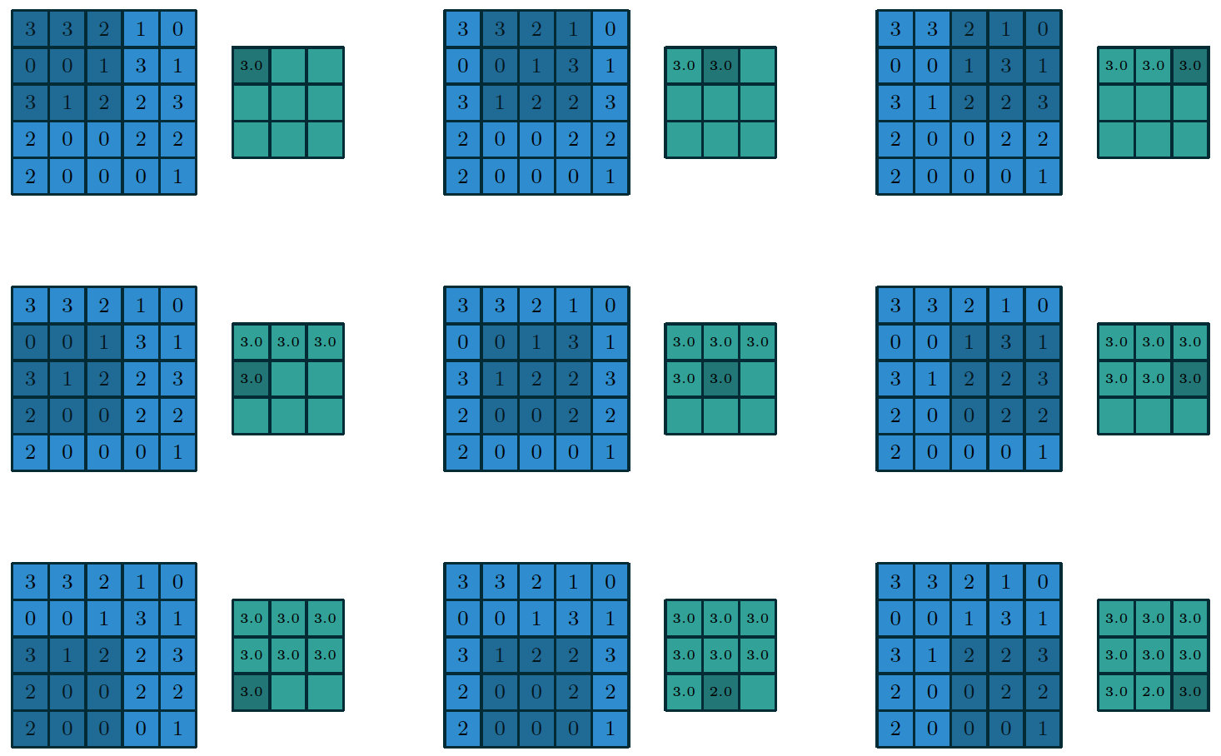
Pooling
3x3 max-pooling on 5x5 input with
1x1 stride
Image courtesy:Vincent Dumoulin

Slide 28
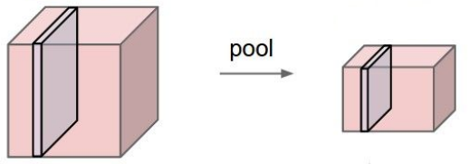
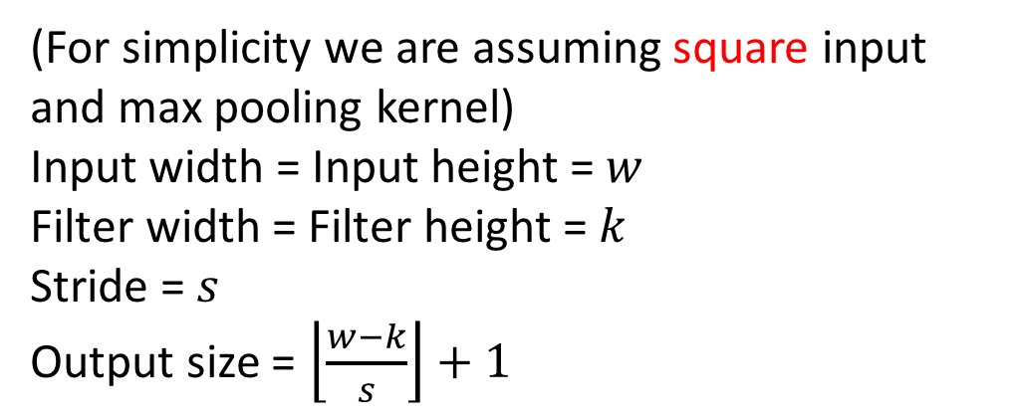

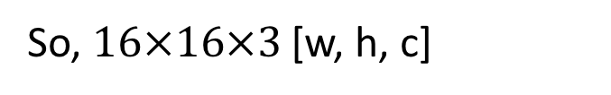
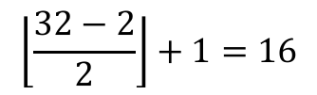
Pooling Arithmetic
(For simplicity we are assuming square input
and max pooling kernel)
Input width = Input height = $w$
Filter width = Filter height = $k$
Stride = $s$
Output size = $\left\lfloor \frac{w−k}{s}\right\rfloor +1$
And What is the number of parameters in this pooling layer?
Input volume: 32x32x3 [w, h, c].
Max-pooling kernel of size 2x2 [k, k] with
stride 2 [s]
What is the output feature map size?
$$0$$
$$\left\lfloor \frac{32−2}{2}\right\rfloor +1=16$$
So, $16×16×3$ [w, h, c]
Image courtesy: Andrej Karpathy

