Slide 1

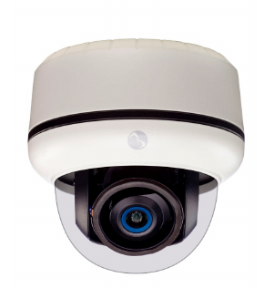
ANOMALY DETECTION IN VIDEO FEEDS
TEAM NAME: Team Gabru
PROJECT SUPERVISOR: Prof. Pabitra Mitra
PROJECT MENTOR: Anirban Santara
TEAM MEMBERS
Aishik Chakraborty | | | 13CS30041
Ashish Sharma | | | 13CS30043
Chinmaya Pancholi | | | 13CS30010
Jatin Arora | | | 13CS10057
Jeenu Grover | | | 13CS30042
Prabhat Agarwal | | | 13CS10060

Slide 2
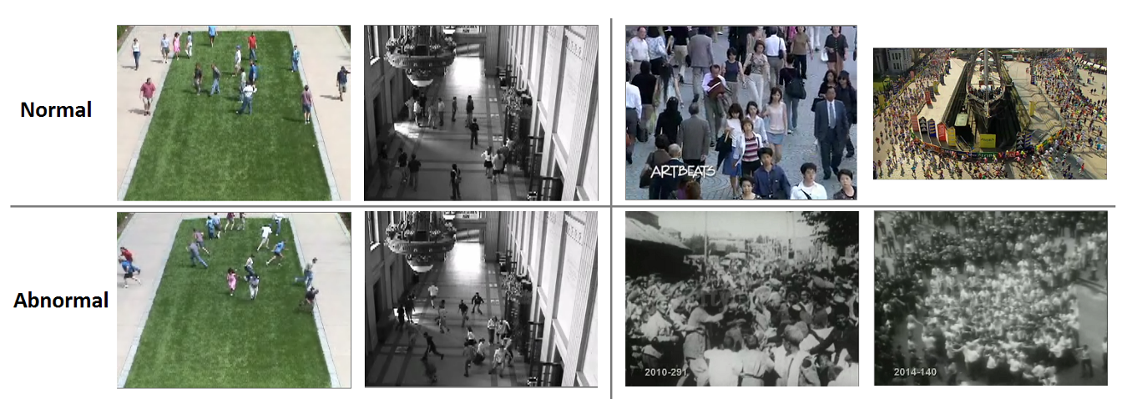
What are we doing?
Anomaly: unusual motion patterns of unusual objects in unusual locations
Service Description`
Identify such outliers in video feeds using Machine Learning techniques

Slide 3

Motivation
Requirement to process high volumes of data automatically
Use Cases
- Security
- Health
- Old-age homes monitoring
- Child monitoring
- and many more…
Challenges
- High Computational Complexity
- Online Detection of Anamolies
- Anomaly is context-dependent
- Difficult to annotate extremely rare events

Slide 4
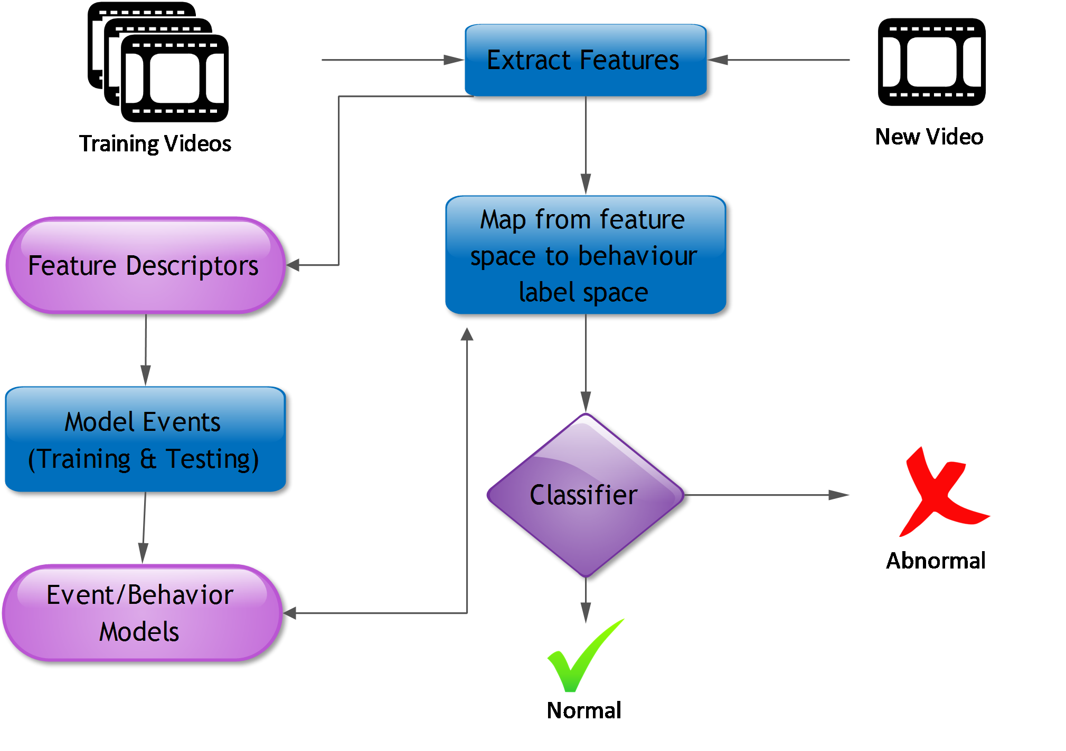
General Approach

Slide 5
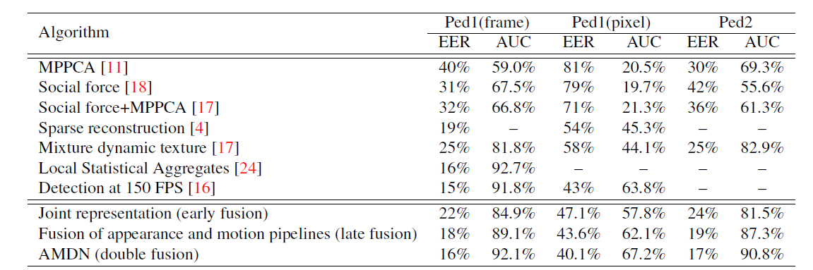
Performance of existing methods

Slide 6
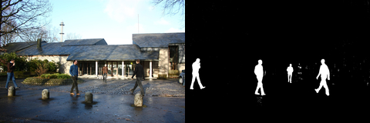
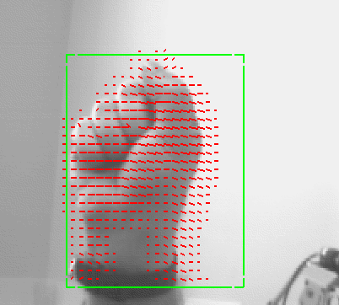

Methodology
Feature Extraction
[
]
Video
Background Subtraction
Optical Flow
Obtain Feature Vector
Incorporate
Spatial-Temporal Features & use some intelligent algorithms
Improved Feature Vector

Slide 7

Methodology
Anomaly Detection
Using Classifiers
Dynamic Bayesian Networks
- Naive Bayes
- Decision Trees
- K-nearestNeighbours
- SVM
- Random Forest
- Neural Networks
- Using Hidden Markov Model & its variants
Topic Modelling
-
Deep Learning
- Using a modified version of LDA
Notes:
<a href='http://www.freepik.com/free-vector/silhouettes-of-entrepreneurs_824366.htm'>Designed by Freepik</a>

Slide 8

Dataset
UCSD Dataset
Traffic Train
1
2
Data split into 2 subsets - Ped1 and Ped2
Ped1: Contains 34 training and 36 testing videos
Ped2: Contains 16 training and 12 testing videos
10 clips from Ped1 and 12 from Ped2 are provided with manually generated pixel level binary masks
Provided by York University, Toronto
Total No. of frames = 19218
Subway Exit
Canoe
3
4
Provided by York University, Toronto
Total No. of frames = 32426
Provided by York University, Toronto
Total No. of frames = 1050

Slide 9
Project Timeline
Remember to plan before you take the journey. Remember the carpenter’s rule : Measure twice, cut once.
Step 2 : (1.5 weeks)
Step 4 : (2 weeks)
Implement the basic framework for anomaly detection as used in existing methods to enhance understanding.
Develop and implement original algorithms and strategies using previous work to solve the problem of anomaly detection
Step 3 : (1 week)
Step 1 : (1.5 week)
Assess the performance of each method from the results obtained w.r.t. factors such as nature of data, desired accuracy v/s obtained accuracy etc. Make any required changes to the original approaches and examine the effects on the results.
Step 5 : (1.5 weeks)
Read and examine related work to understand the approaches already tested by others. Collect relevant data.
Test and tweak the methods developed using feedback from the results being obtained and refine approach
Notes:
<a href='http://www.freepik.com/free-vector/rocket-launch-illustration_759862.htm'>Designed by Freepik</a>

Slide 10

Thank You!!

Slide 11
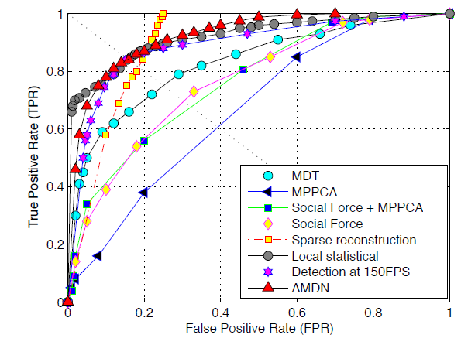
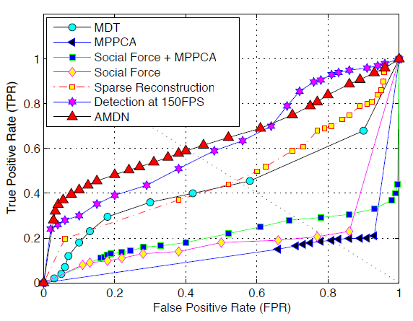
Performance of existing methods

