Slide 1

Final Project Presentation
Jihao Zhang & Zeyang Wang

Slide 2

What is the Problem?

Slide 3

Problem Statement
Vehicle Counting
Crowd Counting
Object Counting on Image
Animal Counting
…

Slide 4
Why is it Interesting?

Slide 5
Importance & Application
Public Safety and Security: political rallies, sports events, concerts, protests, and crowd density estimation
Transportation and Urban Planning: sidewalks, crossings, public transit stations, and parks
Retail and Business Intelligence: analyzing peak times, gauging the popularity of displays, and improving customer experience
Public Health: public health crises, like the COVID-19 pandemic

Slide 6

Dataset

Slide 7

About Dataset
Name: Crowd Counting
URL: https://www.kaggle.com/datasets/fmena14/crowd-counting/data
Content: The dataset is composed by 2000 RGB images of frames in a video (as inputs) and the object counting on every frame, this is the number of pedestrians (object) in the image. The images are 480x640 pixels at 3 channels of the same spot recorded by a webcam in a mall, but it has different number of person on every frame, is a problem of crowd counting.

Slide 8
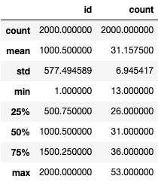
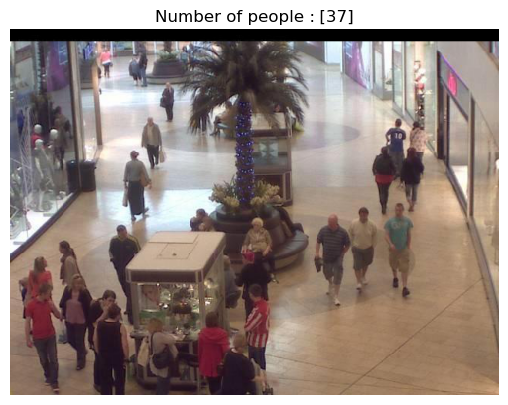
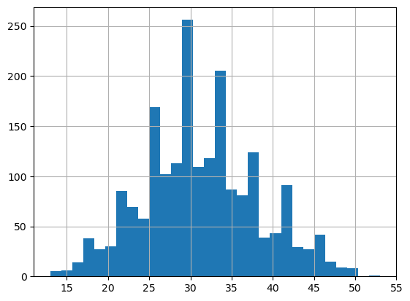
Data Review

Slide 9

Approaches to explore

Slide 10
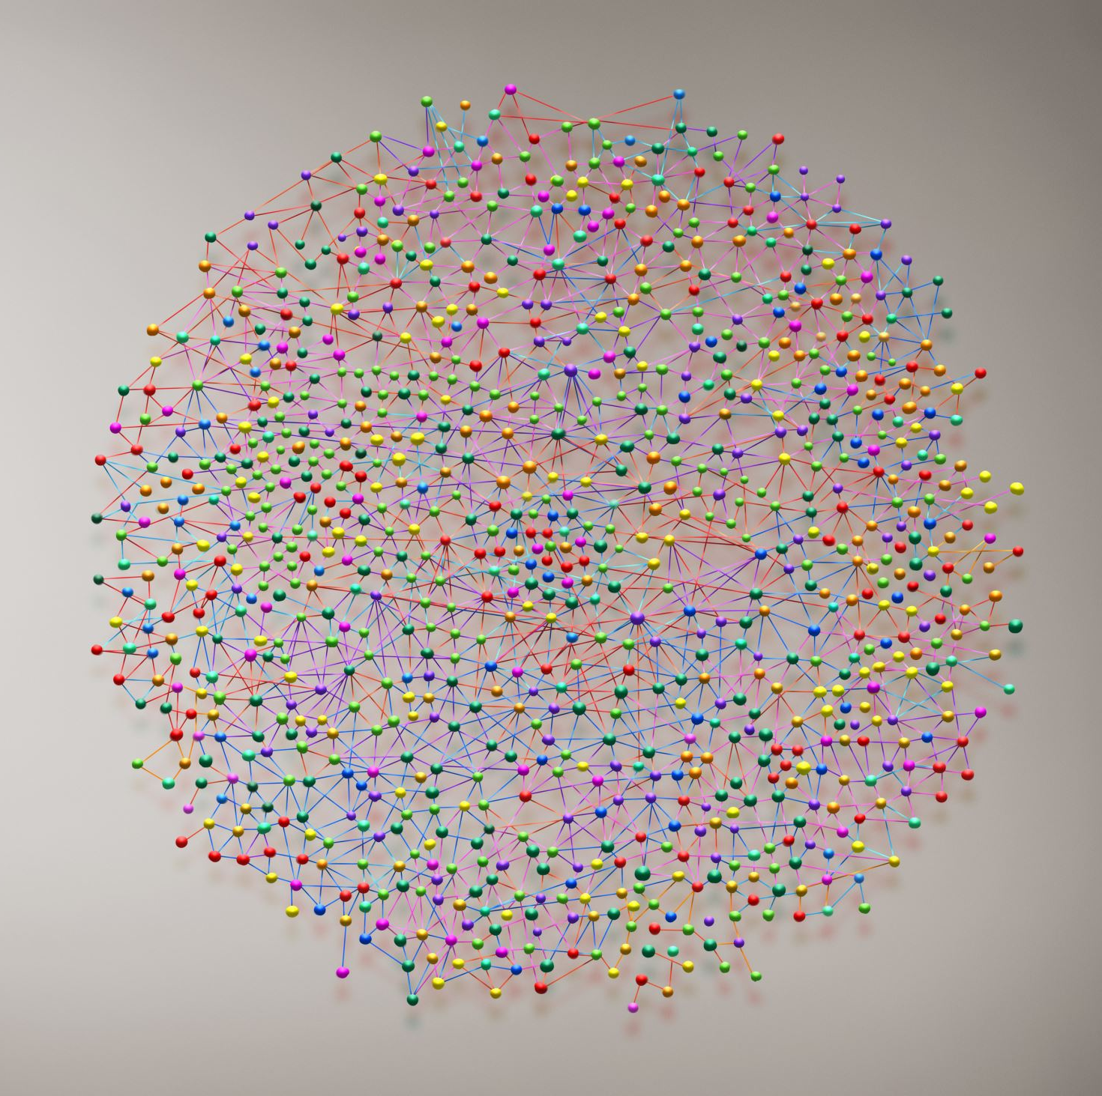
Choices
Neural Network Methods
Neural networks, particularly in the form of deep learning, have revolutionized the field of computer vision. Their ability to learn complex patterns from data makes them exceptionally powerful for visual recognition tasks.

Slide 11
Rationality
Performance: Neural networks have achieved state-of-the-art results in numerous computer vision tasks, such as image classification, object detection, and semantic segmentation. This high level of performance is a strong justification for their widespread adoption.
Generalization: Neural networks have achieved state-of-the-art results in numerous computer vision tasks, such as image classification, object detection, and semantic segmentation. This high level of performance is a strong justification for their widespread adoption.
Scalability: Neural networks scale well with the increasing amount of data and computational resources. The advent of GPUs and TPUs has significantly accelerated neural network training, making them feasible for large-scale applications.

Slide 12

Timeline

Slide 13
Timeline
Week 1: Data Preprocessing
Week 2: Algorithm Analysis & Model Selection
Week 3: Model Training
Week 4: Data Analysis & Model Optimization
Week 5: Summary of Findings

Slide 14
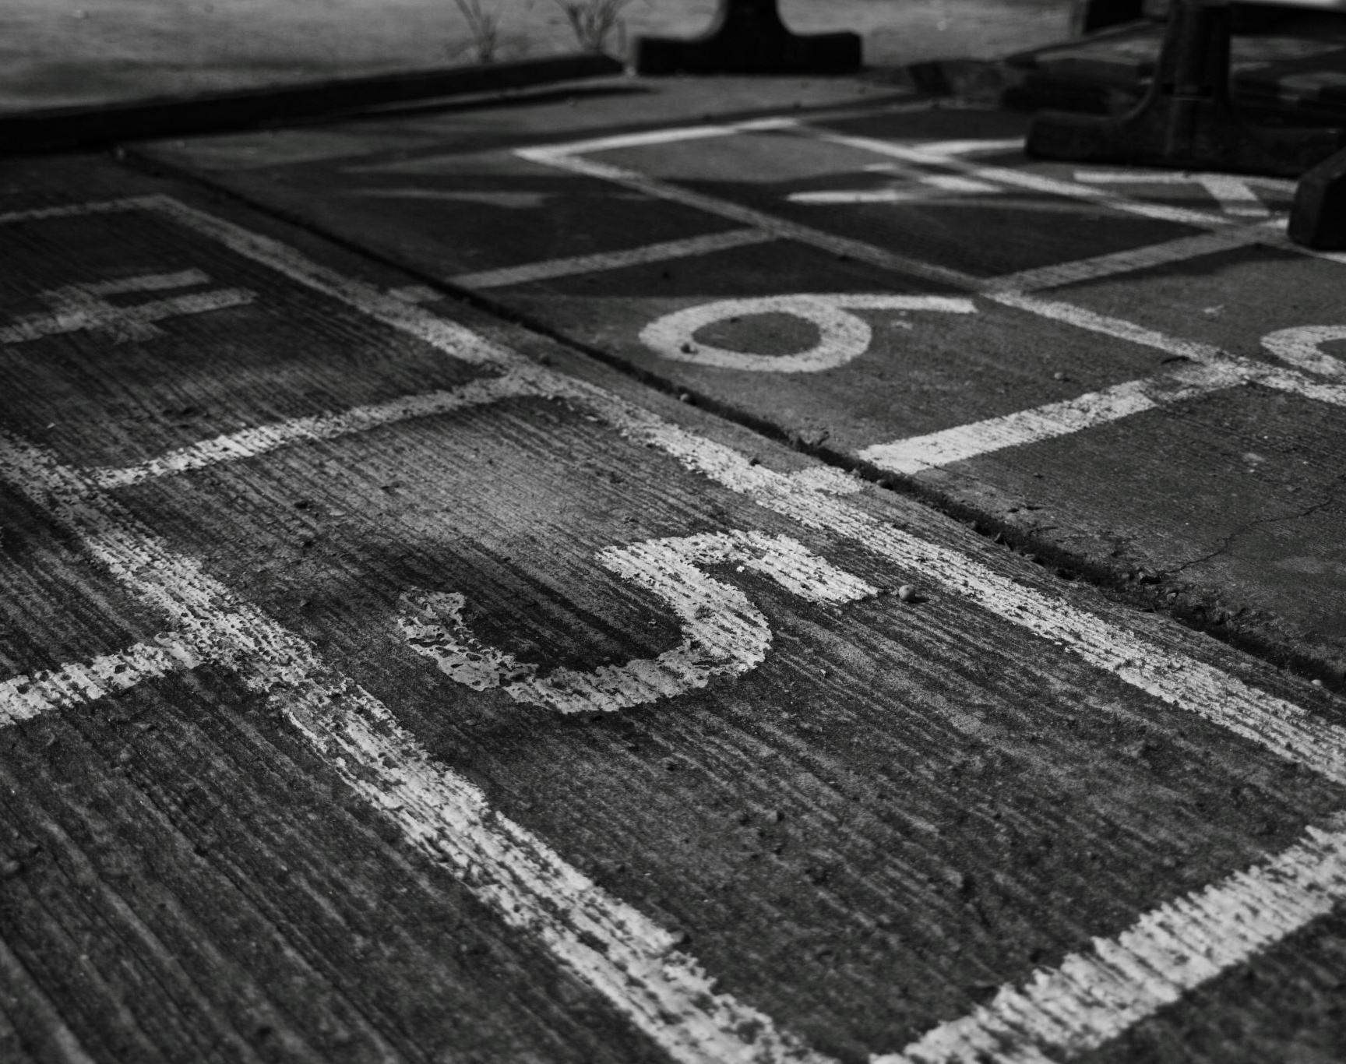
Practice

Slide 15
Model Selection
CSRNet
General CNN
Mobile Net
VGG16

Slide 16
Common Aspects & Rationality
Based on Convolutional Layers: All these models are built using convolutional layers, which are effective in capturing spatial and pattern information in images.
Hierarchical Feature Extraction: These networks typically extract features in a hierarchical manner, gradually moving from simple to complex patterns, aiding in recognizing complex patterns in images.
Versatile for Various Vision Tasks: Although these models might be optimized for specific tasks like image classification, object detection, or crowd counting, they are generally adaptable to a variety of computer vision tasks.

Slide 17
Unique Features
CSRNet
Specially designed for crowd counting tasks.
Utilizes densely connected convolutional layers to better handle highly congested scenes.
Suitable for estimating the density of crowds in images.
CNN (General Term)
A broad category referring to any neural network built with convolutional layers.
Can have various architectures, ranging from simple few-layered networks to complex multi-layered ones.
MobileNet
Designed for vision applications on mobile and embedded devices, optimizing for speed and memory efficiency.
Uses depthwise separable convolutions to reduce computation and model size.
Ideal for real-time vision processing in resource-constrained environments.
VGG16
A deep network with 16 layers, featuring repetitive convolutional and pooling layers.
Though larger in size, it's simple, efficient, and easy to comprehend.
Performs exceptionally well in image classification and feature extraction tasks.

Slide 18
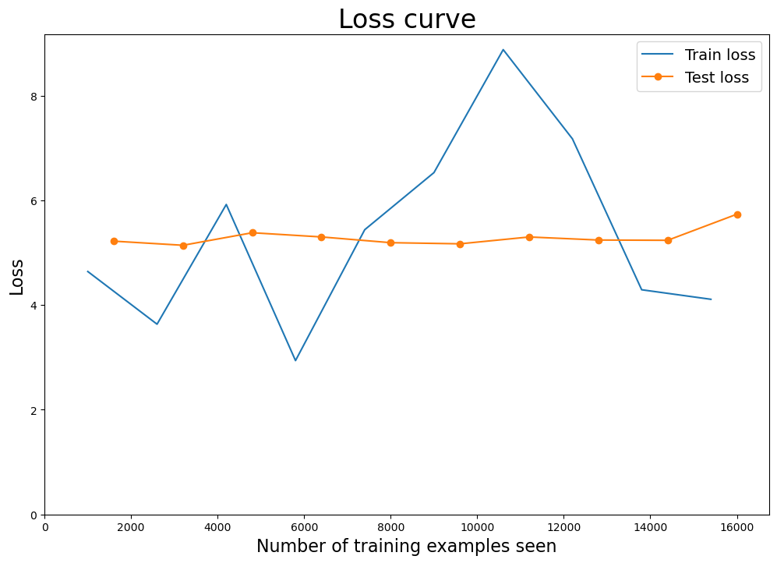
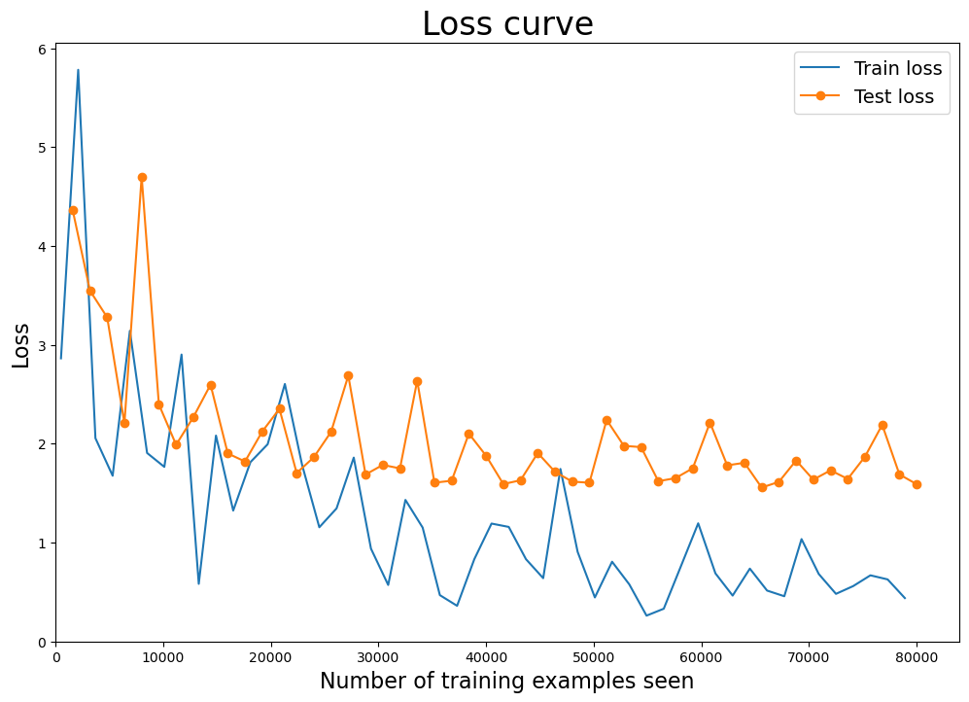
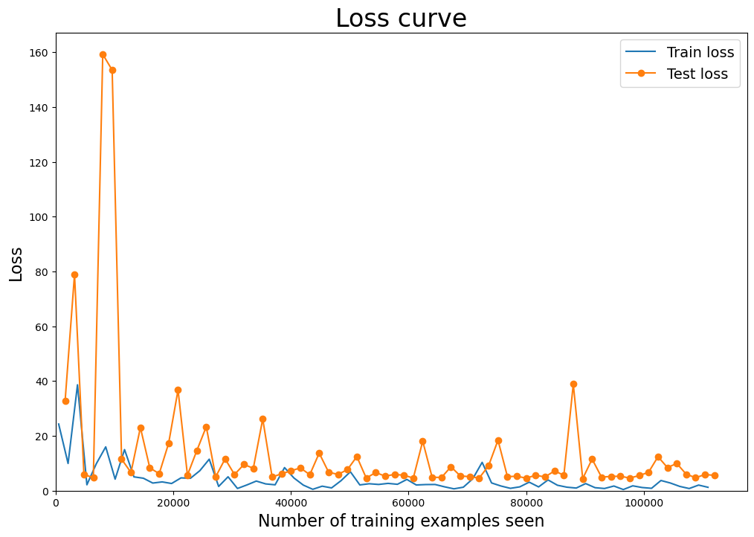
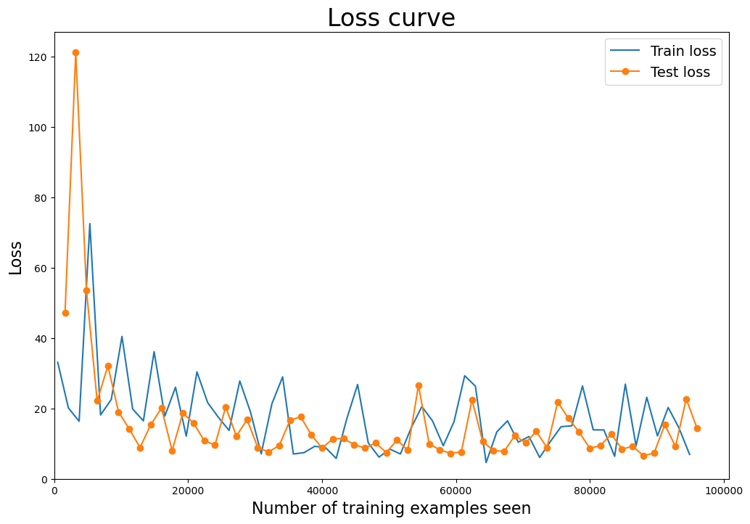
Result
CSRNet
Training Set: Average loss: 0.5631, Accuracy: 33.94%
Test Set: Average loss: 0.5735, Accuracy: 34.00%
General CNN
Training Set: Average loss: 0.0490, Accuracy: 98.12%
Test Set: Average loss: 0.1591, Accuracy: 79.25%
Mobile Net
Training Set: Average loss: 0.1468, Accuracy: 95.38%
Test Set: Average loss: 0.5592, Accuracy: 77.75%
VGG16
Training Set: Average loss: 0.8667, Accuracy: 71.62%
Test Set: Average loss: 1.4430, Accuracy: 59.25%

Slide 19

Findings
Model Architecture and Complexity: Simpler models or those with the right inductive biases for the task might outperform more complex models like VGG16, which has a much deeper architecture.
Data Suitability: The type and quality of the dataset play a significant role. For instance, if the dataset doesn't match CSRNet's expectations for crowd scenes, it may not perform well.
Training Regime: The choice of hyperparameters, including learning rates, regularization, and the number of epochs, directly impacts the model's learning trajectory.
Task Alignment: The nature of the task and how well it aligns with the model's design intent (e.g., crowd counting for CSRNet) is crucial.
The General CNN's superior performance suggests that its architecture and training were well-suited to the task and dataset. Meanwhile, CSRNet's lower performance indicates a potential mismatch in task alignment or suboptimal training setup. MobileNet and VGG16's performance suggest potential overfitting, with VGG16 also potentially being too complex for the amount of training data or requiring more extensive tuning to perform optimally on this task.

Slide 20

Discussion
What causes the underperformance of CSRNet?
Data Mismatch: If the training and testing data do not consist of highly congested scenes, or if they differ significantly from the scenes on which CSRNet was trained on other datasets, it may not perform well.
Data Quantity: Insufficient training data to cover the diversity of scenes might lead to inadequate learning of generalized features.
Model Complexity: The complexity of CSRNet might be too high for the provided data and task, resulting in undertraining.

Slide 21

Conclusion
The analysis of the four models—CSRNet, a general CNN, MobileNet, and VGG16—reveals a notable variance in performance on the crowd counting task. The General CNN emerged as the top performer, achieving high accuracy and maintaining low loss, suggesting a well-suited architecture and effective training strategy for the task. CSRNet, while specifically designed for crowd counting, exhibited unexpectedly low accuracy, which may point to issues with data compatibility or the need for further tuning of its hyperparameters and training regimen. MobileNet's performance was robust, but a drop in test accuracy indicates a potential overfitting problem. VGG16, the most complex model, showed significant overfitting, as evidenced by the highest test loss and lowest accuracy figures.
For future efforts, focusing on the data preprocessing, ensuring a diverse and representative dataset, and fine-tuning the models' hyperparameters could potentially improve results. Additionally, experimenting with data augmentation, regularization techniques, and extending the training period may address overfitting issues. Given CSRNet's specialized nature, ensuring task alignment or modifying the network to better suit the data and task could help in harnessing its full potential. Investigating the impact of different loss functions and evaluation metrics more aligned with the task's objectives may also provide insights into improving model performance.

Slide 22

THANKS

