Slide 1
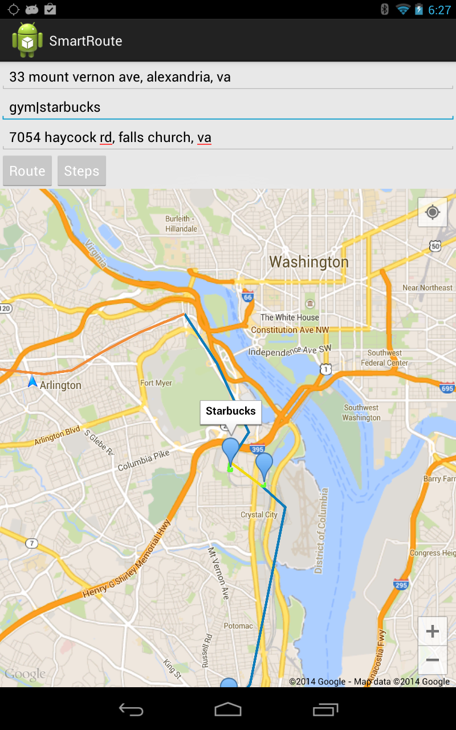
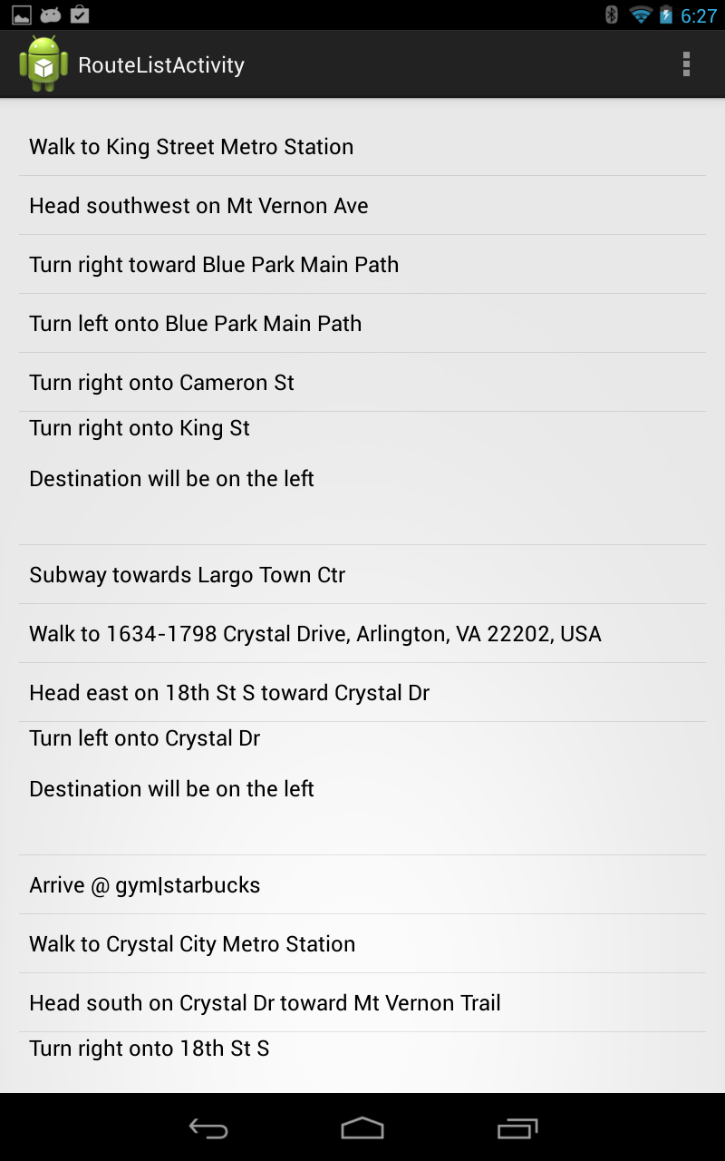
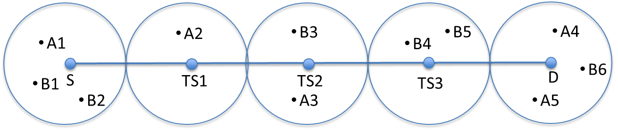
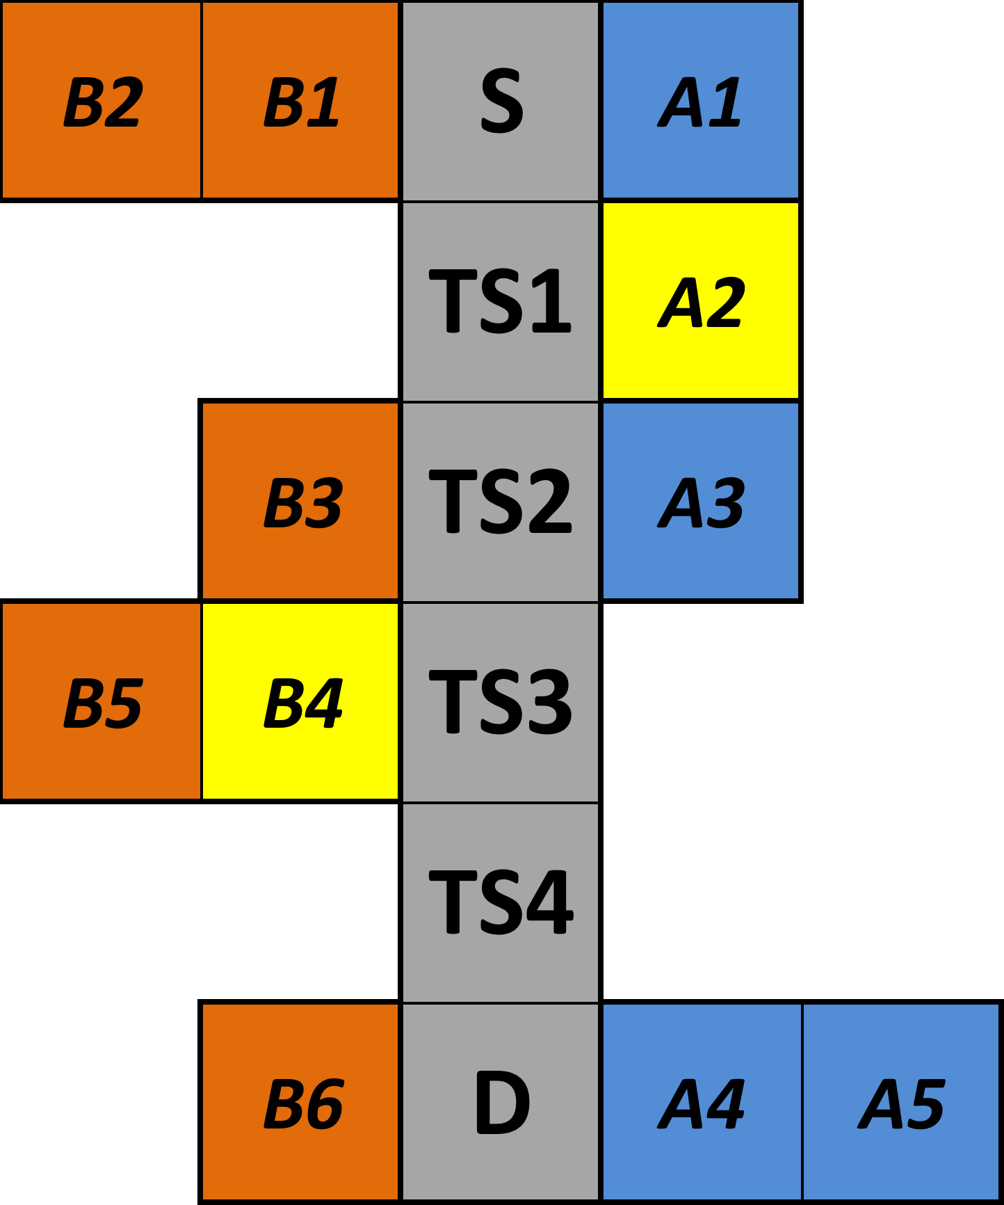
SmartRoute: Extending Waypoint Navigation
Wei Wang, Parang Saraf, Kyle Schutt
CS6604: Spatial Databases
Project Introduction
Client-side Application
Project Introduction
Algorithm Overview

