Slide 1
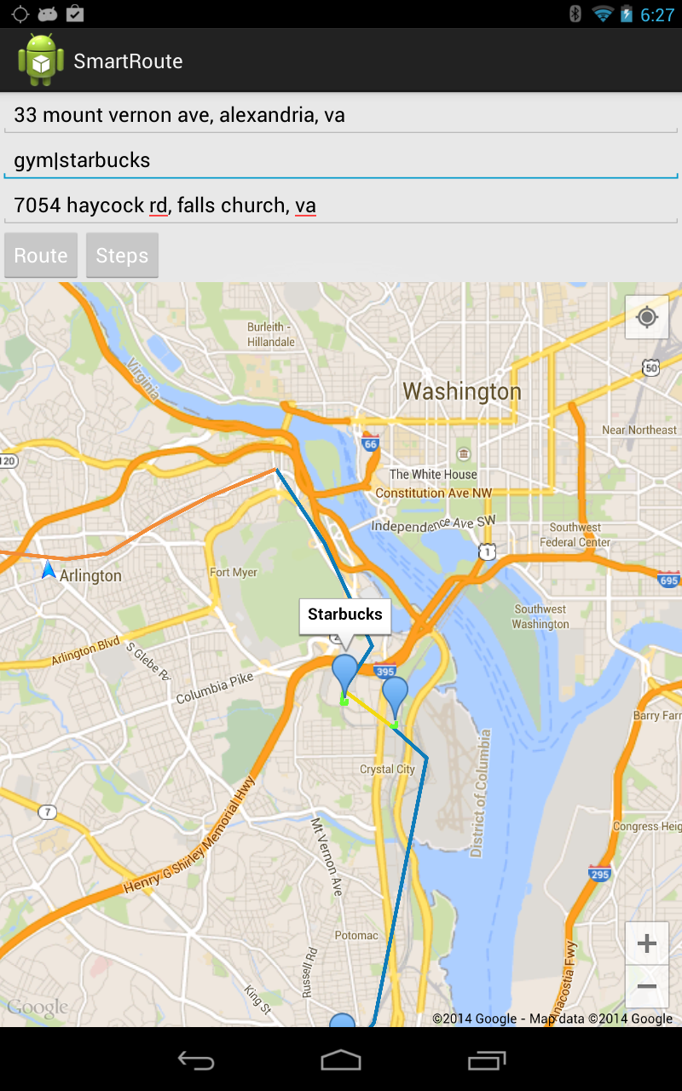
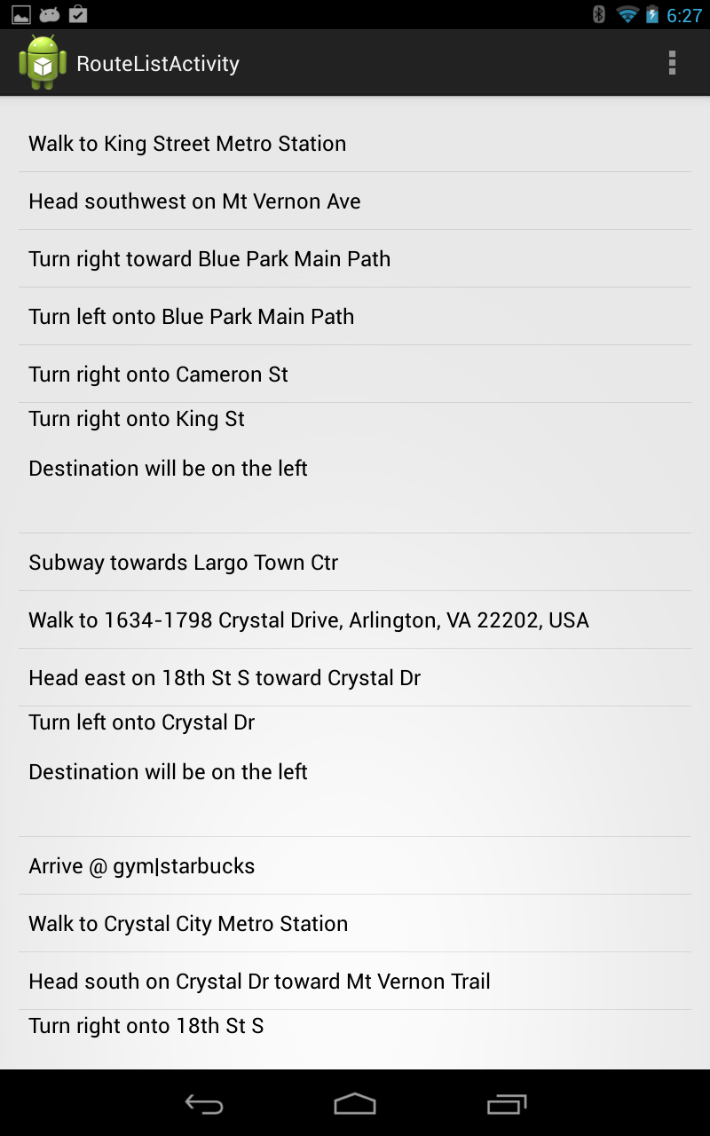
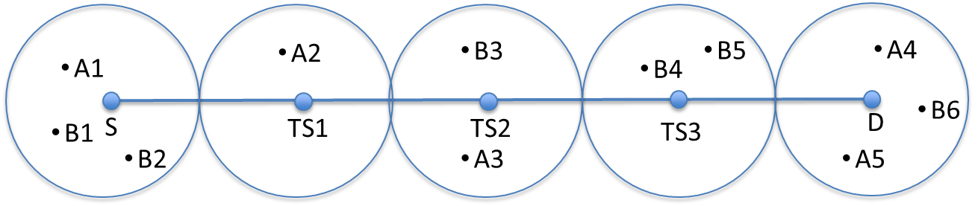
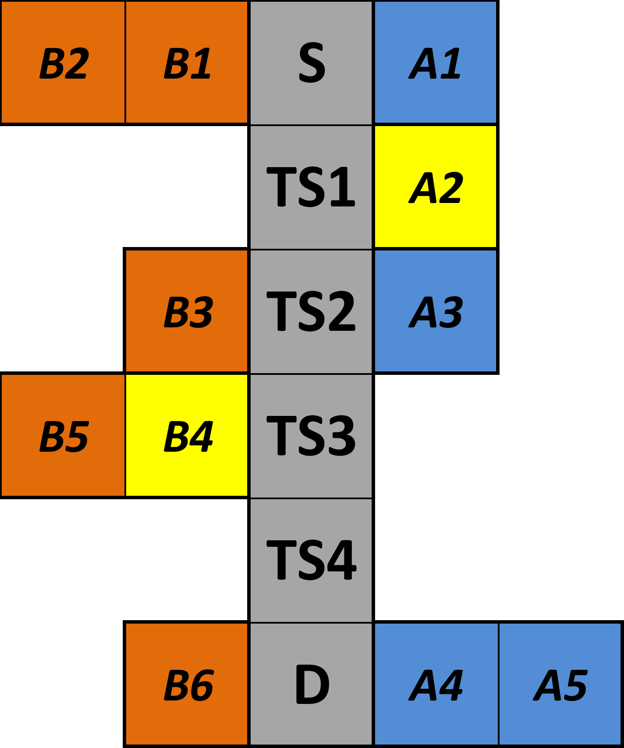
SmartRoute: Extending Waypoint Navigation
Wei Wang, Parang Saraf, Kyle Schutt
CS6604: Spatial Databases
Project Introduction
Client-side Application
We elected to create a native Android application that leverages the Google Maps API v2 for Android as the basis for displaying and communicating the results of our custom algorithm for determining multi-modal transit routes between destinations and specific points of interest. The algorithm itself was developed in python to be run on a server. We decided to offload this computation from the client-side because of the complexity and resource-intensive calculation that must occur to determine the least costly route from an origin to a destination via some points of interest.
The client side application is a simple single-page app that provides the user with auto-completion on the addresses or points of interest that they are searching. The points of interest can be as simple as a single category for a business type (e.g., a gym) or as specific as a restaurant (e.g., The Greene Turtle).
Algorithm Overview

