Slide 1
Smart IoT Memory Drives
1) Nishant Kathpal (153079026) 2) Darshit Vaghani (15307R010)

Slide 2
Introduction/Motivation
Sharing between memory drives require 3rd party device.
Missing the drive somewhere, Headache!!
Presently the embedded system used in large automation industries have huge number of sensors and actuators. In order to transfer data from the sensors/actuators with the central hub, wired/ethernet connections are used.
But it is very hectic process and costly. Why not transfer the data wirelessly if technology is available currently.
This motivates us to propose memory drive which is smart enough to get or transfer data wirelessly.

Slide 3
Abstract
With the advancement in technology day by day, IoT is one of such which is catching most of the eyes.
The internet of things (IoT) is the internet working of physical media which can be vehicles, buildings and other item, or embedded components like sensors, actuators, that enable objects to collect and exchange data.
Using IoT technology, we propose a new kind of memory drives called smart IoT Memory drives. Days are gone when someone needs pc to exchange data with the pendrive.
But with this smart drive we won’t need PC for exchanging Data.

Slide 4


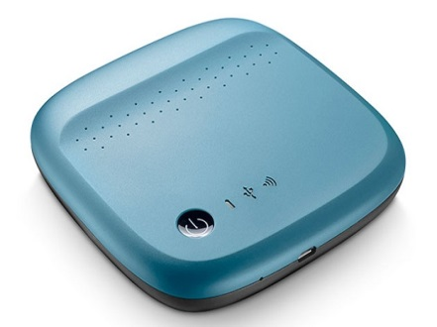
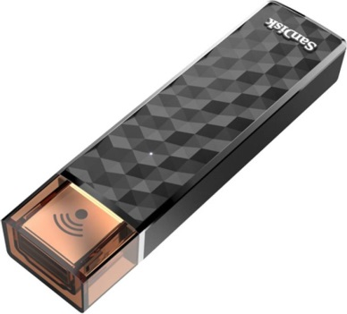
Innovation And Challenges
Sharing data among 2 drives
Sharing data over the Internet
IoT Technology
Don’t Need 3rd party Device
High speed data Transfer

Slide 5
Tasks Specification
Data transfer between memory drives without using any physical medium like PC.
Selective data transfer with the help of switches and LCD.
Data transfer between memory drives which are remotely placed but within same network.
Data transfer between memory drives which are remotely placed but having static IP.
Data to be transferred wirelessly at speed comparable to wired connection.

Slide 6
Project Plan
Setting up of wifi link by interfacing CC3100 wifi module with TIVA µC. (1 week)
Data transfer over intranet or internet using socket programming. (1 week)
Interfacing SD Card Module with TIVA µC. (1 week)
Transferring the Data block saved in SD Card using CC3100 module. (2 days)
Enabling file transfer require integrating FATFS module. (1 week)
Interfacing LCD with TIVA for selective data transfer. (1 week)
Short version of OS having options for the flexible flow of data transfer. (1 week)

Slide 7
Work Allocation
Nishant Kathpal ::
Interfacing CC3100 with TIVA Launchpad And Testing.
TCP/IP Link Setup between two TIVA Launchpad Using CC3100 Booster.
Interfacing SD Card with TIVA Launchpad And Testing.
Enabling data block transfer using CC3100 module.
Integrating FATFS module to enable file transfer instead of block transfer. (Most Critical One)
Darshit Waghani ::
Interfacing LCD and switches (including switch debounce) with TIVA Launchpad And Testing.
Enabling data transfer between 2 SD Cards.
Selection of Data Using LCD.
Making short version OS for flexible flow. (Most Critical One)

Slide 8
Flow Chart
Mode 1 : Drive To Drive Direct
Mode 2 : Between Drives Over Local N/W
Mode 3 : Between Drives Over Internet

Slide 9
Tasks Completed
Data transfer between memory drives without using any physical medium like PC.
Knowledge of socket programming.
Understanding the hardware structure of wifi module CC3100.
With the help of sources available on the web, we learnt how to make socket connection and initialise the module.
Selective data transfer with the help of switches and LCD.
Interfacing SD card with TIVA Launchpad is itself a big task.
Implementing FATFS module to enable file transfer instead of block transfer. This is the most difficult task to implement.

Slide 10
Tasks Completed
Data transfer between drives which are remotely placed but within same network.
Data transfer between memory drives which are remotely placed but having static IP.
Above two tasks require knowledge of IP addressing.
CC3100 require IP in Hex format, so initially we faced difficulty as we were giving the ip address directly without converting to Hex format.
TCP socket programming would be of great help.
Maintaining the TCP link active was also one of the problem. Initially TCP link became inactive if it does not find any receiver. So i placed one infinite loop to wait for the connection to establish and following the data transfer process.

Slide 11
Re-Usability
Code written is well commented so that any one having basic knowledge of programming can get the idea of it.
More than 70% of the code is implemented with the functions and these are implemented in such a way that it can be understood easily and modified later on.
Functions for different hardware module are well separated.

Slide 12
Testing
Test 1:: While interfacing the modules, each component we are going to use will be checked according to the function it’s going to perform like for example, are we able to Read/Write with SD Card, wireless functions of CC3100.
Result :: Every module used for this product is tested and satisfies our requirement.
Test 2:: Speed of data transfer between 2 SD Cards through wireless link and its maximum capability of handling the data transfer according to its Class.
Result :: Speed of data transfer here depends on many factors here like SD card class, bandwidth offered by CC3100, mode of accessing the SD card, file type etc. As per analysis it can offer average speed of 10Mb/s

Slide 13
Testing
Test 3:: File transfer or block transfer.
Result :: First data is transferred in blocks from SD card to the other module and is received perfectly. But for the file transfer, integration of FATFS module is required and implemented successfully.

Slide 14
Future Enhancements
Currently one need to send and receive files manually. Like for sending the file, one need to select it and then transfer it. But this drive will become more smarter if it acts like temporary cloud and one can view the contents of his/her pendrive anywhere anytime.

Slide 15

Question

Slide 16
Thank You

