Slide 1

Motivation
“Chapping lips without any sound look really weird”
– chromecast audio user
“Google, you should be better than this”
– another chromecast audio user
Existing systems like Bose SoundTouch or Sonos Play are either costly or not available in the Indian Market.
Do not want to plug in speakers wires intro every other device.
Speaker wires are fragile (even getting them soldered back costs INR 100)
We need a device which can stream PC audio in realtime!
14th September, 2016

Slide 2

Rāgam: Project Proposal under the guidance of Prof. Kavi Arya
Bharat Reddy, Diptesh Kanojia, and Vinod Saini
CS684: Embedded Systems Project
CSE Department, IIT Bombay
14th September, 2016

Slide 3
Roadmap
Abstract
Motivation
Prior Work
Problem Statement
Hardware Requirements
Software Requirements
Implementation
Feasibility
Testing
Work Allocation and Timeline
14th September, 2016

Slide 4
Abstract
“Make Wired speakers great again!”
Device to be able to receive music from PC (mandatorily) / Mobile Devices (optionally), and transmit the audio to speakers connected to it.
Our motto – “Make Wired speakers great again!”
We aim to route low bit rate music to the device initially.
Our device should be able to route music of any quality to a standard 3.5mm audio jack later.
Additionally, we aim to stream the music over FM Radio frequency.
Finally, we would like the product to be stripped off any extra components, and become portable / cost – effective for the Indian market.
14th September, 2016

Slide 5
Prior Work
Bose SoundTouch 10 (USD 200!¹ / INR 18,602¹. Costly, app does not support PC setup)
Sonos SoundPlay:1 (INR 26,999!² Costly)
Gramofon (60 EUR³, not available in India)
Trippy⁴ (shelved)
¹https://www.bose.com/en_us/products/speakers/wireless_speakers/soundtouch-10-wireless-system.html
²http://www.ebay.in/itm/Bose-Soundtouch-10-/272349437205
³https://gramofon.com/
⁴http://make.witworks.com/preorder/trippy
14th September, 2016

Slide 6
Problem Statement
To develop a device which can stream audio from PC / Mobile to speakers.
The device should make use of Wi-Fi wireless protocol to receive data.
It should be able to stream higher bitrate audio (usually 320 Kbps).
The device should be able to perform without any lags whatsoever.
Additionally, the device can be made to transmit music over FM frequency thus making it accessible over a large range (across rooms).
14th September, 2016

Slide 7
Hardware Requirements
Raspberry Pi 3/ Arduino (primarily testing)
Wireless router (primarily testing)
PC / Laptop / Mobile Device (programming and testing)
USB sound card (good quality)
FM Transmitter
Wires to connect (Power, LAN, Audio cable etc.)
Power Sockets with Electric Supply!
14th September, 2016

Slide 8
Software Requirements
Python / CPP
RaspbianOS / JessieOS / Energia
14th September, 2016

Slide 9
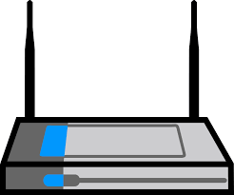
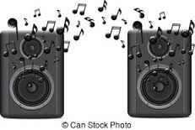
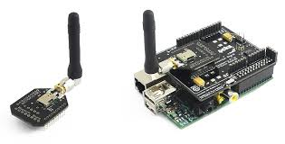
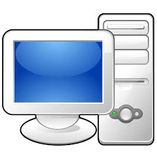
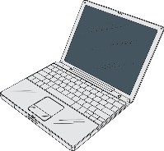

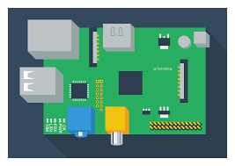
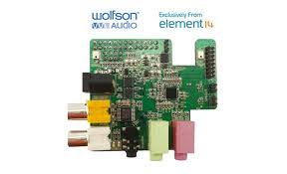
Implementation
Wi-Fi Router
(Access Point for Internet / Music sharing)
Amplified Speakers
(Target)
Wi-Fi Module
PC / Mobile Device
(Source)
Microcontroller Board
Sound Card
(Output Device)
(Optional)
FM Transmitter
FM Receiver
Speakers
Image Sources: OpenClipart, ClicpartKid, Google Image Search
14th September, 2016

Slide 10
Feasibility
It would be feasible, Yes!
But, there are some pitfalls i.e. we might experience temporal lag in the audio, which we would like to remove.
The reasons for such lag could be constrained bandwidth, high bitrate, connectivity issues etc.
We would like to test our device in various scenarios and ample test cases for it to be a viable and cost-effective product.
14th September, 2016

Slide 11
Testing
We would like to test our device based on these cases:
PC -> Device -> Speakers (any audio)
PC -> Device -> Speakers (low bitrate)
PC -> Device -> Speakers (high bitrate)
PC -> Device -> Speakers (FLAC audio)
Optionally, PC -> Device -> FM Transmitter -> FM Receiver -> Speakers (the above cases)
14th September, 2016

Slide 12
Work allocation & Timeline
Work Allocation
Bharat:
Receiving data on the Microcontroller.
Downsampling (if required).
Diptesh and Vinod
Procurement.
Setup (configuring WiFi module on RPi to connect to local WiFi).
Sending data to Microcontroller.
Timeline:
Procurement and Setup - 1 Week
Microcontroller setup – 2 weeks
Audio Streaming API – 1 Week
Quality Control and Testing – 2 Weeks (Upto End Semester)
Application Development (Serious Time Contraint) – 2 Weeks
14th September, 2016

Slide 13
References
http://make.witworks.com/preorder/trippy [5th September 2016]
https://gramofon.com/ [15th September 2016]
https://www.bose.com/en_us/products/speakers/wireless_speakers/soundtouch-10-wireless-system.html [15th September 2016]
http://www.ebay.in/itm/Bose-Soundtouch-10-/272349437205
Google Images (Non – Copyright images like Clipart used from OpenClipart, and ClipartPanda)
14th September, 2016

Slide 14
Thank you! ☺
Questions ?
14th September, 2016

