Slide 1

IoT Based EGC Monitoring System For
Automatic Detection Of Abnormalities
Akshat Garag (17305R003)
Suraj Shingh(173059006)
Amit Vhatkar (17305R011)
Under Guidance of
Prof. Kavi Arya &
Cherupally Naveen
1

Slide 2
Motivation
HealthCare Industry in India
Largest sectors: revenue & employment; public & private investment
Industry size is expected to touch USD 160 bn by 2020
HealthCare Situation in India
Shortage of hospitals and paramedical staff.
Limited access to hospitals and clinics.
The country is 81% short of specialists at rural.
1

Slide 3
Motivation (Cont’d)
Cardiovascular diseases (CVDs)
Globally, CVD led to 17.5 million deaths in 2012. More than 75% of these deaths occurred in developing countries
India ranks highest in death from heart attacks
In India 1.7 mn (17.8% of all deaths), up 53% from 2005.
1

Slide 4
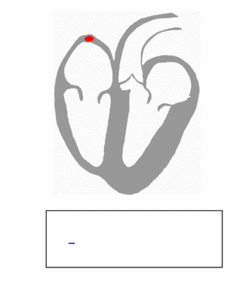
Basic Of ECG waveform
P wave:
Small increase in the voltage (.1mv)
Depolarization of the atria during atrial systole.
• QRS complex:
Small drop in voltage (Q)
Followed by voltage peak (R) and
Another small drop in voltage (S).
Depolarization of the ventricles during ventricular systole.
• T wave:
Small peak (slightly bigger than P wave 0.3 mv)
Repolarization of the ventricles during the relaxation of the cardiac cycle.
1

Slide 5
Problem Statement
Detection & Prediction of abnormality is possible if countinously monitored
Collecting ECG sensor data using IoT architecture.
Large amount of data on premise for visuallization and
Abnormality detection using simple ML algorithm
1

Slide 6
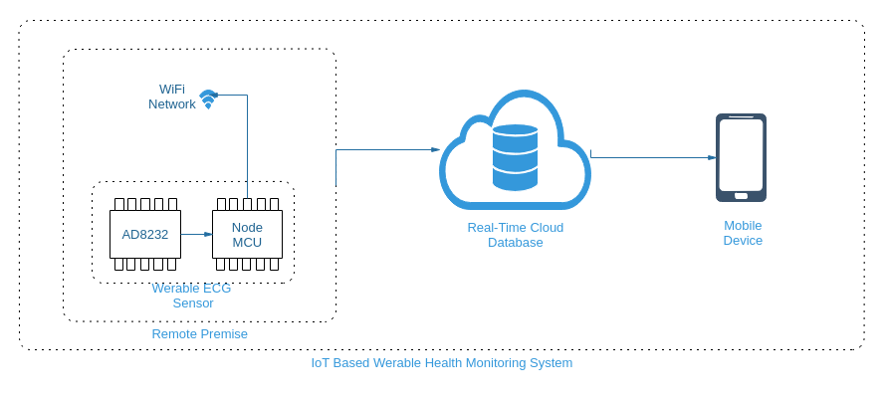
Architecture Diagram:
The pulses are sent in chunks(100 readings) after every 112 ms certain time period.
Fig: Architecutre Diagram
1

Slide 7
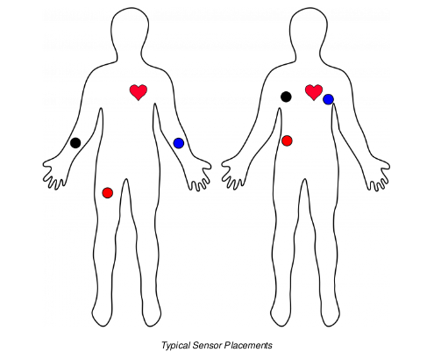
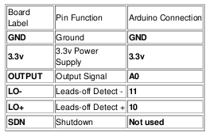
Implementation:
Fig: Electrod application points
Fig: Pin Configuration
1

Slide 8
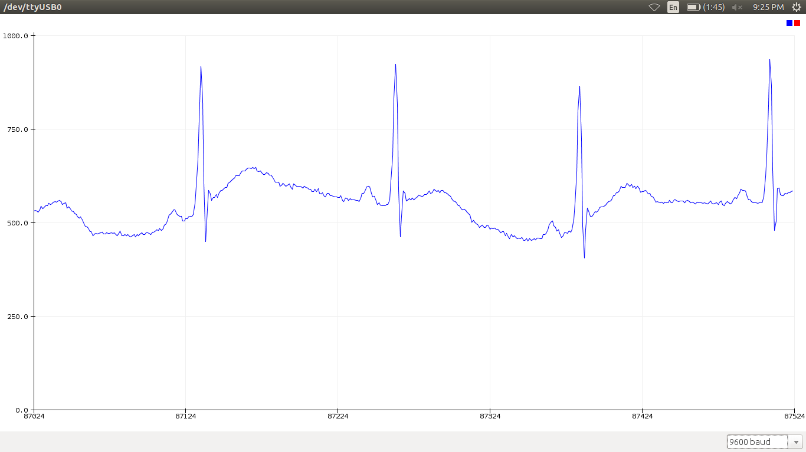
Real Time Data At Microcontroller Level
Obtained waveform is very simmilar to actual ECG waveform
We’ve done it with 3 electrodes only. So, 100% accuracy is not possible.
Fig: Ontained ECG waveform
1

Slide 9
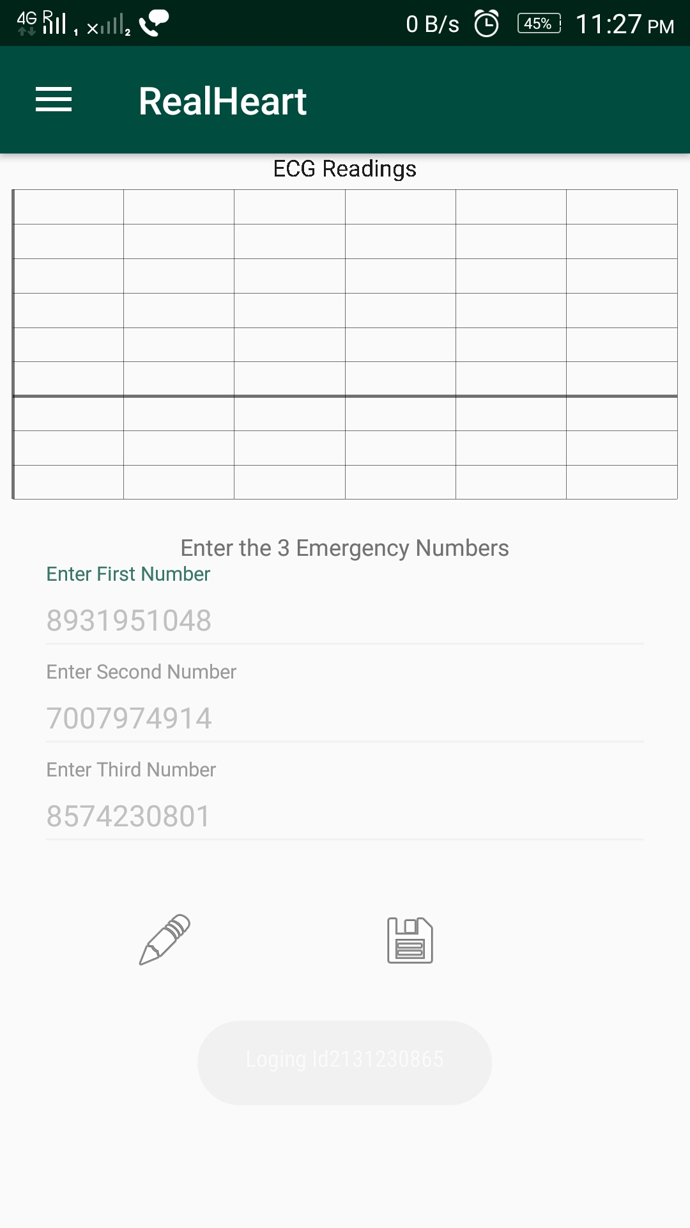
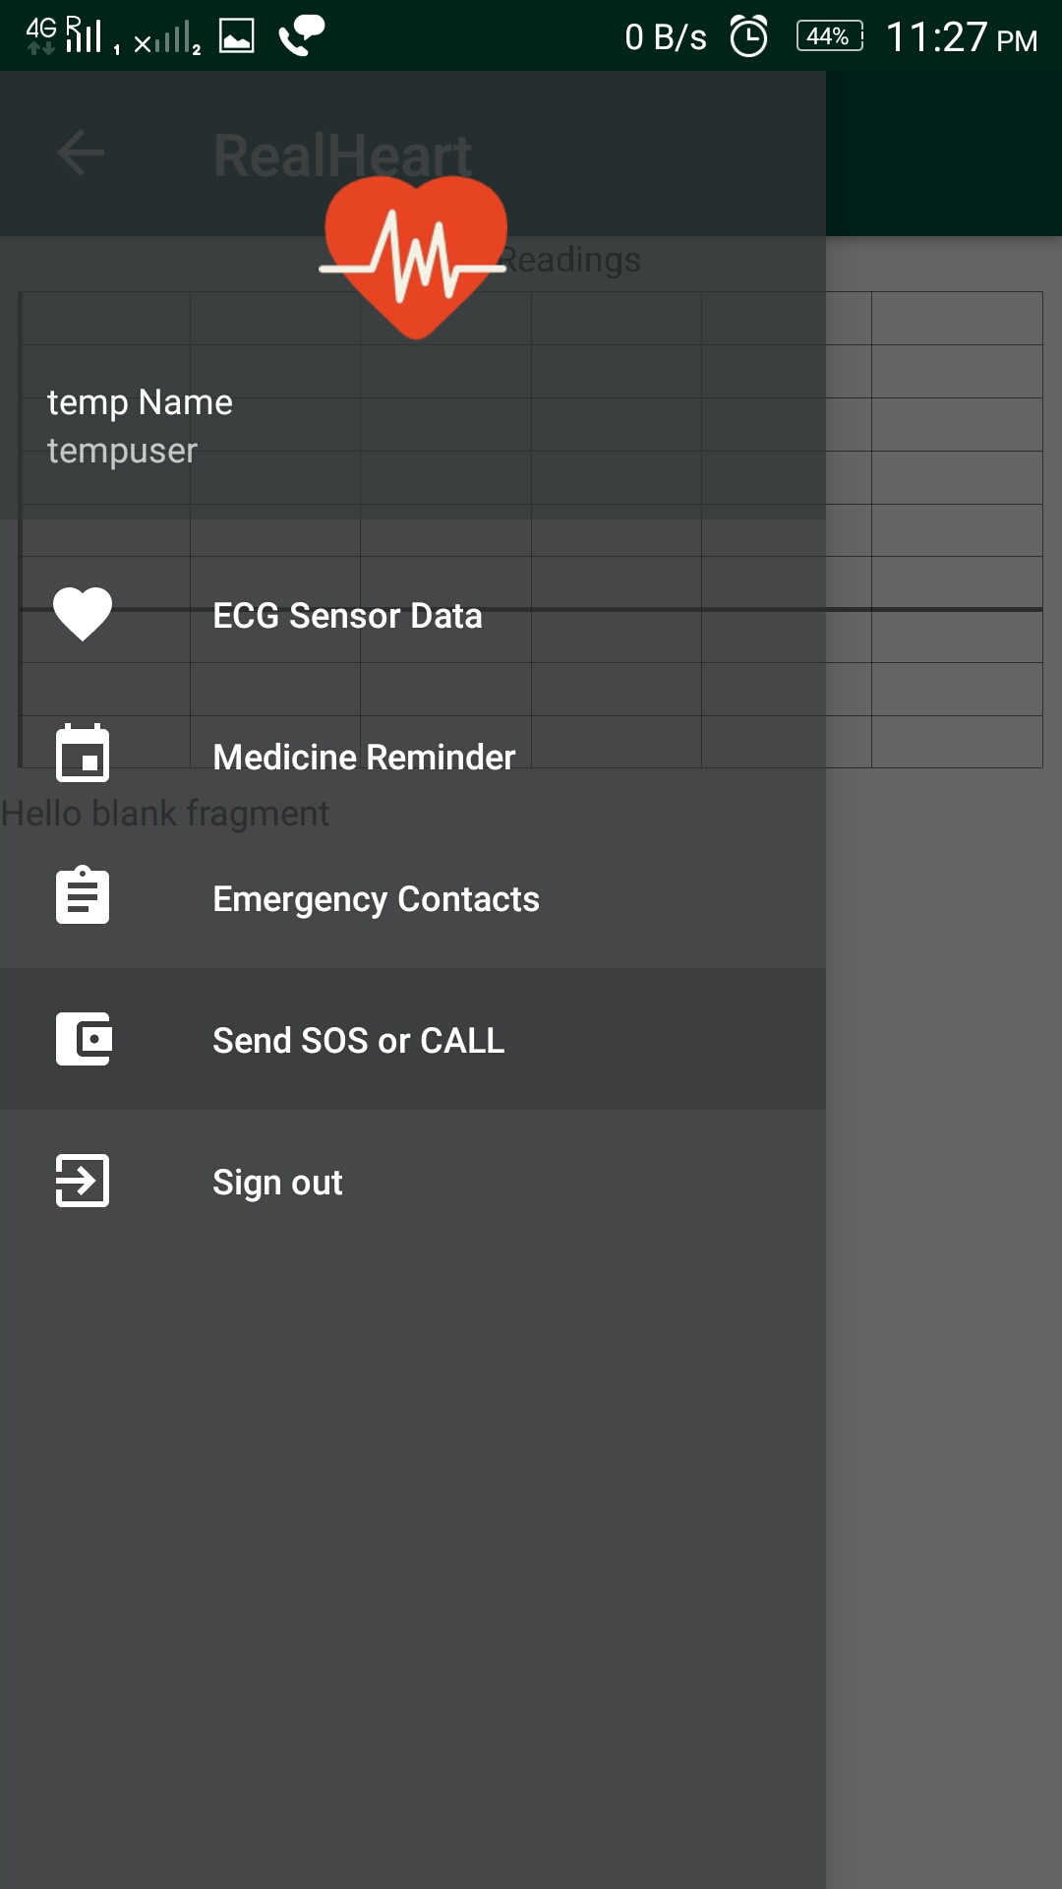
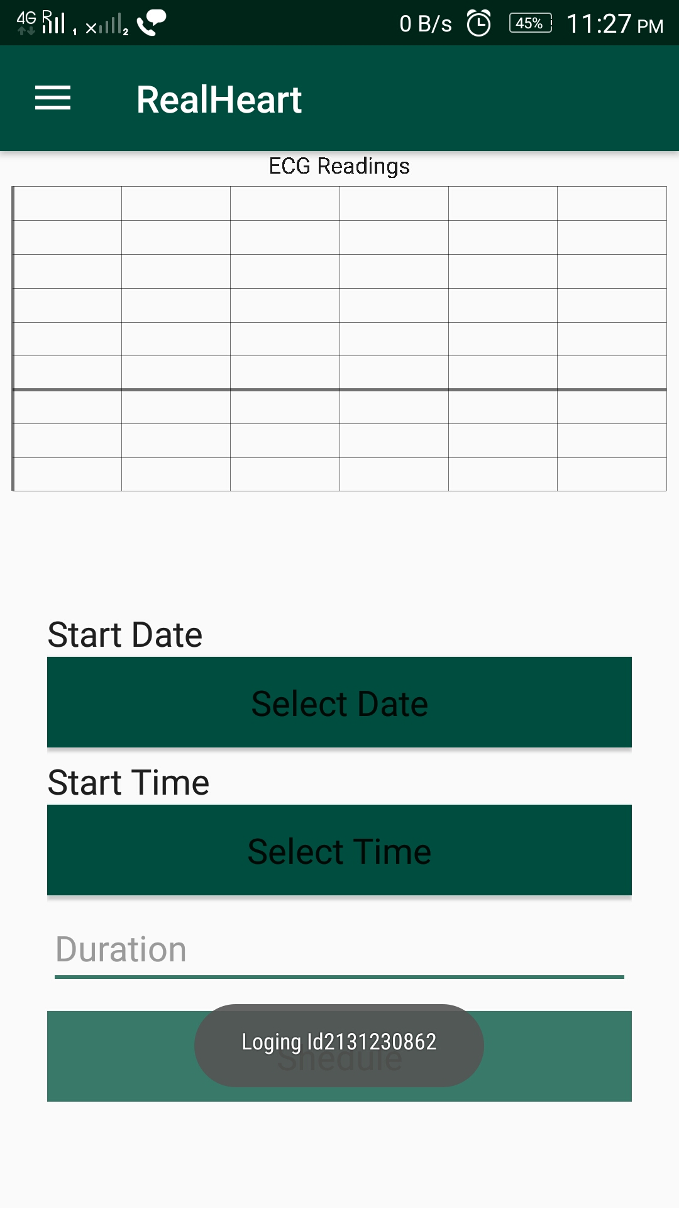
Functionalities In App:
.
1

Slide 10
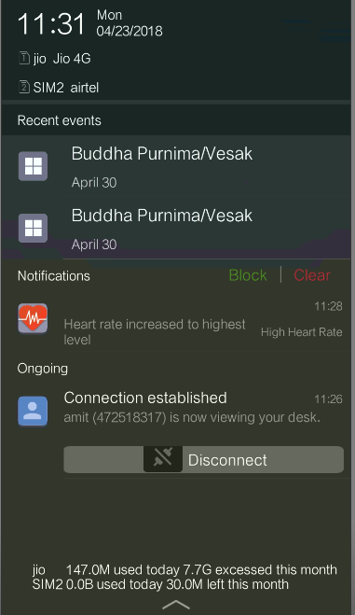
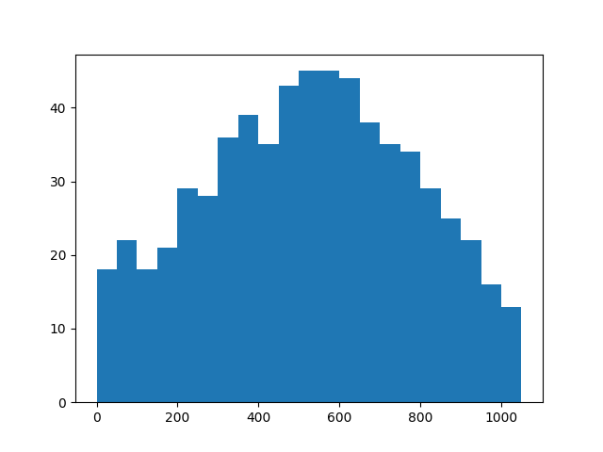
Functionalities In App: Abnormality Detection
.
Fig: Histogram of values in ECG waveform
1

Slide 11
Project Plan:
Sr. No. | Activity/Task | Dates of completion | Criticallity
1 | Integrating ecg sensor with microcontroller | 14/3/18 | 3
2 | Integrating wifi and module | 20/3/18 | 2
3 | Sending sensor data on cloud | 2/4/18 | 4
4 | Creating APIs for application | 8/4/18 | 3
5 | Building android application | 15/4/18 | 3
All work done in collaboration by having brain storming sessions
Note: Criticallity on scale of 1-5 ( 5 heighly crititcal)

Slide 12
Requirements
Hardware
ECG sensor
Node-MCU
Software
Arduino IDE
Android studio
Firebase Account
1

Slide 13
Challenges
Getting real-time from sensor and sending it over internet
Noise and motion
Reliably with ECG electrodes
Synchronization of data at sensor level and application level
1

Slide 14
Deliverables
Hardware
ECG integrated with microcontroller
Software
Microcontroller code
Android application code
1

Slide 15
Future Enhancements
Frequency of reading from AD8232 can be increased to get granular level details.
Abnormality detectiong algorithm can be revised for accuracy.
Abnormality detection logic can be moved from mobile appliacation to new server for modularity.
1

Slide 16
References
M. Hamiane, I. Y. Al-Heddi, "Automatic Detection of Abnormalities in ECG Signals : A MATLAB Study"
Dave Evans, "The Internet of Things:How the Next Evolution of the Internet Is Changing Everything"
Xiaoqiang Ji , Chunyu Ning, Chunhua Zhao and Xiaofeng Zhang, "Design of the HRV Analysis System Based on AD8232", School of Life Science and Technology, Changchun University of Science and Technology, Changchun, China.
AD8232 Heart Rate Monitor Hookup Guide
Single-Lead, Heart Rate Monitor Front End Data Sheet Ad8232
Firebase-Arduino Documentation Release 1.0

Slide 17
Thank You
.

