Slide 1

CS 684 - Embedded Systems
Spring 2018
Data Visualization in IoT
Group members
Avais Ahmad (173050043)
Pankaj Kumar (173050052)

Slide 2
Initial Problem Statement
We are building a data visualization framework or a dashboard framework for IoT.
This will be a pluggable solution and a very general solution for all data visualization problems.
It will give user the ability to add/delete widgets or widget containers. User can also resize ,drag or group widget containers together.
The widgets will give various methods for data visualization like text, gauge, plots and graphs, histogram, etc.
Main goal is to make complicated data understandable visually.
Various data source :- JSON, Device Shadow, DynamoDB, Websocket

Slide 3
Requirements
Hardware
A ESP8266 board
Various Sensors (e.g. DHT, our goal is to make it more generic)
Software
Javascript will be used to design user interface.
Text editor like VS Code for javascript
We will be using Vuejs framework for javascript
We will be using various libraries like plotly, ChartJS

Slide 4
Challenges
Making decoupled data-sources and mapping of data to widgets.
Making the User Interface more customizable and flexible
Making it completely component based
Finding trends in the device data

Slide 5
Planned Deliverables
By the end of the project we will be able to deliver a data visualization framework for IoT with functionalities that will meet the demands of the Eyantra IoT platform.
The framework will be loaded with necessary widgets and data-sources but it will also provide easy addition and customization facility to developers for adding more of them.
It will be similar to freeboard and thingsboard dashboard, but easier to work with.
It will be integrated into Eyantra IoT Platform.

Slide 6
Test Strategies
We will test various sensors on various widgets
We will check for correctness on the visualization by comparing the outputs with actual output / using visualization tools available online.
We will test the working of user interface on different browsers and operating systems.

Slide 7
Our Final Output
User friendly Dashboard
Easy to add multiple data sources
Completely component based model developed on Vuejs framework.
Easily customize widgets like add,delete,resize and draggable.
Contains widgets like gauge, line, Text, Map.
Visualize past data which is stored in a file.

Slide 8
Our Final Output
Decoupled Data Sources and widgets
Customizable widgets.
Working on generic data source
Various widgets like gauge, line, text, map
Problems:-
User Interface is not up to mark.
Have some glitches.
We are able to add only few widgets.

Slide 9
Final Testing
We have tested with following :-
DHT22, DHT11
ESP8266
e-yantra IoT Platform
As the result of test we were able to successfully visualize shadow data coming from the “Thing”.
Also we tested successfully on various data source.

Slide 10
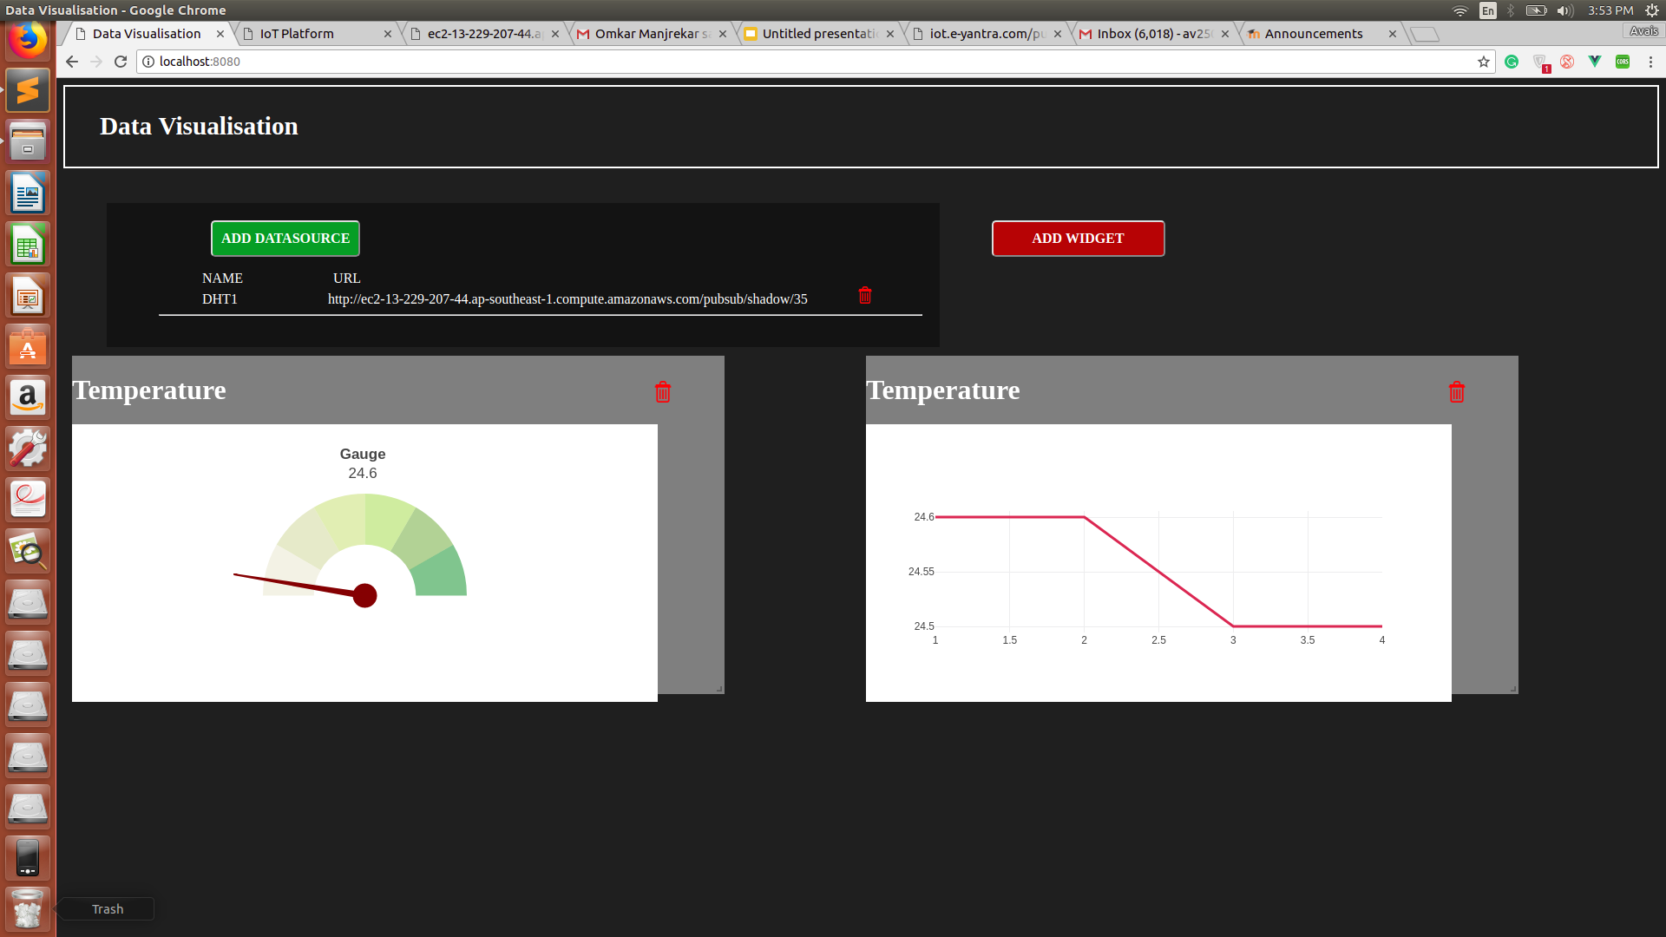
Screenshot

Slide 11
Future Work
In our current implementation we have only implemented few widgets , we can add more variety of widgets like scatter plot, bar chart.
We can add feature to add different data source like dynamoDB and socket.
We can use materialize CSS for better UI
We can add feature to customize each widget.
Saving/Exporting state of dashboard
Integrating it to e-yantra IoT platform.

Slide 12
Conclusion
We were successfully able to build a data visualization dashboard in which we can add generic json data source and visualise by means of few widgets like gauges and line plot.

Slide 13
Thank You !

