Slide 1
CS684 Project

Slide 2
Tentative Deadline:
Project is divided into two tasks:
Final Presentation and Demonstration: 12/04/2021 and 15/04/2021
Tasks | Release Date | Doubt clearing session | Deadline
Task 1 | 22/03/2021 | 25/03/2021 | 01/04/2021
Task 2 | 29/03/2021 | 05/04/2021 | 08/04/2021

Slide 3
Task 1:
Project has three parts -
Hardware side (Firebird V and components)
Algorithm side (based on Simulation)
IoT side (Web based and GUI development)
Both tasks will cover each part of the project.
Hence Task 1 is divided into two subtasks - Task 1A and Task1B

Slide 4
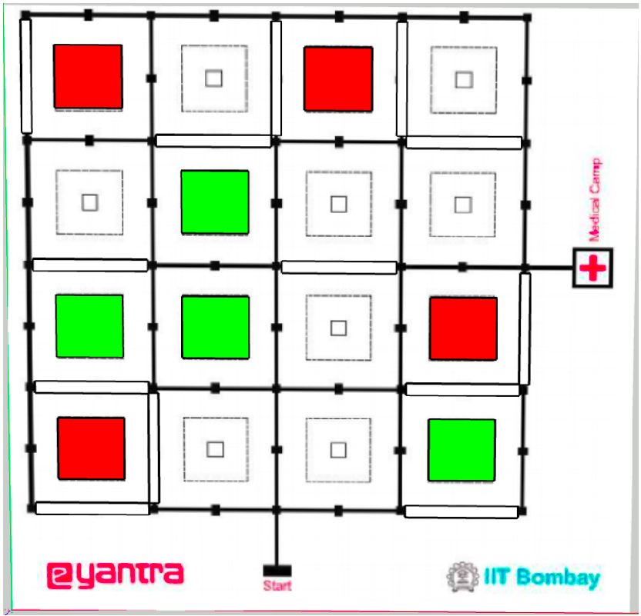
Task 1A:
Algorithm Side (on Simulator)
Problem Statement - Scan the entire medical camp and find out the plot locations of injured people.
Output - <Plot No> - <Type of Injury>
E.g. 1 - MajorInjury
Challenges:
Line following
Color sensor interfacing
Debris detection
Path planning

Slide 5
Task 1B:
Hardware and IoT side
Problem Statement: Get one request from the server, satisfy the request through robot and acknowledge back to server.
Note: Robot can start from the node of requested plot. It just have to traverse till mid-point marker.
Challenges:
Color sensor interfacing
End to end communication
Interactive GUI development
Time keeping on Robot.

Slide 6
Hardware Side (Hints):
Color Sensor Interfacing:
https://cs684-iitb.github.io/CS684-Spring-2021/Resources.html
Communication between Firebird V and ESP32:
https://drive.google.com/drive/folders/1vac3uNvSwOX17k1qqO0ARTgmKYEigYFd
Timer/Counter on Firebird V: (Alternative RTC on ESP32)
https://drive.google.com/drive/folders/1AMpRDXjxTLKOb-KZuS81j4n-uo7Nea3e

