Slide 1
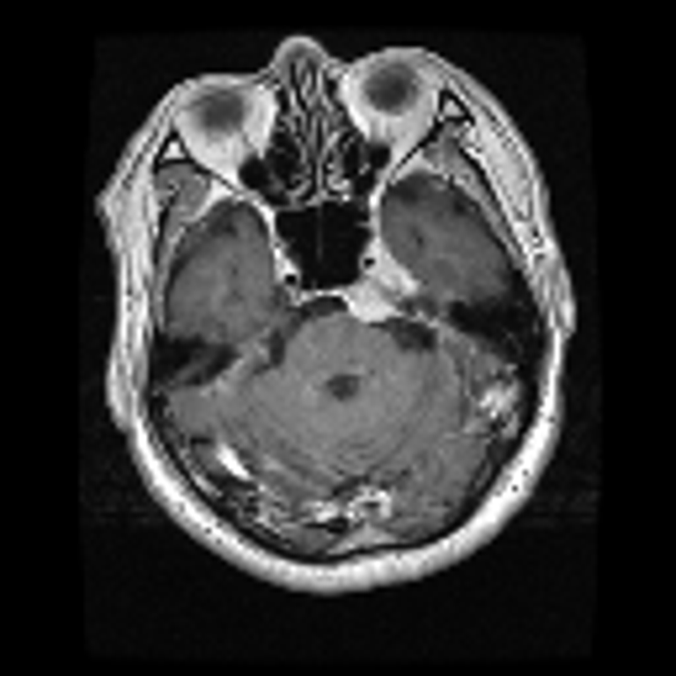
SoftROI-Boundary
U-Net
A proposed architecture for
brain tumor segmentation
Project progress update
Small-subset experiment with two training seeds
Notes:
I implemented and evaluated a proposed architecture on our Figshare data. The motivation is to preserve image context while focusing on the tumor region and refining uncertain boundaries. This is preliminary project evidence, and the individual architectural ideas have prior art. The MRI is an actual training image from our supplied dataset.

Slide 2
Motivation from the base paper
The paper uses YOLOv5 to select a tumor region, then U-Net to segment the extracted patch.
Design choice | Base paper | Our proposal
Region selection | Detected bounding box | Learned soft ROI map
Image context | Cropped patch | Full image retained
Segmentation | Separate 2D U-Net | Shared network + boundary refinement
Hypothesis: soft guidance may reduce dependence on the quality of a hard crop.
Notes:
Source: Ahsan et al., Brain tumor detection and segmentation using deep learning, https://doi.org/10.1007/s10334-024-01203-5, local papers/brain-tumor-base.pdf, methods pp. 15-16 and limitations pp. 20-21. The authors select the highest-confidence detected box and acknowledge possible loss of tumor parts. We hypothesize that keeping whole-image context may help. We have not run a direct comparison against their full pipeline.

Slide 3
Proposed architecture
Stage | Representation | Operation
Shared encoder | 128 x 128 MRI to 16 x 16 features | Extract features at four scales
Soft region guidance | 16 x 16 tumor probability R | Reweight skip features by 0.5 + R
Decoder + boundary head | 128 x 128 mask and boundary logits | Preserve context and predict edges
Uncertainty refinement | u = 4p(1-p) | Final logit = base logit + u x residual
492,167 parameters. The full proposal adds 0.83% over the shared baseline.
Ground-truth masks supervise training targets only. They never enter the forward pass.
Notes:
Implementation source: src/models.py. Input is MRI intensity only. Encoder widths are 16,32,64,128 at spatial sizes 128,64,32,16. A sigmoid coarse ROI map gates all three skips as S*(0.5+R). The decoder uses bilinear upsampling. The full-resolution boundary head and residual refinement operate on final decoder features. The uncertainty proxy is 4*p*(1-p), which is largest around p=0.5. Classification uses global average pooling of the deepest encoder features.

Slide 4
Controlled experiment
Split | Patients | MRI slices
Training | 48 | 398
Validation | 12 | 117
Test | 15 | 129
128 x 128 inputs. Three tumor classes. Two seeds per variant.
60 epochs, batch size 16, AdamW. No patient overlap.
Best checkpoint: validation patient Dice. Fixed threshold: 0.5. Test set used for final scoring.
Notes:
Source: data/processed/manifest.json, EXPERIMENT_PROTOCOL.md, runs/main/config.json. Patients are randomly sampled within supplied folds and tumor classes. Split seed 2026. Train uses original folds 1-3, validation fold 4, test fold 5. At most 10 slices per chosen patient. All models train from scratch with identical common weights and augmentation streams per seed. The initial 20-epoch validation-only pilot motivated 60 epochs before test scoring. No skull stripping, in contrast to the paper.

Slide 5
Held-out segmentation results
Model | Patient Dice | Patient IoU | Boundary F1
Compact U-Net | 59.79% | 49.82% | 60.71%
SoftROI | 61.97% | 52.04% | 62.73%
SRB-U-Net | 63.17% | 53.76% | 65.79%
+3.38 percentage points
SRB minus baseline in patient Dice. 95% paired interval: [-0.18, +6.74] points.
Preliminary result on 15 test patients. Paper benchmark values are not directly comparable.
Notes:
Source: runs/main/results.json and metrics.csv. Values are averages of two independent runs, not an inference ensemble. Patient Dice and IoU average slices within each patient, then average 15 patients. Boundary F1 averages slices and uses a two-pixel tolerance at 128x128. The paired bootstrap interval averages seeds within each patient, then resamples the 15 patients 10,000 times. It does not capture full seed or split uncertainty.

Slide 6
Ablation and repeatability
Model | Seed 17 Dice | Seed 29 Dice | Parameters
Compact U-Net | 59.80% | 59.78% | 488,100
SoftROI | 59.59% | 64.36% | 488,229
SRB-U-Net | 63.29% | 63.04% | 492,167
Adding region guidance: +2.18 points in patient Dice.
Adding boundary/refinement: +1.19 points beyond SoftROI.
The current ablation tests modules plus their losses. A finer ablation is the next step.
Notes:
Source: runs/main/results.json. The SoftROI comparison tests coarse supervision and gating jointly. The full model adds both a boundary objective and a residual refinement head, so this ablation does not isolate their individual effects. The seeds share the same frozen data split. All planned runs appear in this table, including any regression.

Slide 7
Validation learning curves
Each curve averages two seeds. The training budget and checkpoint rule are the same for all variants.
Notes:
Source: per-epoch history.csv files under runs/main. Each line is the average validation patient Dice over seeds 17 and 29 at that epoch. Individual checkpoints are selected independently by each run's best validation score. These are validation learning curves, not test-set tuning.

Slide 8
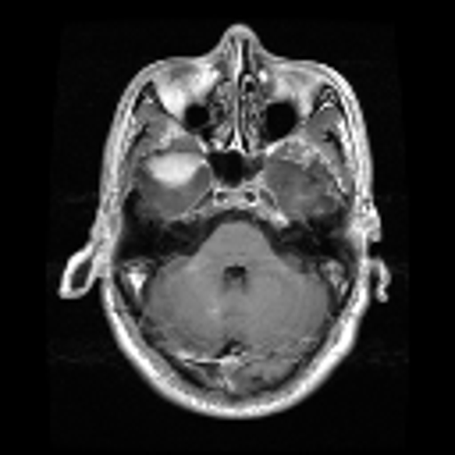
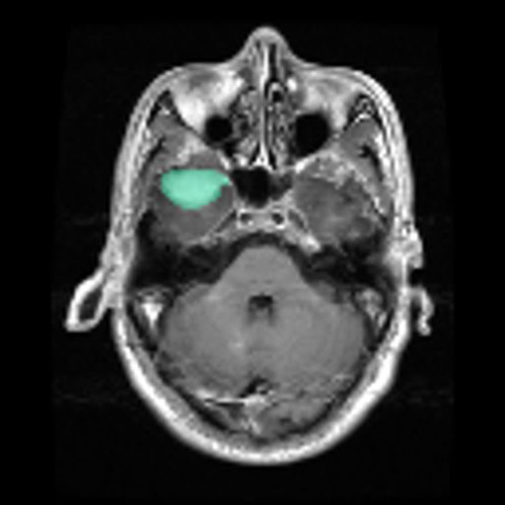
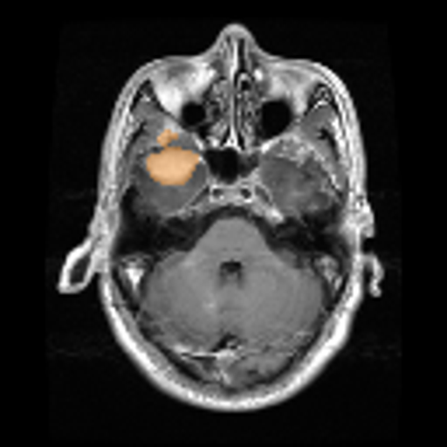
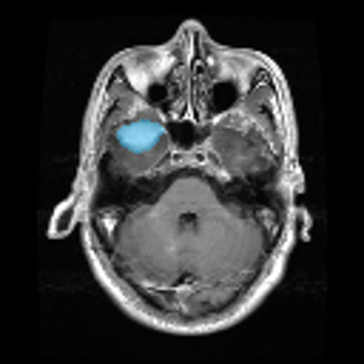
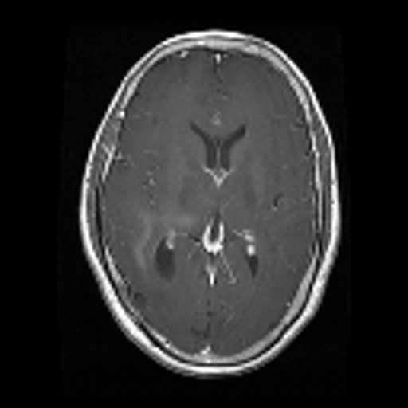
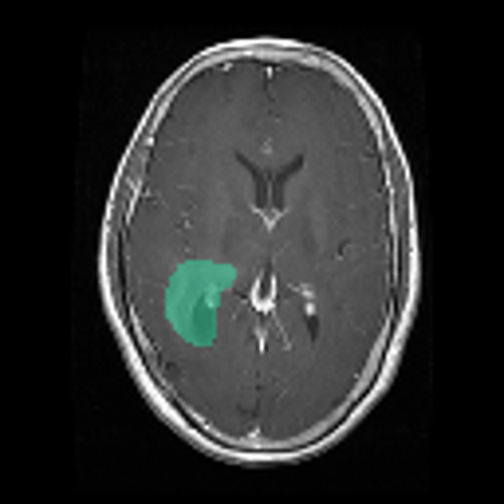
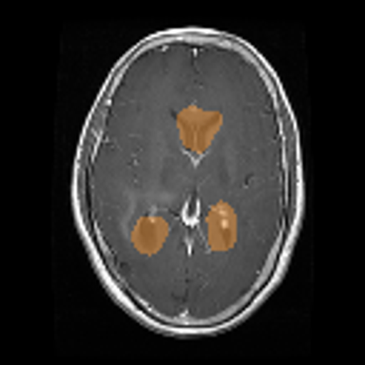
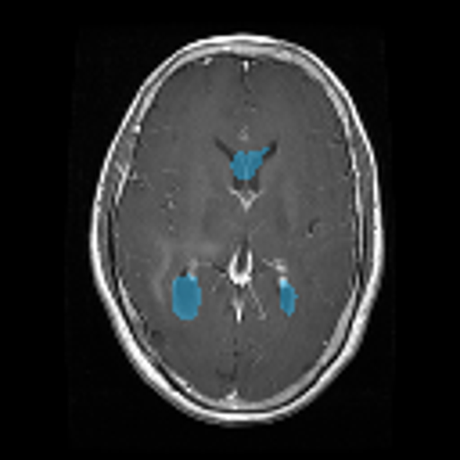
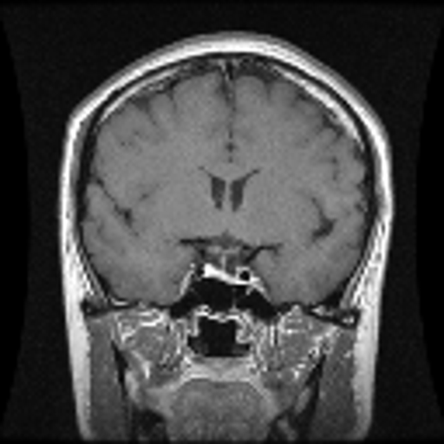
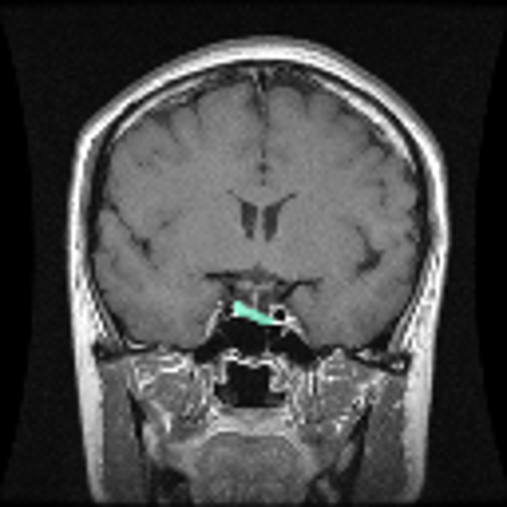
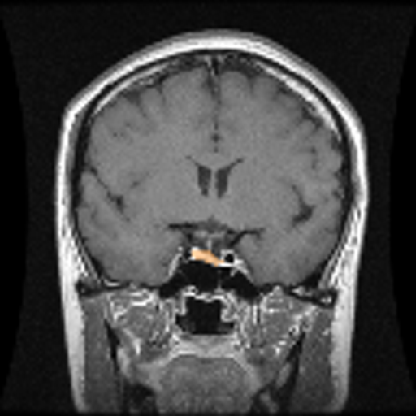
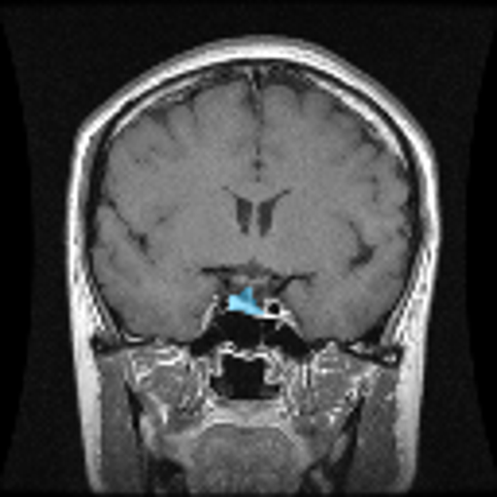
Qualitative test examples
MRI
Ground truth
Compact U-Net
SRB-U-Net
Meningioma
Glioma
Pituitary
Fixed example rule: first held-out slice per class in manifest order. Predictions from seed 17.
Notes:
Source: output/qualitative_selection.json, runs/main/*_seed17/test_predictions.npz, and frozen subset. Selection rule: the first test slice of each class in the manifest. These are not selected as the strongest results. Columns show MRI, ground truth in green, baseline in orange, and SRB in blue. All predictions use threshold 0.5 and seed 17.

Slide 9
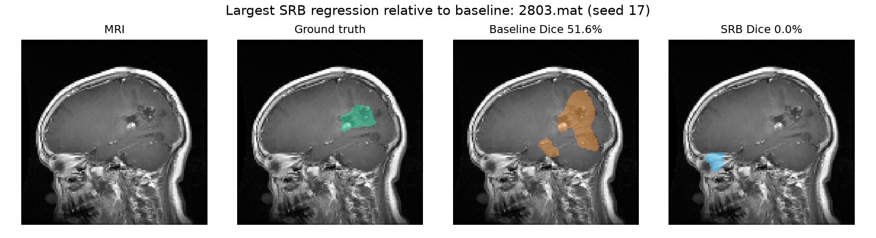
Observed failure case
The mean result does not guarantee a better mask for every slice.
Failure analysis will guide a fuller ablation and higher-resolution runs.
Notes:
Source: output/figures/failure_case.png and output/qualitative_selection.json. This example has the largest drop in SRB Dice relative to the baseline among test slices for seed 17. It is intentionally selected to expose a weakness. A higher mean score does not guarantee better segmentation for every patient or slice. This case was inspected after all training and checkpoint choices were finalized.

Slide 10
Current contribution and next experiments
Implemented: a soft ROI gate, boundary prediction, and uncertainty-weighted residual refinement in one compact network.
Next experiments
1. Repeat across patient folds and additional seeds.
2. Separate the effect of each module and auxiliary loss.
3. Increase resolution and reproduce the paper baseline.
Scope: a project architecture proposal and small-subset pilot. No claim of global novelty or clinical validation.
Notes:
The contribution is an implemented architecture proposal with controlled preliminary evidence and a reproducible pipeline. Global novelty has not been established. Attention U-Net and boundary-guidance networks are relevant prior art. Next work must examine more patient splits, isolate module effects, increase input resolution, and compare a faithful implementation of the source paper. This dataset contains tumor-positive scans only, so it cannot establish healthy-versus-tumor screening performance.

Slide 11
Appendix: additional measured outcomes
Outcome | Compact U-Net | SoftROI | SRB-U-Net
Meningioma patient Dice | 68.78% | 67.29% | 66.84%
Glioma patient Dice | 36.80% | 37.82% | 39.83%
Pituitary patient Dice | 73.79% | 80.80% | 82.83%
Small-tumor slice Dice | 62.99% | 66.64% | 68.66%
Tumor-type accuracy | 86.82% | 80.62% | 87.21%
Two-seed averages. Small-tumor cutoff comes from training data. Classification is an auxiliary outcome.
Notes:
Source: runs/main/results.json. Classification is an auxiliary three-way tumor-type task, never healthy-versus-tumor detection. Classification accuracy is slice-level and checkpoint selection optimizes segmentation, not classification. Small-tumor Dice uses a cutoff equal to the median training mask area fraction. Per-class Dice averages each of five held-out patients, then averages the two training seeds.

Slide 12
Appendix: related work and evidence
Ahsan et al. (2024 online / 2025 issue)
Brain tumor detection and segmentation using deep learning
Oktay et al. (2018)
Attention U-Net: Learning Where to Look for the Pancreas
Xu et al. (2024)
Boundary guidance network for medical image segmentation
Li et al. (2022)
Category Guided Attention Network for Brain Tumor Segmentation in MRI
Source URLs are in speaker notes. Code, checkpoints, split manifest, and raw metrics accompany the deck.
Notes:
Primary references:
Ahsan et al. https://doi.org/10.1007/s10334-024-01203-5
Oktay et al. https://arxiv.org/abs/1804.03999
Xu et al. https://www.nature.com/articles/s41598-024-67554-0
Li et al. https://arxiv.org/abs/2203.15383
Local sources: EXPERIMENT_PROTOCOL.md; src/models.py; runs/main/results.json; data/processed/manifest.json. The literature search is targeted and not an exhaustive novelty audit.

