Slide 1
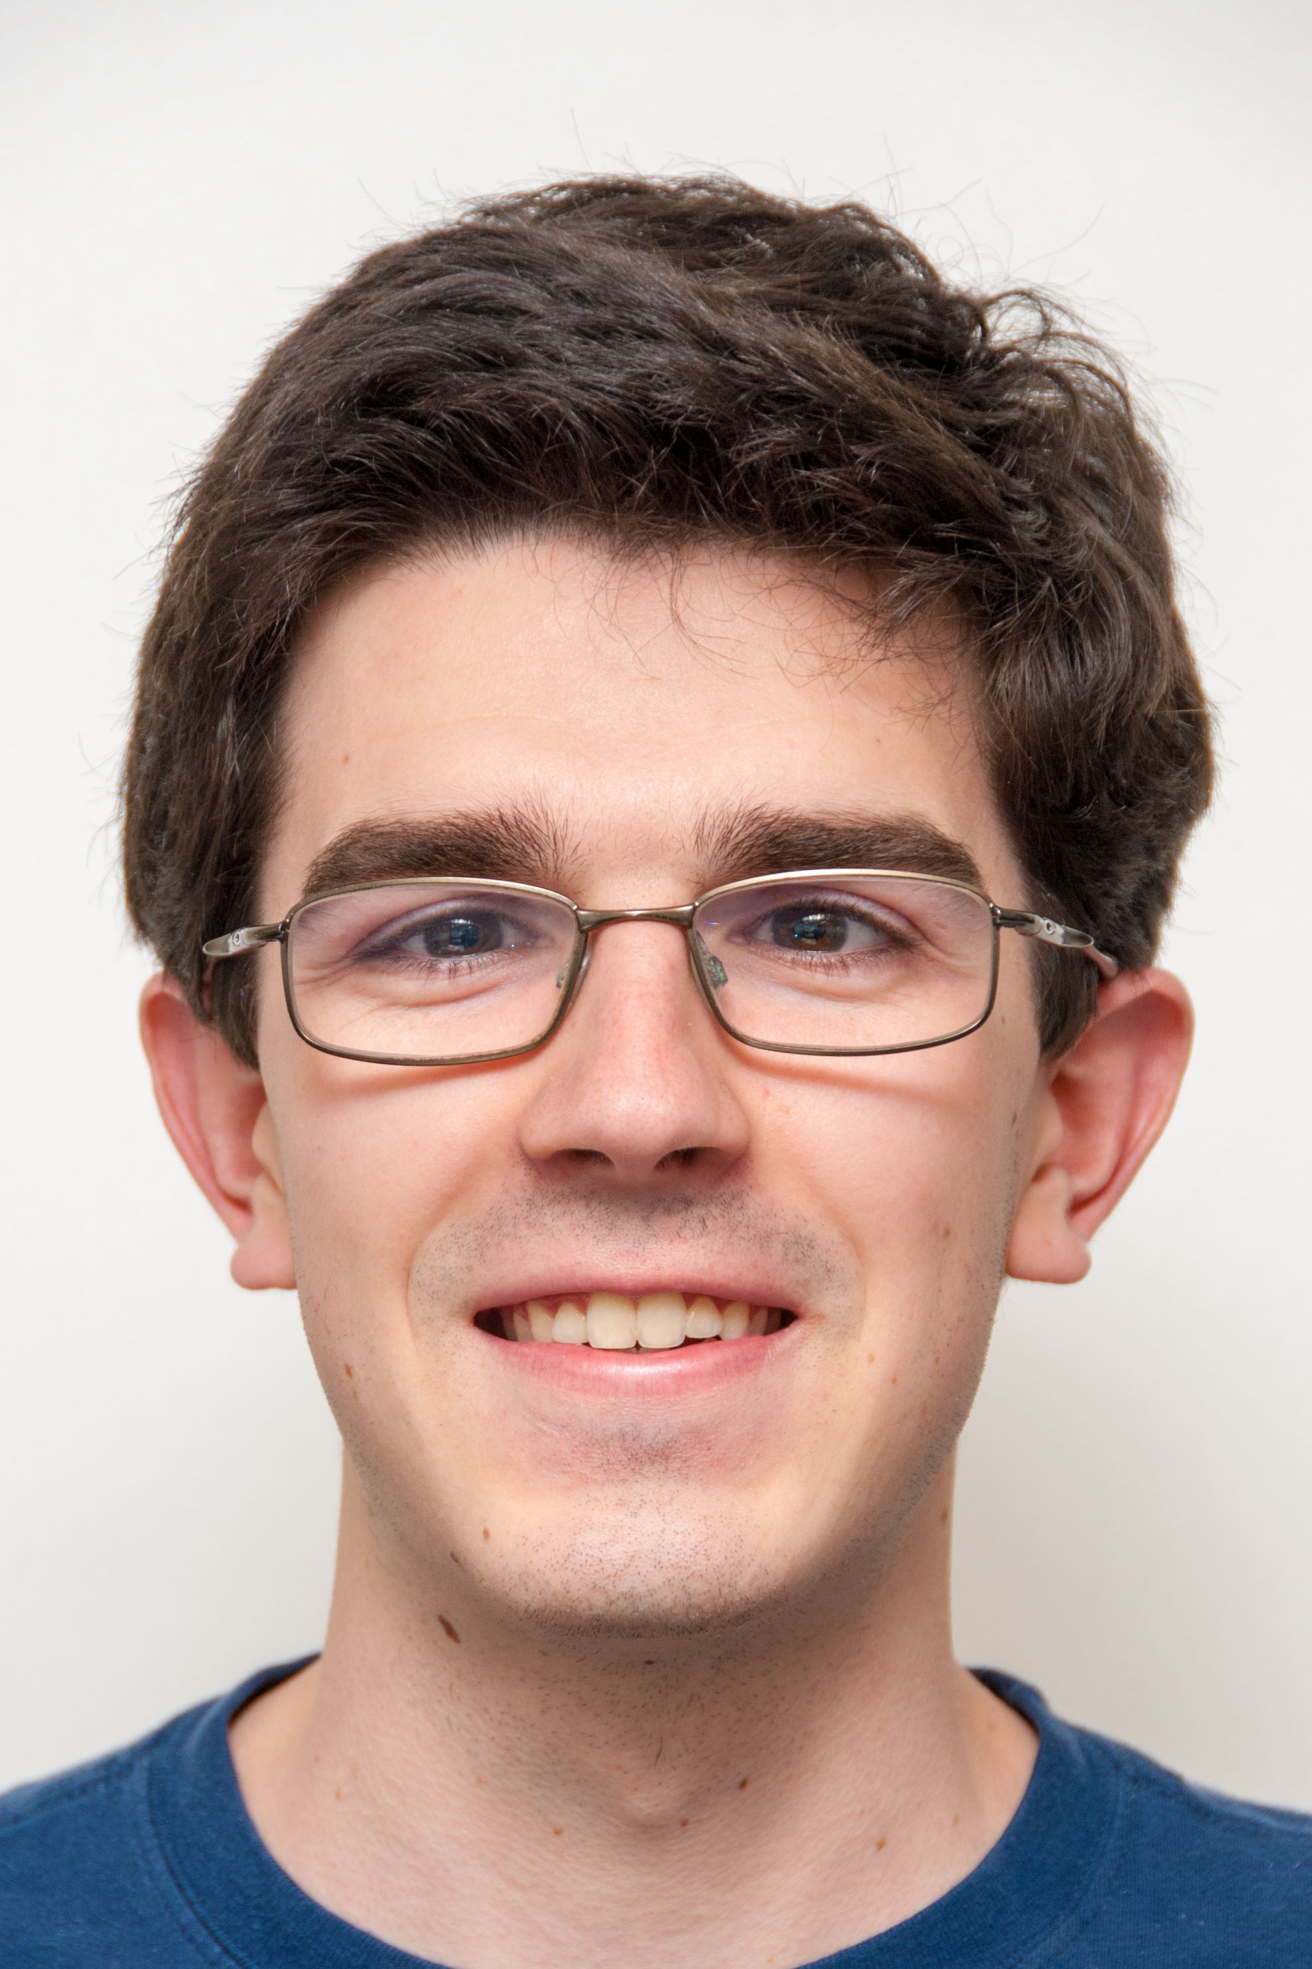

Computational Structures in Data Science
UC Berkeley EECS Lecturer
Michael Ball
Lecture #2:
Programming Structures: Loops and Functions
September 16, 2019
http://cs88.org

Slide 2
Administrivia
Everyone should be enrolled now
iClickers: Start next week.

Slide 3

Computational Concepts Today
Fundamentals of Python
Conditional Statements
Functions
Lists
Iteration

Slide 4
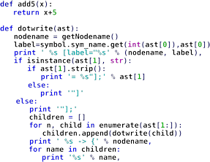
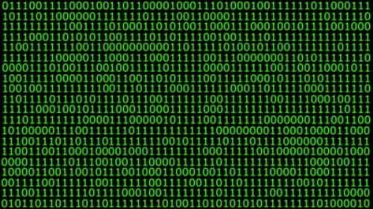
Data or Code? Abstraction!
Human-readable code (programming language)
Machine-executable instructions (byte code)
Compiler or Interpreter Here: Python

Slide 5
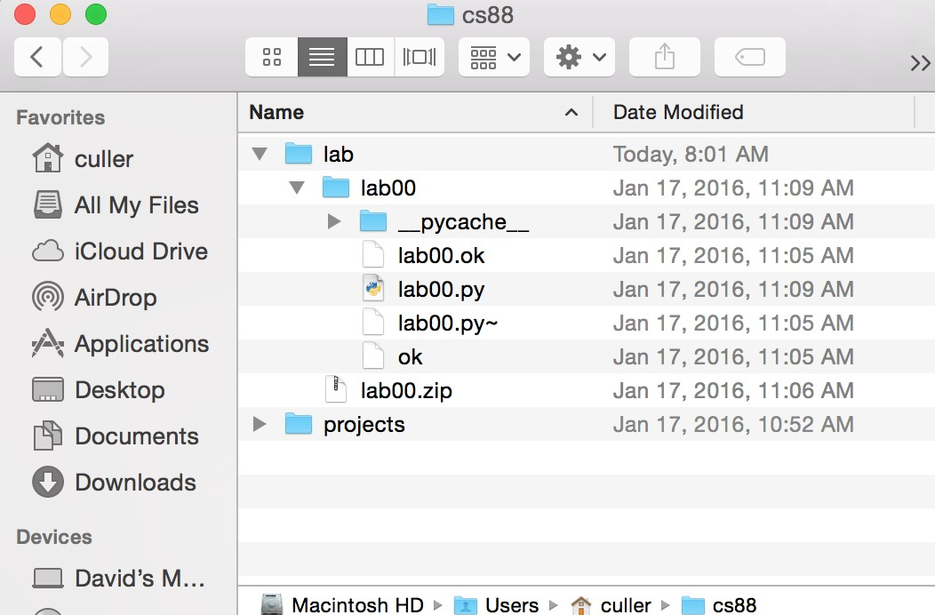
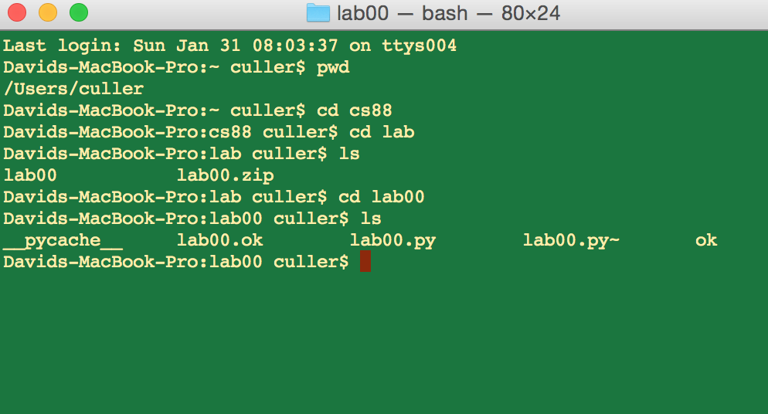
Code or GUI: More Abstraction!
Big Idea: Layers of Abstraction
– The GUI look and feel is built out of files, directories, system code, etc.

Slide 6
Let’s talk Python
Expression
Call expression
Variables
Assignment Statement
Define Function:
Control Statements:
3.1 * 2.6
max(0, x)
x = <expression>
def <function name> (<argument list>) :
if …
for …
while …
list comprehension

Slide 7
Conditional statement
Do some statements, conditional on a predicate
expression
if <predicate>:
<true statements>
else:
<false statements>
Example:
if (temperature>37.2):
print(“fever!”)
else:
print(“no fever”)

Slide 8
Defining Functions
def <function name> (<argument list>) :
return
expression
Abstracts an expression or set of statements to apply to lots of instances of the problem
A function should do one thing well

Slide 9
Functions: Calling and Returning Results
def my_function(number):
print(argument)
statements
return number
data = my_function(1)
# data becomes whatever value is, returned.
# In this case data holds the value of number.
# 1 is an _argument_ to my_function,
# the argument number will be 1.

Slide 10
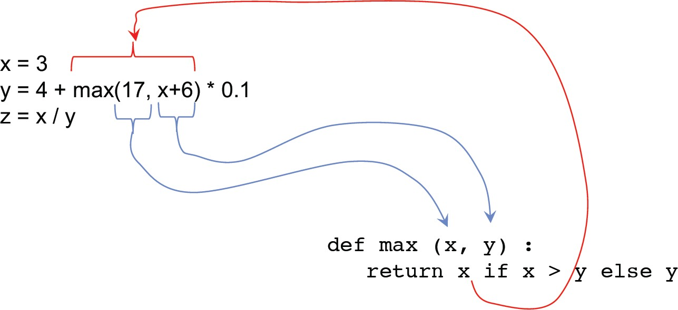
Functions: Example

Slide 11
How to write a good Function
Give a descriptive name
Function names should be lowercase. If necessary, separate words by underscores to improve readability. Names are extremely suggestive!
Chose meaningful parameter names
Again, names are extremely suggestive.
Write the docstring to explain what it does
What does the function return? What are corner cases for parameters?
Write doctest to show what it should do
Before you write the implementation.
Python Style Guide: https://www.python.org/dev/peps/pep-0008/

Slide 12
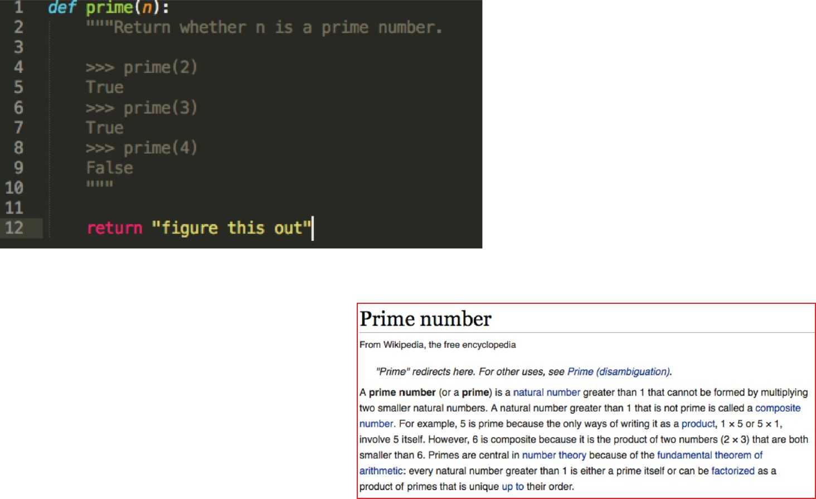
Example: Prime Numbers
Why do we have prime numbers? https://www.youtube.com/watch?
v=e4kevnq2vPI&t=72s&index=6&list=PL17CtGMLr0Xz3vNK31TG7mJIzmF78vsFO

Slide 13
list – A data structure for iteration
A list is a collection of items in a single group.
They can hold just about anything.
my_list = [1, 2, 3]
my_courses = [‘CS88’, ‘DATA8’, ‘MATH1A’]
len(my_courses) == 3 # len returns the length
print(my_courses[0]) # prints CS88

Slide 14
for statement – iteration control
Repeat a block of statements for a structured sequence of variable bindings
<initialization statements>
for <variables> in <sequence expression>:
<body statements>
<rest of the program>
def cum_OR(lst):
"""Return cumulative OR of entries in lst.
>>> cum_OR([True, False]) True
>>> cum_OR([False, False])
False """
co = False for item in lst:
co = co or item return co

Slide 15
while statement – iteration control
Repeat a block of statements until a predicate expression is satisfied
<initialization statements>
while <predicate expression>:
<body statements>
<rest of the program>
def first_primes(k):
""" Return the first k primes. """
primes = []
num = 2
while len(primes) < k : if prime(num):
primes = primes + [num] num = num + 1
return primes

Slide 16
Data-driven iteration
describe an expression to perform on each item in a sequence
let the data dictate the control
[ <expr with loop var> for <loop var> in <sequence expr > ]
def dividers(n):
"""Return list of whether numbers greater than 1 that divide n.
>>> dividers(6) [True, True]
>>> dividers(9)
[False, True, False] """
return [divides(n,i) for i in range(2,(n//2)+1) ]

