Slide 1

Computational Structures in Data Science
Lecture #3: Higher Order Functions
& Environment Diagrams
Alex Kassil
Head TA
Subbing for Michael while he’s in Germany☺
September 23, 2019
cs88.org
Notes:
1

Slide 2
Announcements!
Tutoring
Sign up for computer science mentor sections – super helpful and a great way to get EPA!
Prep for midterm – chance to practice writing code by hand
Link: https://scheduler.csmentors.org/
More Info: https://piazza.com/class/jzknkt427nz3oz?cid=131
Sign up for one on one tutoring through cs370:
More Info: https://piazza.com/class/jzknkt427nz3oz?cid=180
Midterm:
October 7th 7-9pm
Thats two weeks away!
More info will be emailed out – might be a good time to start prepping!
First project after midterm!
09/23/19
UCB CS88 Fa19 L3
1

Slide 3

Computational Concepts Toolbox
Data type: values, literals, operations,
e.g., int, float, string
Expressions, Call expression
Variables
Assignment Statement
Sequences: list
Data structures
Call Expressions
Function Definition Statement
Conditional Statement
Iteration:
data-driven (list comprehension)
control-driven (for statement)
while statement
09/23/19
UCB CS88 Fa19 L3
1
Notes:
z = 1,2
x,y = 3,4
a,b = z
1

Slide 4
Computational Concepts today
Higher Order Functions
Functions as Values
Functions with functions as argument
Functions with functions as return values
Environment Diagrams
Big Idea: Software Design Patterns
09/23/19
UCB CS88 Fa19 L3
1

Slide 5
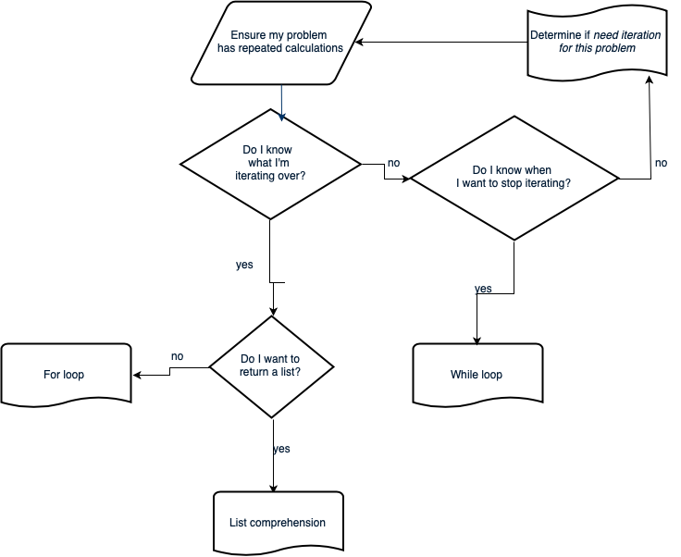
Iteration flow chart
09/23/19
UCB CS88 Fa19 L3
1
Notes:
Roll the three slides into a flow chart. Do I have a sequence of things I’m iterating through / Can I easily make it? If not, Do I have a condition for when I should stop iterating? If not, go back to defining your problem, iteration might not be the correct tool. If so, while loop. If you have a seq, do I want to return a list? If so, most likely list comp will be more compact. If not, for loop.
1

Slide 6
Control Structures Review
The result of list(range(0,10)) is… A) [0, 1, 2, 3, 4, 5, 6, 7, 8, 9] B) [0, 1, 2, 3, 4, 5, 6, 7, 8, 9, 10] C) [1, 2, 3, 4, 5, 6, 7, 8, 9, 10] D) [1, 2, 3, 4, 5, 6, 7, 8, 9] E) an error
http://bit.ly/88Lec3Q1
Solution: A) list(range(m,n)) creates a list with elements from m to n-1.
09/23/19
UCB CS88 Fa19 L3
1

Slide 7
Control Structures Review
The result of [i for i in range(3,9) if i % 2 == 1] is… A) [3, 4, 5, 6, 7, 8, 9] B) [3, 4, 5, 6, 7, 8] C) [1, 3, 5, 7, 9] D) [3, 5, 7, 9] E) [3, 5, 7]
http://bit.ly/88Lec3Q2
Solution: E) [3, 5, 7]
09/23/19
UCB CS88 Fa19 L3
1

Slide 8
Control Structures Review
The result of len([i for i in range(1,10) if i % 2 == 0)]) is… A) 5 B) 4 C) 3 D) 2 E) 1
http://bit.ly/88Lec3Q3
Solution: B) len([2, 4, 6, 8])=4
09/23/19
UCB CS88 Fa19 L3
1

Slide 9
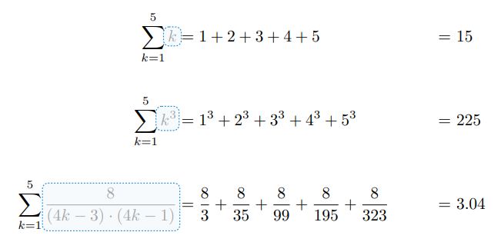
An Interesting Example
09/23/19
UCB CS88 Fa19 L3
1

Slide 10
Environment Diagrams aka what python tutor makes
Environment Diagrams are organizational tools that help you understand code
Terminology:
- Frame: keeps track of variable-to-value bindings, each function call has a frame
- Global Frame: global for short, the starting frame of all python programs, doesn’t correspond to a specific function
- Parent Frame: The frame of where a function is defined (default parent frame is global)
- Frame number: What we use to keep track of frames, f1, f2, f3, etc
- Variable vs Value: x = 1. x is the variable, 1 is the value
Steps:
1 Draw the global frame
2 When evaluating assignments (lines with single equal), always evaluate right side first
3 When you call a function MAKE A NEW FRAME!
4 When assigning a primitive expression (number, boolean, string) right the value in the box
5 When assigning anything else, draw an arrow to the value
6 When calling a function, name the frame with the intrinsic name – the name of the function that variable points to
7 The parent frame of a function is the frame in which it was defined in (default parent frame is global)
8 If the value isn’t in the current frame, search in the parent frame
NEVER EVER EVER draw an arrow from one variable to another.
Source:
http://markmiyashita.com/cs61a/environment_diagrams/rules_of_environment_diagrams/
http://albertwu.org/cs61a/notes/environments.html
09/23/19
UCB CS88 Fa19 L3
1

Slide 11
Another example
Higher Order Functions
http://pythontutor.com/composingprograms.html#code=def%20square%28x%29%3A%0A%20%20%20%20return%20x%20*%20x%0A%20%20%20%20%0As%20%3D%20square%0Ax%20%3D%20s%283%29%0A%0Adef%20make_adder%28n%29%3A%0A%20%20%20%20def%20adder%28k%29%3A%0A%20%20%20%20%20%20%20%20return%20k%20%2B%20n%0A%20%20%20%20return%20adder%0A%20%20%20%20%0Aadd_2%20%3D%20make_adder%282%29%0Aadd_3%20%3D%20make_adder%283%29%0Ax%20%3D%20add_2%28x%29%0A%0Adef%20compose%28f,%20g%29%3A%0A%20%20%20%20def%20h%28x%29%3A%0A%20%20%20%20%20%20%20%20return%20f%28g%28x%29%29%0A%20%20%20%20return%20h%0A%0Aadd_5%20%3D%20compose%28add_2,%20add_3%29%0Ay%20%3D%20add_5%28x%29%0A%0Az%20%3D%20compose%28square,%20make_adder%282%29%29%283%29&cumulative=true&mode=edit&origin=composingprograms.js&py=3&rawInputLstJSON=%5B%5D
09/23/19
UCB CS88 Fa19 L3
1

Slide 12
Higher Order Functions
Functions that operate on functions
A function
A function that takes a function arg
def odd(x):
return x%2==1
odd(3)
True
Why is this not ‘odd’ ?
def filter(fun, s):
return [x for x in s if fun(x)]
filter(odd, [0,1,2,3,4,5,6,7])
[1, 3, 5, 7]
09/23/19
UCB CS88 Fa19 L3
1

Slide 13
Higher Order Functions (cont)
A function that returns (makes) a function
def leq_maker(c):
def leq(val):
return val <= c
return leq
>>> leq_maker(3)
<function leq_maker.<locals>.leq at 0x1019d8c80>
>>> leq_maker(3)(4)
False
>>> filter(leq_maker(3), [0,1,2,3,4,5,6,7])
[0, 1, 2, 3]
09/23/19
UCB CS88 Fa19 L3
1

Slide 14
Three super important HOFS (Wait for lab)
* For the builtin filter/map, you need to then call list on it to get a list. If we define our own, we do not need to call list
list(map(function_to_apply, list_of_inputs))
Applies function to each element of the list
list(filter(condition, list_of_inputs))
Returns a list of elements for which the condition is true
reduce(function, list_of_inputs)
Reduces the list to a result, given the function
09/23/19
UCB CS88 Fa19 L3
1

Slide 15
Computational Concepts today
Higher Order Functions
Functions as Values
Functions with functions as argument
Functions with functions as return values
Environment Diagrams
Big Idea: Software Design Patterns
09/23/19
UCB CS88 Fa19 L3
1

