Slide 1


Computational Structures in Data Science
Lecture 5: Recursion
UC Berkeley EECS Lecturer
Michael Ball
October 7, 2019
http://cs88.org

Slide 2
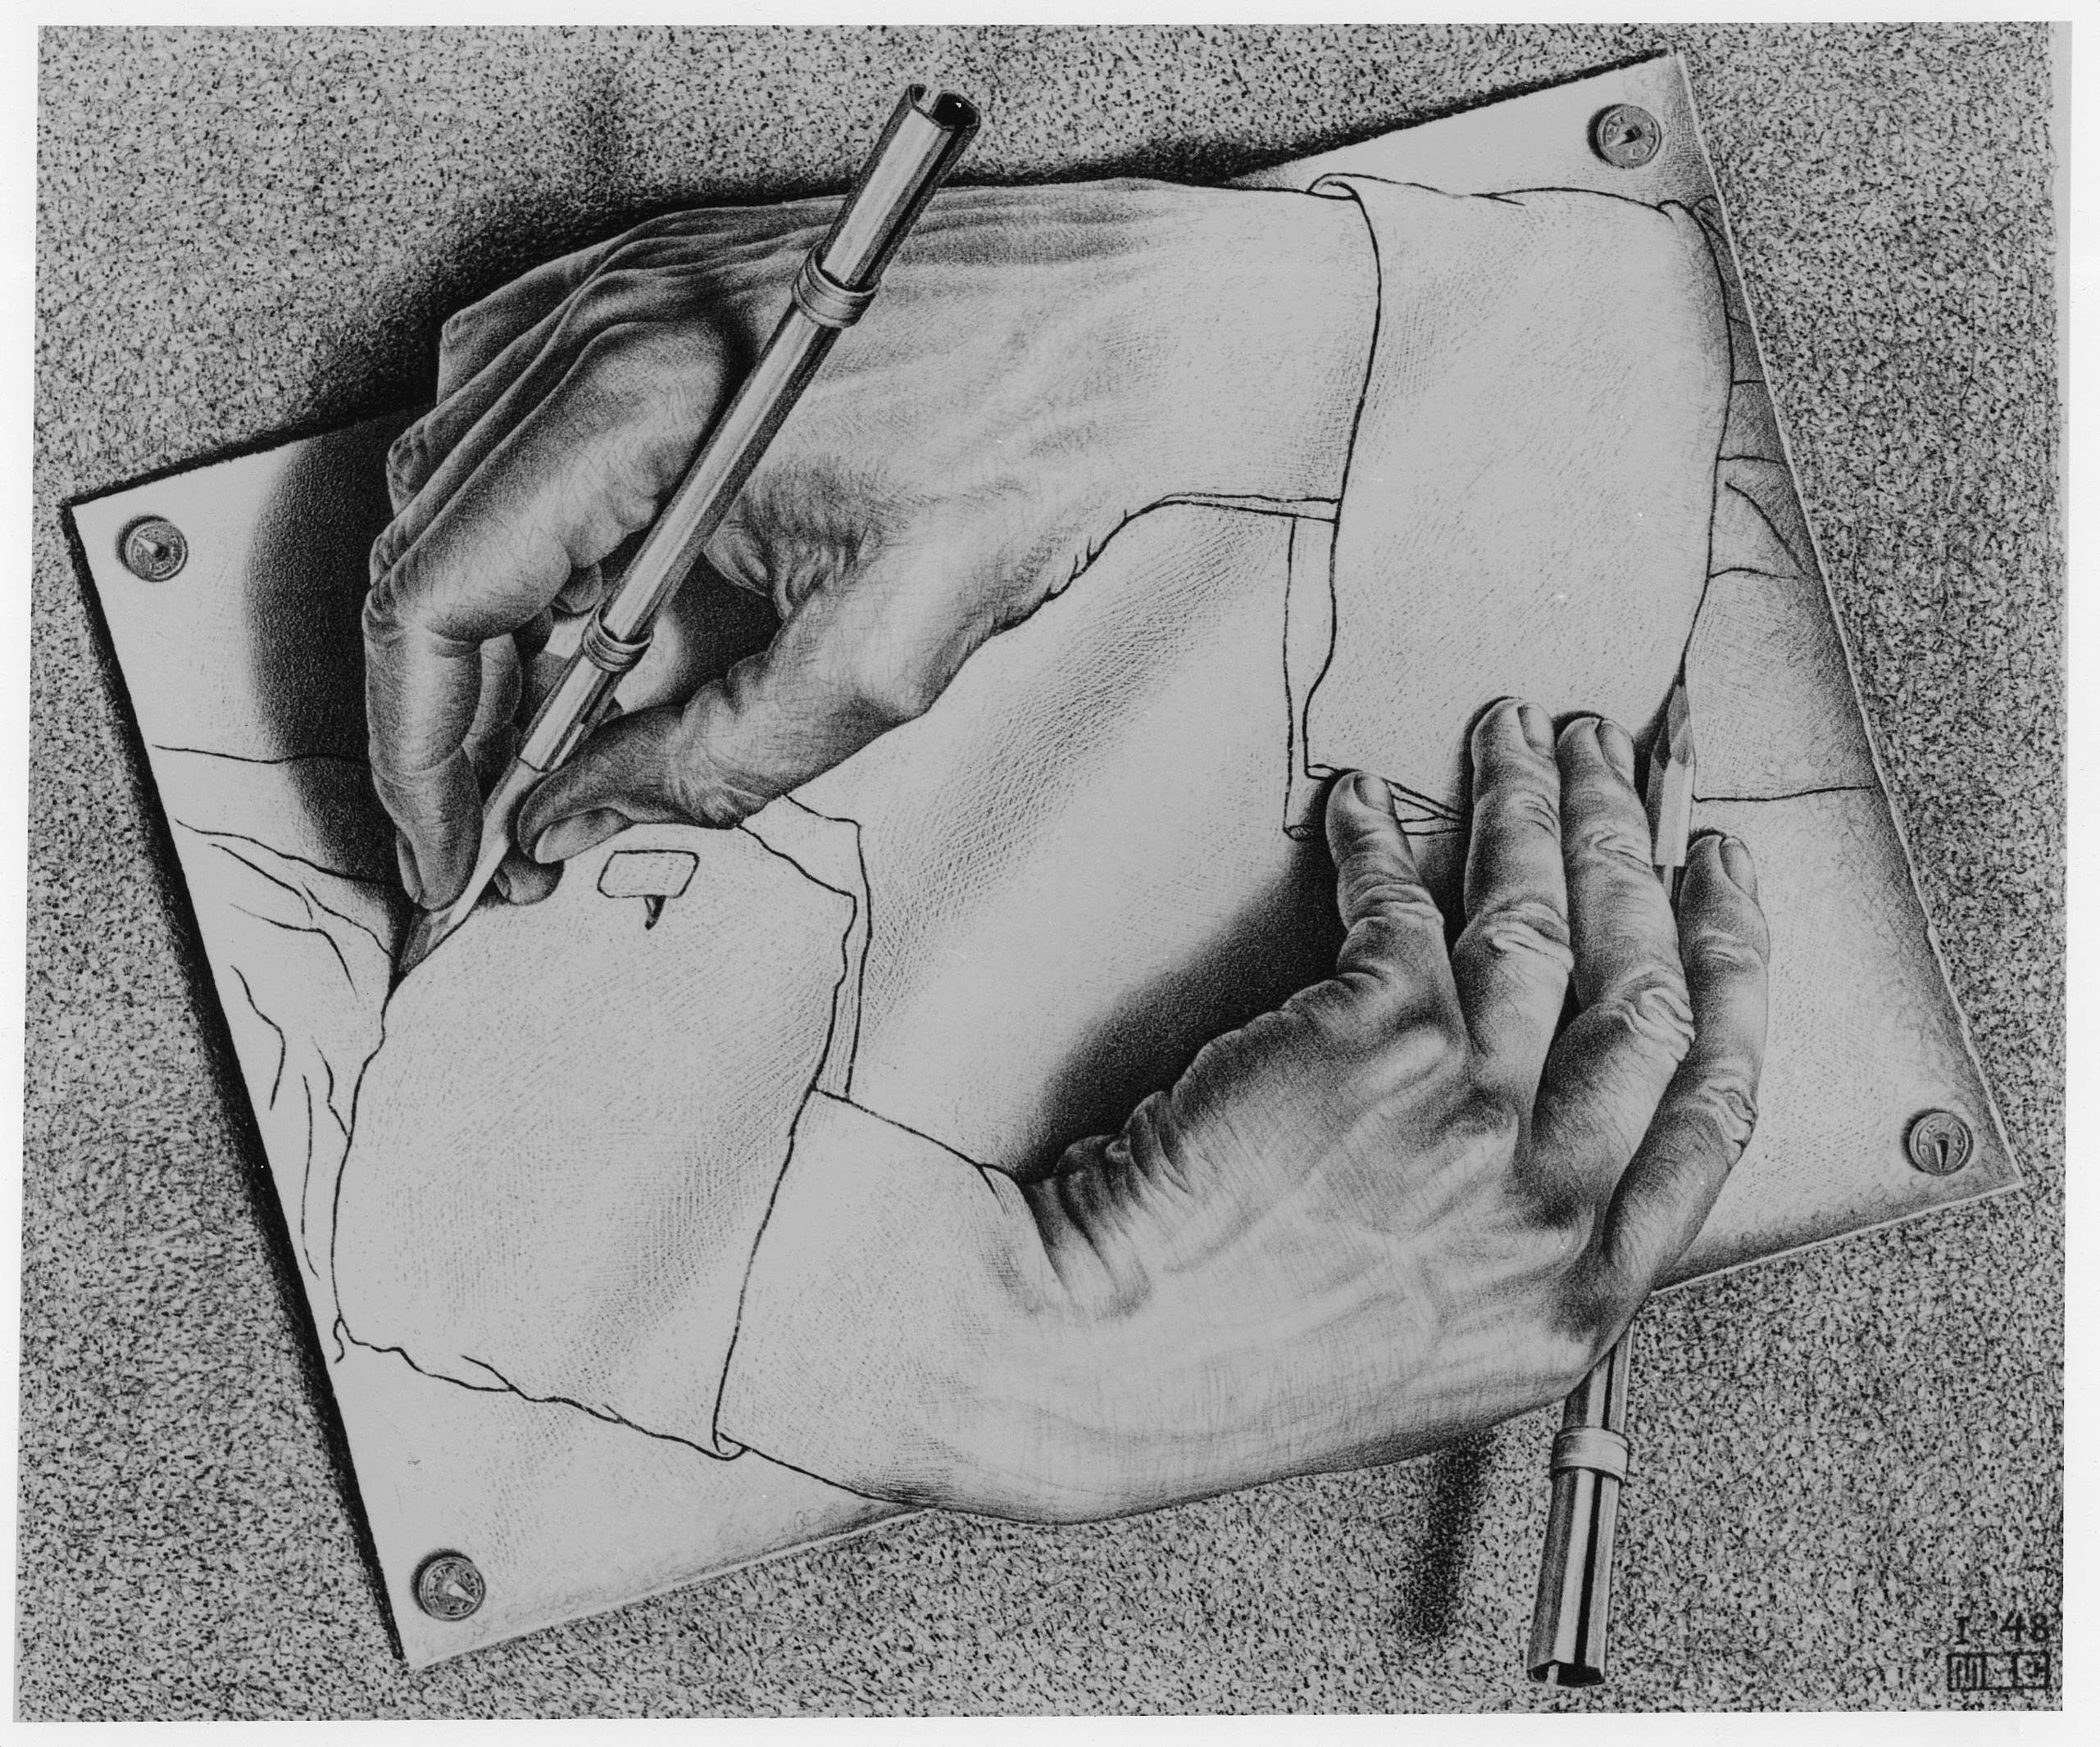
MC Escher “Drawing Hands” 1948

Slide 3
Administrative Issues
Midterm Next Week!
7-9pm, Dwinelle 155

Slide 4
Computational Concepts Toolbox
Data type: values, literals, operations,
e.g., int, float, string
Expressions, Call expression
Variables
Assignment Statement
Sequences: tuple, list
indexing
Data structures
Tuple assignment
Call Expressions
Function Definition Statement
Conditional Statement
Iteration:
data-driven (list comprehension)
control-driven (for statement)
while statement
Higher Order Functions
Functions as Values
Functions with functions as argument
Assignment of function values
Higher order function patterns
Map, Filter, Reduce
Recursion
Notes:
z = 1,2
x,y = 3,4
a,b = z

Slide 5
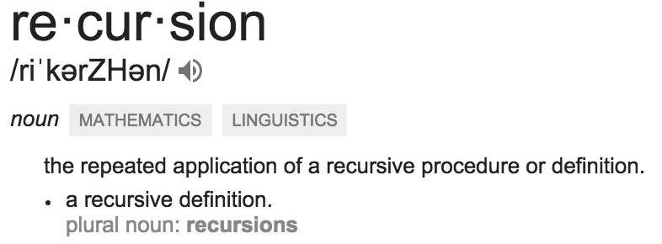
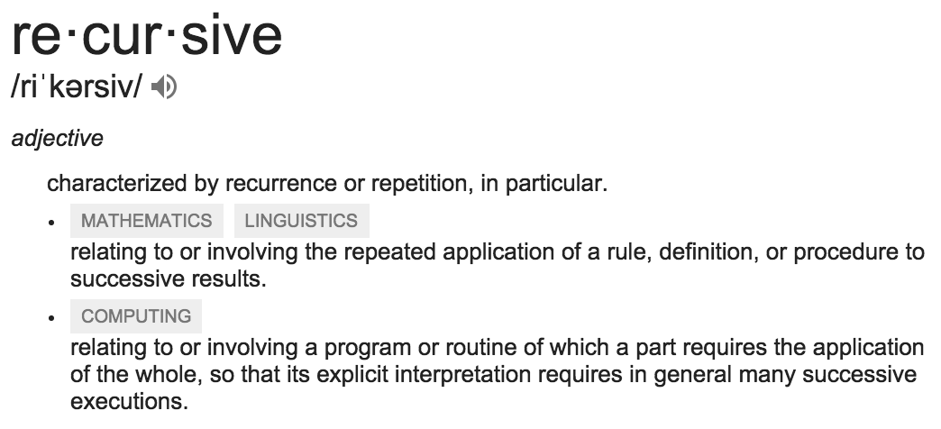
Today: Recursion
Recursive function calls itself, directly or indirectly

Slide 6
Why Recursion?
“After Abstraction, Recursion is probably the 2nd biggest idea in this course”
“It’s tremendously useful when the problem is self-similar”
“It’s no more powerful than iteration, but often leads to more concise & better code”
“It embodies the beauty and joy of computing”

Slide 7
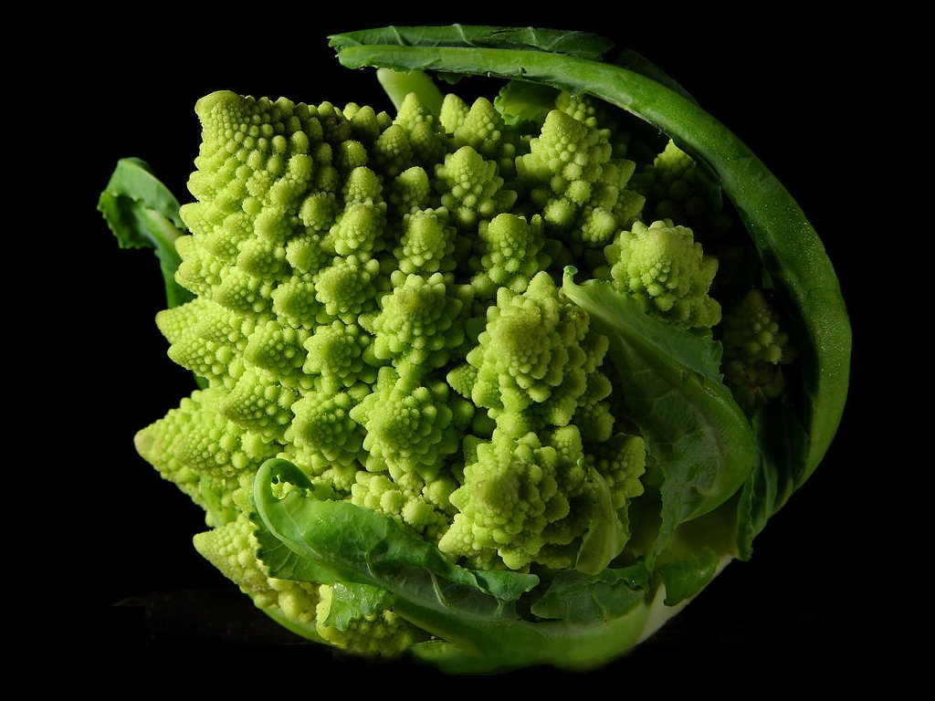
Why Recursion? More Reasons
Recursive structures exist (sometimes hidden) in nature and therefore in data!
It’s mentally and sometimes computationally more efficient to process recursive structures using recursion.

Slide 8
Function Review
A function cannot… A) have a function as argument B) define a function within itself C) return a function D) call itself E) None of the above.
Solution: E) A, B, C, D are all possible!

Slide 9
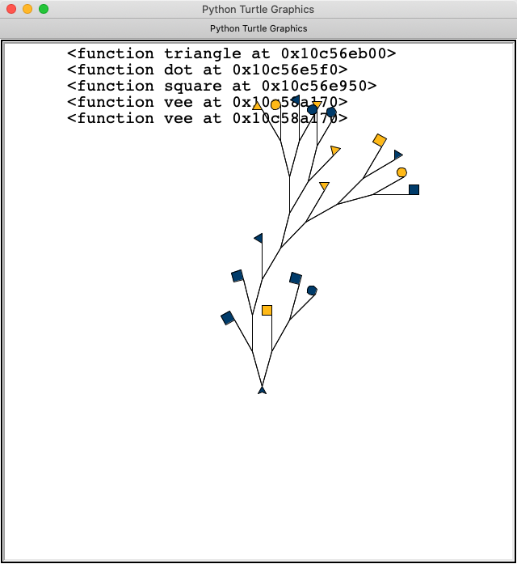
Demo Time
Vee a randomly recursive fractal

Slide 10
Recursion
Recursion is…
A) Less powerful than a for loop B) As powerful as a for loop C) As powerful as a while loop D) More powerful than a while loop E) Just different but equally powerful
as a for loop AND a while loop
Solution: E) Different – it reads differently, but you can solve any problem with one of these techniques. (Some tools are better suited for some jobs though.)`

Slide 11
So far I feel…
I “get” vee and countdown A) I am totally lost B) It’s confusing, but I kinda get it C) Starting to make sense… D) I get it, but have questions E) No questions at all!

