Slide 1

Computational Structures in Data Science
Lecture #09: Object-Oriented Programming
UC Berkeley EECS Lecturer Michael Ball
Nov 4, 2019
http://inst.eecs.berkeley.edu/~cs88

Slide 2
Internet Turns 50 This Week!
First Message Sent By UCLA 50 years ago.
It was… “LO”
Because the computer crashed after 2 characters!
https://blog.cloudflare.com/fifty-years-ago/

Slide 3
50 Lines of Code That Changed The Word
https://slate.com/technology/2019/10/consequential-computer-code-software-history.html
Apollo’s Lunar guidance system
Printf(‘Hello, world\n’);
The origins of email
Google’s PageRank Algorithm

Slide 4

Computational Concepts Toolbox
Data type: values, literals, operations,
Expressions, Call expression
Variables
Assignment Statement
Sequences: tuple, list
Dictionaries
Data structures
Tuple assignment
Function Definition Statement
Conditional Statement
Iteration: list comp, for, while
Lambda function expr.
Higher Order Functions
Functions as Values
Functions with functions as argument
Assignment of function values
Higher order function patterns
Map, Filter, Reduce
Function factories – create and return functions
Recursion
Linear, Tail, Tree
Abstract Data Types
Generators
Mutation
Object Orientation
Notes:
z = 1,2
x,y = 3,4
a,b = z

Slide 5
Mind Refresher 1
A mutation is…
A) A monster from a movie B) A change of state C) Undesirable D) All of the above

Slide 6
Mind Refresher 2
We try to hide states because…
A) We don’t like them B) Math doesn’t have them C) It’s easier to program not having to think about them D) All of the above

Slide 7
Mind Refresher 3
Where do we hide states?
A) Local variables in functions B) Private variables in objects C) Function arguments in recursion D) All of the above
Solution: D) All of the above

Slide 8
Object-Oriented Programming (OOP)
Objects as data structures
With methods you ask of them
These are the behaviors
With local state, to remember
These are the attributes
Classes & Instances
Instance an example of class
E.g., Fluffy is instance of Dog
Inheritance saves code
Hierarchical classes
E.g., pianist special case of musician, a special case of performer
Examples (though not pure)
Java, C++
www3.ntu.edu.sg/home/ehchua/programming/java/images/OOP-Objects.gif

Slide 9
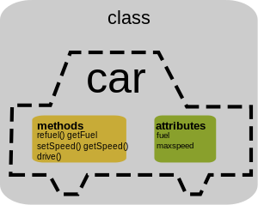
Classes
Consist of data and behavior, bundled together to create abstractions
Abstract Data Types
A class has
attributes (variables)
methods (functions)
that define its behavior.

Slide 10
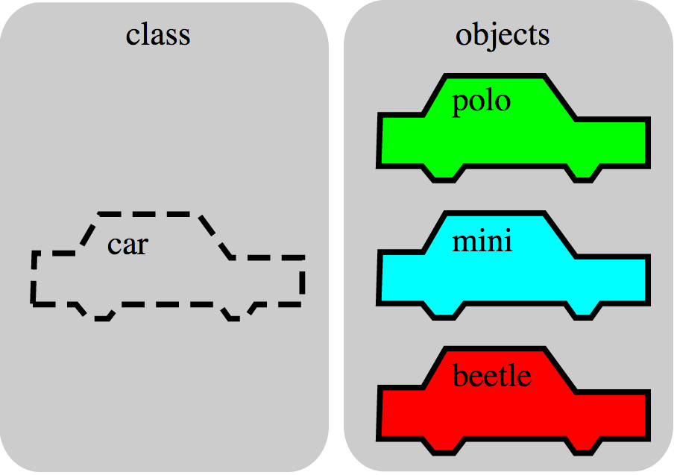
Objects
An object is the instance of a class.

Slide 11
Objects
Objects are concrete instances of classes in memory.
They can have state
mutable vs immutable
Functions do one thing (well)
Objects do a collection of related things
In Python, everything is an object
All objects have attributes
Manipulation happens through methods

Slide 12
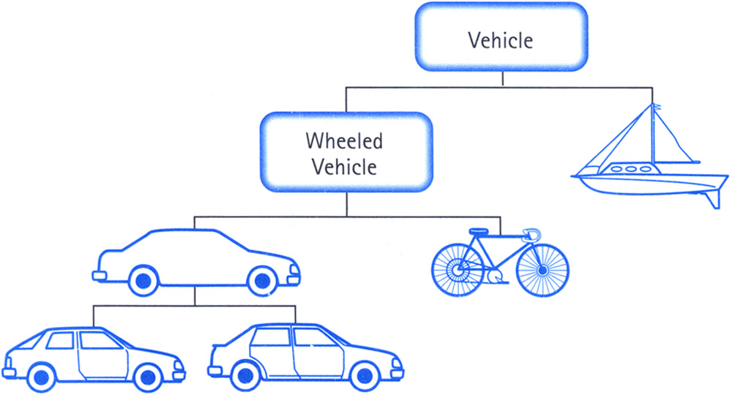
Class Inheritance
Classes can inherit methods and attributes from parent classes but extend into their own class.

Slide 13
Inheritance
Define a class as a specialization of an existing class
Inherent its attributes, methods (behaviors)
Add additional ones
Redefine (specialize) existing ones
Ones in superclass still accessible in its namespace

Slide 14
Review: Bank account using dictionary
account_number_seed = 1000
def account(name, initial_deposit):
global account_number_seed
account_number_seed += 1
return {'Name' : name, 'Number': account_number_seed,
'Balance' : initial_deposit}
def account_name(acct):
return acct['Name']
def account_balance(acct):
return acct['Balance']
def account_number(acct):
return acct['Number']
def deposit(acct, amount):
acct['Balance'] += amount
return acct['Balance']
def withdraw(acct, amount):
acct['Balance'] -= amount
return acct['Balance']
>>> my_acct = account('David Culler', 100)
>>> my_acct
{'Name': ’John Doe', 'Balance': 100, 'Number': 1001}
>>> account_number(my_acct)
1001
>>> your_acct = account("Fred Jones", 475)
>>> account_number(your_acct)
1002
>>>

Slide 15
Python class statement
class ClassName:
<statement-1>
.
.
.
<statement-N>
class ClassName ( inherits ):
<statement-1>
.
.
.
<statement-N>

Slide 16
Example: Account
class BaseAccount:
def init(self, name, initial_deposit):
self.name = name
self.balance = initial_deposit
def account_name(self):
return self.name
def account_balance(self):
return self.balance
def withdraw(self, amount):
self.balance -= amount
return self.balance
attributes
new namespace
The object
da dot
methods

Slide 17
Creating an object, invoking a method
The Class Constructor
my_acct = BaseAccount()
my_acct.init(”John Doe", 93)
my_acct.withdraw(42)
da dot

Slide 18
Special Initialization Method
class BaseAccount:
def __init__(self, name, initial_deposit):
self.name = name
self.balance = initial_deposit
def account_name(self):
return self.name
def account_balance(self):
return self.balance
def withdraw(self, amount):
self.balance -= amount
return self.balance
return None

Slide 19
More on Attributes
Attributes of an object accessible with ‘dot’ notation
obj.attr
You can distinguish between ”public” and “private” data.
Used to clarify to programmers how you class should be used.
In Python an _ prefix means “this thing is private”
_foo and __foo do different things inside a class.
More for the curious.
Class variables vs Instance variables:
Class variable set for all instances at once
Instance variables per instance value

Slide 20
Example
class BaseAccount:
def __init__(self, name, initial_deposit):
self.name = name
self.balance = initial_deposit
def name(self):
return self.name
def balance(self):
return self.balance
def withdraw(self, amount):
self.balance -= amount
return self.balance

Slide 21
Example: “private” attributes
class BaseAccount:
def __init__(self, name, initial_deposit):
self._name = name
self._balance = initial_deposit
def name(self):
return self._name
def balance(self):
return self._balance
def withdraw(self, amount):
self._balance -= amount
return self._balance

Slide 22
Example: class attribute
class BaseAccount:
account_number_seed = 1000
def __init__(self, name, initial_deposit):
self._name = name
self._balance = initial_deposit
self._acct_no = BaseAccount.account_number_seed
BaseAccount.account_number_seed += 1
def name(self):
return self._name
def balance(self):
return self._balance
def withdraw(self, amount):
self._balance -= amount
return self._balance

Slide 23
More class attributes
class BaseAccount:
account_number_seed = 1000
accounts = []
def __init__(self, name, initial_deposit):
self._name = name
self._balance = initial_deposit
self._acct_no = BaseAccount.account_number_seed
BaseAccount.account_number_seed += 1
BaseAccount.accounts.append(self)
def name(self):
...
def show_accounts():
for account in BaseAccount.accounts:
print(account.name(),
account.account_no(),account.balance())

Slide 24
Example
class Account(BaseAccount):
def deposit(self, amount):
self._balance += amount
return self._balance

Slide 25
More special methods
class Account(BaseAccount):
def deposit(self, amount):
self._balance += amount
return self._balance
def __repr__(self):
return '< ' + str(self._acct_no) +
'[' + str(self._name) + '] >'
def __str__(self):
return 'Account: ' + str(self._acct_no) +
'[' + str(self._name) + ']'
def show_accounts():
for account in BaseAccount.accounts:
print(account)
Goal: unambiguous
Goal: readable

Slide 26
Classes using classes
class Bank:
accounts = []
def add_account(self, name, account_type,
initial_deposit):
assert (account_type == 'savings') or
(account_type == 'checking'), "Bad Account type"
assert initial_deposit > 0, "Bad deposit"
new_account = Account(name, account_type,
initial_deposit)
Bank.accounts.append(new_account)
def show_accounts(self):
for account in Bank.accounts:
print(account)

