Slide 1

Computational Structures in Data Science
Lecture #11: More on Object-Oriented Programming and Exceptions
UC Berkeley EECS Lecturer Michael Ball
Nov 18, 2019
http://inst.eecs.berkeley.edu/~cs88

Slide 2

Computational Concepts Toolbox
Data type: values, literals, operations,
Expressions, Call expression
Variables
Assignment Statement
Sequences: tuple, list
Dictionaries
Data structures
Tuple assignment
Function Definition Statement
Conditional Statement
Iteration: list comp, for, while
Lambda function expr.
Higher Order Functions
Functions as Values
Functions with functions as argument
Assignment of function values
Higher order function patterns
Map, Filter, Reduce
Function factories – create and return functions
Recursion
Abstract Data Types
Mutation
Class
Object Oriented Programming
Inheritance
Exceptions
Notes:
z = 1,2
x,y = 3,4
a,b = z

Slide 3
Administrative Issues
Project 2 “Wheel” goes out soon
Discussion in lab
Reading: (2.5-7), 2.9 , exceptions: 3.3
Notebooks from L09+L10:
http://bit.ly/cs88-fa18-L09

Slide 4
Today:
Review Class concept
Using class to create and manipulate objects
Inheritance to specialize a class
Create subtypes of the object type
Exceptions
Unprogrammed control transfers to catch unusual situations or errors
How they arise
How to handle exception
How to raise your own

Slide 5
Review: Python class
class <ClassName>:
def <method-1>(self, ..)
self.<instance_attr> = …
.
.
.
def <method-N>
https://docs.python.org/3/tutorial/classes.html
Class names should normally use the CapWords convention.
https://www.python.org/dev/peps/pep-0008/

Slide 6
Creating an object, invoking a method
The Class Constructor
my_acct = Account ("David Culler", 93)
my_acct.withdraw(42)

Slide 7
Review: class example
class Account:
# Class astributes outside and class defs
_account_number_seed = 1000
# Constructor
def __init__(self, name, initial_deposit):
# Initialize the instance attributes
self._name = name
self._acct_no = Account._account_number_seed
Account._account_number_seed += 1
self._balance = initial_deposit
# Return None
# Selectors
def account_name(self):
return self._name
. . .
def account_number(self):
return self._acct_no
. . .
class attributes
The object
private instance attributes,
dot notation
object namespace
Methods
class attributes, dot notation

Slide 8
Inheritance
Define a class as a specialization of an existing class
Inherent its attributes, methods (behaviors)
Add additional ones
Redefine (specialize) existing ones
Ones in superclass still accessible in its namespace
class ClassName ( <inherits> ):
<statement-1>
.
.
.
<statement-N>

Slide 9
Inheritance
subclass
Derived Class
Derived Class
Base Class
superclass

Slide 10
Example
class CheckingAccount(Account):
def __init__(self, name, initial_deposit):
# Use superclass initializer
Account.__init__(self, name, initial_deposit)
# Additional initialization
self._type = "Checking"
def account_type(self):
return self._type
# Display representation
def __repr__(self):
return '<' + str(self.account_type()) + 'Account:…’
Attribute in subclass, not in superclass

Slide 11
Another Example
class SavingsAccount(Account):
interest_rate = 0.02
def __init__(self, name, initial_deposit):
# Use superclass initializer
Account.__init__(self, name, initial_deposit)
# Additional initialization
self._type = "Savings"
def account_type(self):
return self._type
def acrue_interest(self):
self._balance = self._balance *
(1 + SavingsAccount.interest_rate)
Methods in subclass, not in superclass

Slide 12
Classes using classes
class Bank:
_accounts = []
def add_account(self, name, account_type, initial_deposit):
if account_type == 'Savings':
new_account = SavingsAccount(name, initial_deposit)
elif account_type == 'Checking':
new_account = CheckingAccount(name, initial_deposit)
else:
assert True, "Bad Account type: " + account_type
assert initial_deposit > 0, "Bad deposit"
Bank._accounts.append(new_account)
return new_account
def accounts(self):
return self._accounts[:]
def show_accounts(self):
for acct in self.accounts():
print(acct.account_number(), acct.account_type(),
acct.account_name(), acct.account_balance())

Slide 13
Key concepts to take forward
Classes embody and allow enforcement of ADT methodology
Class definition
Class namespace
Methods
Instance attributes (fields)
Class attributes
Inheritance
Superclass reference

Slide 14
Additional examples
Redesign our KV as a class
How should “new KV” vs mutation be handled
Inheritance and “new object” in superclass

Slide 15
KV as a true object
class KV:
"""Key-Value container abstractionma collection of key-value pairs"""
def __init__(self, kv_pairs=[]):
self._kv = []
for (key, val) in kv_pairs: # Verify and initialize
assert (type(key) == str) # the key should be a string
self._kv.append((key, val))
def items(self):
"""Return a list of the (key, value) pairs in kv."""
return self._kv
def get(self, key):
"""Return the value bound to key in kv, or None if not present.”””
for k, v in self.items():
if k == key:
return v
return None
def keys(self):
"""Return a list of the keys in kv"""
return [key for (key, val) in self.items()]
def values(self):
"""Return a list of the values in kv"""
return [val for (key, val) in self.items()]
def add(self, key, value):
"""Return a new KV adding binding (key, value)"""
return KV([(key, value)] + self.items())
def delete(self, key):
"""Return a new KV having removed any binding for key"""
return KV([(k, v) for (k, v) in self.items(kv) if not k == key])

Slide 16
Class methods
Defined on the class
rather than objects of the class
Like class attributes
Indicated by @classmethod
Take a class argument, rather than self
class KV:
"""Key-Value container abstraction
a collection of key-value pairs such that kv_get(kv, key) returns the value
"""
def __init__(self, kv_pairs=[]):
self._kv = []
for (key, val) in kv_pairs: # Verify and initialize
assert (type(key) == str) # the key should be a string
self._kv.append((key, val))
@classmethod
def create(cls, kv_pairs=[]):
return cls(kv_pairs)

Slide 17
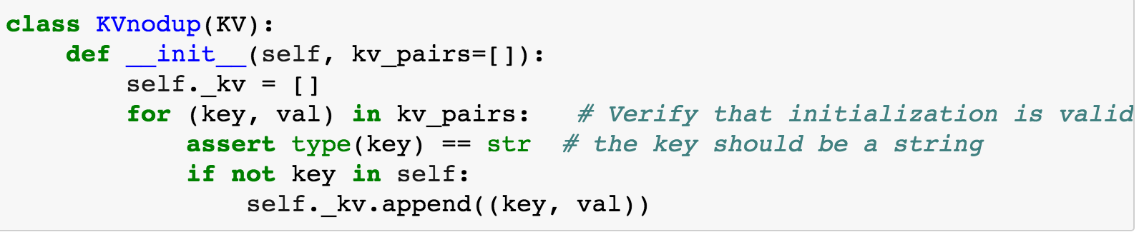
Inheritance Example

Slide 18
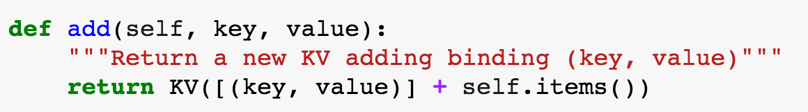
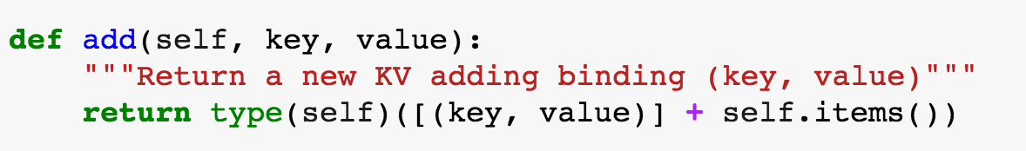
Subclass type
Explicit use of class constructor – interferes with inheritance
Use type(self) as constructor to maintain inherited type

Slide 19
Exception (read 3.3)
Mechanism in a programming language to declare and respond to “exceptional conditions”
enable non-local cntinuations of control
Often used to handle error conditions
Unhandled exceptions will cause python to halt and print a stack trace
You already saw a non-error exception – end of iterator
Exceptions can be handled by the program instead
assert, try, except, raise statements
Exceptions are objects!
They have classes with constructors

Slide 20
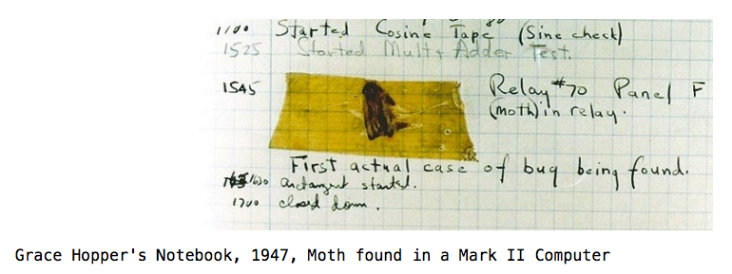
Handling Errors
Function receives arguments of improper type?
Resource, e.g., file, is not available
Network connection is lost or times out?

Slide 21
Example exceptions
notebook
>>> 3/0
Traceback (most recent call last):
File "<stdin>", line 1, in <module>
ZeroDivisionError: division by zero
>>> str.lower(1)
Traceback (most recent call last):
File "<stdin>", line 1, in <module>
TypeError: descriptor 'lower' requires a 'str' object but received a 'int'
>>> ""[2]
Traceback (most recent call last):
File "<stdin>", line 1, in <module>
IndexError: string index out of range
>>>
Unhandled, “thrown” back to the top level interpreter
Or halt the Python program

Slide 22
Functions
Q: What is a function supposed to do?
A: One thing well
Q: What should it do when it is passed arguments that don’t make sense?
>>> def divides(x, y):
... return y%x == 0
...
>>> divides(0, 5)
???
>>> def get(data, selector):
... return data[selector]
...
>>> get({'a': 34, 'cat':'9 lives'}, 'dog’)
????

Slide 23
Exceptional exit from functions
>>> def divides(x, y):
... return y%x == 0
...
>>> divides(0, 5)
Traceback (most recent call last):
File "<stdin>", line 1, in <module>
File "<stdin>", line 2, in divides
ZeroDivisionError: integer division or modulo by zero
>>> def get(data, selector):
... return data[selector]
...
>>> get({'a': 34, 'cat':'9 lives'}, 'dog')
Traceback (most recent call last):
File "<stdin>", line 1, in <module>
File "<stdin>", line 2, in get
KeyError: 'dog'
>>>
Function doesn’t “return” but instead execution is thrown out of the function

Slide 24
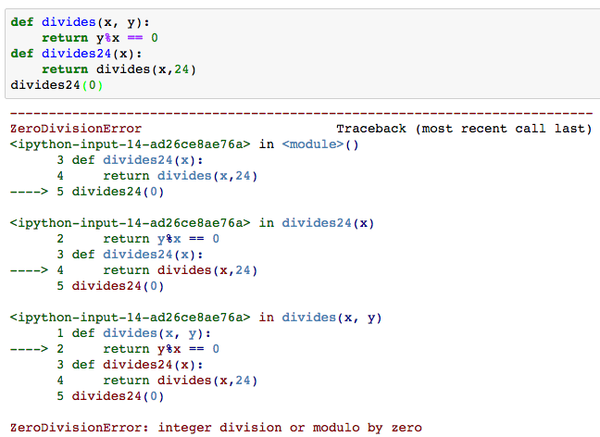
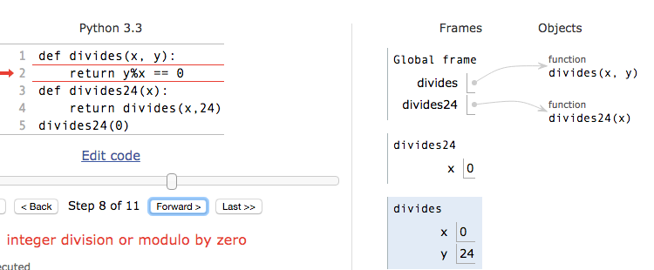
Continue out of multiple calls deep
Stack unwinds until exception is handled or top

Slide 25
Types of exceptions
TypeError -- A function was passed the wrong number/type of argument
NameError -- A name wasn't found
KeyError -- A key wasn't found in a dictionary
RuntimeError -- Catch-all for troubles during interpretation
. . .

Slide 26
Demo

Slide 27
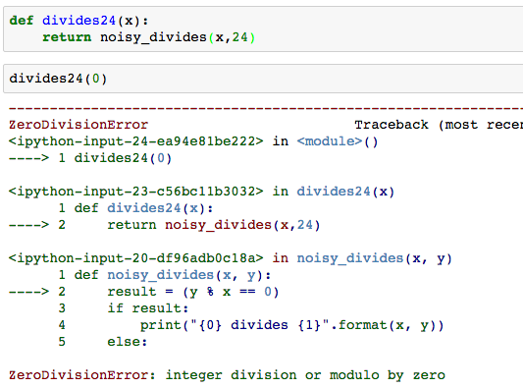
Flow of control stops at the exception
And is ‘thrown back’ to wherever it is caught

Slide 28
Assert Statements
Allow you to make assertions about assumptions that your code relies on
Use them liberally!
Incoming data is dirty till you’ve washed it
Raise an exception of type AssertionError
Ignored in optimize flag: python3 –O …
Governed by bool __debug__
assert <assertion expression>, <string for failed>
def divides(x, y):
assert x != 0, ”Denominator must be non-zero”
return y%x == 0

Slide 29
Handling Errors – try / except
Wrap your code in try – except statements
Execution rule
<try suite> is executed first
If during this an exception is raised and not handled otherwise
And if the exception inherits from <exception class>
Then <except suite> is executed with <name> bound to the exception
Control jumps to the except suite of the most recent try that handles the exception
try:
<try suite>
except <exception class> as <name>:
<except suite>
... # continue here if <try suite> succeeds w/o exception

Slide 30
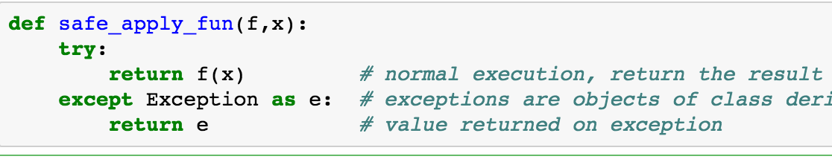
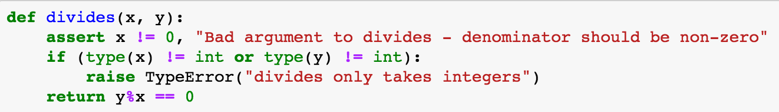
Demo

Slide 31
Raise statement
Exception are raised with a raise statement\
raise <exception>
<expression> must evaluate to a subclass of BaseException or an instance of one
Exceptions are constructed like any other object
TypeError(‘Bad argument’)

Slide 32
Exceptions are Classes
class NoiseyException(Exception):
def __init__(self, stuff):
print("Bad stuff happened", stuff)
try:
return fun(x)
except:
raise NoiseyException((fun, x))

Slide 33
Demo

Slide 34
Summary
Approach creation of a class as a design problem
Meaningful behavior => methods [& attributes]
ADT methodology
What’s private and hidden? vs What’s public?
Design for inheritance
Clean general case as foundation for specialized subclasses
Use it to streamline development
Anticipate exceptional cases and unforeseen problems
try … catch
raise / assert

