Slide 1

Computational Structures in Data Science
UC Berkeley EECS Lecturer
Michael Ball
Lecture #12: Exceptions and Iterators
Tax day, 2019
http://inst.eecs.berkeley.edu/~cs88

Slide 2

Computational Concepts Toolbox
Data type: values, literals, operations,
Expressions, Call expression
Variables
Assignment Statement, Tuple assignment
Sequences: tuple, list
Dictionaries
Function Definition Statement
Conditional Statement
Iteration: list comp, for, while
Lambda function expr.
Higher Order Functions
Functions as Values
Functions with functions as argument
Assignment of function values
Higher order function patterns
Map, Filter, Reduce
Function factories – create and return functions
Recursion
Abstract Data Types
Mutation
Class & Inheritance
Exceptions
Iterators & Generators
Notes:
z = 1,2
x,y = 3,4
a,b = z

Slide 3
Today:
Exceptions
Sequences vs Iterables
Using iterators without generating all the data
Magic methods
next
Iter
Iterators – the iter protocol
Getitem protocol
Is an object iterable?
Lazy evaluation with iterators

Slide 4
Exception (read 3.3)
Mechanism in a programming language to declare and respond to “exceptional conditions”
enable non-local cntinuations of control
Often used to handle error conditions
Unhandled exceptions will cause python to halt and print a stack trace
You already saw a non-error exception – end of iterator
Exceptions can be handled by the program instead
assert, try, except, raise statements
Exceptions are objects!
They have classes with constructors

Slide 5
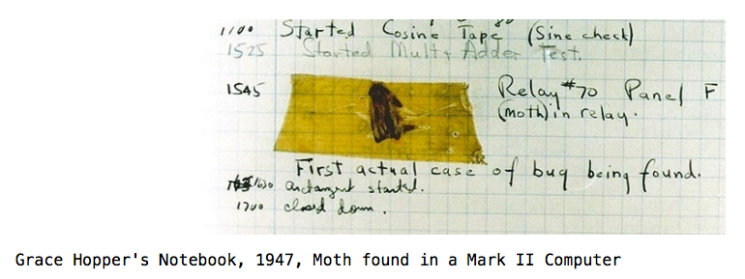
Handling Errors
Function receives arguments of improper type?
Resource, e.g., file, is not available
Network connection is lost or times out?

Slide 6
Example exceptions
notebook
>>> 3/0
Traceback (most recent call last):
File "<stdin>", line 1, in <module>
ZeroDivisionError: division by zero
>>> str.lower(1)
Traceback (most recent call last):
File "<stdin>", line 1, in <module>
TypeError: descriptor 'lower' requires a 'str' object but received a 'int'
>>> ""[2]
Traceback (most recent call last):
File "<stdin>", line 1, in <module>
IndexError: string index out of range
>>>
Unhandled, “thrown” back to the top level interpreter
Or halt the Python program

Slide 7
Functions
Q: What is a function supposed to do?
A: One thing well
Q: What should it do when it is passed arguments that don’t make sense?
>>> def divides(x, y):
... return y%x == 0
...
>>> divides(0, 5)
???
>>> def get(data, selector):
... return data[selector]
...
>>> get({'a': 34, 'cat':'9 lives'}, 'dog’)
????

Slide 8
Exceptional exit from functions
>>> def divides(x, y):
... return y%x == 0
...
>>> divides(0, 5)
Traceback (most recent call last):
File "<stdin>", line 1, in <module>
File "<stdin>", line 2, in divides
ZeroDivisionError: integer division or modulo by zero
>>> def get(data, selector):
... return data[selector]
...
>>> get({'a': 34, 'cat':'9 lives'}, 'dog')
Traceback (most recent call last):
File "<stdin>", line 1, in <module>
File "<stdin>", line 2, in get
KeyError: 'dog'
>>>
Function doesn’t “return” but instead execution is thrown out of the function

Slide 9
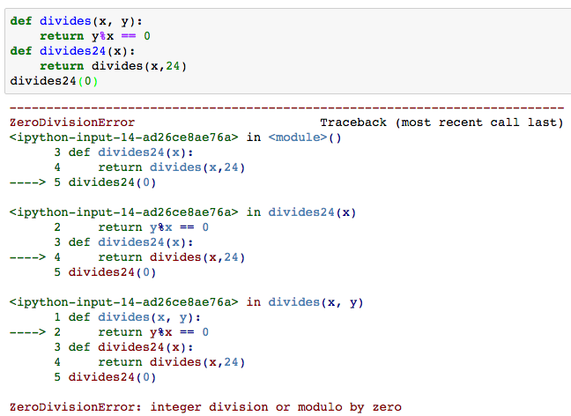
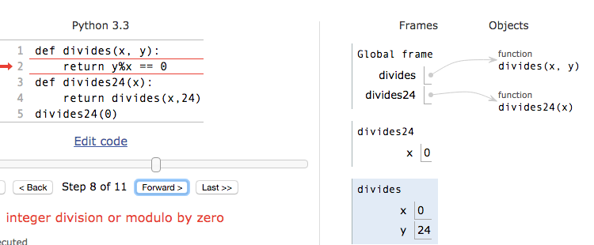
Continue out of multiple calls deep
Stack unwinds until exception is handled or top

Slide 10
Types of exceptions
TypeError -- A function was passed the wrong number/type of argument
NameError -- A name wasn't found
KeyError -- A key wasn't found in a dictionary
RuntimeError -- Catch-all for troubles during interpretation
. . .

Slide 11
Demo

Slide 12
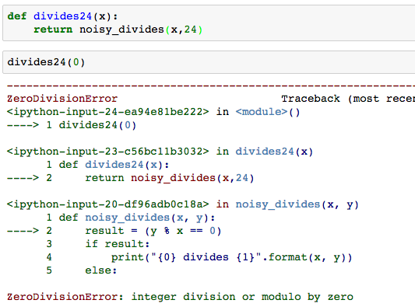
Flow of control stops at the exception
And is ‘thrown back’ to wherever it is caught

Slide 13
Assert Statements
Allow you to make assertions about assumptions that your code relies on
Use them liberally!
Incoming data is dirty till you’ve washed it
Raise an exception of type AssertionError
Ignored in optimize flag: python3 –O …
Governed by bool __debug__
assert <assertion expression>, <string for failed>
def divides(x, y):
assert x != 0, ”Denominator must be non-zero”
return y%x == 0

Slide 14
Handling Errors – try / except
Wrap your code in try – except statements
Execution rule
<try suite> is executed first
If during this an exception is raised and not handled otherwise
And if the exception inherits from <exception class>
Then <except suite> is executed with <name> bound to the exception
Control jumps to the except suite of the most recent try that handles the exception
try:
<try suite>
except <exception class> as <name>:
<except suite>
... # continue here if <try suite> succeeds w/o exception

Slide 15
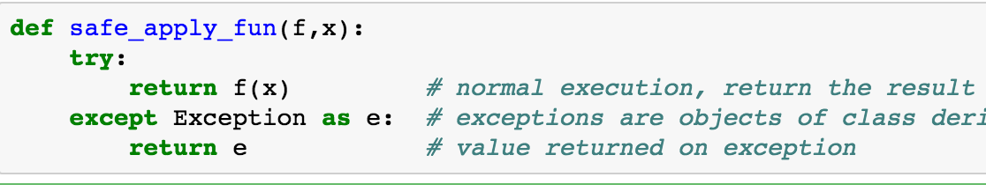
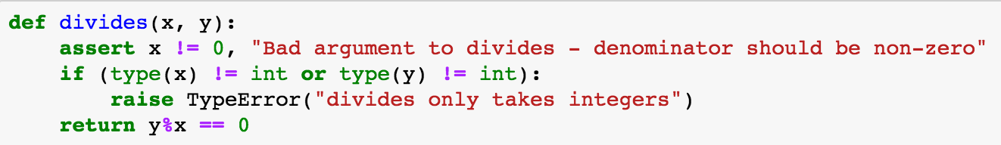
Demo

Slide 16
Raise statement
Exception are raised with a raise statement\
raise <exception>
<expression> must evaluate to a subclass of BaseException or an instance of one
Exceptions are constructed like any other object
TypeError(‘Bad argument’)

Slide 17
Exceptions are Classes
class NoiseyException(Exception):
def __init__(self, stuff):
print("Bad stuff happened", stuff)
try:
return fun(x)
except:
raise NoiseyException((fun, x))

Slide 18
Demo

Slide 19
Key concepts to take forward
Classes embody and allow enforcement of ADT methodology
Class definition
Class namespace
Methods
Instance attributes (fields)
Class attributes
Inheritance
Superclass reference

Slide 20
Summary of last week
Approach creation of a class as a design problem
Meaningful behavior => methods [& attributes]
ADT methodology
What’s private and hidden? vs What’s public?
Design for inheritance
Clean general case as foundation for specialized subclasses
Use it to streamline development
Anticipate exceptional cases and unforeseen problems
try … catch
raise / assert

Slide 21
Mind Refresher 1
An object is…
A) an instance of a class B) a python thing C) inherited from a class D) All of the above
Solution: A) An object is an instance of a class

Slide 22
Mind Refresher 2
A setter method…
A) constructs an object B) changes the internal state of an object or class C) is required by Python to access variables
D) All of the above
Solution: B) Changes the internal state of an object or class by allowing access to a private variable.

Slide 23
Exception (read 3.3)
Mechanism in a programming language to declare and respond to “exceptional conditions”
enable non-local cntinuations of control
Often used to handle error conditions
Unhandled exceptions will cause python to halt and print a stack trace
You already saw a non-error exception – end of iterator
Exceptions can be handled by the program instead
assert, try, except, raise statements
Exceptions are objects!
They have classes with constructors

Slide 24
Handling Errors – try / except
Wrap your code in try – except statements
Execution rule
<try suite> is executed first
If during this an exception is raised and not handled otherwise
And if the exception inherits from <exception class>
Then <except suite> is executed with <name> bound to the exception
Control jumps to the except suite of the most recent try that handles the exception
try:
<try suite>
except <exception class> as <name>:
<except suite>
... # continue here if <try suite> succeeds w/o exception

Slide 25
Types of exceptions
TypeError -- A function was passed the wrong number/type of argument
NameError -- A name wasn't found
KeyError -- A key wasn't found in a dictionary
RuntimeError -- Catch-all for troubles during interpretation
. . .

Slide 26
Demo

Slide 27
Exceptions are Classes
class NoiseyException(Exception):
def __init__(self, stuff):
print("Bad stuff happened", stuff)
try:
return fun(x)
except:
raise NoiseyException((fun, x))

Slide 28
Mind Refresher 3
Exceptions…
A) allow to handle errors non-locally B) are objects
C) cannot happen within a catch block
D) B, C
E) A, B
Solution: B, C) Exceptions are objects and they can occur any time.

Slide 29
Iterable - an object you can iterate over
iterable: An object capable of yielding its members one at a time.
iterator: An object representing a stream of data.
We have worked with many iterables as if they were sequences

Slide 30
Functions that return iterables
map
range
zip
These objects are not sequences.
If we want to see all of the elements at once, we need to explicitly call list() or tuple() on them

Slide 31
Generators: turning iteration into an iterable
Generator functions use iteration (for loops, while loops) and the yield keyword
Generator functions have no return statement, but they don’t return None
They implicitly return a generator object
Generator objects are just iterators
def squares(n):
for i in range(n):
yield (i*i)

Slide 32
Nest iteration
def all_pairs(x):
for item1 in x:
for item2 in x:
yield(item1, item2)

Slide 33
Next element in generator iterable
Iterables work because they have some "magic methods" on them. We saw magic methods when we learned about classes,
e.g., __init__, __repr__ and __str__.
The first one we see for iterables is __next__
iter( ) – transforms a sequence into an iterator

Slide 34
Iterators – iter protocol
In order to be iterable, a class must implement the iter protocol
The iterator objects themselves are required to support the following two methods, which together form the iterator protocol:
__iter__() : Return the iterator object itself. This is required to allow both containers and iterators to be used with the for and in statements.
This method returns an iterator object, Iterator can be self
__next__() : Return the next item from the container. If there are no further items, raise the StopIteration exception.
Classes get to define how they are iterated over by defining these methods

Slide 35
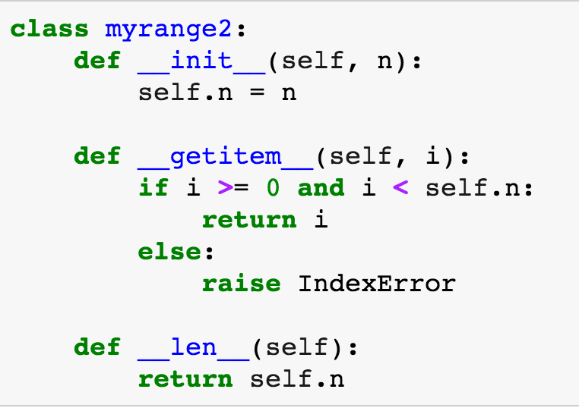
Getitem protocol
Another way an object can behave like a sequence is indexing: Using square brackets “[ ]” to access specific items in an object.
Defined by special method: __getitem__(self, i)
Method returns the item at a given index

Slide 36
Determining if an object is iterable
from collections.abc import Iterable
isinstance([1,2,3], Iterable)
This is more general than checking for any list of particular type, e.g., list, tuple, string...

Slide 37
Solutions for the Wandering Mind
N bits can represent 2^{N} configurations.
1) How many functions can be created that map from N bits to 1 bit (binary functions)? #functions=2^{2N}
2) How many functions can be created that map from N bits to M bits? #functions=M^{2N}
3) How many functions can be created that map from N k-bit length integers to M bits? #functions=M^{2kN}
4) If we were representing the functions 1, 2, and 3 in tables: a) How many different tables would we need? 2^{2N} , M^{2N}, M^{2kN} tables, respectively.
b) How big is each table? (N+1)*2^{N} table cells.
=> It’s easier to abstract the tables using functions, abstract data types, and object orientation!

Slide 38
Questions for the Wandering Mind
1) Adding two n-bit integers, how many bits can the result have?
2) Multiplying two n bit integers, how many bits can the result have?
Assume:
Exceptions don’t exist
We only reserve 8bit for an integer variable (0-255)
Questions:
What would be the result of an addition 255+255?
What would be the result of a multiplication 255*255?
Assume l additions of 8bit integers into the same 8bit variable. Can you formulate the maximum error that can occur as a function of l?

