Slide 1

Computational Structures in Data Science
Lecture 6: Environment Diagrams, Recursion Review, Midterm Review
UC Berkeley EECS Adj. Ass. Prof. Dr. Gerald Friedland
March 4, 2019
http://inst.eecs.berkeley.edu/~cs88

Slide 2

Computational Concepts Toolbox
Data type: values, literals, operations,
e.g., int, float, string
Expressions, Call expression
Variables
Assignment Statement
Sequences: tuple, list
indexing
Data structures
Tuple assignment
Call Expressions
Function Definition Statement
Conditional Statement
Iteration:
data-driven (list comprehension)
control-driven (for statement)
while statement
Higher Order Functions
Functions as Values
Functions with functions as argument
Assignment of function values
Recursion
Environment Diagrams
Notes:
z = 1,2
x,y = 3,4
a,b = z

Slide 3
Recursion Key concepts – by example
1. Test for simple “base” case
2. Solution in simple “base” case
def sum_of_squares(n):
if n < 1:
return 0
else:
return sum_of_squares(n-1) + n**2
3. Assume recusive solution to simpler problem
4. Transform soln of simpler problem into full soln

Slide 4
In words
The sum of no numbers is zero
The sum of 1² through n² is the
sum of 1² through (n-1)²
plus n²
def sum_of_squares(n):
if n < 1:
return 0
else:
return sum_of_squares(n-1) + n**2

Slide 5
How does it work?
Each recursive call gets its own local variables
Just like any other function call
Computes its result (possibly using additional calls)
Just like any other function call
Returns its result and returns control to its caller
Just like any other function call
The function that is called happens to be itself
Called on a simpler problem
Eventually bottoms out on the simple base case
Reason about correctness “by induction”
Solve a base case
Assuming a solution to a smaller problem, extend it

Slide 6
Local variables
def sum_of_squares(n):
n_squared = n**2
if n < 1:
return 0
else:
return n_squared + sum_of_squares(n-1)
Each call has its own “frame” of local variables
What about globals?
Let’s see the environment diagrams
https://goo.gl/CiFaUJ

Slide 7
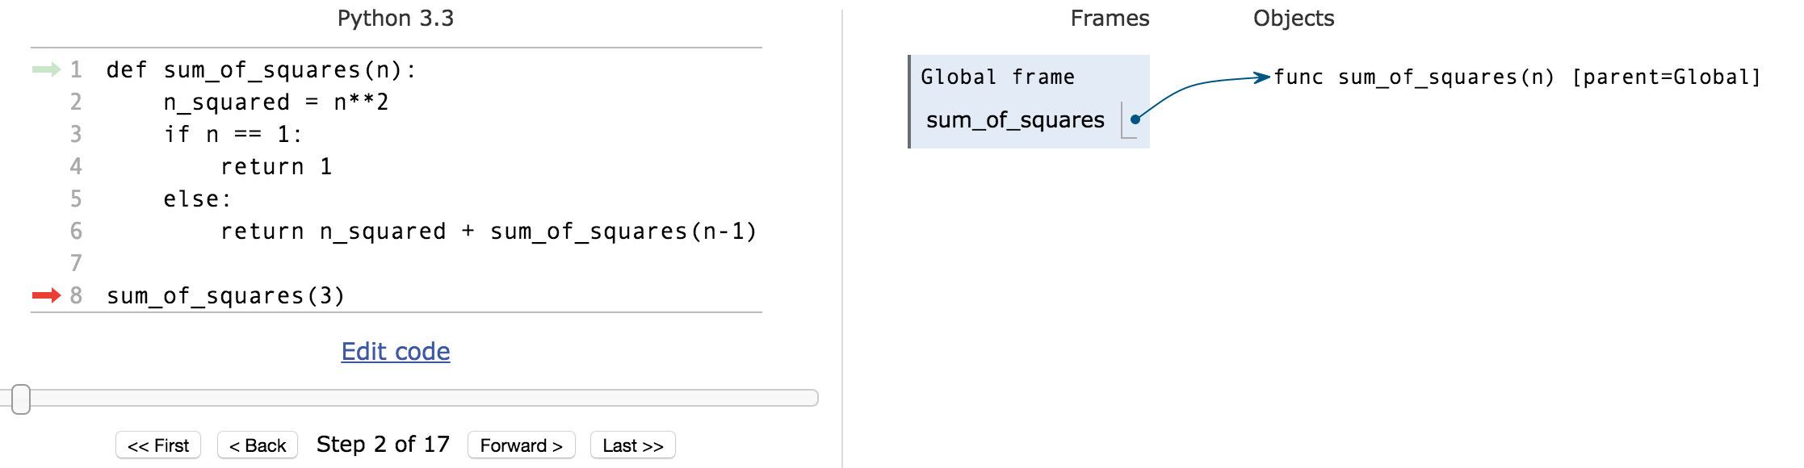
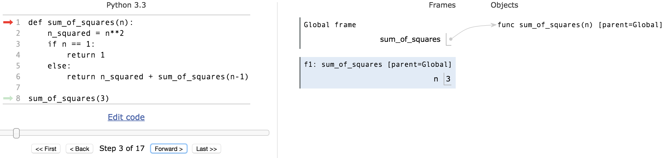
Environments Example
pythontutor.com

Slide 8
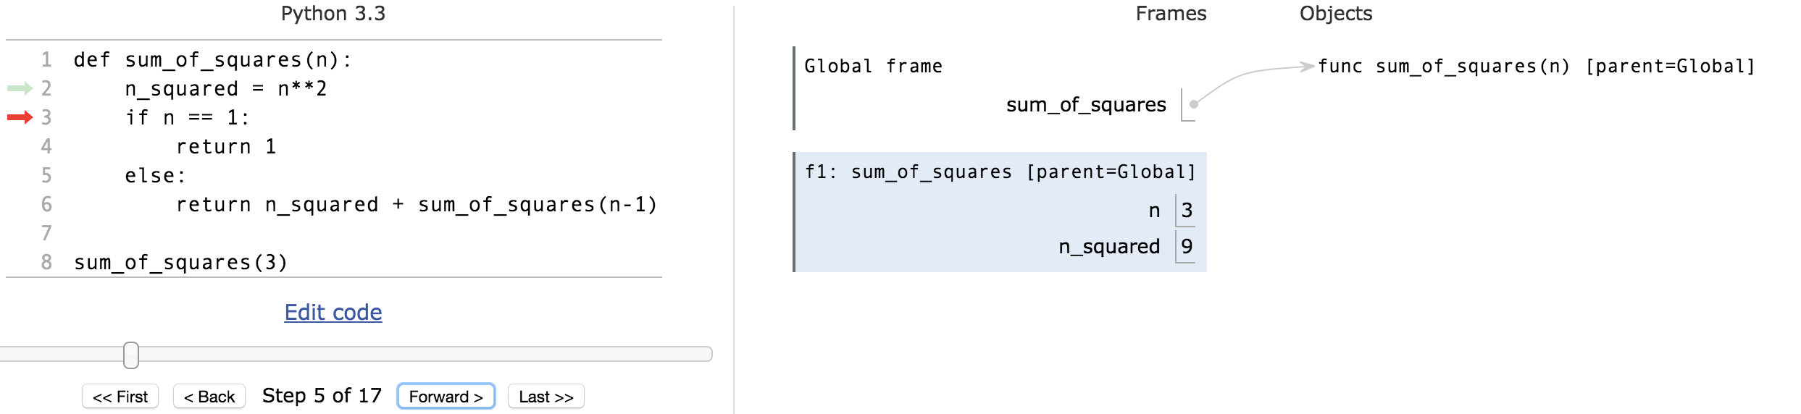
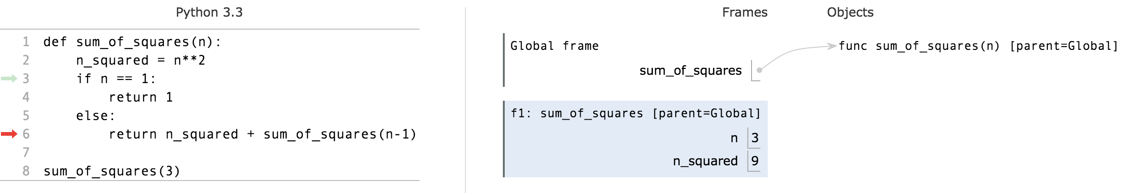
Environments Example

Slide 9
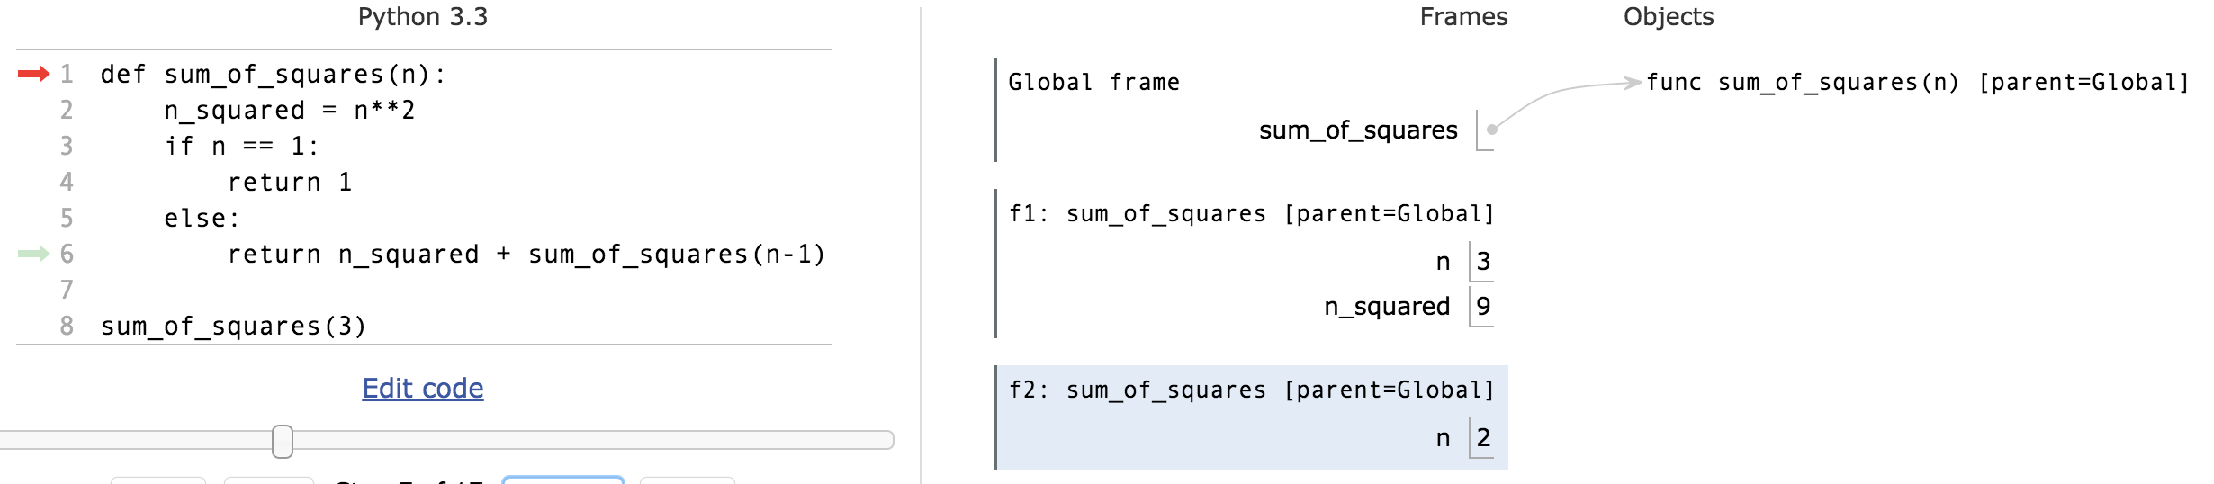
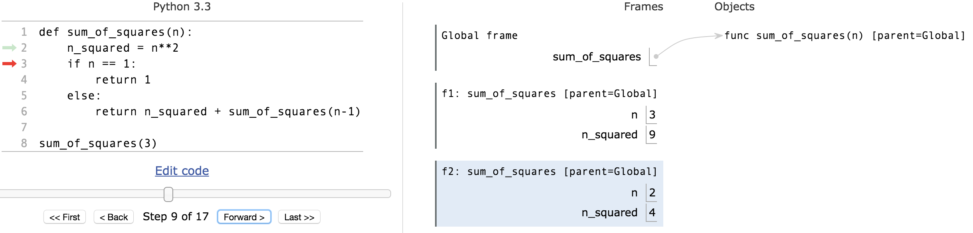
Environments Example

Slide 10
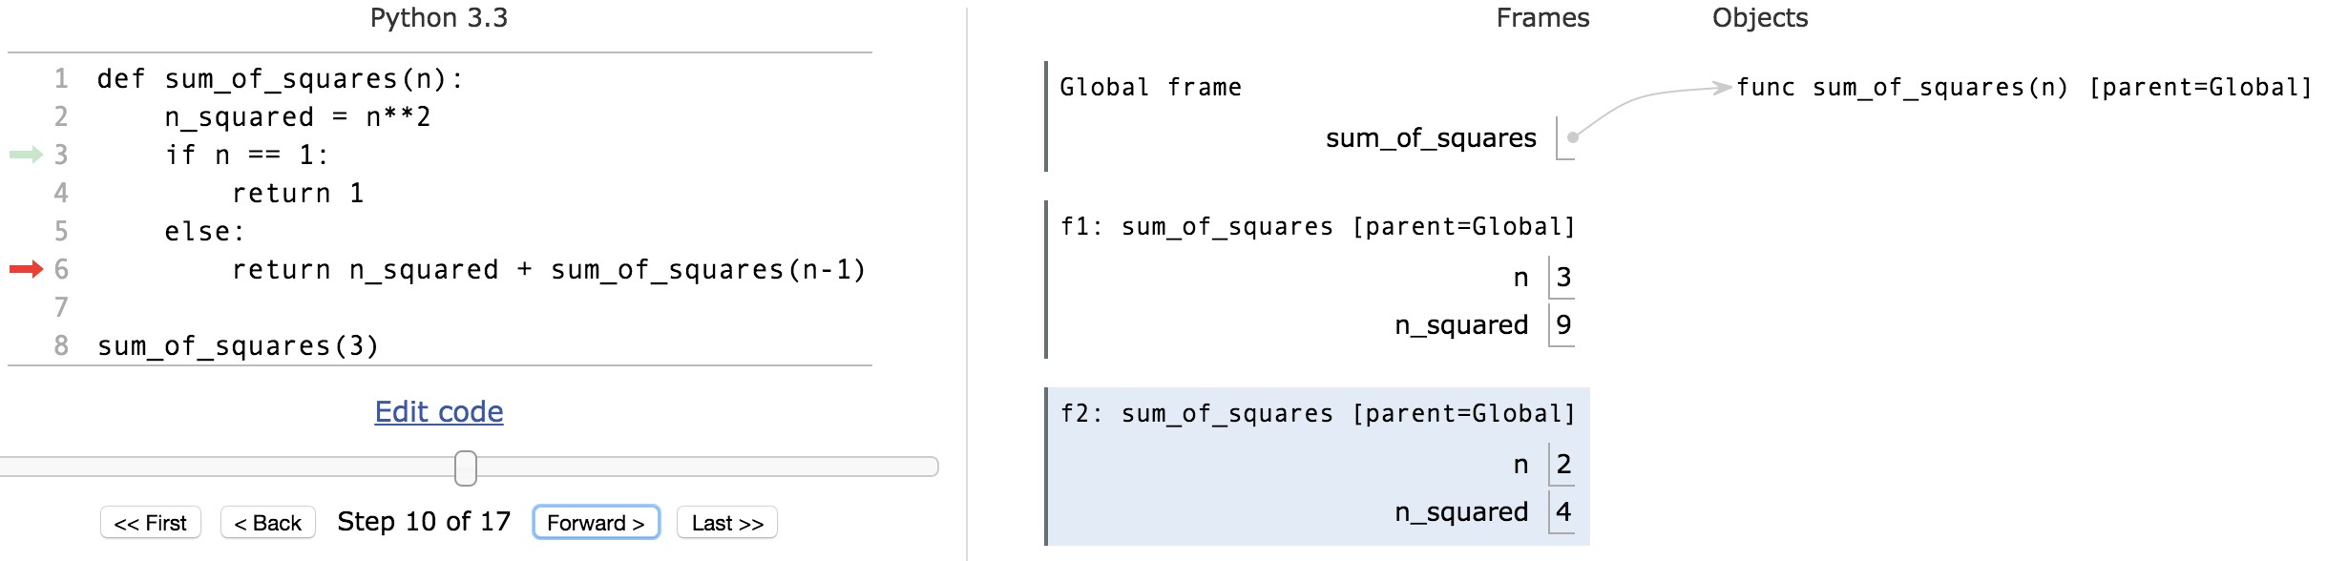
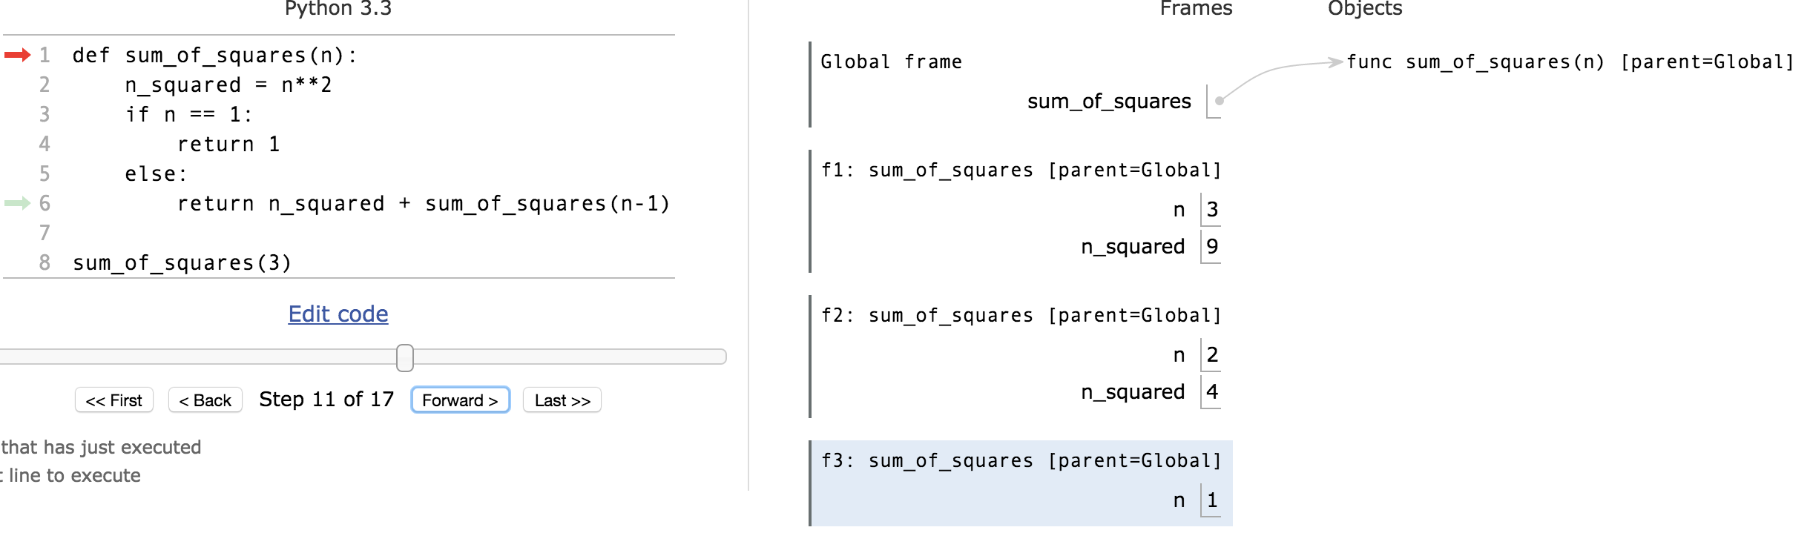
Environments Example

Slide 11
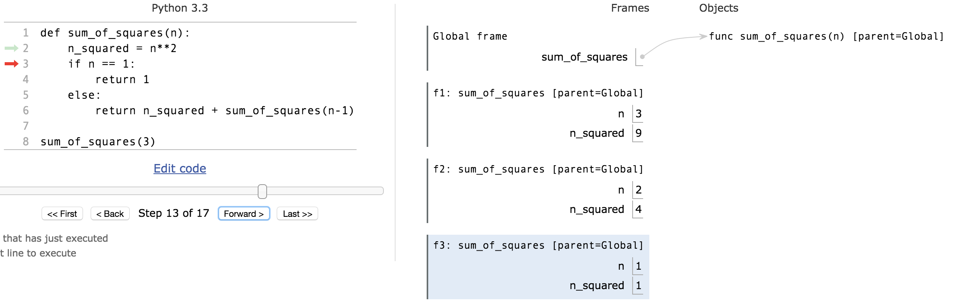
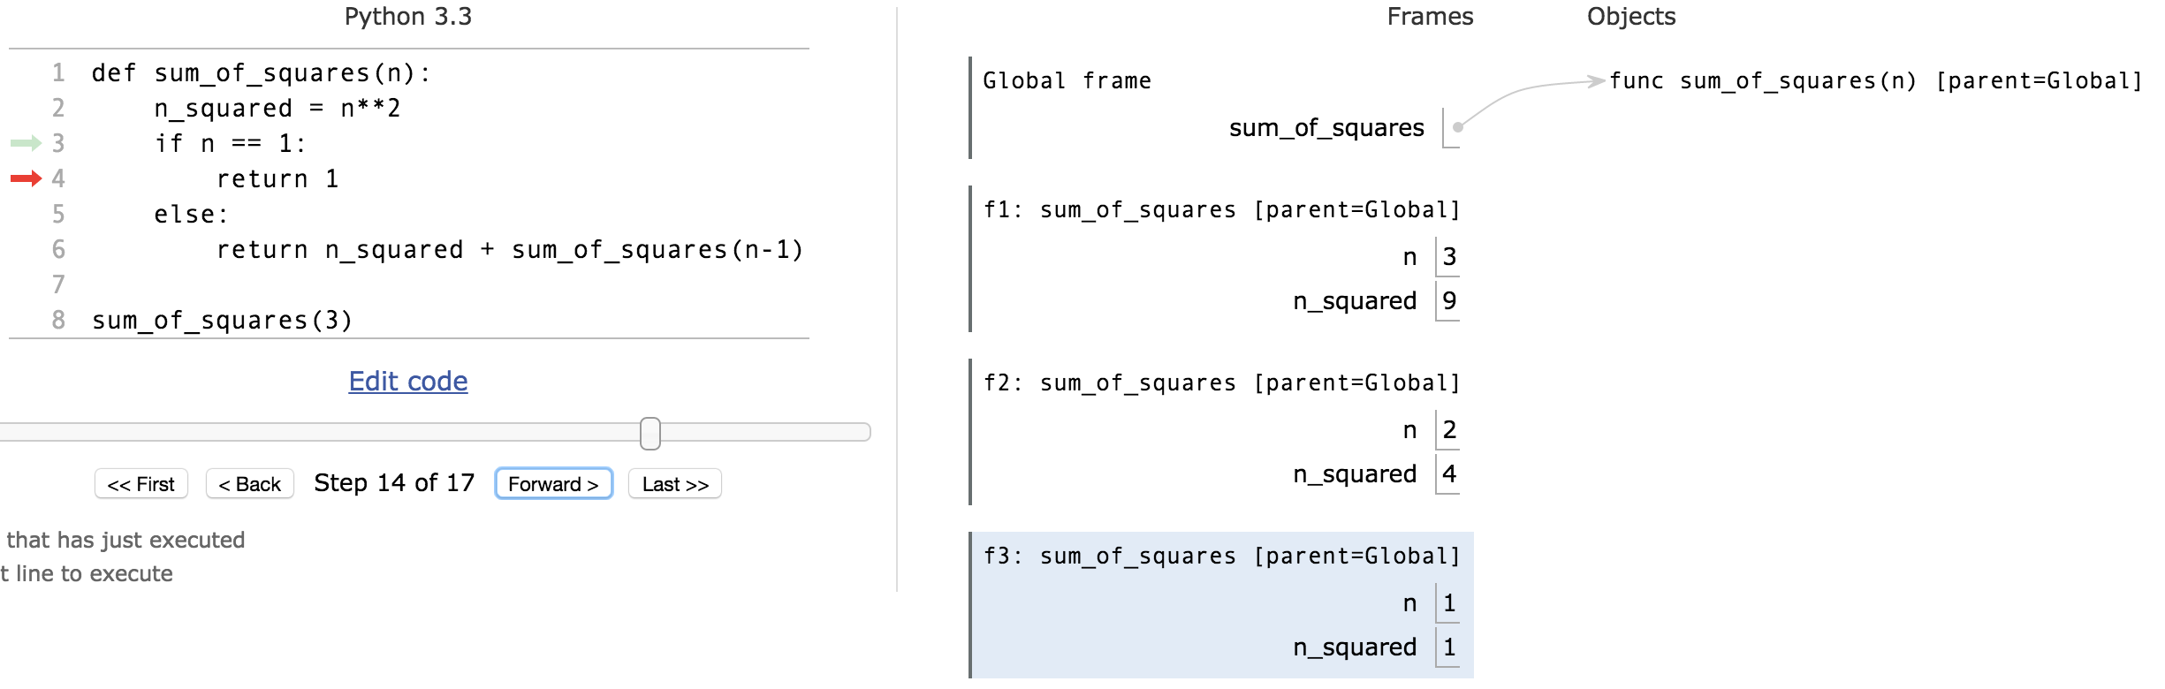
Environments Example
permlink

Slide 12
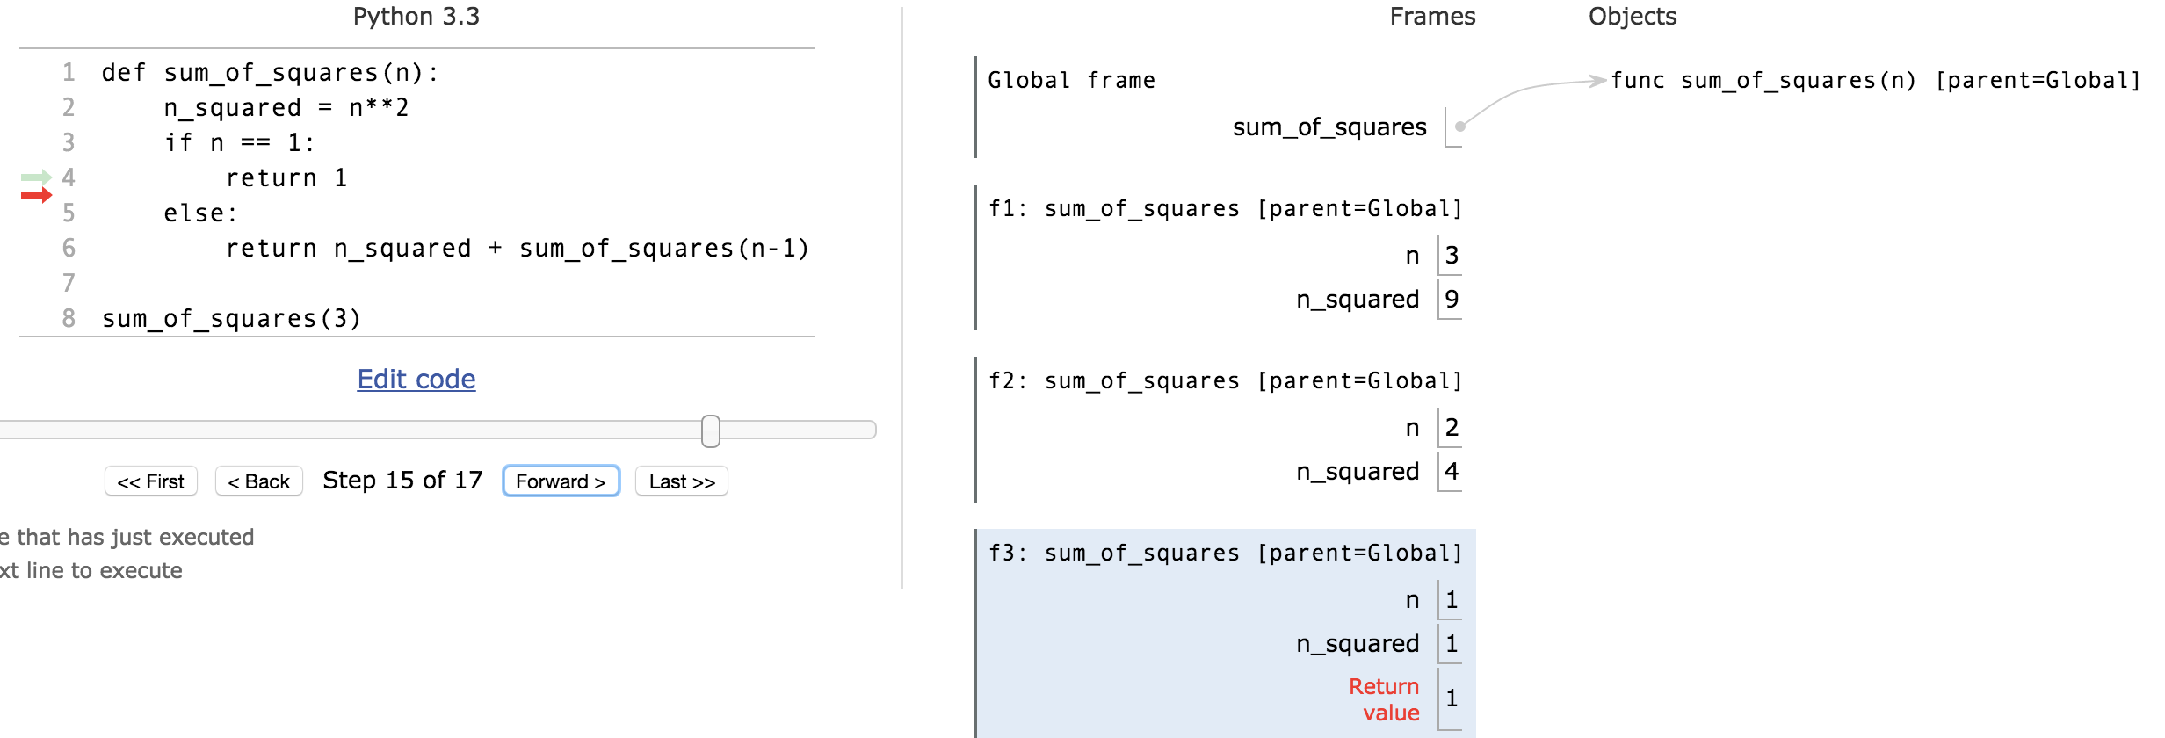
Environments Example

Slide 13
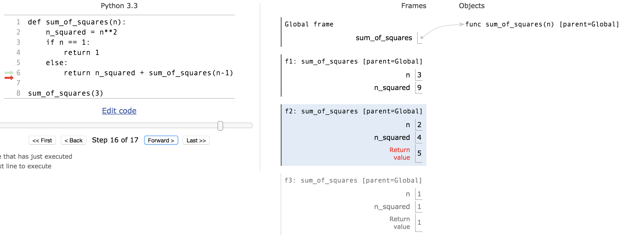
Environments Example

Slide 14
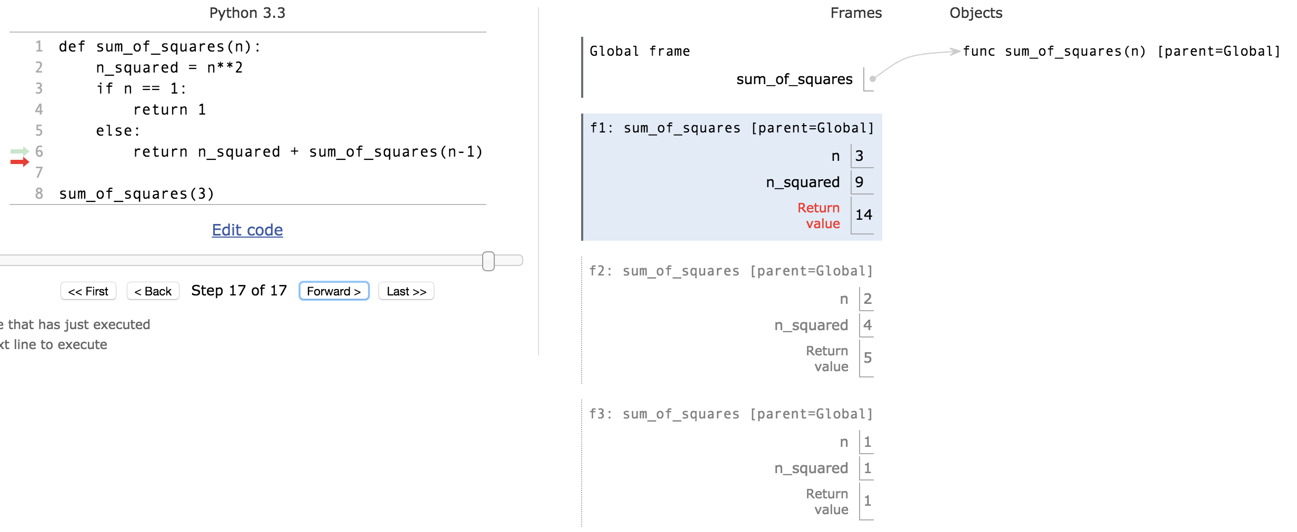
Environments Example

Slide 15
How much ???
Time is required to compute sum_of_squares(n)?
Recursively?
Iteratively ?
Space is required to compute sum_of_squares(n)?
Recursively?
Iteratively ?
Count the frames…
Recursive is linear, iterative is constant!
Linear
proportional to n
cn for some c

Slide 16
Tail Recursion
All the work happens on the way down the recursion
On the way back up, just return
def sum_up_squares(i, n, accum):
"""Sum the squares from i to n in incr. order"""
if i > n:
return accum
else:
return sum_up_squares(i+1, n, accum + i**2)
>>> sum_up_squares(1,3,0)
14
Base Case
Tail Recursive Case

Slide 17
Tree Recursion
Break the problem into multiple smaller sub-problems, and Solve them recursively
def split(x, s):
return [i for i in s if i <= x], [i for i in s if i > x]
def qsort(s):
"""Sort a sequence - split it by the first element,
sort both parts and put them back together."””
if not s:
return []
else:
pivot = first(s)
lessor, more = split(pivot, rest(s))
return qsort(lessor) + [pivot] + qsort(more)
>>> qsort([3,3,1,4,5,4,3,2,1,17])
[1, 1, 2, 3, 3, 3, 4, 4, 5, 17]

Slide 18
QuickSort Example
[3, 3, 1, 4, 5, 4, 3, 2, 1, 17]
[3, 1, 3, 2, 1]
[4, 5, 4, 17]
[1, 3, 2, 1]
[]
[4]
[5, 17]
[1]
[3, 2]
[]
[]
[]
[17]
[]
[]
[2]
[]
[4]
[]
[]
[1]
[]
[]
[5, 17]
[2, 3]
[4, 4, 5, 17]
[1, 1, 2, 3]
[1, 1, 2, 3, 3]
[1, 1, 2, 3, 3, 3, 4, 4, 5, 17]

Slide 19
Tree Recursion with HOF
def qsort(s):
"""Sort a sequence - split it by the first element,
sort both parts and put them back together.""”
if not s:
return []
else:
pivot = first(s)
lessor, more = split_fun(leq_maker(pivot), rest(s))
return qsort(lessor) + [pivot] + qsort(more)
>>> qsort([3,3,1,4,5,4,3,2,1,17])
[1, 1, 2, 3, 3, 3, 4, 4, 5, 17]

Slide 20
On Computer Science Exams
In computer science exams, we try to assess the student’s understanding of concepts and his or her ability to practically apply these.
In CS, we do not:
require extensive memorization (e.g. we allow cheat sheet)
require a lot of reading
require essay writing skills
In CS, we do:
require the ability to translate a given textual problem into programming code
require you to be able to read other people’s code
value solutions that are almost right over no solution
accept solutions we did not think about if they work
prioritize math (logic) and science (experiment) over opinion or authority

Slide 21
How to prepare for a CS exam
Explain the content of the computational concepts toolbox to somebody else
Describe the concept
What is an example of using it?
When does it not work? Corner cases?
Why does it exist?
Practice programming:
Play around with the examples from lecture, lab, homework
Think about your own similar examples
In the exam:
Make sure you understand the question: What is the given input? What is the required output?
Think of easy cases first (e.g. n=1?).
What is the iteration/recursion doing (e.g. i=i+1)?
What are corner cases that need explicit handling (e.g. division by zero, negative numbers, empty list)?

Slide 22
Computational Concepts Toolbox
Data type: values, literals, operations,
e.g., int, float, string
Expressions, Call expression
Variables
Assignment Statement
Sequences: tuple, list
indexing
Data structures
Tuple assignment
Call Expressions
Function Definition Statement
Conditional Statement
Iteration:
data-driven (list comprehension)
control-driven (for statement)
while statement
Higher Order Functions
Functions as Values
Functions with functions as argument
Assignment of function values
Recursion
Environment Diagrams
Notes:
z = 1,2
x,y = 3,4
a,b = z

Slide 23
Answers for the Wandering Mind
The computer choses a random element x of the list generated by range(0,n). What is the smallest amount of iteration/recursion steps the best algorithm needs to guess x?
log₂ n
How would the algorithm look like?
Guess the binary digits of x starting with the highest significant digit. This is, ask questions of the form “smaller than 2^{n-1}?” (yes => 0…), “smaller than 2^{n-2}?” (no => 0 1…), “smaller than 2^{n-2}+2^{n-3}?”, …
This method is also called: binary search
Quantum physics: Allow less than log₂ n guesses.

