Slide 1

Computational Structures in Data Science
Lecture 8:
Mutability
March 18, 2019
http://inst.eecs.berkeley.edu/~cs88

Slide 2

Computational Concepts Toolbox
Data type: values, literals, operations,
Expressions, Call expression
Variables
Assignment Statement
Sequences: tuple, list
Dictionaries
Data structures
Tuple assignment
Function Definition Statement
Conditional Statement
Iteration: list comp, for, while
Lambda function expr.
Higher Order Functions
Functions as Values
Functions with functions as argument
Assignment of function values
Higher order function patterns
Map, Filter, Reduce
Function factories – create and return functions
Recursion
Linear, Tail, Tree
Abstract Data Types: Mutability
Notes:
z = 1,2
x,y = 3,4
a,b = z

Slide 3
Review: C.O.R.E concepts
Perform useful computations treating objects abstractly as whole values and operating on them.
Compute
Operations
Provide operations on the abstract components that allow ease of use – independent of concrete representation.
Abstract Data Type
Representation
Constructors and selectors that provide an abstract interface to a concrete representation
Evaluation
Execution on a computing machine
application
Abstraction Barrier
adt operations
adt representation

Slide 4
Review: Creating an Abtract Data Type
Operations
Express the behavior of objects, invariants, etc
Implemented (abstractly) in terms of Constructors and Selectors for the object
Representation
Constructors & Selectors
Implement the structure of the object
An abstraction barrier violation occurs when a part of the program that can use the higher level functions uses lower level ones instead
At either layer of abstraction
Abstraction barriers make programs easier to get right, maintain, and modify
Few changes when representation changes

Slide 5
Dictionaries – by example
Constructors:
dict( hi=32, lo=17)
dict([('hi',212),('lo',32),(17,3)])
{'x':1, 'y':2, 3:4}
{wd:len(wd) for wd in "The quick brown fox".split()}
Selectors:
water[‘lo’]
<dict>.keys(), .items(), .values()
<dict>.get(key [, default] )
Operations:
in, not in, len, min, max
‘lo’ in water
Mutators
water[ ‘lo’ ] = 33

Slide 6
Objects
An Abstract Data Type consist of data and behavior bundled together to abstract a view on the data
An object is a concrete instance of an abstract data type.
Objects can have state
mutable vs immutable
Next lectures: Object-oriented programming
A methodology for organizing large programs
So important it is supported in the language (classes)
In Python, every value is an object
All objects have attributes
Manipulation happens through methods
Functions do one thing (well)
Object do a collection of related things with respect to certain types of data

Slide 7
Mutability
Immutable – the value of the object cannot be changed
integers, floats, booleans
strings, tuples
Mutable – the value of the object can …
Lists
Dictionaries
>>> adict = {'a':1, 'b':2}
>>> adict
{'b': 2, 'a': 1}
>>> adict['b']
2
>>> adict['b'] = 42
>>> adict['c'] = 'elephant'
>>> adict
{'b': 42, 'c': 'elephant', 'a': 1}
>>> alist = [1,2,3,4]
>>> alist
[1, 2, 3, 4]
>>> alist[2]
3
>>> alist[2] = 'elephant'
>>> alist
[1, 2, 'elephant', 4]

Slide 8
From value to storage …
A variable assigned a compound value (object) is a reference to that object.
Mutable object can be changed but the variable(s) still refer to it
x = [1, 2, 3]
y = 6
x[1] = y
x[1]
frame
1
•
2
6
•
3
•
x:
•
y:
6
…

Slide 9
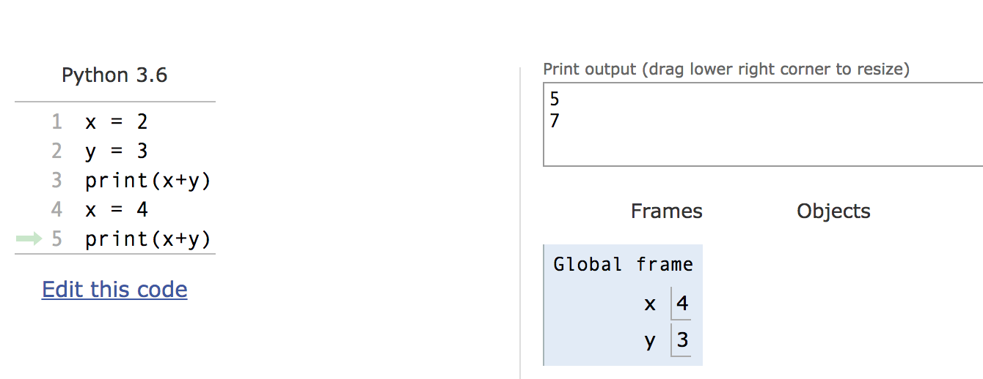
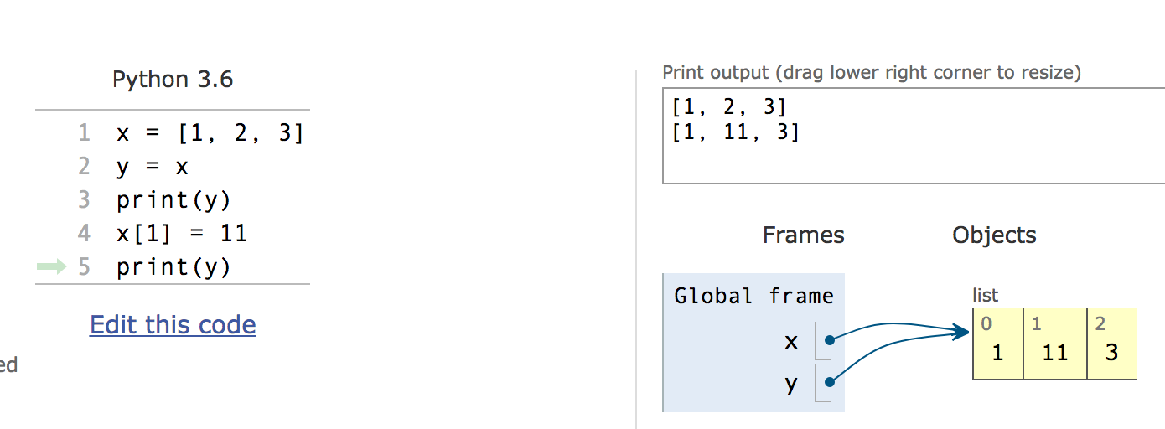
Mutation makes sharing visible

Slide 10
Sharing
Global frame
grid:
•
•
•
•
•
•
•
•
•
…
0
•
0
•
0
1
•
0
•

Slide 11
Copies, ‘is’ and ‘==‘
>>> alist = [1, 2, 3, 4]
>>> alist == [1, 2, 3, 4] # Equal values?
True
>>> alist is [1, 2, 3, 4] # same object?
False
>>> blist = alist # assignment refers
>>> alist is blist # to same object
True
>>> blist = list(alist) # type constructors copy
>>> blist is alist
False
>>> blist = alist[ : ] # so does slicing
>>> blist is alist
False
>>> blist
[1, 2, 3, 4]
>>>

Slide 12
Are these ‘mutations’ ?
def sum(seq):
psum = 0
for x in seq:
psum = psum + x
return psum
def reverse(seq):
rev = []
for x in seq:
rev = [x] + rev
return rev
A) Yes, both B) Only sum C) Only reverse D) None of them
Solution: D) No change of seq

Slide 13
Creating mutating ‘functions’
Pure functions have referential transparency
Result value depends only on the inputs
Same inputs, same result value
Functions that use global variables are not pure
Higher order function returns embody state
They can be “mutating”
>>> counter = -1
>>> def count_fun():
... global counter
... counter += 1
... return counter
...
>>> count_fun()
0
>>> count_fun()
1

Slide 14
Creating mutating ‘functions’
>>> counter = -1
>>> def count_fun():
... global counter
... counter += 1
... return counter
...
>>> count_fun()
0
>>> count_fun()
1
>>> def make_counter():
... counter = -1
... def counts():
... nonlocal counter
... counter +=1
... return counter
... return counts
...
>>> count_fun = make_counter()
>>> count_fun()
0
>>> count_fun()
1
>>> nother_one = make_counter()
>>> nother_one()
0
>>> count_fun()
2
How do I make a second counter?

Slide 15
Creating mutable objects
Follow the ADT methodology, enclosing state within the abstraction

Slide 16
Useless bank account
def account(name, initial_deposit):
return (name, initial_deposit)
def account_name(acct):
return acct[0]
def account_balance(acct):
return acct[1]
def deposit(acct, amount):
return (acct[0], acct[1]+amount)
def withdraw(acct, amount):
return (acct[0], acct[1]-amount)
>>> my_acct = account('David Culler', 175)
>>> my_acct
('David Culler', 175)
>>> deposit(my_acct, 35)
('David Culler', 210)
>>> account_balance(my_acct)
175

Slide 17
Bank account using dict
def account(name, initial_deposit):
return {'Name' : name, 'Number': 0,
'Balance' : initial_deposit}
def account_name(acct):
return acct['Name']
def account_balance(acct):
return acct['Balance']
def deposit(acct, amount):
acct['Balance'] += amount
return acct['Balance']
def withdraw(acct, amount):
acct['Balance'] -= amount
return acct['Balance']
>>> my_acct = account('David Culler', 93)
>>> account_balance(my_acct)
93
>>> deposit(my_acct, 100)
193
>>> account_balance(my_acct)
193
>>> withdraw(my_acct, 10)
183
>>> account_balance(my_acct)
183
>>> your_acct = account("Fred Jones",0)
>>> deposit(your_acct, 75)
75
>>> account_balance(my_acct)
183

Slide 18
State for a class of objects
account_number_seed = 1000
def account(name, initial_deposit):
global account_number_seed
account_number_seed += 1
return {'Name' : name, 'Number': account_number_seed,
'Balance' : initial_deposit}
def account_name(acct):
return acct['Name']
def account_balance(acct):
return acct['Balance']
def account_number(acct):
return acct['Number']
def deposit(acct, amount):
acct['Balance'] += amount
return acct['Balance']
def withdraw(acct, amount):
acct['Balance'] -= amount
return acct['Balance']
>>> my_acct = account('David Culler', 100)
>>> my_acct
{'Name': 'David Culler', 'Balance': 100, 'Number': 1001}
>>> account_number(my_acct)
1001
>>> your_acct = account("Fred Jones", 475)
>>> account_number(your_acct)
1002
>>>

Slide 19
Hiding the object inside
account_number_seed = 1000
accounts = []
def account(name, initial_deposit):
global account_number_seed
global accounts
account_number_seed += 1
new_account = {'Name' : name, 'Number': account_number_seed,
'Balance' : initial_deposit}
accounts.append(new_account)
return len(accounts)-1
def account_name(acct):
return accounts[acct]['Name’]
. . .
def deposit(acct, amount):
account = accounts[acct]
account['Balance'] += amount
return account['Balance']
def account_by_number(number):
for account, index in zip(accounts,range(len(accounts))):
if account['Number'] == number:
return index
return -1

Slide 20
Hiding the object inside
>>> my_acct = account('David Culler', 100)
>>> my_acct
0
>>> account_number(my_acct)
1001
>>> your_acct = account("Fred Jones", 475)
>>> accounts
[{'Name': 'David Culler', 'Balance': 100, 'Number': 1001}, {'Name': 'Fred Jones', 'Balance': 475, 'Number': 1002}]
>>> account_by_number(1001)
0
>>> account_name(account_by_number(1001))
'David Culler’
>>> your_acct
1
>>> account_name(your_acct)
'Fred Jones'
>>>

Slide 21
Hazard Beware
def remove_account(acct):
global accounts
accounts = accounts[0:acct] + accounts[acct+1:]
>>> my_acct = account('David Culler', 100)
>>> your_acct = account("Fred Jones", 475)
>>> nother_acct = account("Wilma Flintstone", 999)
>>> account_name(your_acct)
'Fred Jones'
>>> remove_account(my_acct)
>>> account_name(your_acct)
'Wilma Flintstone'
>>>

Slide 22
A better way …
account_number_seed = 1000
accounts = []
def account(name, initial_deposit):
global account_number_seed
global accounts
account_number_seed += 1
new_account = {'Name' : name, 'Number': account_number_seed,
'Balance' : initial_deposit}
accounts.append(new_account)
return account_number_seed
def _get_account(number):
for account in accounts:
if account['Number'] == number:
return account
return None
def account_name(acct):
return _get_account(acct)['Name']
. . .

Slide 23
A better way …
account_number_seed = 1000
accounts = []
def account(name, initial_deposit):
global account_number_seed
global accounts
account_number_seed += 1
new_account = {'Name' : name, 'Number': account_number_seed,
'Balance' : initial_deposit}
accounts.append(new_account)
return account_number_seed
def _get_account(number):
for account in accounts:
if account['Number'] == number:
return account
return None
def account_name(acct):
return _get_account(acct)['Name']
. . .
>>> my_acct = account('David Culler', 100)
>>> your_acct = account("Fred Jones", 475)
>>> nother_acct = account("Wilma Flintstone", 999)
>>> account_name(your_acct)
'Fred Jones'
>>> remove_account(my_acct)
>>> account_name(your_acct)
'Fred Jones’
>>> your_acct
1002

Slide 24
Solutions for the Wandering Mind
Consider the following simple Python code:
x = input("Enter a number between 0 and 1:")
for i in range(10):
x=-x**2+4*x
print x
Run the program…
Input: 0.5 Output: 1.534…
Input: 0.51 Output: 0.007…
Input: 0.511 Output: 0.688…
Input: 0.512 Output: 2.103…
Input: 0.5109 Output: 0.577…
Small changes in the input: Large changes in the output! (butterfly effect)

Slide 25
Solutions for the Wandering Mind
Plot the function implemented by the code.
Could you predict using sampling (e.g., interpolate from the results of inputs 0, 0.25, 0.5, 0.75, 1)?
No. The program is not predictable in the input variable.
Could you predict using calculus (e.g., using the derivative of f(x)=-x²+4x)?
No. Recursive application of f changes it to chaotic behavior.
Could a neural network learn the function, given enough (input, output) tuples as training data?
Unlikely. A 10-layer deep network can be shown to be able to represent the function but is unlikely to learn using current methods due to reliance on calculus for neural network training.

Slide 26
Thoughts for the Wandering Mind
Consider the following Python3 code:
_='_=%r;print _(%%)_';print _(%)_
What does it do?
Can you find other ways to do the same?

