Slide 1

Computational Structures in Data Science
UC Berkeley EECS Adj. Ass. Prof. Dr. Gerald Friedland
Lecture #12: SQL
April 22nd, 2019
http://inst.eecs.berkeley.edu/~cs88

Slide 2
Btw. CNN criticizing my work…
https://www.cnn.com/2019/04/19/tech/ai-facial-recognition/index.html
Notes:
http://datahub.berkeley.edu/user-redirect/interact?account=data-8&repo=cs-connector&branch=gh-pages&path=SQL

Slide 3
Question
Next lecture…
A) Q&A Session B) Fun Lecture C) Review Lecture D) All of the above

Slide 4
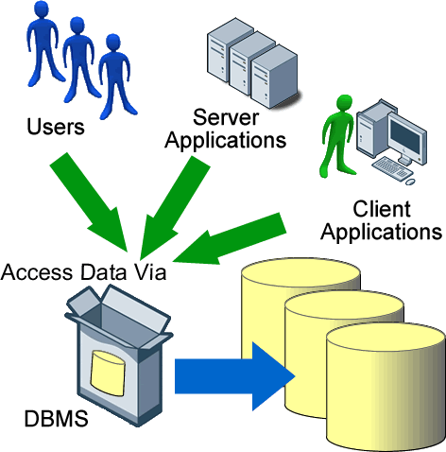
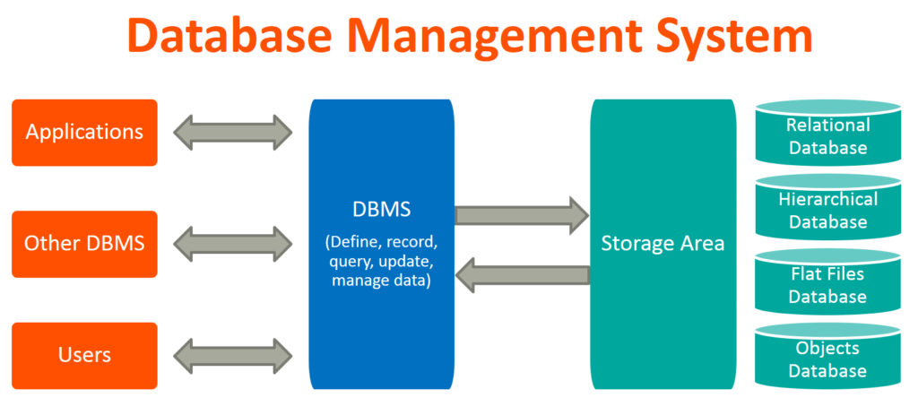
Database Management Systems

Slide 5
App in program language issues queries to a database interpreter
User
Application
Classes & Objects
Database Query Processor,
i.e., Interpreter
Response
Tables
Python Interpreter
SQL query
The SQL language is represented in query strings delivered to a DB backend.
Use the techniques learned here to build clean abstractions.
You have already learned the relational operators!

Slide 6


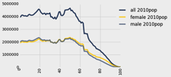
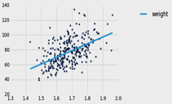
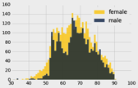
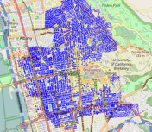
Data 8 Tables
ordered collection of labeled columns of anything
label
select, where, take, drop, group
stats, bin
sample
dict, record,tuple
pivot, pivot_bin
values
split
join
Numpy array
T[‘label’]
A single, simple, powerful data structure for all
Inspired by Excel, SQL, R, Pandas, Numpy, …

Slide 7
Database Management Systems
DBMS are persistent tables with powerful relational operators
Important, heavily used, interesting!
A table is a collection of records, which are rows that have a value for each column
Structure Query Language (SQL) is a declarative programming language describing operations on tables
column has a name and a type
row has a value for each column
Name | Latitude | Longitude
Berkeley | 38 | 122
Cambridge | 42 | 71
Minneapolis | 45 | 93
table has columns and rows

Slide 8
SQL
A declarative language
Described what to compute
Imperative languages, like python, describe how to compute it
Query processor (interpreter) chooses which of many equivalent query plans to execute to perform the SQL statements
ANSI and ISO standard, but many variants
select statement creates a new table, either from scratch or by projecting a table
create table statement gives a global name to a table
Lots of other statements
analyze, delete, explain, insert, replace, update, …
The action is in select

Slide 9
SQL example
SQL statements create tables
Give it a try with sqlite3 or http://kripken.github.io/sql.js/GUI/
Each statement ends with ‘;’
culler$ sqlite3
SQLite version 3.9.2 2015-11-02 18:31:45
Enter ".help" for usage hints.
Connected to a transient in-memory database.
Use ".open FILENAME" to reopen on a persistent database.
sqlite> select 38 as latitude, 122 as longitude, "Berkeley" as name;
38|122|Berkeley
sqlite>

Slide 10
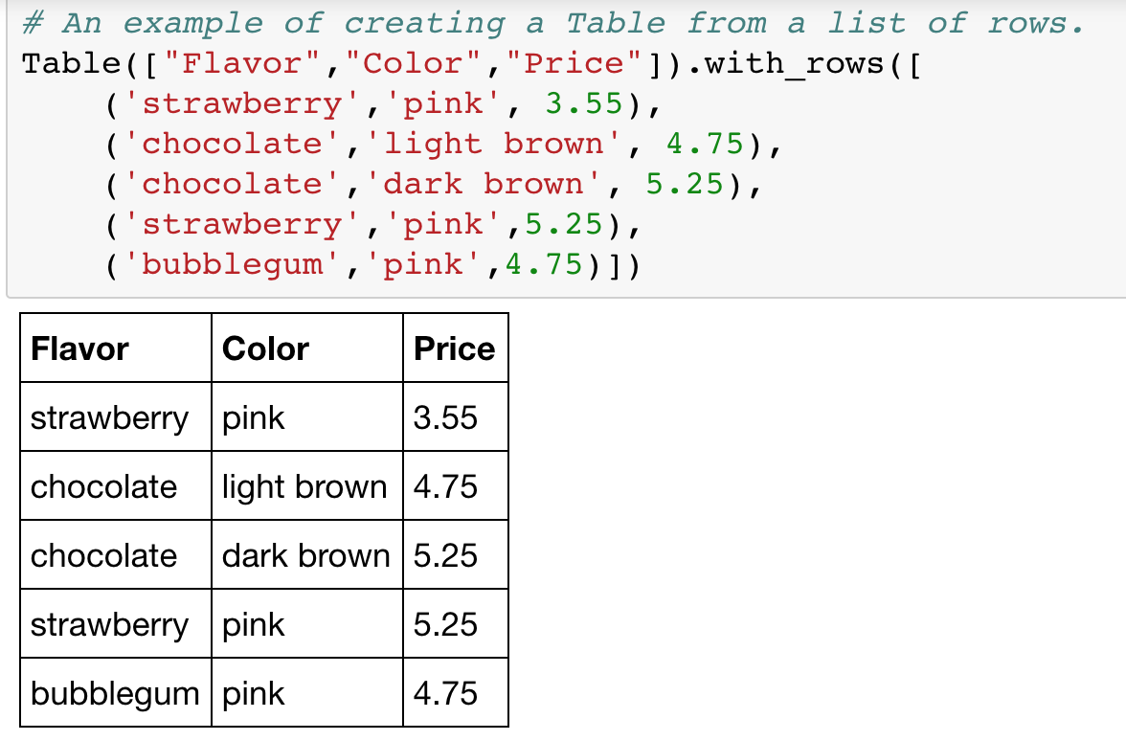

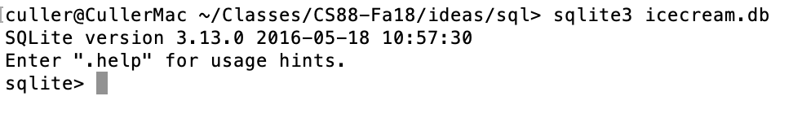
A Running example from Data 8 Lec 10

Slide 11
select
Comma-separated list of column descriptions
Column description is an expression, optionally followed by as and a column name
Selecting literals creates a one-row table
union of select statements is a table containing the union of the rows
select [expression] as [name], [expression] as [name]; . . .
select "strawberry" as Flavor, "pink" as Color, 3.55 as Price;
select "strawberry" as Flavor, "pink" as Color, 3.55 as Price union
select "chocolate","light brown", 4.75 union
select "chocolate","dark brown", 5.25 union
select "strawberry","pink",5.25 union
select "bubblegum","pink",4.75;

Slide 12
create table
SQL often used interactively
Result of select displayed to the user, but not stored
Create table statement gives the result a name
Like a variable, but for a permanent object
create table [name] as [select statement];

Slide 13
SQL: creating a named table
create table cones as
select 1 as ID, "strawberry" as Flavor, "pink" as Color, 3.55 as Price union
select 2, "chocolate","light brown", 4.75 union
select 3, "chocolate","dark brown", 5.25 union
select 4, "strawberry","pink",5.25 union
select 5, "bubblegum","pink",4.75 union
select 6, "chocolate", "dark brown", 5.25;
Notice how column names are introduced and implicit later on.

Slide 14
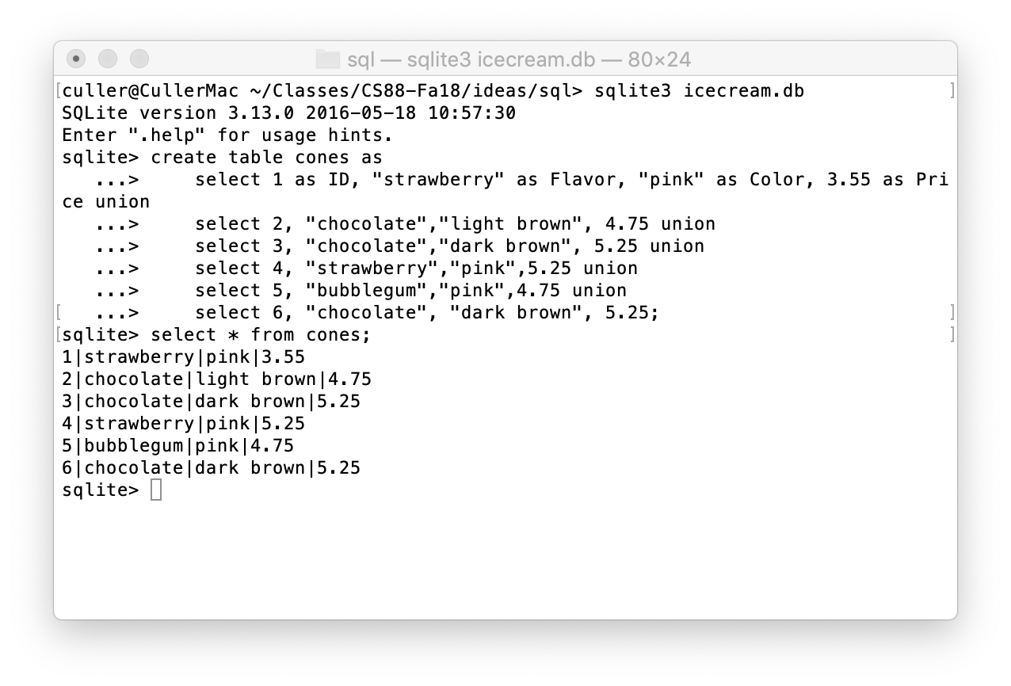
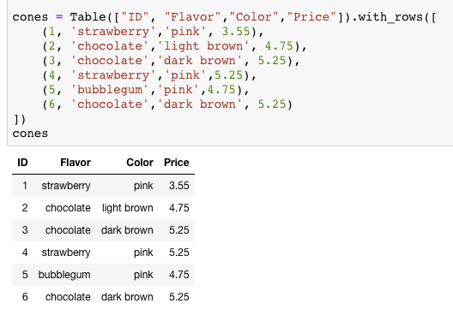
Select …

Slide 15
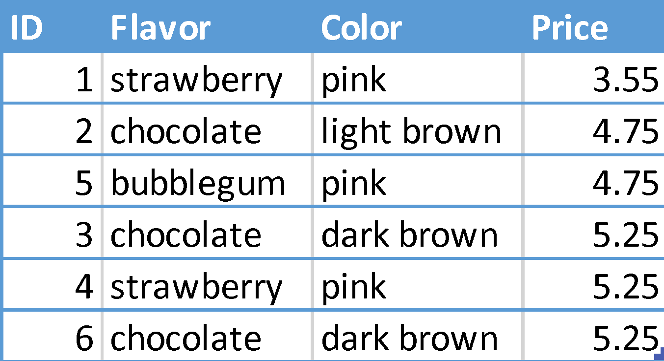
Projecting existing tables
Input table specified by from clause
Subset of rows selected using a where clause
Ordering of the selected rows declared using an order by clause
select [columns] from [table] where [condition] order by [order] ;
select * from cones order by Price;

Slide 16
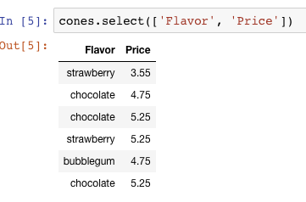
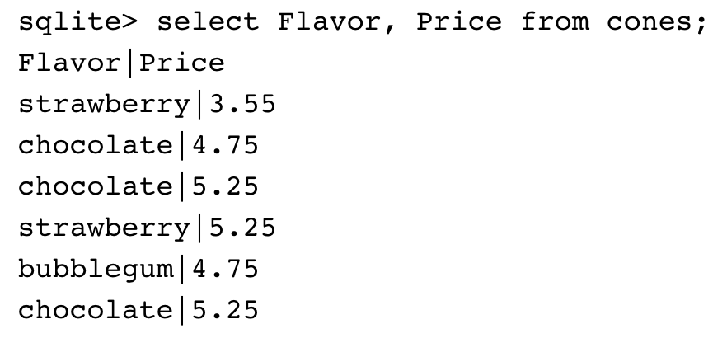
Projection
Select versus indexing a column?

Slide 17
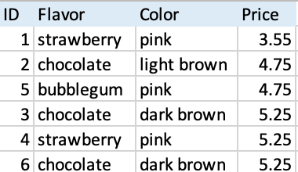
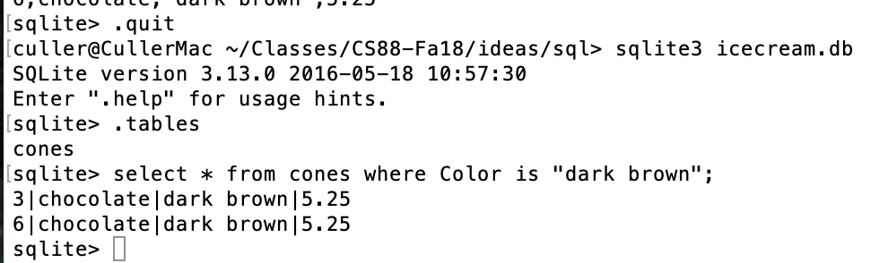
Permanent Data Storage

Slide 18
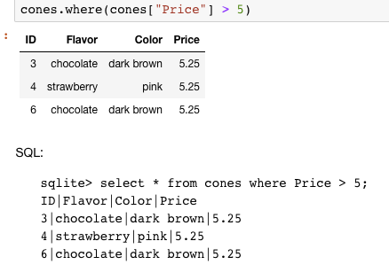
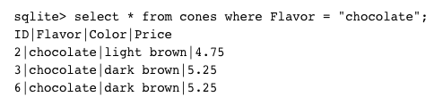
Filtering rows - where
Set of Table records (rows) that satisfy a condition
select [columns] from [table] where [condition] order by [order] ;

Slide 19
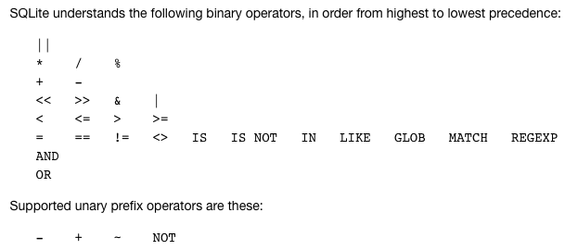
SQL Operators for predicate
use the WHERE clause in the SQL statements such as SELECT, UPDATE and DELETE to filter rows that do not meet a specified condition

Slide 20
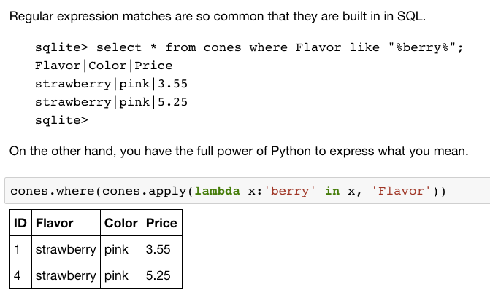
Approximate Matching …

Slide 21
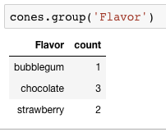
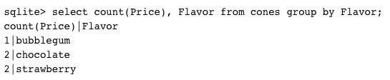
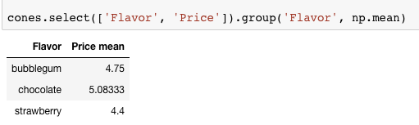
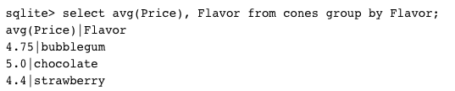
Group and Aggregate
The GROUP BY clause is used to group rows returned by SELECT statement into a set of summary rows or groups based on values of columns or expressions.
Apply an aggregate function, such as SUM, AVG, MIN, MAX or COUNT, to each group to output the summary information.

Slide 22
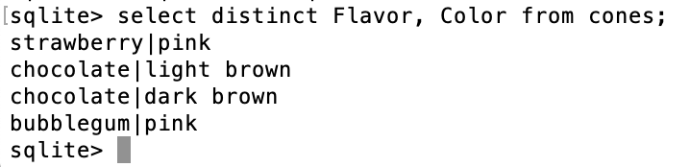
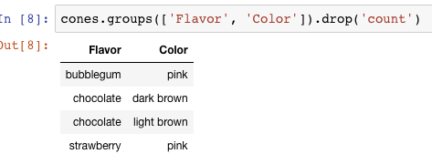

Unique / Distinct values
select DISTINCT [columns] from [table] where [condition] order by [order] ;
Built in to the language or a composable tool?

Slide 23
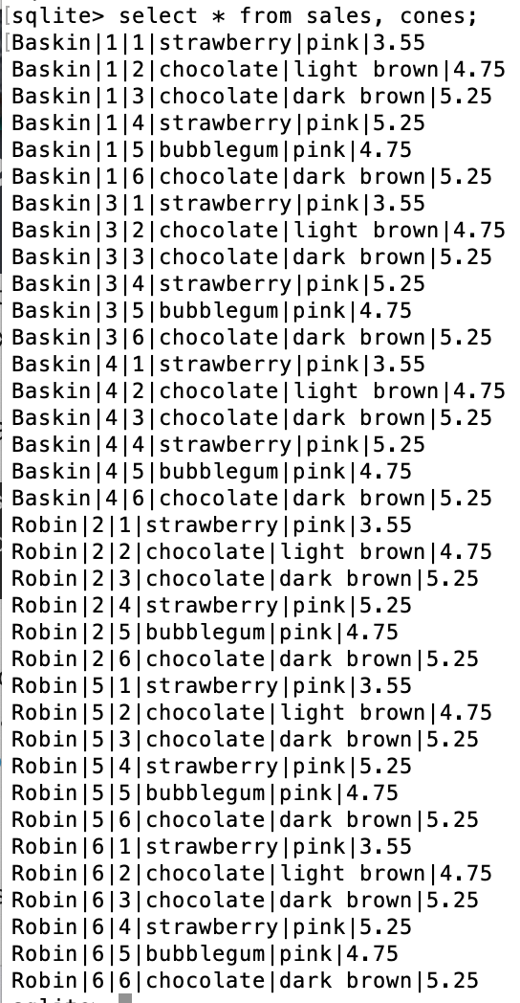
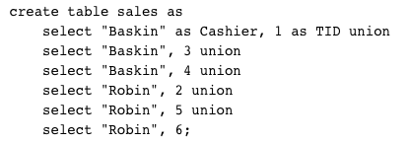
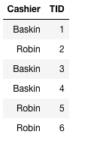
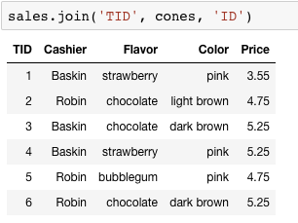
Joining tables
Two tables are joined by a comma to yield all combinations of a row from each
select * from sales, cones;

Slide 24
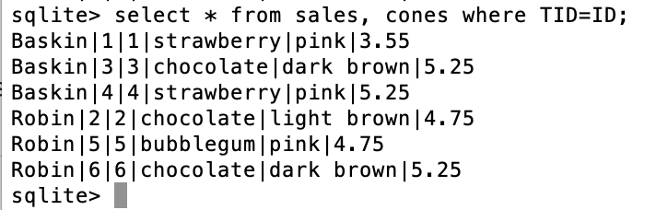
Inner Join
select * from sales, cones where TID=ID;

Slide 25
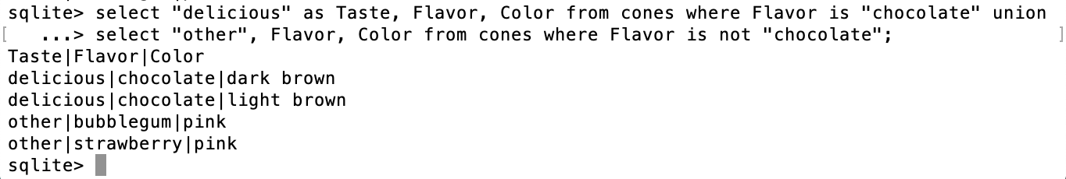
SQL: using named tables - from
select "delicious" as Taste, Flavor, Color from cones
where Flavor is "chocolate" union
select "other", Flavor, Color from cones
where Flavor is not "chocolate";

Slide 26
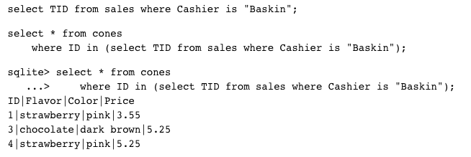
Queries within queries
Any place that a table is named within a select statement, a table could be computed
As a sub-query

Slide 27
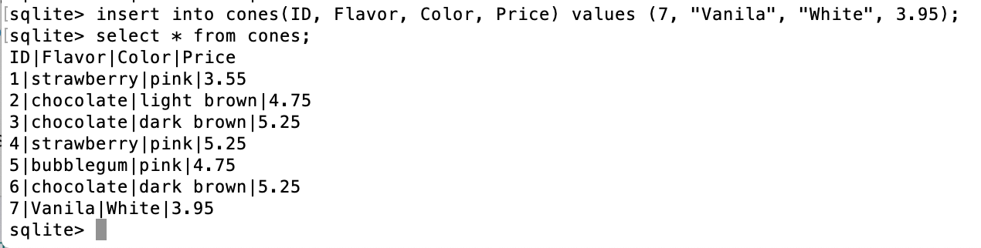
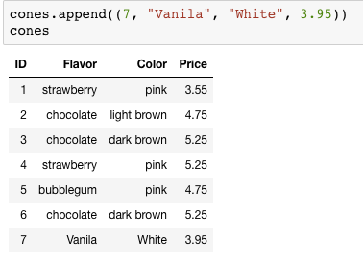
Inserting new records (rows)
INSERT INTO table(column1, column2,...)
VALUES (value1, value2,...);
A database table is typically a shared, durable repository shared by multiple applications

Slide 28
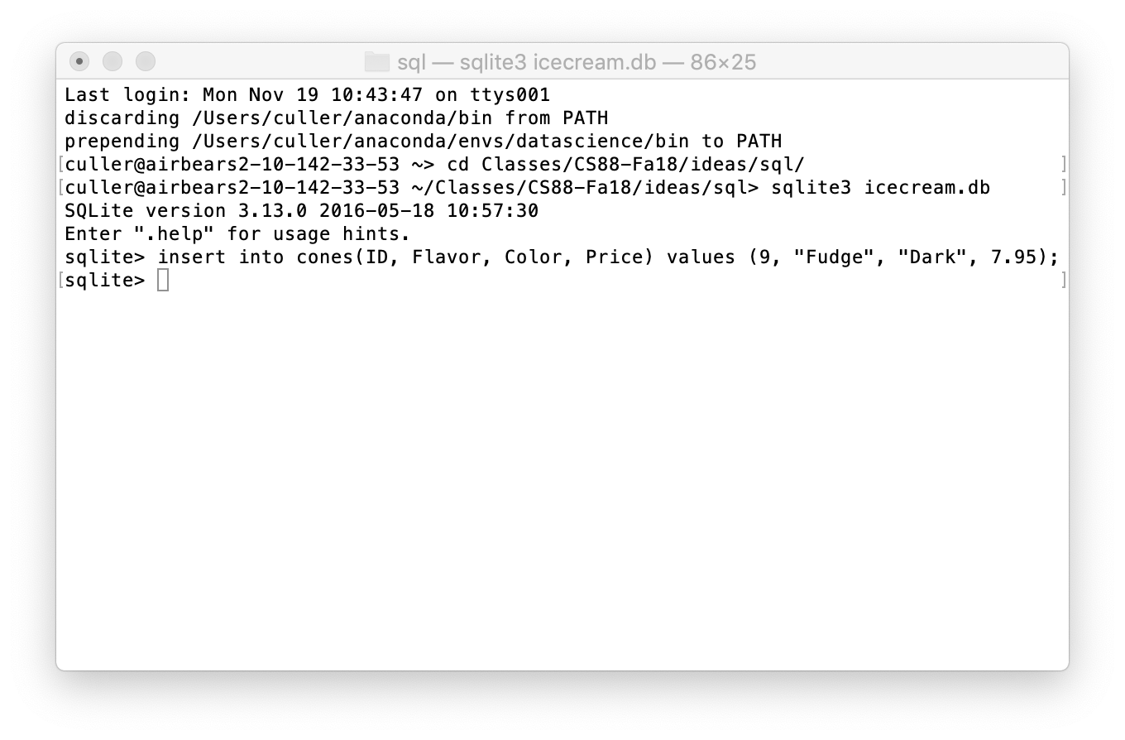
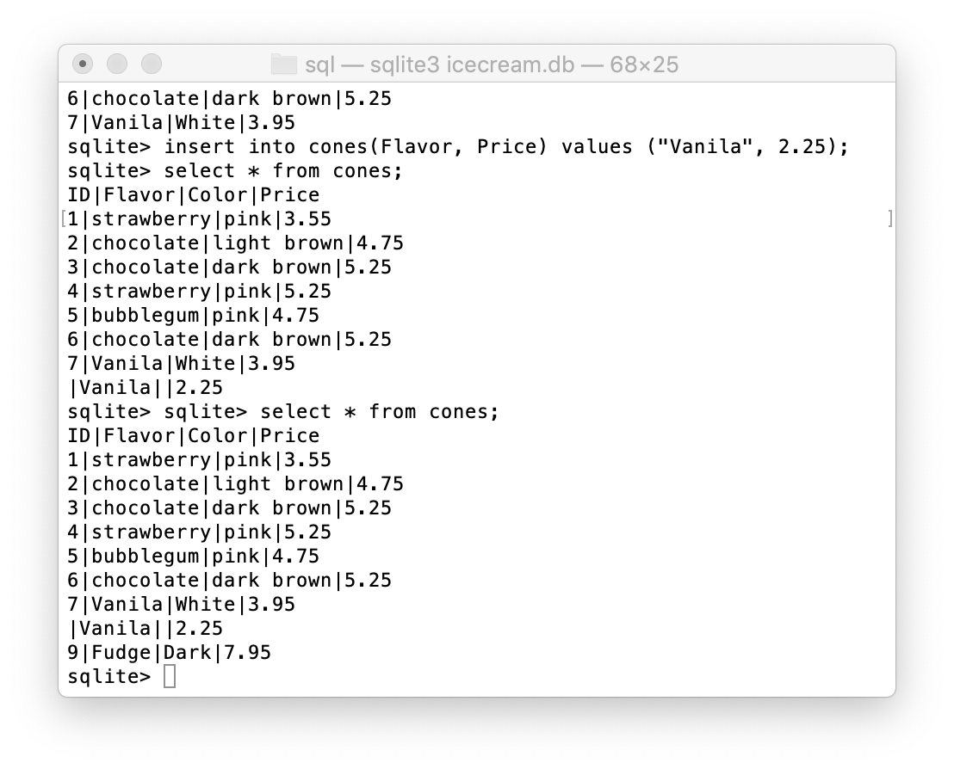
Multiple clients of the database
All of the inserts update the common repository

Slide 29
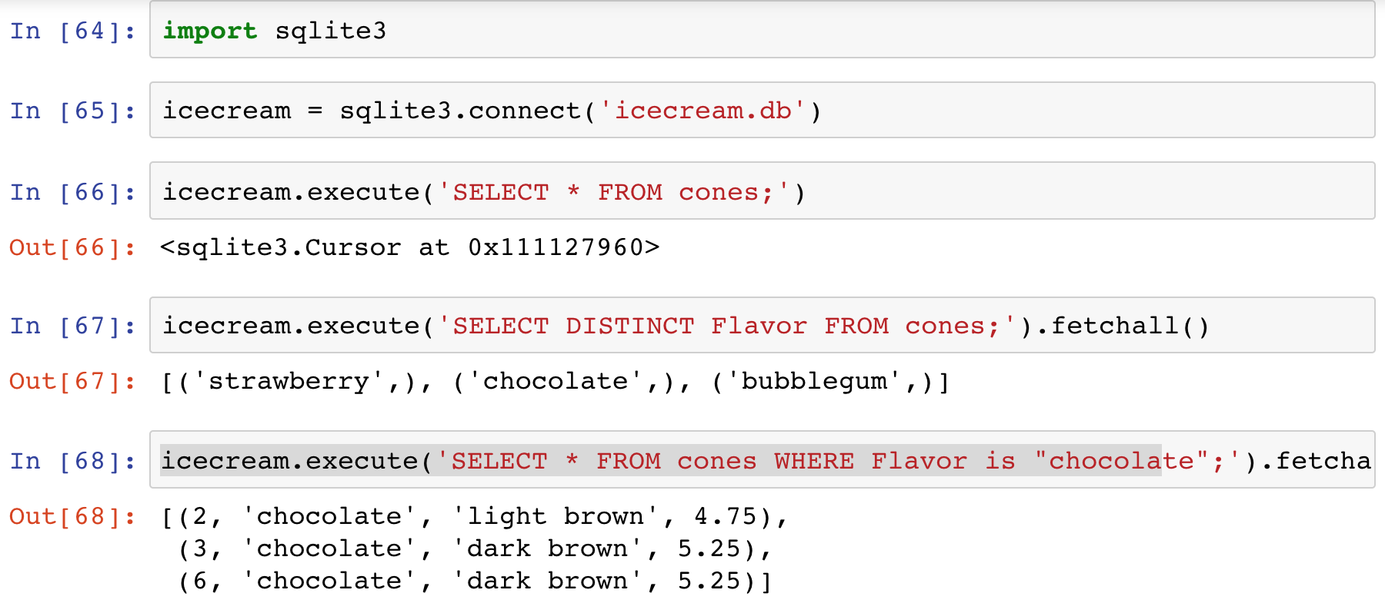
SQLite python API

Slide 30
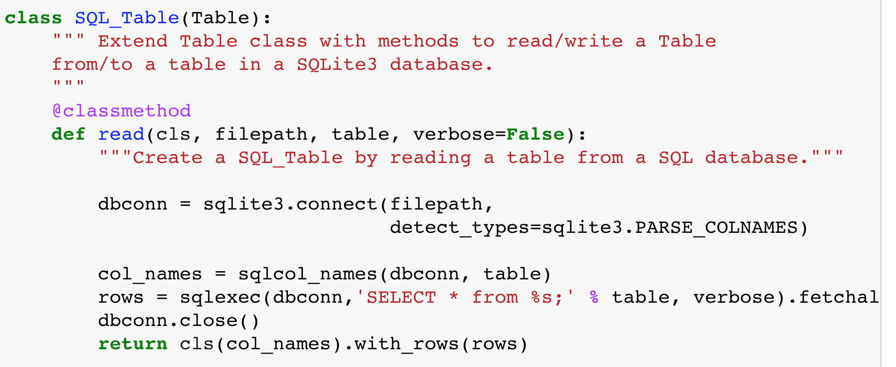
Creating DB Abstractions

Slide 31
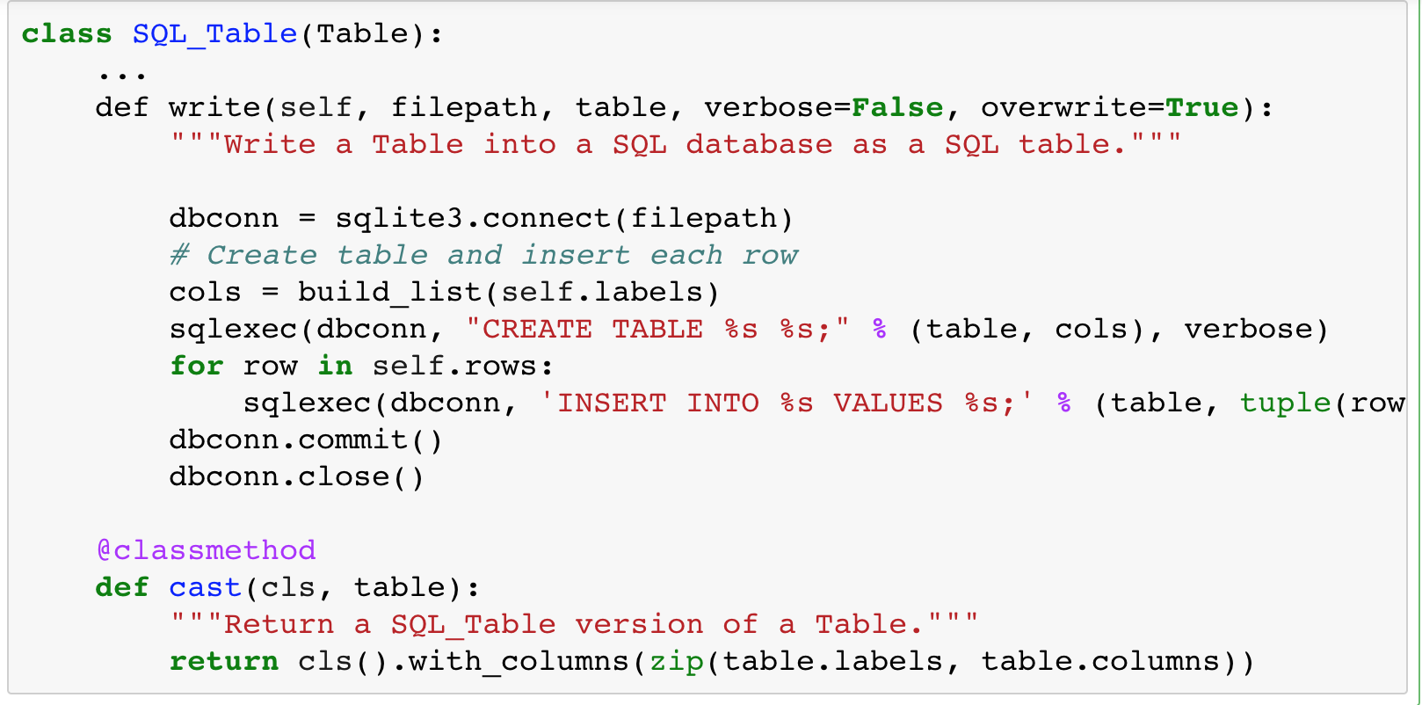
DB Abstraction (cont)

Slide 32
Summary – Part 1
SELECT <col spec> FROM <table spec> WHERE <cond spec>
GROUP BY <group spec> ORDER BY <order spec> ;
INSERT INTO table(column1, column2,...)
VALUES (value1, value2,...);
CREATE TABLE name ( <columns> ) ;
CREATE TABLE name AS <select statement> ;
DROP TABLE name ;

Slide 33
Summary
SQL a declarative programming language on relational tables
largely familiar to you from data8
create, select, where, order, group by, join
Databases are accessed through Applications
e.g., all modern web apps have Database backend
Queries are issued through API
Be careful about app corrupting the database
Data analytics tend to draw database into memory and operate on it as a data structure
e.g., Tables
More in lab

Slide 34
Solutions for the Wandering Mind
1) Adding two n-bit integers, how many bits can the result have?
Maximally n+1 bits (1 overflow bit).
2) Multiplying two n bit integers, how many bits can the result have?
log a*b=log a+log b=>log n*n=2*log n. 2*n bits.
Assume:
Exceptions don’t exist
We only reserve 8bit for an integer variable (0-255)
Questions:
1) What would be the result of an addition 255+255?
(255+255) modulo 255=0. One entire summand is lost!
2) What would be the result of a multiplication 255*255?
(255*255) modulo 255=0. The error is: 64770!

Slide 35
Solutions for the Wandering Mind
3) Assume l additions of 8bit integers into the same 8bit variable. Can you formulate the maximum error that can occur as a function of l?
Each addition can maximally lose the entire 8bits. The error accumulates. This is, each addition loses maximally 8bits. So it’s l*8bits of loss. So the maximum error 255*l.
For multiplication it’s 255^{l}. This is, exponential error!
(Also compare Lyapunov Exponent in physics)
This is taught in CS61C

