Slide 1

Computational Structures in Data Science
UC Berkeley EECS Adj. Ass. Prof. Dr. Gerald Friedland
Lecture #13: Review
April 29th, 2019
http://inst.eecs.berkeley.edu/~cs88

Slide 2

Computational Concepts Toolbox
Data type: values, literals, operations,
Expressions, Call expression
Variables
Assignment Statement, Tuple assignment
Sequences: tuple, list
Dictionaries
Function Definition Statement
Conditional Statement
Iteration: list comp, for, while
Lambda function expr.
Higher Order Functions
Functions as Values
Functions with functions as argument
Assignment of function values
Higher order function patterns
Map, Filter, Reduce
Function factories – create and return functions
Recursion
Abstract Data Types
Mutation
Class & Inheritance
Exceptions
Iterators & Generators
SQL
Notes:
z = 1,2
x,y = 3,4
a,b = z

Slide 3


The Goal of CS88 …
Idea
Understood by others
Expressed in a clear computational form
Interpreted by a “machine”
Answers and Insights

Slide 4
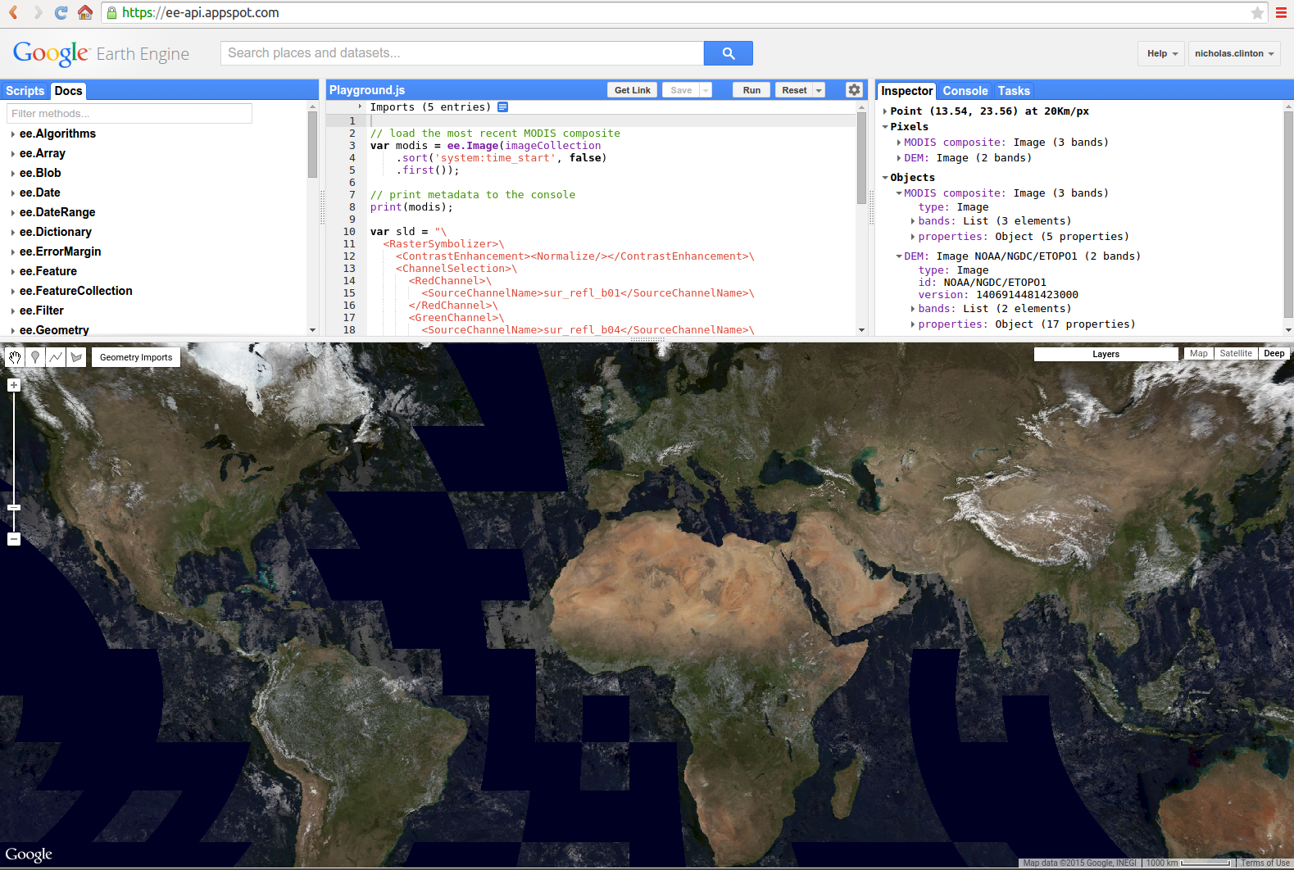
You will use this understanding in many situations that are not .py files and notebooks

Slide 5
SQL Review
SELECT
FROM
WHERE
GROUP BY
ORDER BY ;
[ALL or DISTINCT] expressions over columns (map/reduce), optionally AS names
specification of table or join of tables
conditional expression specifying rows in cols of tables
aggregation expression defining collections of rows in filtered cols of tables
expression on rows of filter cols defining order of result

Slide 6
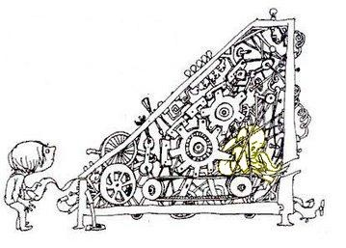
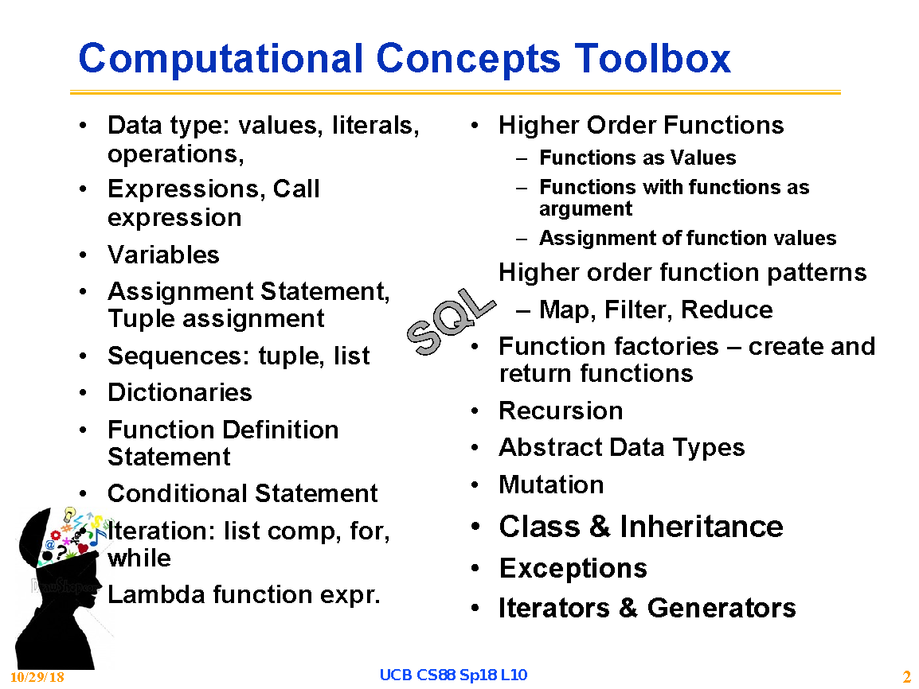
How would you write a Python interpreter?

Slide 7
What do you give to the interpreter?
An Expression
A sequence of Statements
optionally followed by an expression

Slide 8
Basic Process
Parse the input into logical pieces
Expression
Value or variable (leaves) – of a “type”
Tree of operators and operand expressions
.. * .. , .. + .. , …
.. ( .. ) , [ .. ], lambda .. : .. , …
Comprehensions
Sequence of statements
assignment
def
conditional
iteration
operator
operand
expression
operand
expression
operator
operand
expression
value
operand
expression

Slide 9
Values
Primitive Value
int, float, boolean
Complex Values
string, tuple, list, dict,
function, class
object, method
Variable
Reference to a value

Slide 10
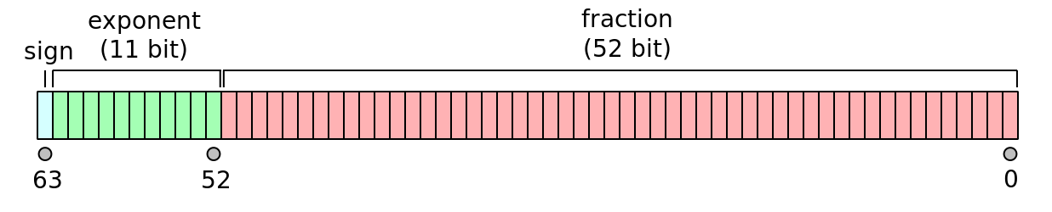
At the bottom it’s a bunch of bits
How many distinct things represented in N bits?
2^{N} - Think recursively
2 “things” in 1 bit – {0,1}
Assume 2^{N-1} things in N-1 bits
0 || {0, …, 2^{N-1} – 1} U 1 || {0, …, 2^{N-1} – 1}
“word” is now (typically) 64 bits
Can represent 2⁶⁴ (over 18 quintillion or 1.8×10¹⁹) different values
Addresses (unsigned ints): 0 .. 2^{N} – 1
Signed Integers: -2^{N-1} .. 2^{N-1} – 1
IEEE Float Point: -1^{S} x 1.f x 2 ^{e-1023}

Slide 11
Variable
Starting with current frame
Look up variable in frame
If not present, try parent frame, repeatedly
Until global frame is reached
If not found there
Raise an exception

Slide 12
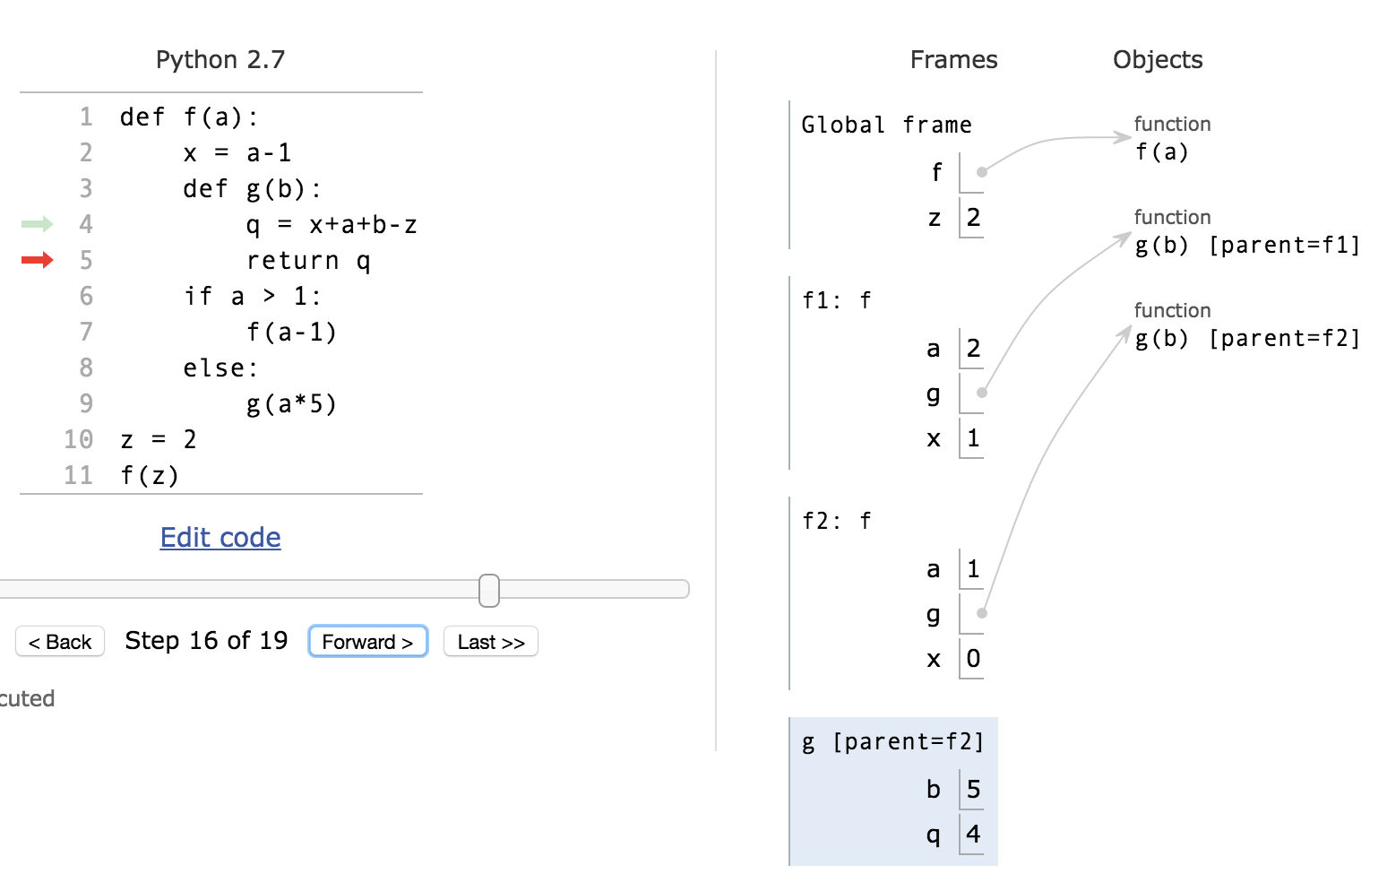
Variable
Starting with current frame
Look up variable in frame
If not present, try parent frame, repeatedly
Until global frame is reached
If not found there
Raise an exception

Slide 13
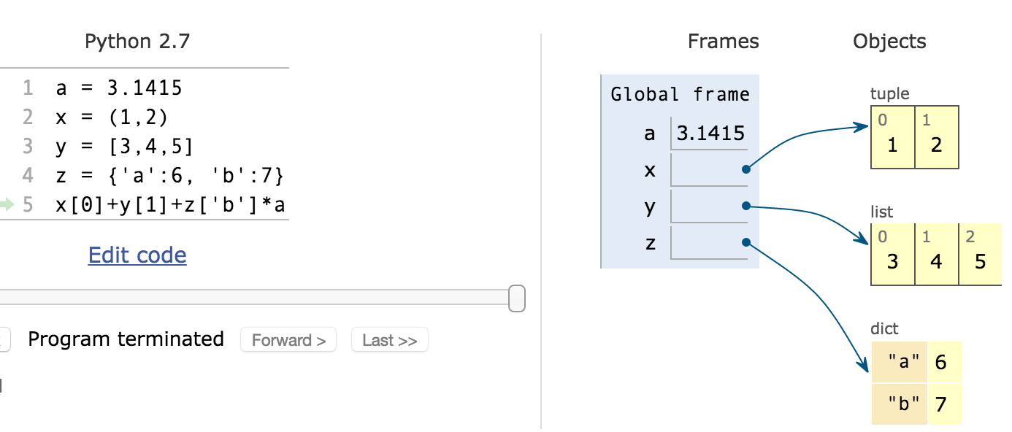
Data Structures

Slide 14
Operators
*
[ ]
Evaluate the operand expressions (recursively)
Check the types of the resulting values to determine the operator for symbol
If no valid combination, raise exceptions
Apply operator to resulting values to produce result

Slide 15
Call Expressions
( , , ... )
Evaluate the operand expressions (recursively)
Evaluate “function” expression to get function to apply
This may involve function return values or “.” or …
Check that it is of function type
If not, raise exception
Apply function to resulting values to produce result

Slide 16
Built-in Data Structure Constructor
( , , ... )
{ : , ... }
Evaluate each of the index and value expressions
Or raise error
Allocate storage to hold the data structure
Fill in values at indices/Key
Return a reference to the object

Slide 17
Comprehension Expression
[ for <var tuple> in ]
i-exp
Evaluate iterable expression
For each element in iteration
Bind var tuple to value tuple
Evaluate with each of those variable bindings
Construct resulting object and return reference to it

Slide 18
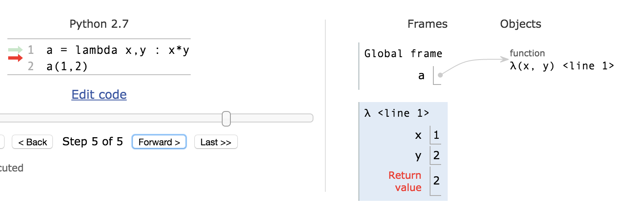
Lambda Expression
lambda <vars> :
Construct a function object that evaluates expression in a frame with variables in <vars> bound to argument values and returning the result
Return reference to the function object

Slide 19
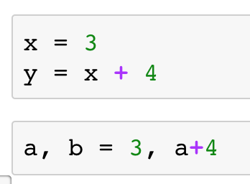
Assignment Statement
<var list> =
Evaluate RHS expression to get value
Or raise and exception
Locate LHS variable(s) in frame path
For each variable
If exists, set variable to expression value
If not, create variable of name(s) <var list> in current frame

Slide 20
Set operation
[ ] =
Evaluate RHS to get value
Or raise and exception
Evaluation LHS expressions to get object and index/key
Or raise exception
Set obj [ key ] to expression value

Slide 21
Define Statement
def <fun name> ( <var list> ) :
<suite of statements>
Construct a function object to evaluate <suite of statements> in a frame with <var list> as local variable bound to argument expressions
return statements evaluate expression in current frame and return it as result of the call expression
Introduce <fun name> into current frame, assigned a reference to the function object

Slide 22
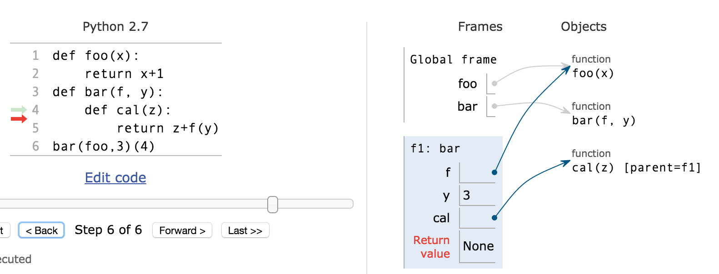
Define

Slide 23
Control Flow

Slide 24
Sequence of Statements
Evaluate each statement in sequence
Introducing new variables up updating objects with each

Slide 25
Conditional Statement
if :
< true suite of statements >
else:
<false suite>
Evaluate
If it yields a truthy result, evaluate <true suite>
Otherwise, if else: present, evaluate <false suite>

Slide 26
Call Expressions
( , , ... )
Evaluate the operand expressions (recursively)
Evaluate “function” expression to get function to apply
This may involve function return values or “.” or …
Check that it is of function type
If not, raise exception
Apply function to resulting values to produce result
Evaluate the statements within the function body

Slide 27
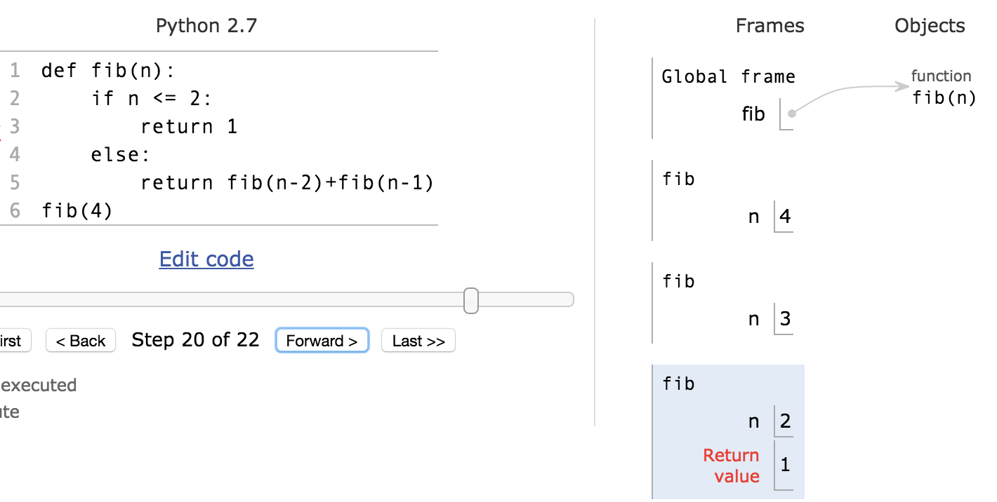
Functions plus conditionals …
Recursion

Slide 28
While Statement
while :
< suite of statements >
else:
< exit suite>
Repeatedly evaluate
If it yields a truthy result, evaluate <suite>
Otherwise, if else: is present evaluate <exit suite>
continue skips remain statements in suite
break exits loop skipping <exit suite>

Slide 29
For Statement
for <var list> in :
< suite of statements >
else:
< exit suite>
Evaluate to get an iterable
Repeatedly bind <var list> to next
Evaluate <suite> with these bindings
Until StopIteration is raised
if else: is present evaluate <exit suite>

Slide 30
Try statement
try :
< suite of statements >
except as <var> :
< except suite>
Evaluate suite of statements
If exception is raised which matches
Evaluate except suite is var bound to exception object

Slide 31
Class statement
class <classname> ( <inheritance> ):
< suite of statements >
If present, evaluate the inheritance list to obtain a class object or class type.
Create new namespace for classname
Evaluate <suite> in a new execution frame using a newly created namespace and global namespace
Typically sequence of define statements
self in define for methods, self otherwise for object attributes
vars in class namespace for class attributes
Return resulting class object

Slide 32
. operator
. <var>
References <var> in namespace of

Slide 33
with statement
with as <var> [, more ] :
< suite of statements >
Evaluate suite of statements with vars bound to results of corresponding

Slide 34
Comprehension expressions
[ for <var list> in ]
[ for <var list> in if ]
Iteratively,
Evaluate next
If present, evaluate on it
Evaluate
until stop_iter exception
Collect all resulting values into result object

Slide 35
Software Design Patterns
Higher Order Functions
Recursion
Data Parallel – Map-Reduce
Abstract Data Types
Constructors, Selectors, Actions
Object Oriented Programming
Encapsulation of behavior
Iterators and Generators
Classes with __iter__ and __next__
yield statement

Slide 36
Uses of Computational Thinking
Computational concepts model the world. Programming languages are mathematical formalisms just like any other: linear algebra, differential equations, statistics…
Plus: Automatic verification of the model.
More CS:
CS61b: More programming
CS61c: Machine architecture (how the bits are moved)
So now …

Slide 37
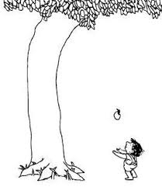
Go model and change the world …

