Slide 1
Wrap Up: Why Linked Lists?

Slide 2
Why are linked lists useful?
Honestly, a list() is easier most of the time
Python handles all the hard details!
When data gets large, there are lots of edge cases.
In terms of efficiency: Linked lists make it fast to move items around, inserts and deletes.
But they are slower to finding any single item.
Linked Lists are a simplified forms of other more complicated structures
a Tree: Each "link" can have multiple children
a Graph: Each "node" can have many neighbors

Slide 3
Uses for a Linked List
Modeling a Polynomial Equation
each item is (coefficient, exponent, next_term)
Items in a music playlist
each item is a (song, next_song) pair
easy to add/remove items
Specifically: often want to remove the first item
Model real-world relationships
Anything that is a "chain" is a good option
Next week: We'll extend this idea to "trees"

Slide 4
Efficiency of Linked Lists vs Lists
Linked Lists generally use less memory.
Linked Lists:
Once you've found an item, inserting / removing is easy, O(1)
Finding anything other than the first/last item is O(n)
"Regular" Lists:
Inserting / Removing items, other than the last is O(n) – due to internal copying
Finding any random item is O(1).
What if you need to iterate over all items in order?
O(n) in both cases

Slide 5
Lecture: Exceptions

Slide 6
Learning Objectives
Exceptions give us a formal way to address error conditions
"Catch" exceptions in a Python Program
Define and Raise our own exceptions

Slide 7
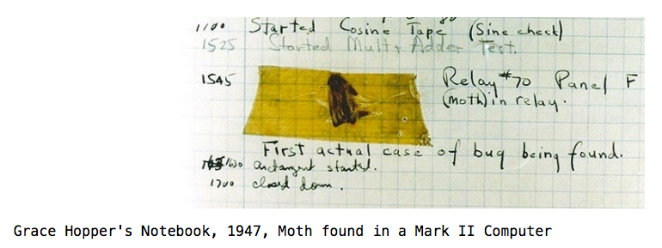
Errors Can Occur Just About Anywhere!
Function receives arguments of improper type?
Resources (e.g. files or some data) are not available
Network connection is lost or times out?

Slide 8
Example exceptions (Docs)
notebook
>>> 3/0
Traceback (most recent call last):
File "<stdin>", line 1, in <module>
ZeroDivisionError: division by zero
>>> str.lower(1)
Traceback (most recent call last):
File "<stdin>", line 1, in <module>
TypeError: descriptor 'lower' requires a 'str' object but received a 'int'
>>> ""[2]
Traceback (most recent call last):
File "<stdin>", line 1, in <module>
IndexError: string index out of range
>>>
Unhandled, thrown back to the top level interpreter
Or halt the python program

Slide 9
Functions
Q: What is a function supposed to do?
A: One thing well
Q: What should it do when it is passed arguments that don’t make sense?
>>> def divides(x, y):
... return y%x == 0
...
>>> divides(0, 5)
???
>>> def get(data, selector):
... return data[selector]
...
>>> get({'a': 34, 'cat':'9 lives'}, 'dog’)
????

Slide 10
Exceptional exit from functions
>>> def divides(x, y):
... return y%x == 0
...
>>> divides(0, 5)
Traceback (most recent call last):
File "<stdin>", line 1, in <module>
File "<stdin>", line 2, in divides
ZeroDivisionError: integer division or modulo by zero
>>> def get(data, selector):
... return data[selector]
...
>>> get({'a': 34, 'cat':'9 lives'}, 'dog')
Traceback (most recent call last):
File "<stdin>", line 1, in <module>
File "<stdin>", line 2, in get
KeyError: 'dog'
>>>
Function doesn’t “return” but instead execution is thrown out of the function

Slide 11
Reading A "Stack Trace" or "Traceback" (Docs)
All errors in Python should return some structured feedback.
Errors may be dense, but it contains some really helpful information!
👉 python3 -i 20-Exceptions.py
What is your age? 5
Catching CS88Error
Traceback (most recent call last):
File "…Exceptions.py", line 24, in <module>
get_age_in_days()
File "…", line 20, in get_age_in_days
raise e
File "…", line 14, in get_age_in_days
raise CS88Error('Are you sure you want to take CS88?')
__main__.CS88Error: Are you sure you want to take CS88?

Slide 12
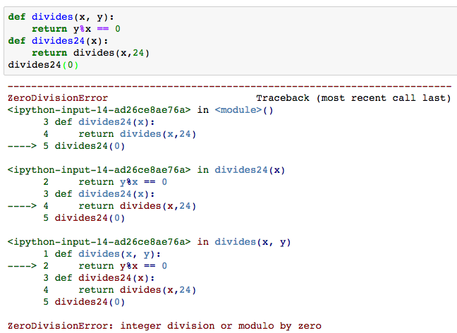
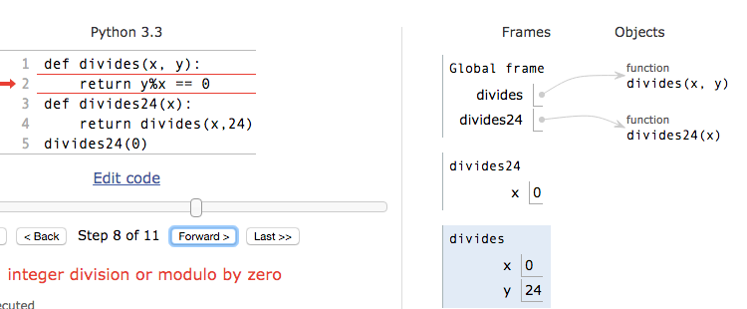
Continue out of multiple calls deep
Stack unwinds until exception is handled or top

Slide 13
types of exceptions
TypeError -- A function was passed the wrong number/type of argument
NameError -- A name wasn't found
KeyError -- A key wasn't found in a dictionary
RuntimeError -- Catch-all for troubles during interpretation
Your own exceptions!

Slide 14
Demo

Slide 15
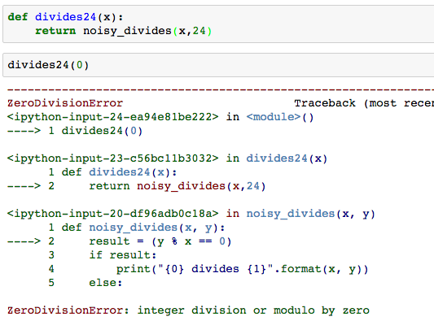
Flow of control stops at the exception
And is ‘thrown back’ to wherever it is caught

Slide 16
Assert Statements
Allow you to make assertions about assumptions that your code relies on
Use them liberally!
Incoming data is "dirty" and unsafe till you’ve "cleaned" it
Raise an exception of type AssertionError
Ignored in optimize flag: python3 –O …
Governed by bool __debug__
assert <assertion expression>, <string for failed>
def divides(x, y):
assert x != 0, ”Denominator must be non-zero”
return y%x == 0

Slide 17
Handling Errors – try / except
Wrap your code in try – except statements
Execution rule
<try suite> is executed first
If during this an exception is raised and not handled otherwise
And if the exception inherits from <exception class>
Then <except suite> is executed with <name> bound to the exception
Control jumps to the except suite of the most recent try that handles the exception
try:
<try suite>
except <exception class> as <name>:
<except suite>
... # continue here if <try suite> succeeds w/o exception

Slide 18
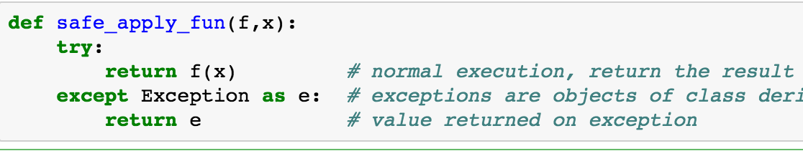
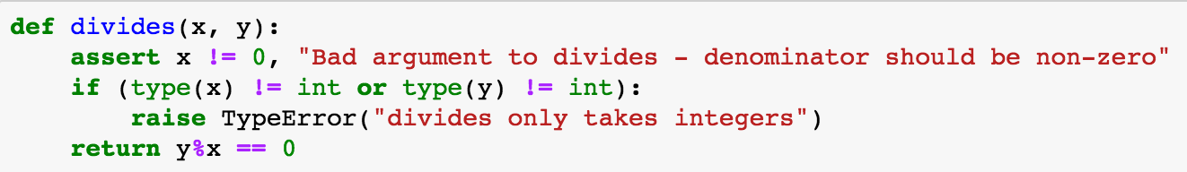
Demo

Slide 19
Raise statement
Exception are raised with a raise statement\
raise <exception>
<expression> must evaluate to a subclass of BaseException or an instance of one
Exceptions are constructed like any other object
TypeError(‘Bad argument’)

Slide 20
Exceptions are Classes
class NoiseyException(Exception):
def __init__(self, stuff):
print("Bad stuff happened", stuff)
class CS88Error(Exception):
pass # The one time you can skip init. ;)
try:
return fun(x)
except:
raise NoiseyException((fun, x))

Slide 21
Demo

Slide 22
Summary
Approach use of exceptions as a design problem
Meaningful behavior => methods [& attributes]
ADT methodology
What’s private and hidden? vs What’s public?
Use it to streamline development
Anticipate exceptional cases and unforeseen problems
try … catch
raise / assert

