Slide 1
Object-Oriented Programming: Part 2, Inheritence

Slide 2
Announcements
Midterm 3/16 7-9pm
Remote option available
Please wear masks in the exam room
Unlimited Handwritten Sheets – but try to use no more than 3-4!
Lecture: Monday 3/14 – Review/Q&A
Lecture: Weds 3/16 – No Lecture, just study / relax.
then you've got Spring break!

Slide 3
Object-Oriented Programming: "Magic" Methods

Slide 4
Learning Objectives
Python's Special Methods define built-in properties
__init__ # Called when making a new instance
__sub__ # Maps to the - operator
__str__ # Called when we call print()
__repr__ # Called in the interpreter

Slide 5
Special Initialization Method
__init__ is called automatically when we write: my_account = BaseAccount('me', 0)
class BaseAccount:
def __init__(self, name, initial_deposit):
self.name = name
self.balance = initial_deposit
def account_name(self):
return self.name
def account_balance(self):
return self.balance
def withdraw(self, amount):
self.balance -= amount
return self.balance
return None

Slide 6
More special methods
class BaseAccount:
… (init, etc removed)
def deposit(self, amount):
self._balance += amount
return self._balance
def __repr__(self):
return '< ' + str(self._acct_no) +
'[' + str(self._name) + '] >'
def __str__(self):
return 'Account: ' + str(self._acct_no) +
'[' + str(self._name) + ']'
def show_accounts():
for account in BaseAccount.accounts:
print(account)
Goal: unambiguous
Goal: readable

Slide 7
More Magic Methods
We will not go through an exhaustive list!
Magic Methods start and end with "double underscores" __
They map to built-in functionality in Python. Many are logical names:
__add__ => + operator
__sub__ => - operator
__getitem__ => [] operator
A longer list for the curious:
https://docs.python.org/3/reference/datamodel.html

Slide 8
Live Demo

Slide 9
Object-Oriented Programming: Inheritance

Slide 10
Learning Objectives
Inheritance allows classes to reuse methods and attributes from a parent class.
super() is a new method in Python
Subclasses or child classes are distinct from on another, but share properties of the parent.

Slide 11
Inheritance
Define a class as a specialization of an existing class
Inherent its attributes, methods (behaviors)
Add additional ones
Redefine (specialize) existing ones
Ones in superclass still accessible in its namespace

Slide 12
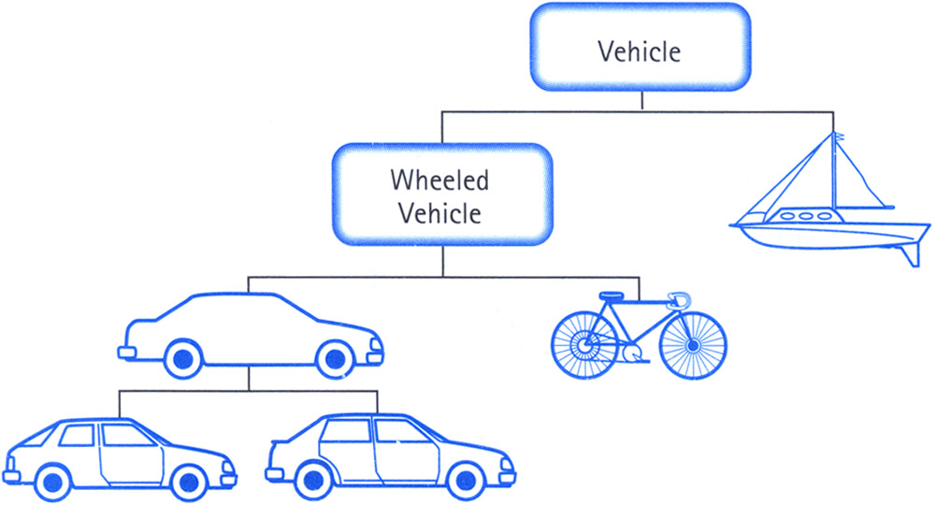
Class Inheritance
Classes can inherit methods and attributes from parent classes but extend into their own class.

Slide 13
Python class statement
class ClassName:
<statement-1>
.
.
.
<statement-N>
class ClassName ( inherits / parent-class ):
<statement-1>
.
.
.
<statement-N>

Slide 14
Example
class Account:
def __init__(self, name, initial_deposit):
# Initialize the instance attributes
self._name = name
self._acct_no = Account._account_number_seed
Account._account_number_seed += 1
self._balance = initial_deposit
class CheckingAccount(Account): def __init__(self, name, initial_deposit):
# Use superclass initializer
Account.__init__(self, name, initial_deposit)
# Alternatively:
# super().__init__(name, initial_deposit)
# Additional initialization
self._type = "Checking"

Slide 15
Accessing the Parent Class
super() gives us access to methods in the parent or "superclass"
Can be called anywhere in our class
Handles passing self to the method
We can directly call ParentClass.method(self, …)
This is not quite as flexible if our class structure changes.

