Slide 1
Midterm Review

Slide 2
Announcements & Policies
Midterm:
2 hours, 120 Minutes
Unlimited Handwritten Cheat sheets – More than ~3 is counter-productive
1 CS88 Provided Reference Sheet
Remote Exams:
Zoom Proctoring https://docs.google.com/document/d/18Zkd-PP5qEa3hQVRhKvU9_6CmL9WVPsQMScu65D1tuI/edit?usp=sharing
Verify Scheduling / Accommodations

Slide 3
My Advice
Don't rush!
Skim the exam first
It's ok to do questions out of order!
Get the stuff you're good without out of the way
BUT don't spend too much time planning the exam.
Read through the question once
What's it asking you to do at a high level?
What do the doctests suggest?
What techniques should you be using?

Slide 4
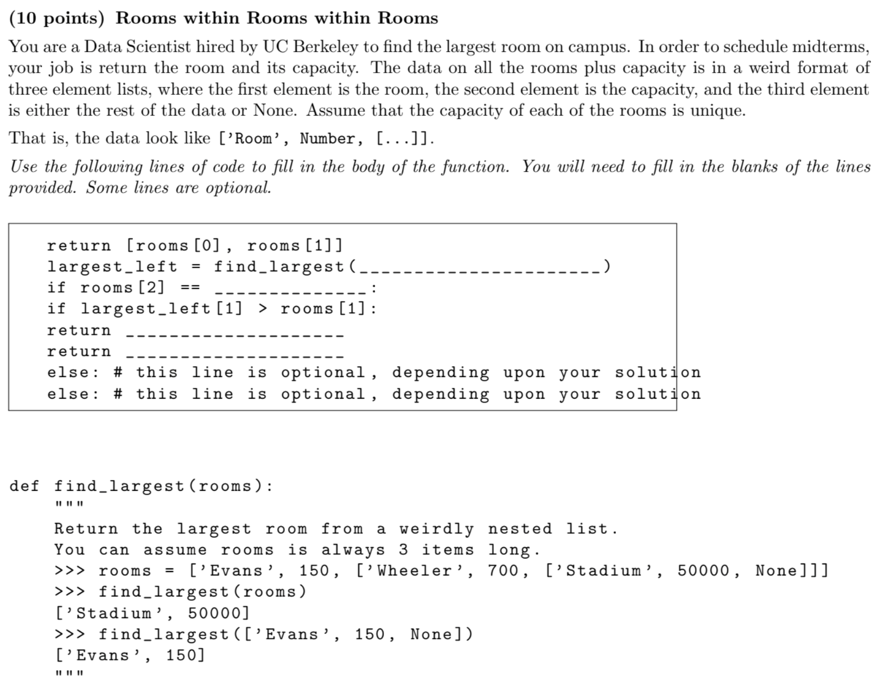
SP20 #6

Slide 5
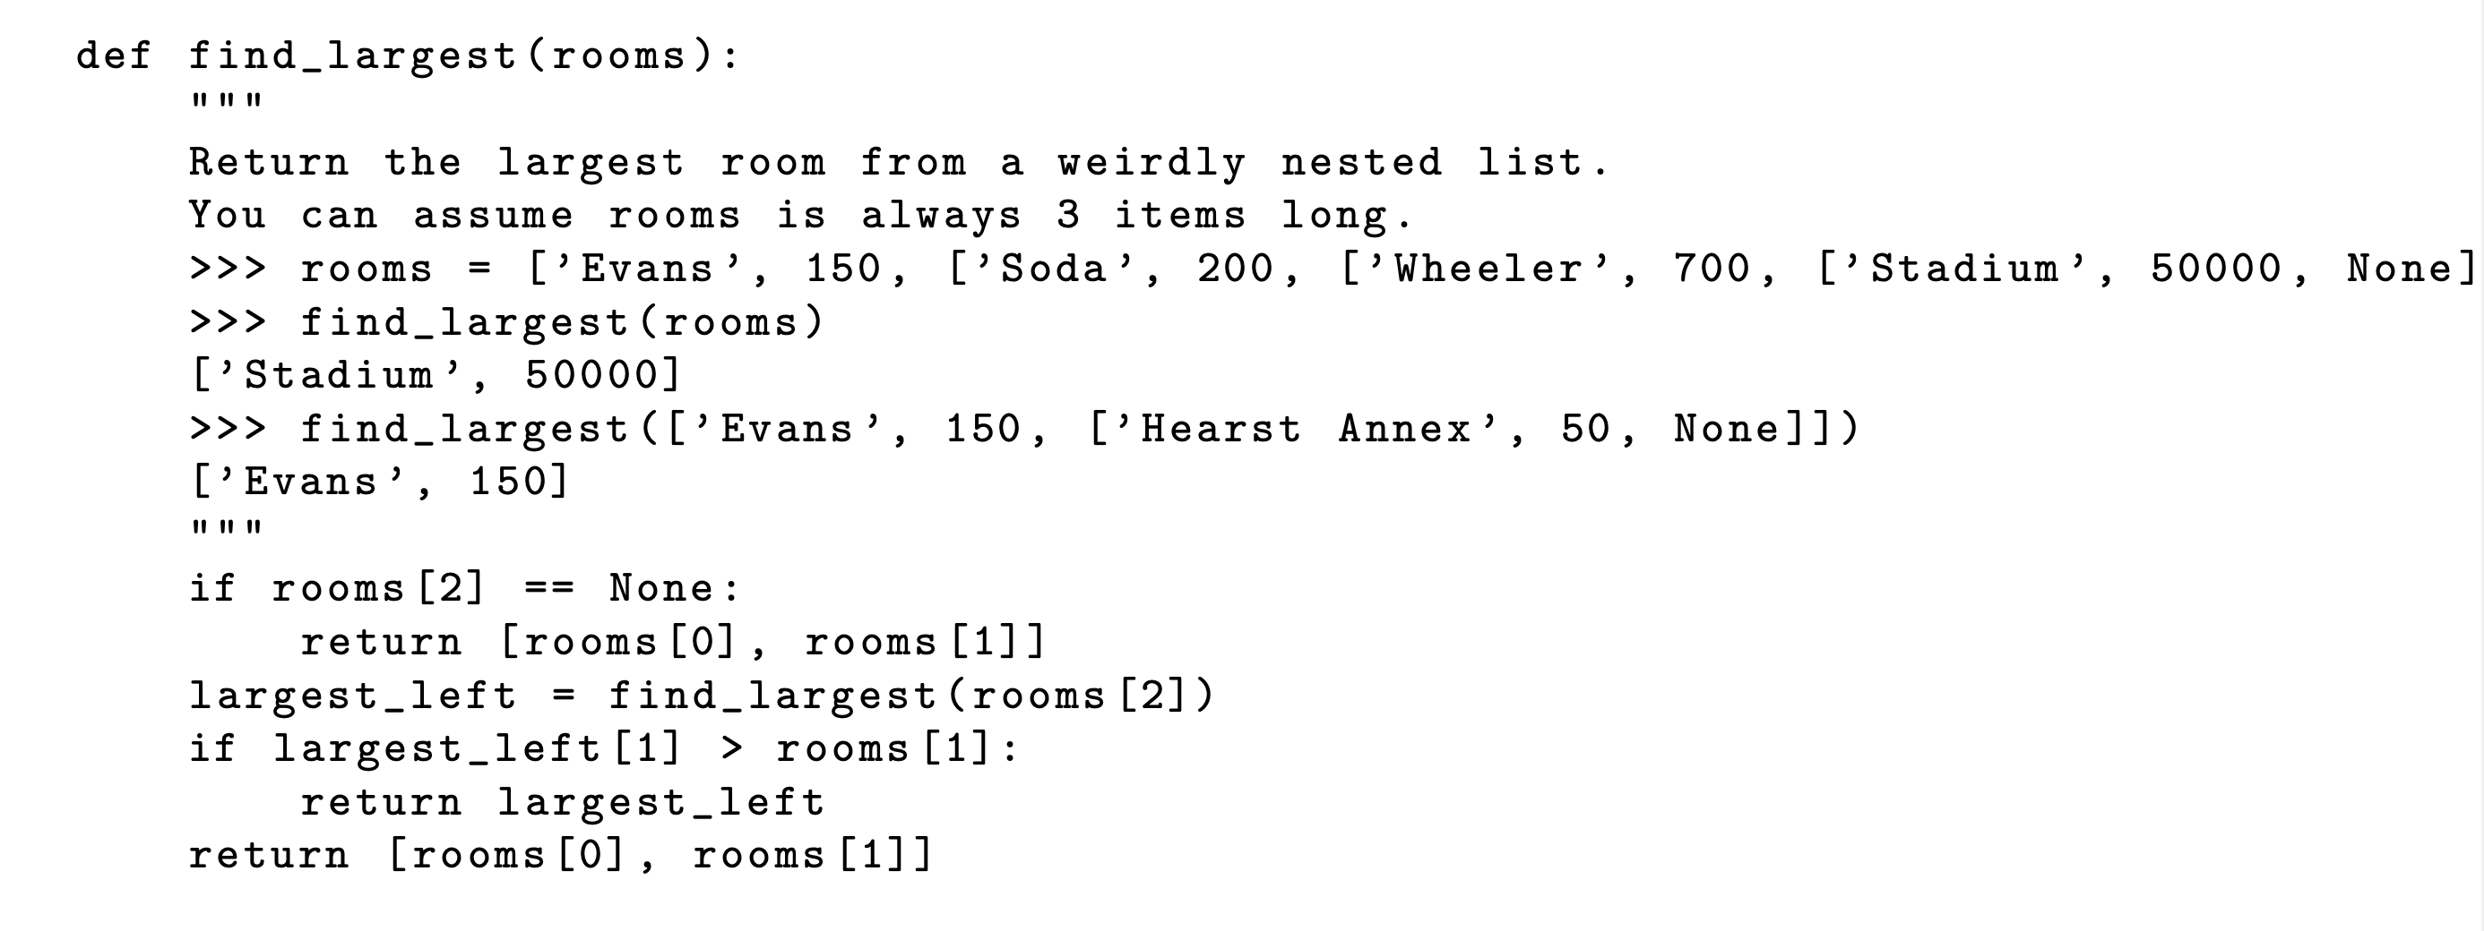

Slide 6
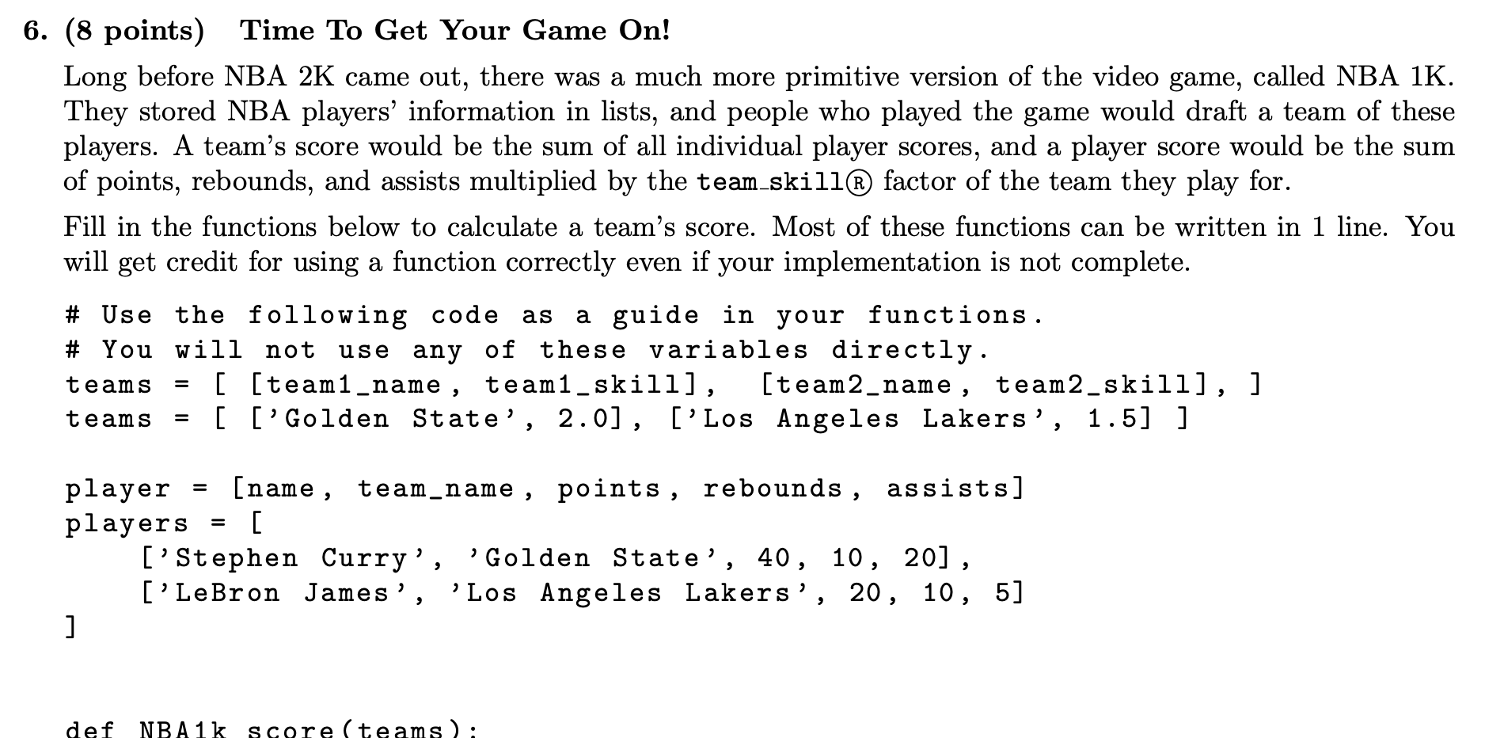
Fall 2019 #6

Slide 8
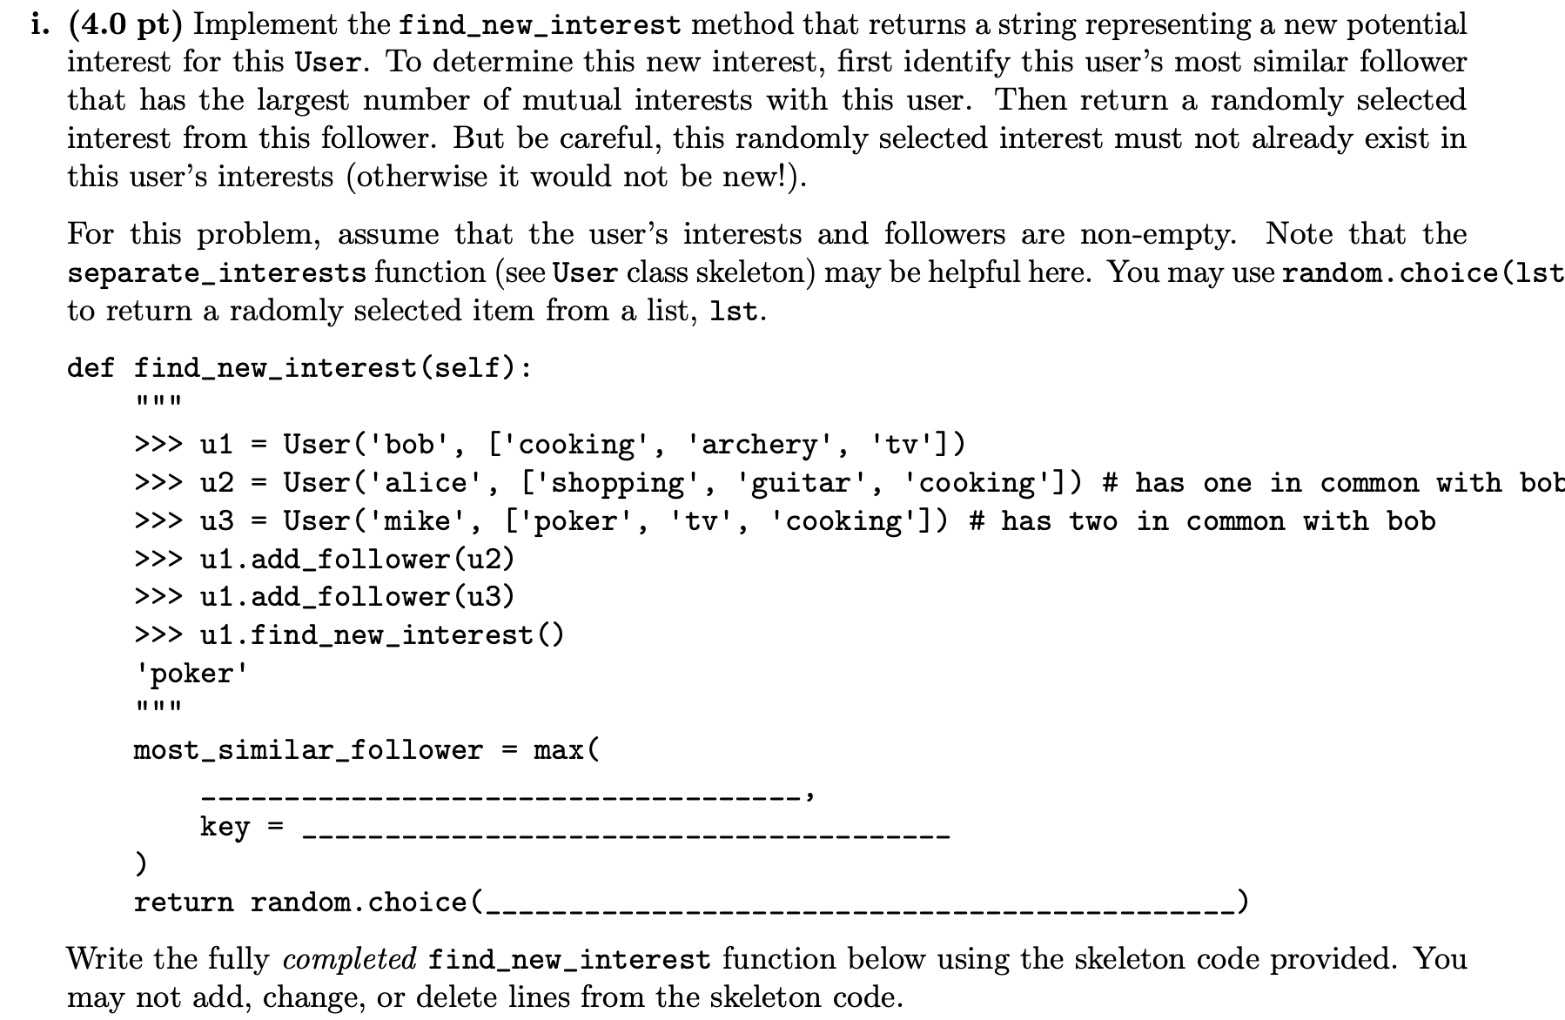
Fa21 8c

Slide 10
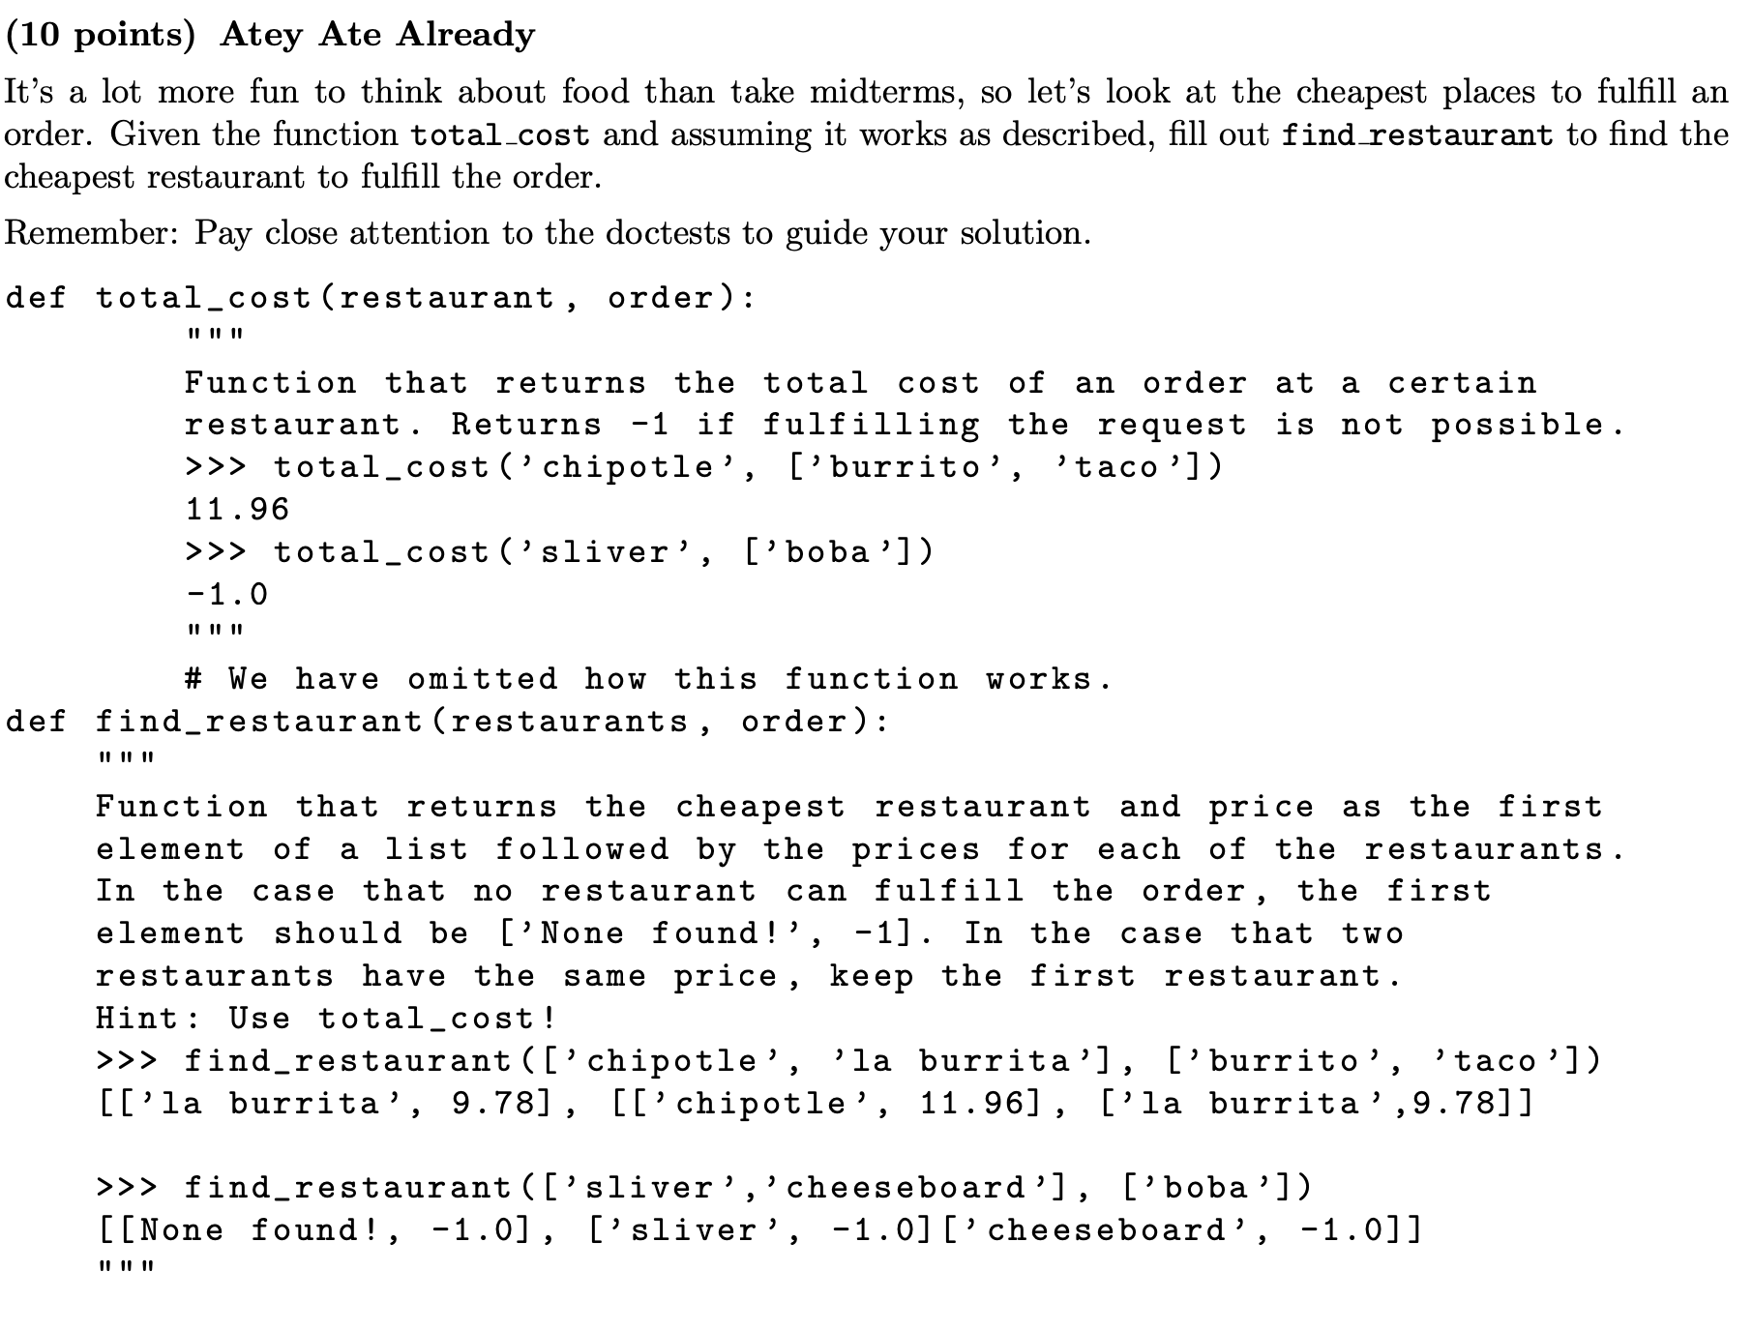
SP20 #5

Slide 11
