Slide 1
Abstract Data Types & Dictionaries

Slide 2
Today’s Lecture
Abstract Data Types
More use of functions!
Value in documentation and clarity

Slide 3
Dictionaries
Notes:
3

Slide 4
Learning Objectives
Dictionaries are a new type in Python
Lists let us index a value by a number, or position.
Dictionaries let us index data by other kinds of data.

Slide 5
Dictionaries vs Lists
Lists: Collect any number of items together in a single entity
Each item has an index or position
A list has a distinct order.
Dictionaries: Map a "key" to a "value"
Keys can be many things, but most commonly strings, numbers, tuple
Values can be any data
Items have no inherent order
If we know an item's index, or a dictionary's key then looking up and item is fast and easy.

Slide 6
Dictionaries
Constructors:
dict( <list of 2-tuples> )
dict( <key>=<val>, ...) # like kwargs
{ <key exp>:<val exp>, … }
{ <key>:<val> for <iteration expression> }
>>> {x:y for x,y in zip(["a","b"],[1,2])}
{'a': 1, 'b': 2}
Selectors: <dict> [ <key> ]
<dict>.keys(), .items(), .values()
<dict>.get(key [, default] )
Operations:
Key in, not in, len, min, max
<dict>[ <key> ] = <val>

Slide 7
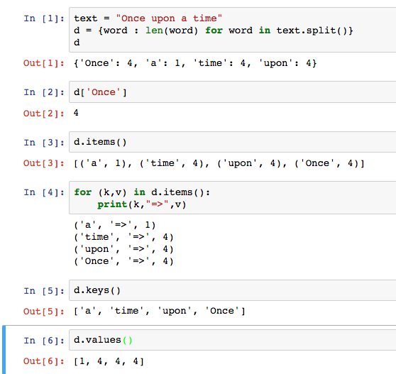
Dictionary Example

Slide 8
Dictionary Example

Slide 9
Abstract Data Type
Uses pure functions to encapsulate some logic as part of a program.
We rely of built-in types (int, str, list, etc) to build ADTs
This is a contrast to object-oriented programming
Which is coming soon!

Slide 10
Creating Abstractions
Compound values combine other values together
date: a year, a month, and a day
geographic position: latitude and longitude
a game board
Data abstraction lets us manipulate compound values as units
Isolate two parts of any program that uses data:
How data are represented (as parts)
How data are manipulated (as units)
Data abstraction: A methodology by which functions enforce an abstraction barrier between representation and use

Slide 11
Why Abstract Data Types?
“Self-Documenting”
contact_name(contact)
vs contact[0]
“0” may seem clear now, but what about in a week? 3 months?
Change your implementation
Maybe today it’s just a Python List
Tomorrow: It could be a file on your computer; a database in web

Slide 12
Abstract Data Type
Operations
Object
Constructors
A new Data Type
Selectors
Internal Representation
Operations
Implementation on that
Internal representation
External Representation
Interface
Abstraction Barrier!

Slide 13
C.O.R.E concepts
Perform useful computations treating objects abstractly as whole values and operating on them.
Compute
Operations
Provide operations on the abstract components that allow ease of use – independent of concrete representation.
Abstract Data Type
Representation
Constructors and selectors that provide an abstract interface to a concrete representation
Evaluation
Execution on a computing machine
Abstraction Barrier

Slide 14
Reminder: Lists
Lists
Constructors:
list( … )
[ <exps>,… ]
[<exp> for <var> in <list> [ if <exp> ] ]
Selectors: <list> [ <index or slice> ]
Operations: in, not in, +, *, len, min, max
Mutable ones too (but not yet
Tuples
A lot like lists, but you cannot edit them. We'll revisit on Monday.

Slide 15
A Small ADT
def point(x, y): # constructor
return [x, y] x = lambda point: point[0] # selector
y = lambda point: point[1]
def distance(p1, p2): # Operator
return ((x(p2) - x(p1)**2 + (y(p2) - y(p1))**2) ** 0.5
origin = point(0, 0)
my_house = point(5, 5)
campus = point(25, 25)
distance_to_campus = distance(my_house, campus)

Slide 16
Creating an Abtract Data Type
Constructors & Selectors
Operations
Express the behavior of objects, invariants, etc
Implemented (abstractly) in terms of Constructors and Selectors for the object
Representation
Implement the structure of the object
An abstraction barrier violation occurs when a part of the program that can use the higher level functions uses lower level ones instead
At either layer of abstraction
Abstraction barriers make programs easier to get right, maintain, and modify
Few changes when representation changes

Slide 17
Question: Changing Representations? http://go.c88c.org/9
Question 1.1
Assuming we update our selectors, what are valid representations for our point(x, y) ADT?
Currently point(1, 2) is represented as [1, 2]
A) [y, x] # [2, 1]
B) “X: ” + str(x) + “ Y: ” + str(y) # “X: 1 Y: 2”
C) str(x) + ' ' + str(y) # '1 2'
D) All of the above
E) None of the above

Slide 18
An Abstract Data Type: Key-Value Pair
Collection of key-Value bindings
Key : Value
Many real-world examples
Dictionary, Directory, Phone book, Course Schedule, Facebook Friends, Movie listings, …
Given some Key, What is the value associated with it?

Slide 19
Key-Value ADT
Constructors
kv_empty: create an empty KV
kv_add: add a key:value binding to a KV
kv_create: create a KV from a list of key,value tuples
Selectors
kv_items: list of (key,value) tuple in KV
kv_keys: list of keys in KV
kv_values: list of values in KV
Operations
kv_len: number of bindings
kv_in: presence of a binding with a key
kv_display: external representation of KV

Slide 20
A Layered Design Process
Build the application based entirely on the ADT interface
Operations, Constructors and Selectors
Build the operations in ADT on Constructors and Selectors
Not the implementation representation
This is the end of the abstraction barrier.
Build the constructors and selectors on some concrete representation

Slide 21
Example: Tic Tac Toe and Phone Book
See the companion notebook.
Download the file "ipynb"
Go to datahub.berkeley.edu
Log in, then select "Upload"

Slide 22
Question: The Abstraction Barrier
Which of these violates a board ADT?
A) diag_left = diagonal(board, 0)
B) board[0][2] = 'x'
C) all_rows = rows(board)
D) board = empty_board()
E) None of the above

