Slide 1
Midterm Review

Slide 2
Announcements & Policies
Midterm:
2 hours, 120 Minutes
Unlimited Handwritten Cheat sheets – More than ~3 is counter-productive
1 CS88 Provided Reference Sheet
Verify Scheduling / Accommodations

Slide 3
My Advice
Don't rush!
Skim the exam first
It's ok to do questions out of order!
Get the stuff you're good without out of the way
BUT don't spend too much time planning the exam.
Read through the question once
What's it asking you to do at a high level?
What do the doctests suggest?
What techniques should you be using?

Slide 4
Questions from Ed

Slide 5
OOP Questions
super() is a method which refers to the parent class of an object.
It returns a special kind of instance of an object.
We can use super() or the class name of the parent class
Private Attributes and Methods:
self.x is "public"
self._x is a convention which means "you shouldn't use this"
self.__x is private. Python prevents other classes from accessing that attribute.

Slide 6
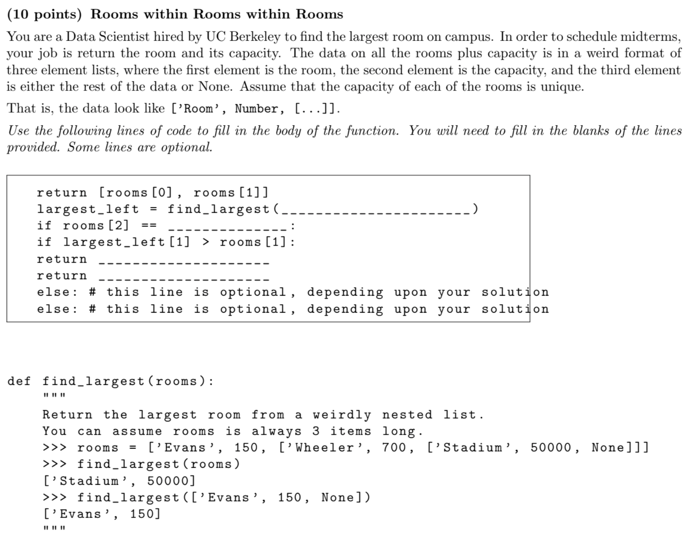
SP20 #6

Slide 7
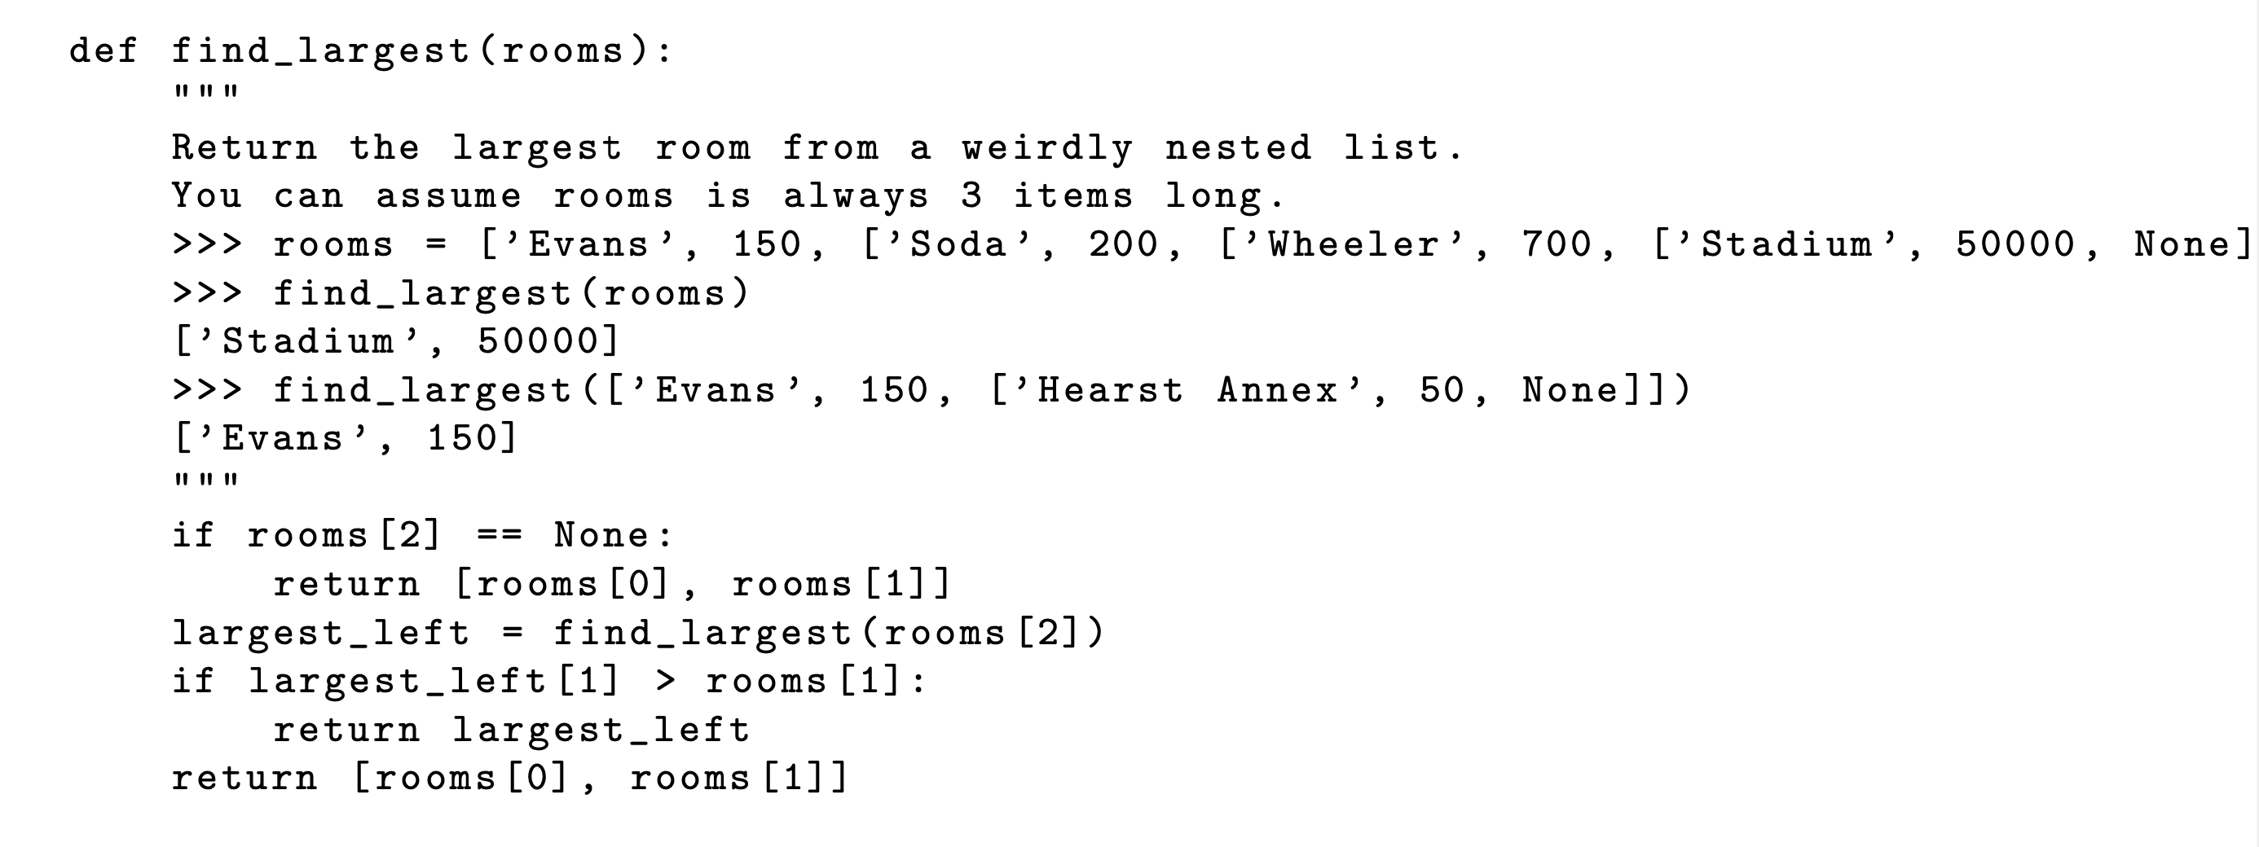

Slide 8
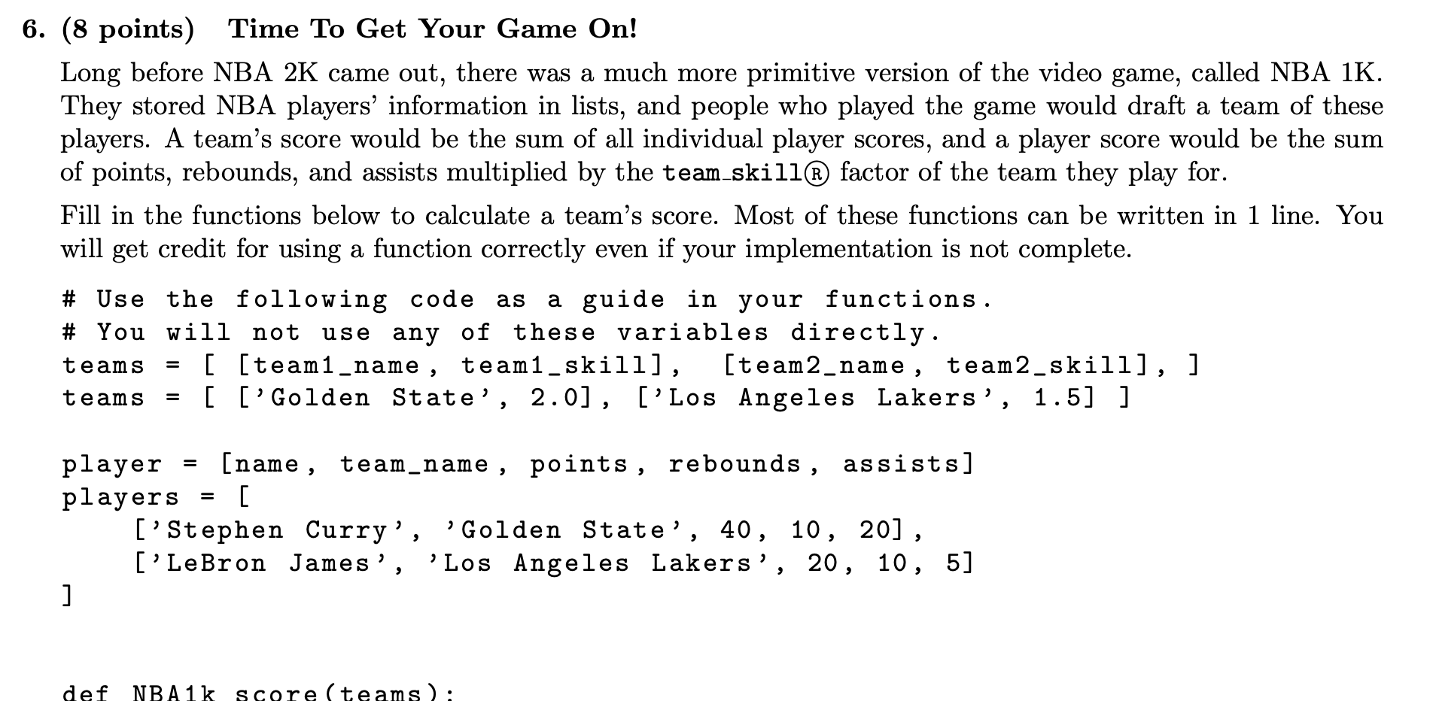
Fall 2019 #6

Slide 10
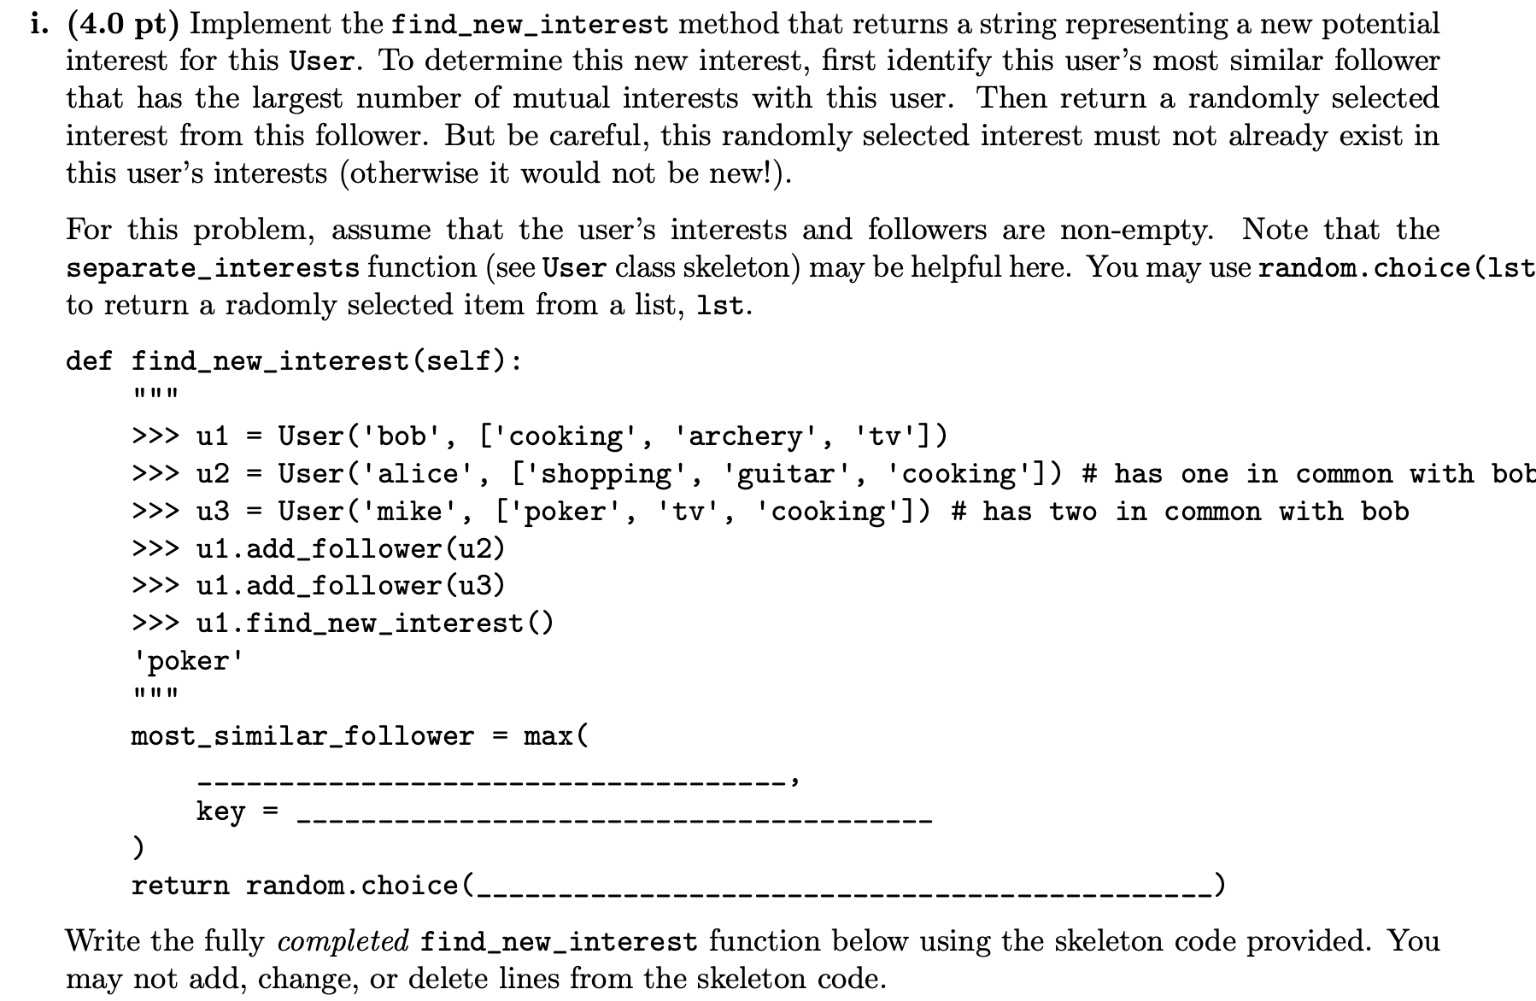
Fa21 8c

Slide 12
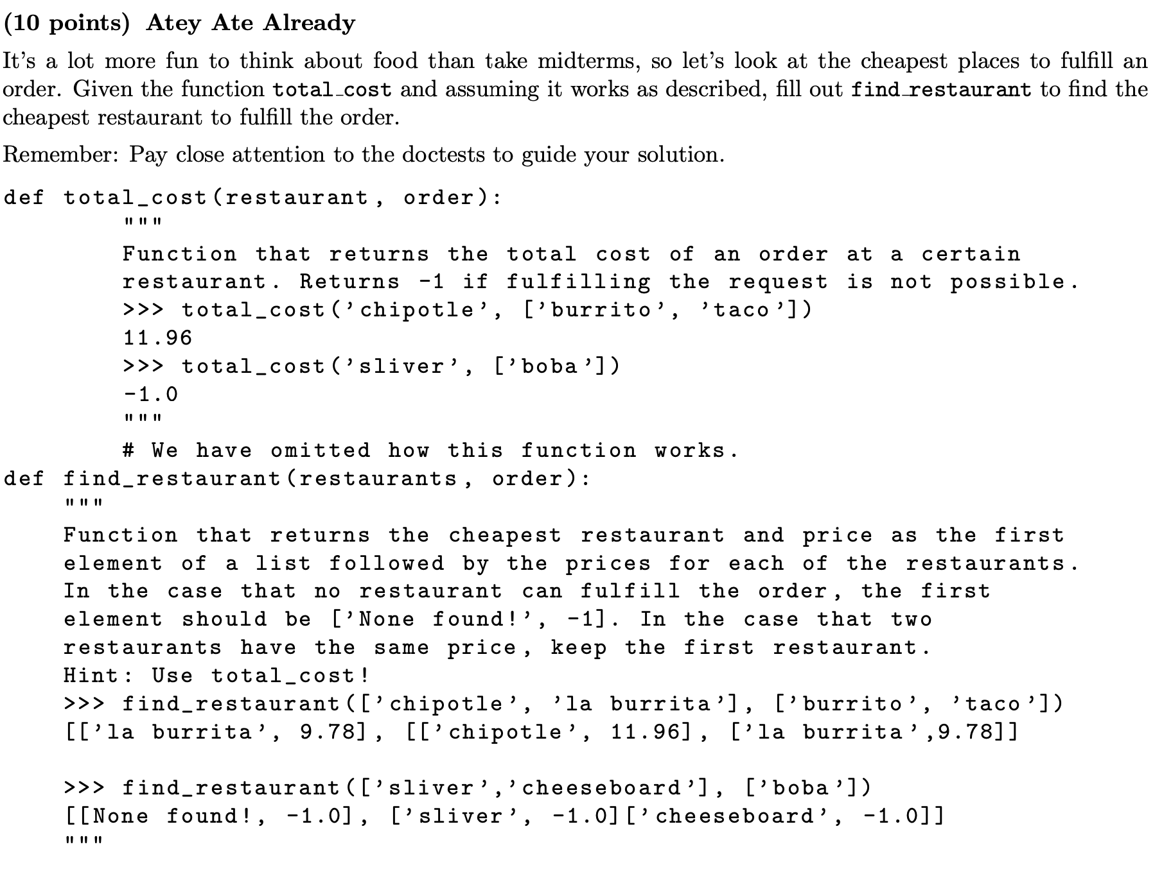
SP20 #5

Slide 13
