Slide 1
Midterm Review

Slide 2
Announcements & Policies
Midterm:
2 hours, 120 Minutes
Unlimited Handwritten Cheat sheets – More than ~3 is counter-productive
1 CS88 Provided Reference Sheet
Verify Scheduling / Accommodations

Slide 3
My Advice
Don't rush!
Skim the exam first
It's ok to do questions out of order!
Get the stuff you're good without out of the way
BUT don't spend too much time planning the exam.
Read through the question once
What's it asking you to do at a high level?
What do the doctests suggest?
What techniques should you be using?

Slide 4
Questions from Ed

Slide 5
OOP Questions
super() is a method which refers to the parent class of an object.
It returns a special kind of instance of an object.
We can use super() or the class name of the parent class
Private Attributes and Methods:
self.x is "public"
self._x is a convention which means "you shouldn't use this"
self.__x is private. Python prevents other classes from accessing that attribute.
Method calls:
object.method(arguments) is the same as Class.method(object, arguments)
cs88.deposit(5o) vs Account.deposit(cs88, 50)

Slide 6
ADTs
Constructors / Selectors / Operators
help us think about the actions to represent an object.
Abstraction Barrier:
Means that a function does not rely directly on a particular implementation
Should a function return data?
Usually yes! It depends on the goals!

Slide 7
Exam Practice
Spring 22 Q7
Spring 20 Q5

Slide 8
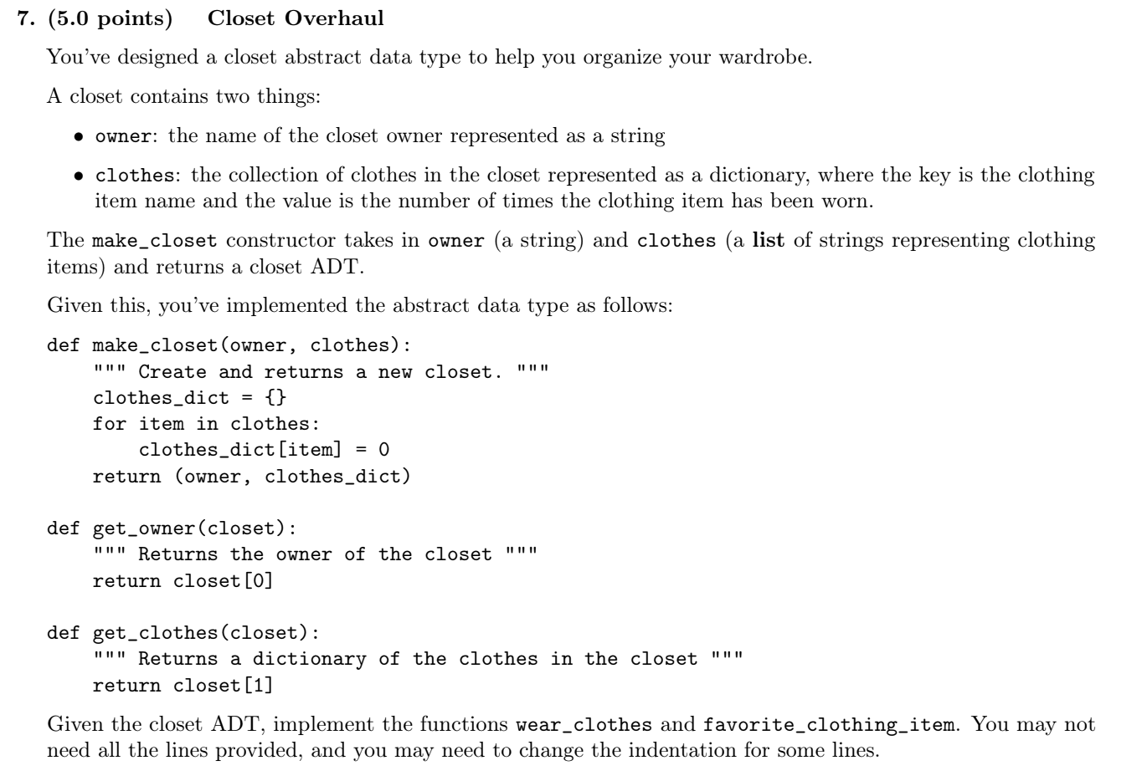
SP22

Slide 9
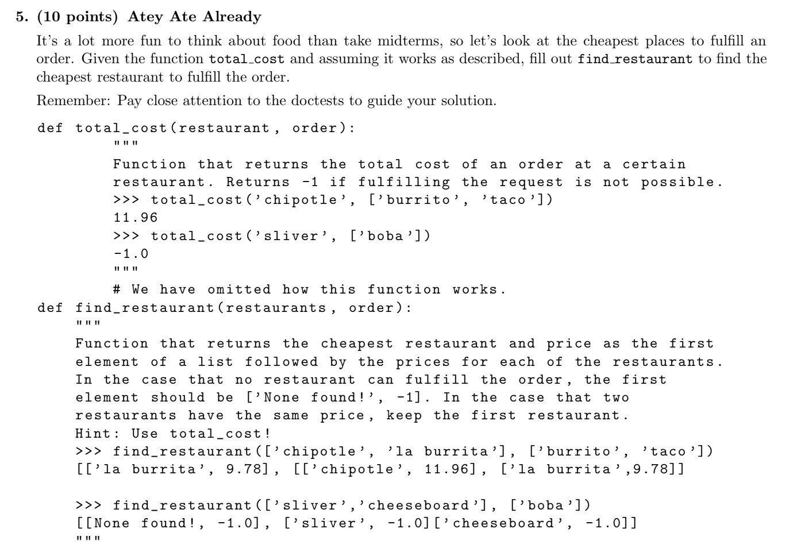

Slide 10
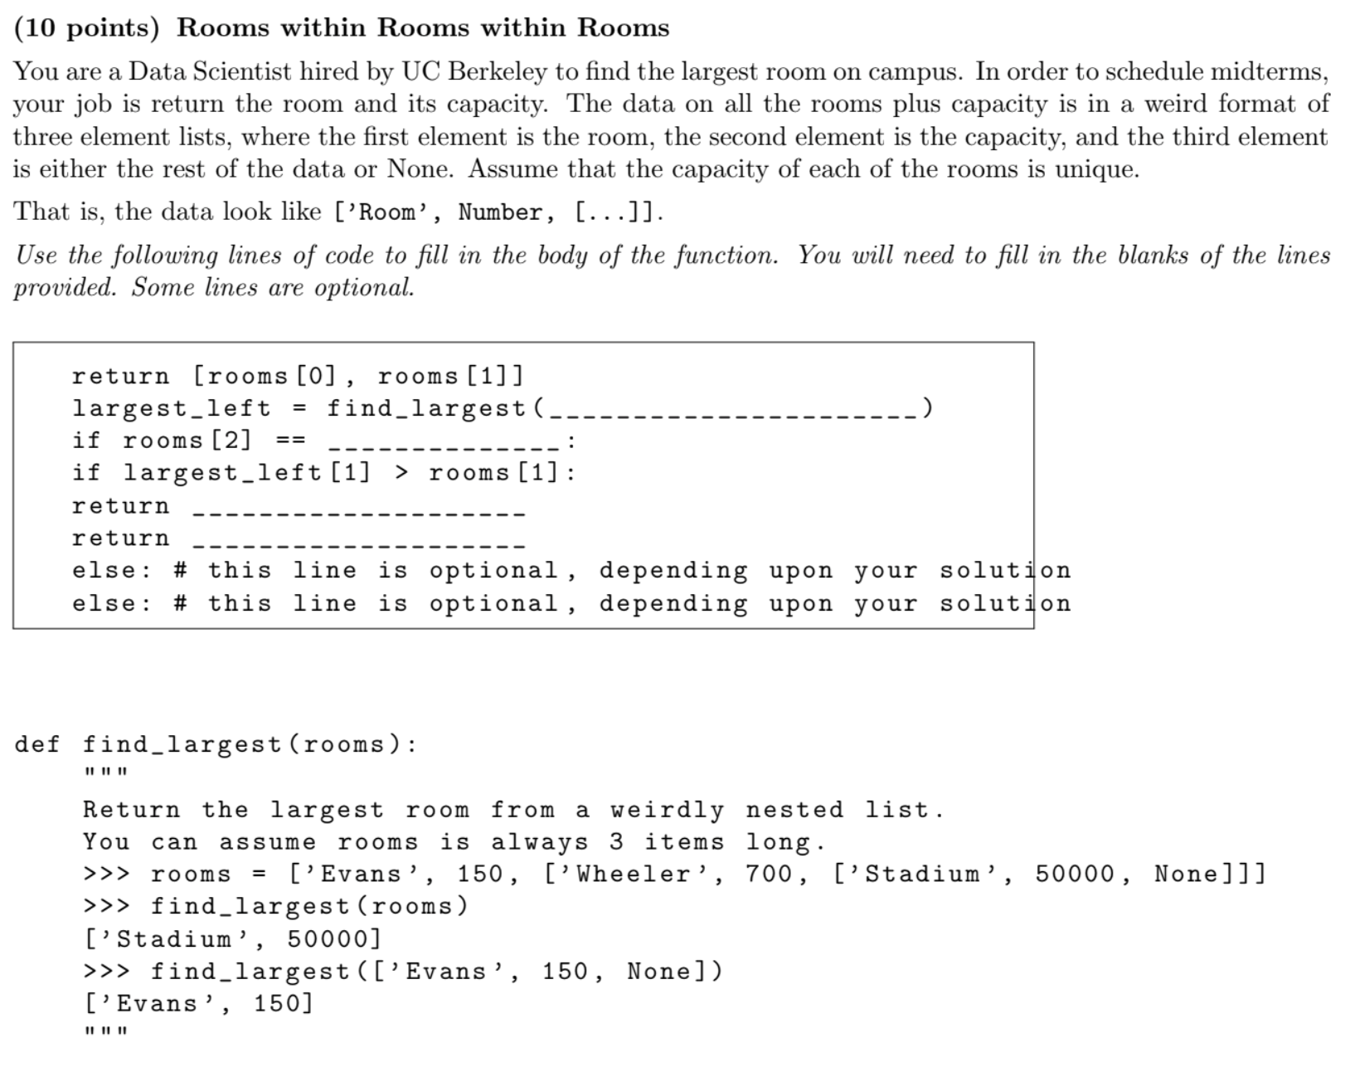
SP20 #6

Slide 11
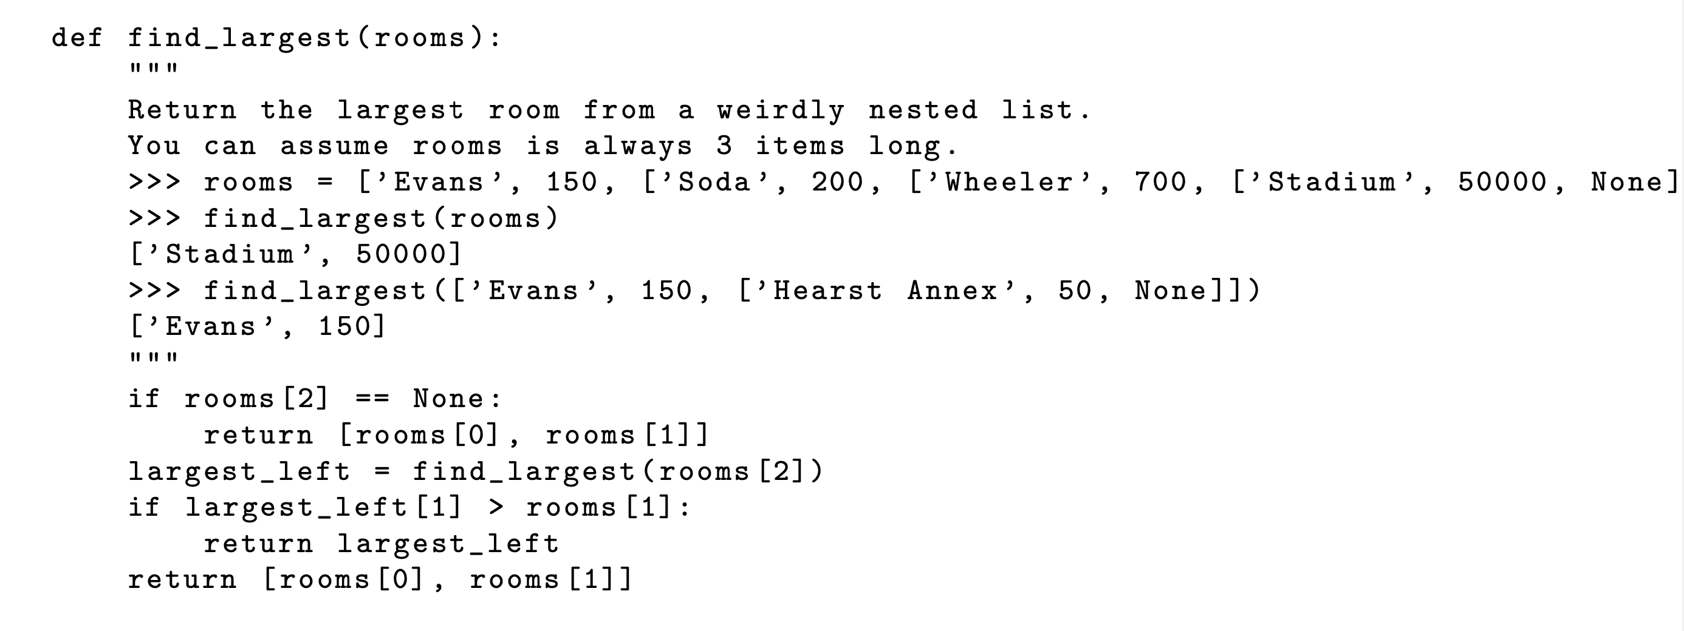

Slide 12
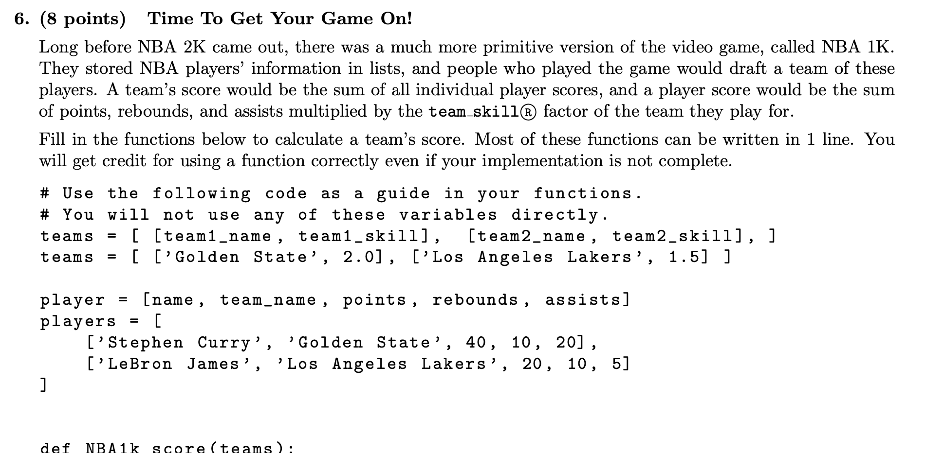
Fall 2019 #6

Slide 14
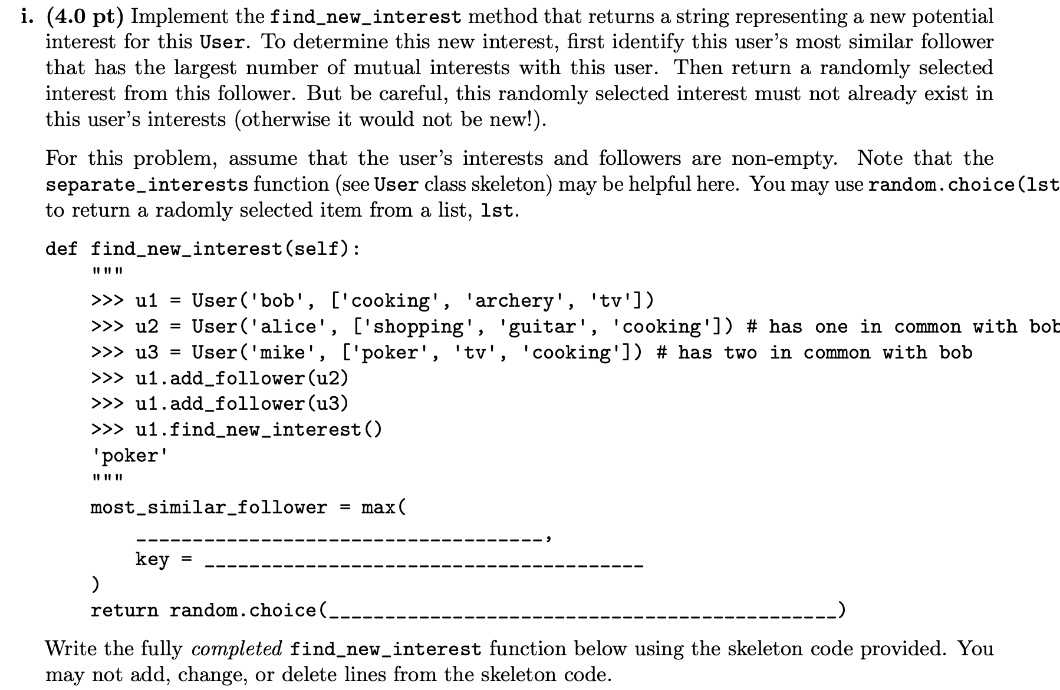
Fa21 8c

Slide 16
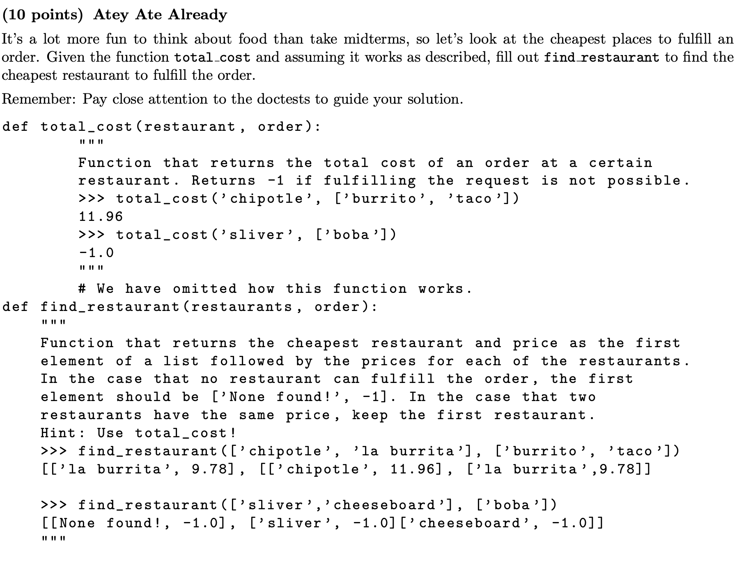
SP20 #5

Slide 17
