Slide 1
Lecture 3: Functions and Lops

Slide 2
Announcements
In person next week!
Please check the CS88 Google Calendar for locations

Slide 3
Let’s Talk About Python
Expression 3.1 * 2.6
Call expression max(0, x)
Variables
Assignment Statement x = <expression>
Define Function: def <function name> (<parameter list>):
Control Statements: if … while …
Notes:
z = 1,2
x,y = 3,4
a,b = z

Slide 4
Python: Definitions and Control

Slide 5
Learning Objectives
Create your own functions.
Write a loop to run the same code multiple times
Use conditionals to control when a loop stops

Slide 6
Conditional Statement
Do some statements, conditional on a predicate expression
Example:
if <predicate>:
<true statements>
else:
<false statements>
if (temperature>37.2):
print(“fever!”)
else:
print(“no fever”)

Slide 7
Defining Functions
def <function name> (<argument list>) :
expression
return
Abstracts an expression or set of statements to apply to lots of instances of the problem
A function should do one thing well

Slide 8
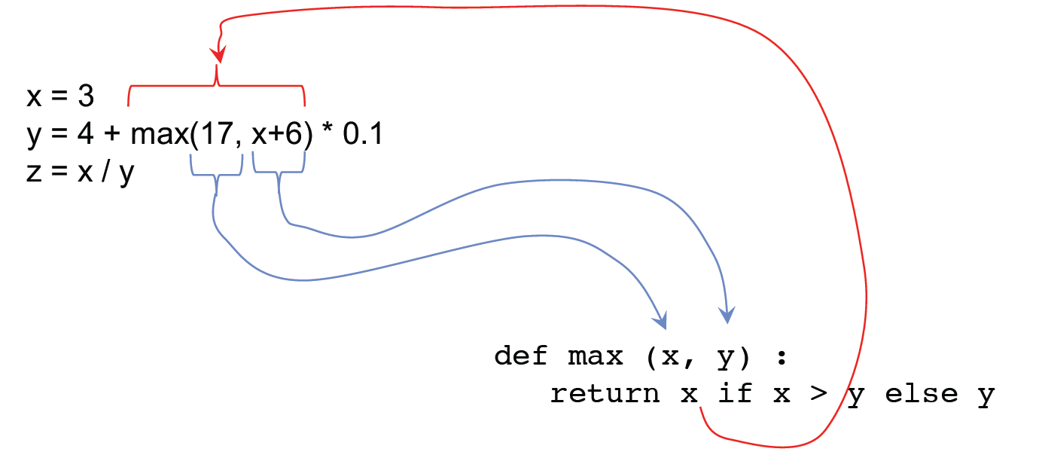
Functions: Example

Slide 9
How to Write a Good Function
Give a descriptive name
Function names should be lowercase. If necessary, separate words by underscores to improve readability. Names are extremely suggestive!
Chose meaningful parameter names
Again, names are extremely suggestive.
Write the docstring to explain what it does
What does the function return? What are corner cases for parameters?
Write doctest to show what it should do
Before you write the implementation.
Python Style Guide: https://www.python.org/dev/peps/pep-0008

Slide 10
Functions: Calling and Returning Results
Python Tutor
def max(x, y):
return x if x > y else y
x = 3
y = 4 + max(17, x + 6) * 0.1
z = x / y

Slide 11
Doctests
Write the docstring to explain what it does
What does the function return? What are corner cases for parameters?
Write doctest to show what it should do
Before you write the implementation.
python3 –m doctest [-v] file.py

Slide 12
Returns and Values
All functions always return SOME value.
If you don’t specify return, the value is None.

Slide 13
Iteration with while Loops

Slide 14
Learning Objectives
Use a while loop to repeat some task.
Write an expression to control when a while loop stops executing

Slide 15
while Statement – Iteration Control
Repeat a block of statements until a predicate expression is satisfied
<initialization statements>
while <predicate expression>:
<body statements>
<rest of the program>

Slide 16
Sum The Numbers
This is a task we'll see many times!
total = 0
n = 1
while n <= 10:
total += n
n += 1
print(total)

Slide 17
Environments & Higher Order Functions
Notes:
17

Slide 18
Learning Objectives
Use environment diagrams to model Python

Slide 19
Example: compose
Python Tutor: http://pythontutor.com/composingprograms.html#code=def%20square%28x%29%3A%0A%20%20%20%20return%20x%20*%20x%0A%20%20%20%20%0As%20%3D%20square%0Ax%20%3D%20s%283%29%0A%0Adef%20make_adder%28n%29%3A%0A%20%20%20%20def%20adder%28k%29%3A%0A%20%20%20%20%20%20%20%2

Slide 20
Environment Diagrams
Organizational tools that help you understand code
Terminology:
Frame: keeps track of variable-to-value bindings, each function call has a frame
Global Frame: global for short, the starting frame of all python programs, doesn’t correspond to a specific function
Parent Frame: The frame of where a function is defined (default parent frame is global)
Frame number: What we use to keep track of frames, f1, f2, f3, etc
Variable vs Value: x = 1. x is the variable (name), 1 is the value

Slide 21
Environment Diagrams Steps
Draw the global frame
When evaluating assignments (lines with single equal), always evaluate right side first
When you call a function MAKE A NEW FRAME!
When assigning a primitive expression (number, boolean, string) write the value in the box
When assigning anything else, draw an arrow to the value
When calling a function, name the frame with the intrinsic name – the name of the function that variable points to
The parent frame of a function is the frame in which it was defined in (default parent frame is global)
If the variable isn’t in the current frame, search in the parent frame

Slide 22
Environment Diagram Tips / Links
NEVER EVER draw an arrow from one variable to another.
Useful Resources:
http://markmiyashita.com/cs61a/environment_diagrams/rules_of_environment_diagrams/
http://albertwu.org/cs61a/notes/environments.html

Slide 23
Iteration With for Loops

Slide 24
Learning Objectives
Compare a for loop and a while loop.
Learn to use range()
Use a string as a sequence of letters

Slide 25
for Statement – Iteration Control
Repeat a block of statements for a structured sequence of variable bindings
<initialization statements>
for <variables> in <sequence expression>:
<body statements>
<rest of the program>

Slide 26
<sequence expression> — What's that?
Sequences are a type of data that can broken down into smaller parts.
Common sequences:
range() – gimme all the numbers
strings
lists (next week!)
We'll start with two basic facts:
range(10) is the numbers 0 to 9, or range(0, 10)
[] means "indexing" an item in a sequence.
"Hello"[0] == "H"

Slide 27
Data-Driven Iteration
describe an expression to perform on each item in a sequence
let the data dictate the control
[ <expr with loop var> for <loop var> in <sequence expr > ]

