Slide 1
Lambda
Notes:
1

Slide 2
Learning Objectives
Lambda are anonymous functions, which use expressions
Don’t use return, lambdas always return the value of the expression.
They are typically short and concise
They don’t have an “intrinsic” name when using an environment diagram.
Their name is the character 𝜆

Slide 3
lambda
Function expression
“anonymous” function creation
Expression, not a statement, no return or any other statement
lambda <arg or arg_tuple> : <expression using args>
add_one = lambda v : v + 1
def add_one(v):
return v + 1

Slide 4
Lambdas
>>> def inc_maker(i):
... return lambda x: x+i
...
>>> inc_maker(3)
<function inc_maker.<locals>.<lambda> at 0x10073c510>
>>> inc_maker(3)(4)
7
>>> map(inc_maker(3), [1,2,3,4])
<map object at 0x1020950b8>
>>> list(map(inc_maker(3), [1,2,3,4]))
[4, 5, 6, 7]
>>>

Slide 5
Lambda with HOFs
A function that returns (makes) a function
def leq_maker(c):
return lambda val: val <= c
>>> leq_maker(3)
<function leq_maker.<locals>.<lambda> at 0x1019d8c80>
>>> leq_maker(3)(4)
False
>>> filter(leq_maker(3), [0,1,2,3,4,5,6,7])
[0, 1, 2, 3]

Slide 6
Lambda Examples
>>> sort([1,2,3,4,5], lambda x: x)
[1, 2, 3, 4, 5]
>>> sort([1,2,3,4,5], lambda x: -x)
[5, 4, 3, 2, 1]
>>> sort([(2, "hi"), (1, "how"), (5, "goes"), (7, "I")],
lambda x:x[0])
[(1, 'how'), (2, 'hi'), (5, 'goes'), (7, 'I')]
>>> sort([(2, "hi"), (1, "how"), (5, "goes"), (7, "I")],
lambda x:x[1])
[(7, 'I'), (5, 'goes'), (2, 'hi'), (1, 'how')]
>>> sort([(2,"hi"),(1,"how"),(5,"goes"),(7,"I")],
lambda x: len(x[1]))
[(7, 'I'), (2, 'hi'), (1, 'how'), (5, 'goes')]
http://cs88-website.github.io/assets/slides/adt/mersort.py

Slide 7
Dictionaries
Notes:
7

Slide 8
Learning Objectives
Dictionaries are a new type in Python
Lists let us index a value by a number, or position.
Dictionaries let us index data by other kinds of data.

Slide 9
Dictionaries
Constructors:
dict( <list of 2-tuples> )
dict( <key>=<val>, ...) # like kwargs
{ <key exp>:<val exp>, … }
{ <key>:<val> for <iteration expression> }
>>> {x:y for x,y in zip(["a","b"],[1,2])}
{'a': 1, 'b': 2}
Selectors: <dict> [ <key> ]
<dict>.keys(), .items(), .values()
<dict>.get(key [, default] )
Operations:
Key in, not in, len, min, max
<dict>[ <key> ] = <val>

Slide 10
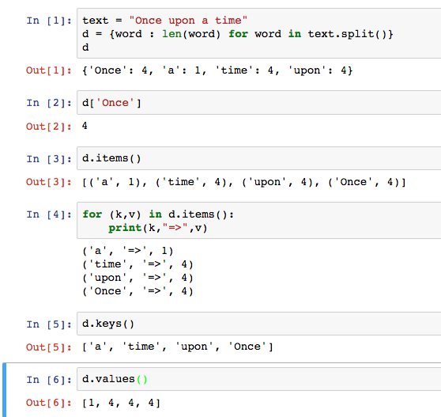
Dictionary Example

Slide 11
Dictionary Example

Slide 12
Bonus / Review
Left over slides we didn’t get to.

Slide 13
Three super important HOFS
list(map(function_to_apply, list_of_inputs))
Applies function to each element of the list
list(filter(condition, list_of_inputs))
Returns a list of elements for which the condition is true
reduce(function, list_of_inputs)
Applies the function, combining items of the list into a "single" value.

Slide 14
What does this do?
list(map(capitalize, ['michael', 'Alex', 'Srinath', 'julia']
)) Assume capitalize('michael') == 'Michael'
A) ['michael', 'Alex', 'Srinath', 'julia']
B) ['Michael', 'Alex', 'Srinath', 'Julia']
C) []
D) Error
E) I'm lost.
02/10/2020
UCB CS88 Fa20 L6
14

Slide 15
What does this do?
list(filter(return_false, range(100)
)) Assume return_false(42) == False
A) range(0, 100) # A standard range object
B) [0, 1, 2, … 96, 97, 98, 99]
C) [ ]
D) Error
E) I'm lost.
02/10/2020
UCB CS88 Fa20 L6
15

