Slide 1
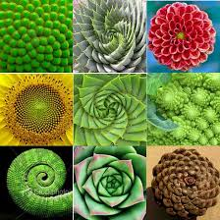
Recursion II

Slide 2
Announcements
Maps due Friday 3/4

Slide 3
Learning Objectives
Write a recursive function
Understand the base case and a recursive case
Apply Recursive Functions to lists

Slide 4
The Recursive Process
Recursive solutions involve two major parts:
Base case(s), the problem is simple enough to be solved directly
Recursive case(s). A recursive case has three components:
Divide the problem into one or more simpler or smaller parts
Invoke the function (recursively) on each part, and
Combine the solutions of the parts into a solution for the problem.

Slide 5
Iteration vs Recursion: Sum Numbers
For loop:
def sum(n):
s=0
for i in range(0,n+1):
s=s+i
return s

Slide 6
Iteration vs Recursion: Sum Numbers
While loop:
def sum(n):
s=0
i=0
while i<n:
i=i+1
s=s+i
return s

Slide 7
Iteration vs Recursion: Sum Numbers
Recursion:
def sum(n):
if n == 0:
return 0
return n+sum(n-1)

Slide 8
Iteration vs Recursion: Cheating!
Sometimes it’s best to just use a formula! But that’s not always the point. ☺
def sum(n):
return (n * (n + 1)) / 2

Slide 9
In words
The sum of no numbers is zero
The sum of 1² through n² is the
sum of 1² through (n-1)²
plus n²
def sum_of_squares(n):
if n < 1:
return 0
else:
return sum_of_squares(n-1) + n**2

Slide 10
Recall: Iteration
1. Initialize the “base” case of no iterations
2. Starting value
def sum_of_squares(n):
accum = 0
for i in range(1,n+1):
accum = accum + i*i
return accum
3. Ending value
4. New loop variable value

Slide 11
Recursion Key concepts – by example
1. Test for simple “base” case
2. Solution in simple “base” case
def sum_of_squares(n):
if n < 1:
return 0
else:
return sum_of_squares(n-1) + n**2
3. Assume recusive solution to simpler problem
4. ”Combine” the simpler part of the solution, with the recursive case

Slide 12
In words
The sum of no numbers is zero
The sum of 1² through n² is the
sum of 1² through (n-1)²
plus n²
def sum_of_squares(n):
if n < 1:
return 0
else:
return sum_of_squares(n-1) + n**2

Slide 13
Why does it work
sum_of_squares(3)
# sum_of_squares(3) => sum_of_squares(2) + 3**2
# => sum_of_squares(1) + 2**2 + 3**2
# => sum_of_squares(0) + 1**2 + 2**2 + 3**2
# => 0 + 1**2 + 2**2 + 3**2 = 14

Slide 14
Questions
In what order do we sum the squares ?
How does this compare to iterative approach ?
def sum_of_squares(n):
accum = 0
for i in range(1,n+1):
accum = accum + i*i
return accum
def sum_of_squares(n):
if n < 1:
return 0
else:
return sum_of_squares(n-1) + n**2
def sum_of_squares(n):
if n < 1:
return 0
else:
return n**2 + sum_of_squares(n-1)

Slide 15
Local variables
Each call has its own “frame” of local variables
Let’s see the environment diagrams
def sum_of_squares(n):
n_squared = n**2
if n < 1:
return 0
else:
return n_squared + sum_of_squares(n-1)
https://goo.gl/CiFaUJ

Slide 16
How does it work?
Each recursive call gets its own local variables
Just like any other function call
Computes its result (possibly using additional calls)
Just like any other function call
Returns its result and returns control to its caller
Just like any other function call
The function that is called happens to be itself
Called on a simpler problem
Eventually stops on the simple base case

Slide 17
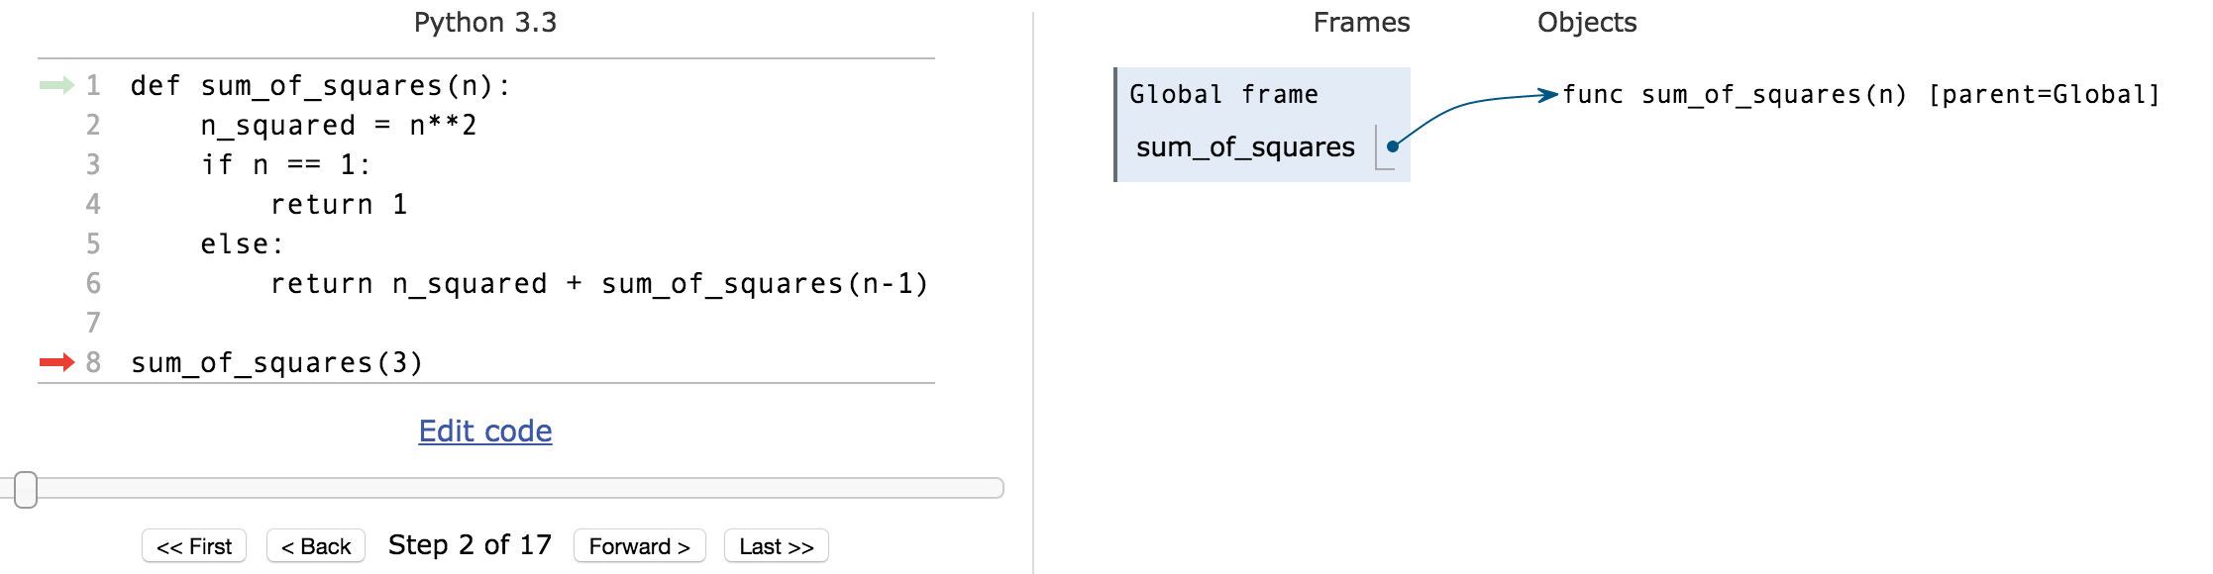
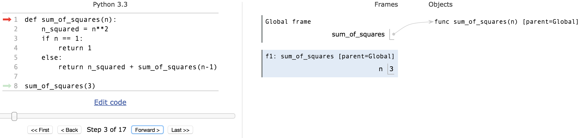
Environments Example
pythontutor.com

Slide 18
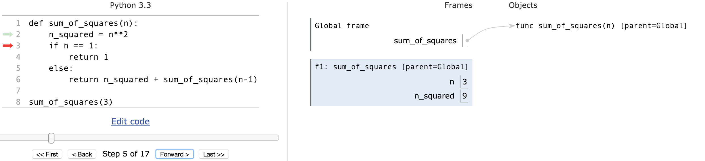
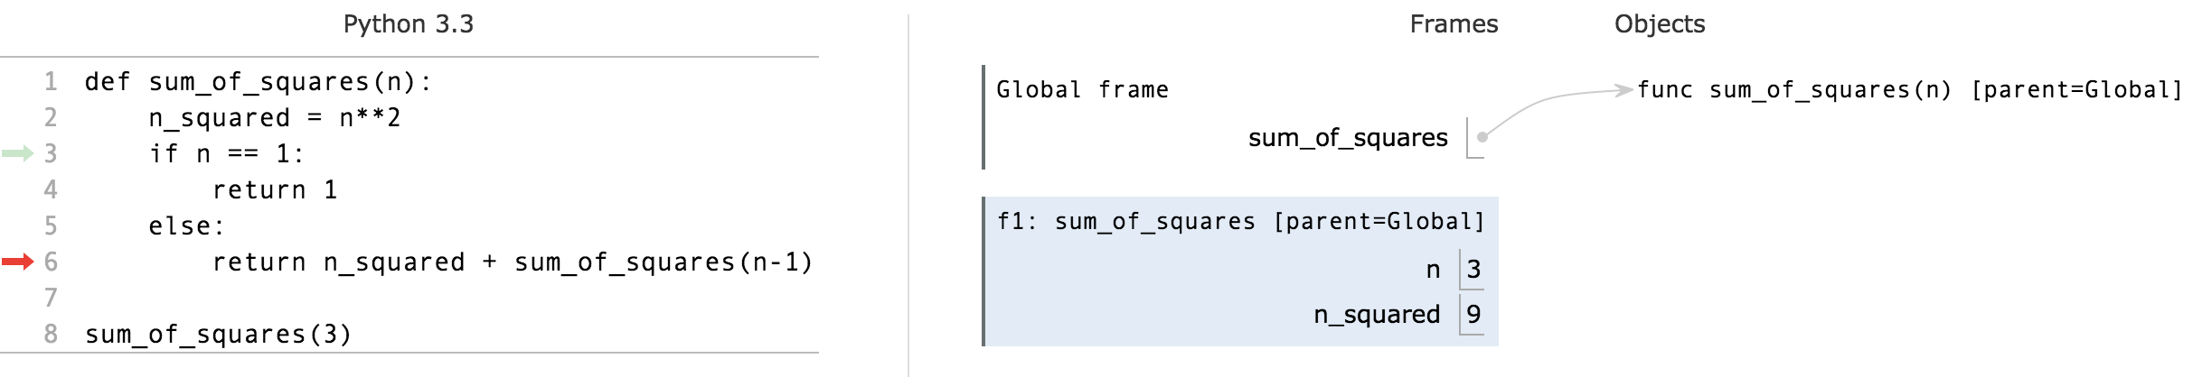
Environments Example

Slide 19
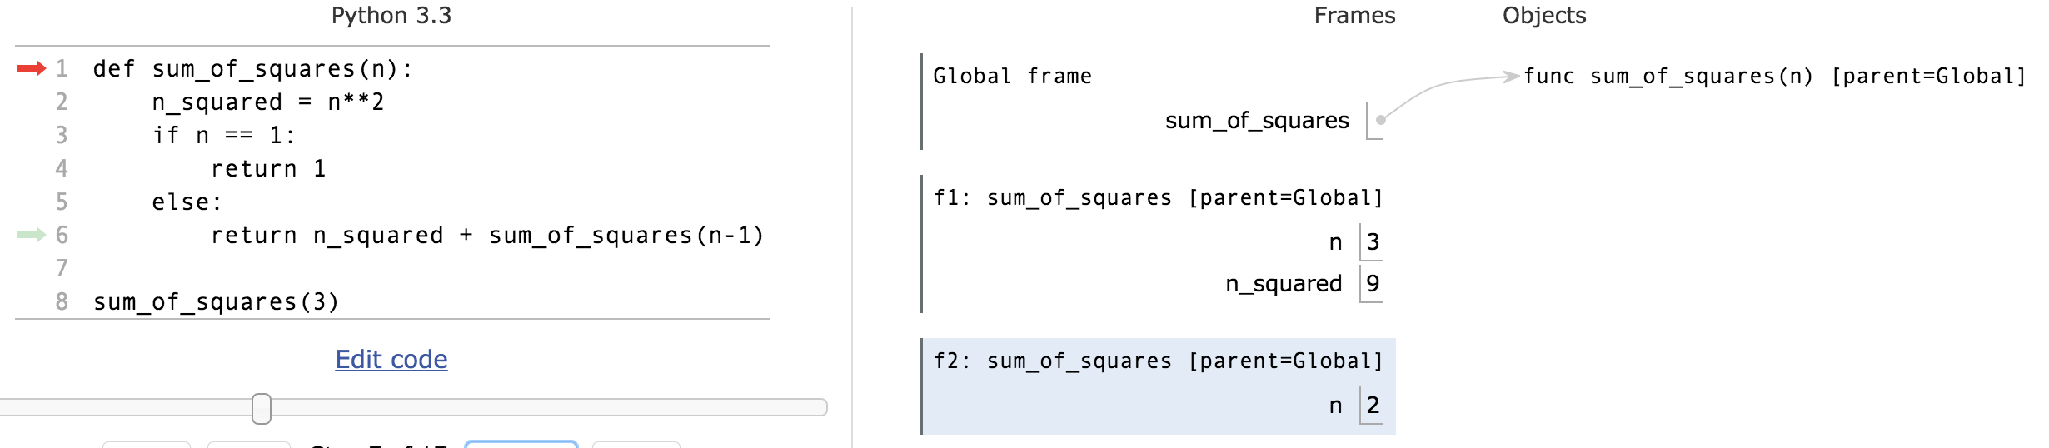
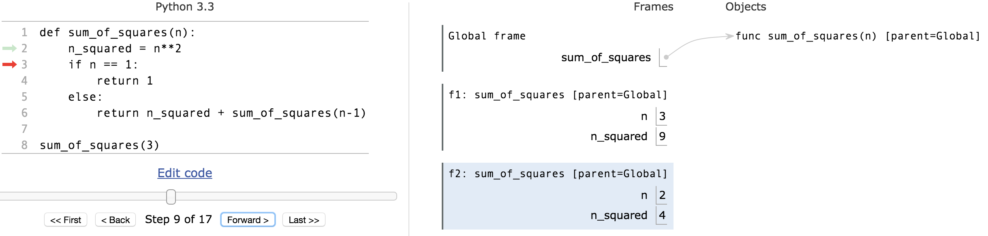
Environments Example

Slide 20
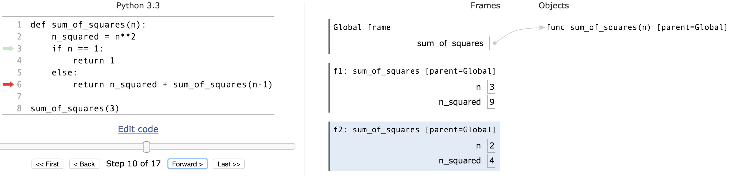
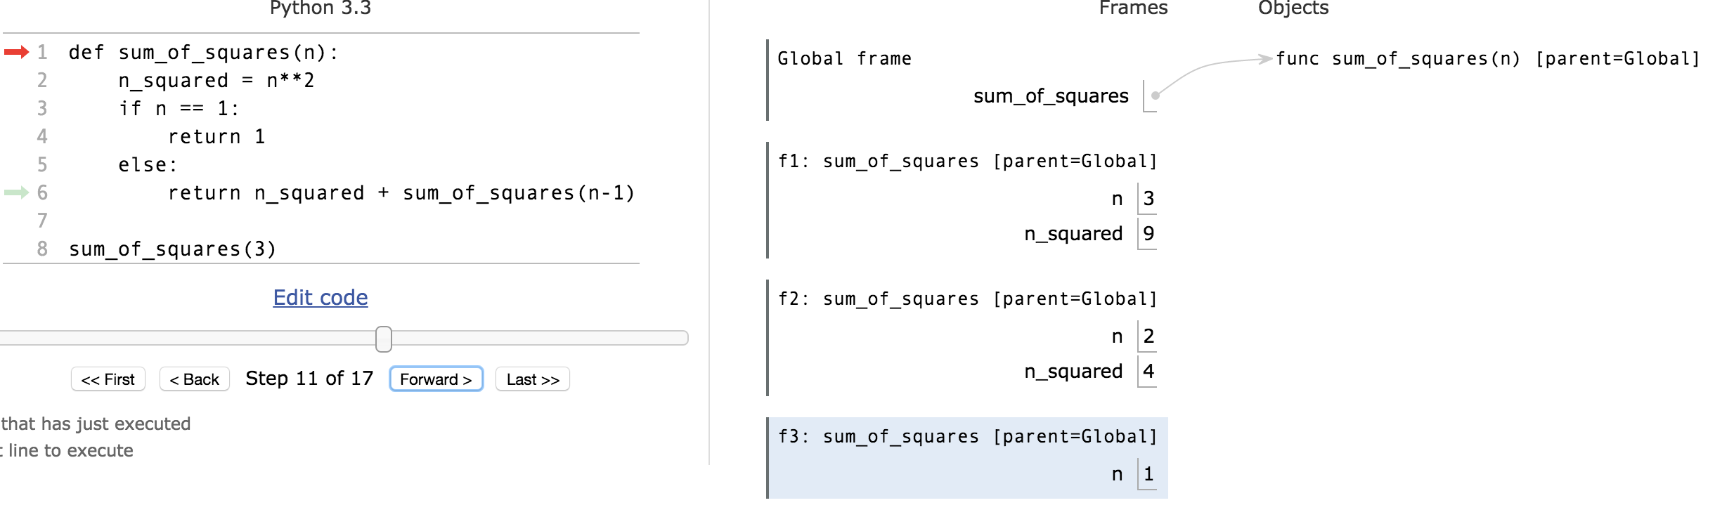
Environments Example

Slide 21
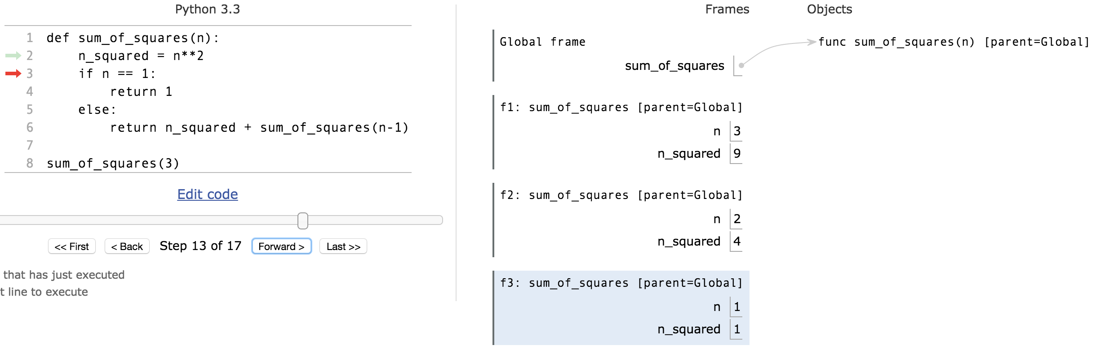
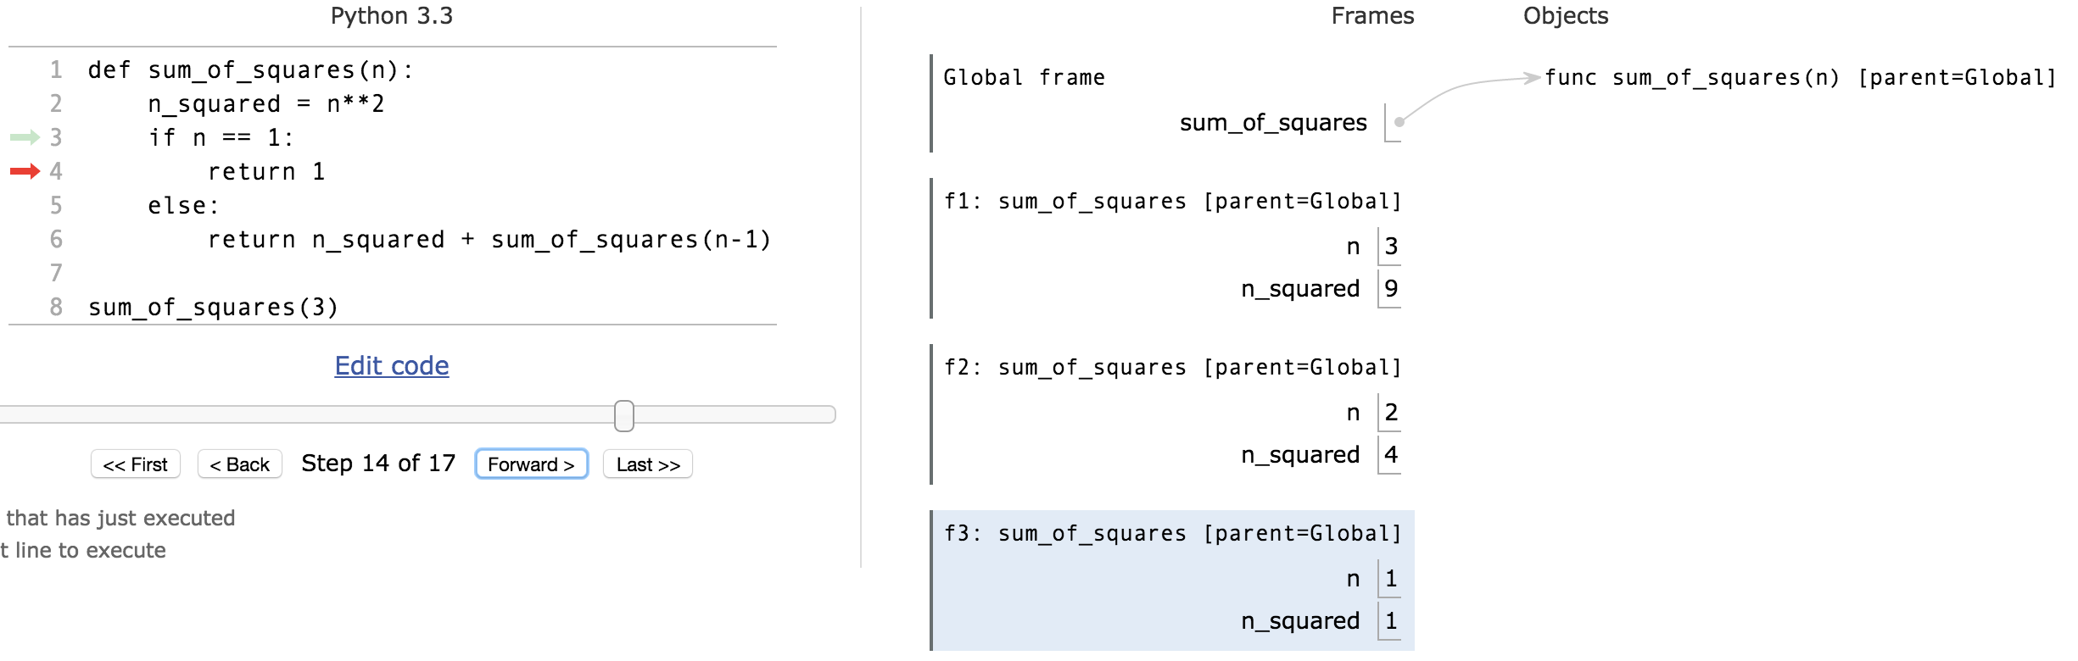
Environments Example
permlink

Slide 22
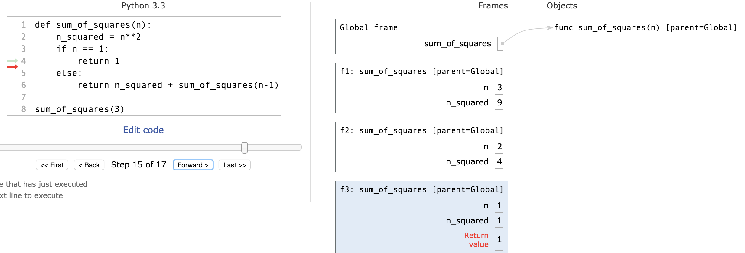
Environments Example

Slide 23
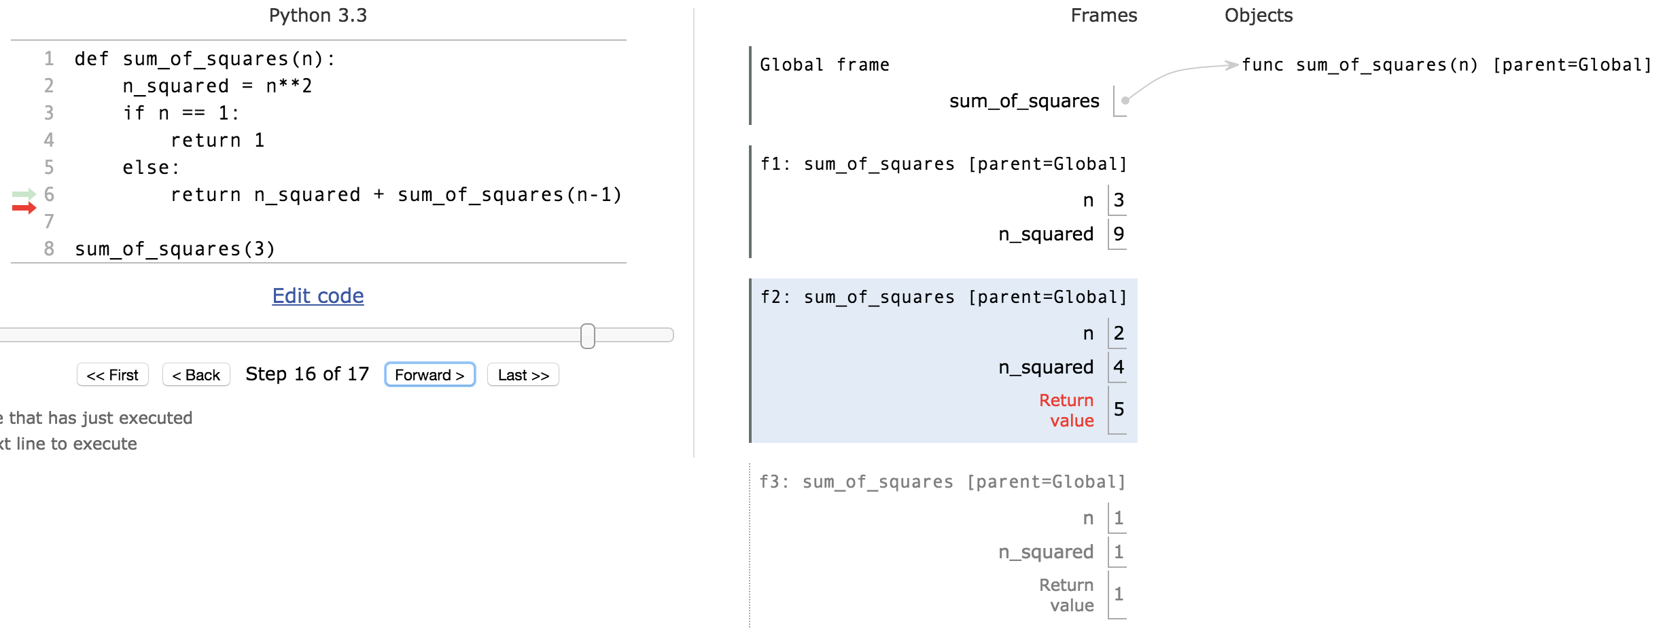
Environments Example

Slide 24
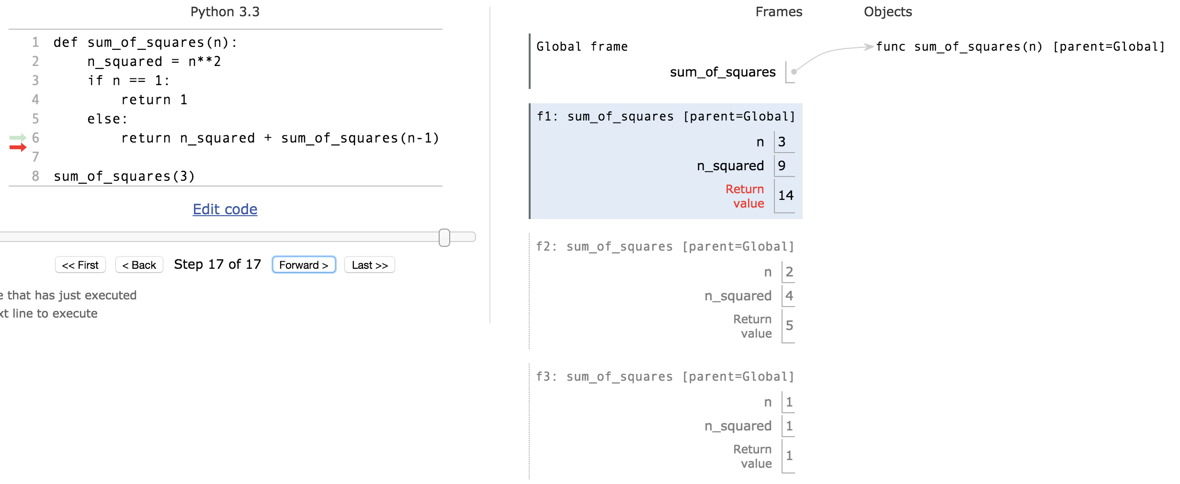
Environments Example

Slide 25
Recursion Visualizer
A new tool, similar to PythonTutor which shows just the recursive calls.
View Recursion

Slide 26
Recursion With Lists
Goal: Find the smallest item in a list, recursively.
Consider: How do we break this task into smaller parts? What is the "smallest list"?
We care about the size of the list itself, not the values.
def first(s):
"""Return the first element in a sequence."""
return s[0]
def rest(s):
"""Return all elements in a sequence after the first"""
return s[1:]
def min_r(s):
'''Return minimum value in a sequence.'''
if len(s) == 1:
return first(s)
else:
return min(first(s), min_r(rest(s)))
Base Case
Recursive Case

Slide 27
min_r
Works because we can eventually call min() with just two numbers
Each recursive call shrinks the list by 1 element.
Python Tutor Link (with first and rest functions)
Python Tutor (no first/rest defined)
This is just shorter and reduces the number of frames, but the same recursive calls
Sadly recursionvisualizer.com doesn't work on this example ☹

Slide 28
Recursion With Strings, and Other Iterables
Consider the lists example. It's basically the same thing. ☺
Recursive case: Split up the item into a small "first" item, and the "rest"
def reverse(s):
"""
>>> reverse('hello')
'olleh'
>>> reverse(reverse('hello'))
'hello'
"""
if not s:
return ''
return reverse(rest(s)) + first(s) # return reverse(s[1:]) + s[0]

Slide 29
Why Recursion?
“After Abstraction, Recursion is probably the 2nd biggest idea in this course”
“It’s tremendously useful when the problem is self-similar”
“It’s no more powerful than iteration, but often leads to more concise & better code”
“It’s more ‘mathematical’”
“It embodies the beauty and joy of computing”

