Slide 1
Object-Oriented Programming: Part 2, Inheritance

Slide 2
Announcements
Midterm 10/ 7-9pm
Locations and assignments will be sent early next week
Unli19mited Handwritten Sheets – but try to use no more than 3-4!
Lecture: Thurs 10/14 – More OOP Practice
Lecture: Tues 10/18 – Exam Review / Q&A
Check the Calendar!
Exam Review Sessions led by Tutors Fri 3-5pm (Cory 277) (time moved!)
New "topical" review sessions by TAs
CSM review sessions too
No labs next week
TAKE A DEEP BREATH! Y'all can do this. ☺

Slide 3
Classes Can Have Attributes Too!
Class attributes (as opposed to instance attributes) belong to the class itself, instead of each object
This means there is one value which is shared for all of the class's objects
Be Careful!
It's easy to overdo class attributes
Methods that rely only on class attributes are called class methods
Python has some special features we won't use, but are useful:
https://docs.python.org/3/library/functions.html?highlight=classmethod#classmethod

Slide 4
Example: class attribute
class BaseAccount:
account_number_seed = 1000
def __init__(self, name, initial_deposit):
self._name = name
self._balance = initial_deposit
self._acct_no = BaseAccount.account_number_seed
BaseAccount.account_number_seed += 1
def name(self):
return self._name
def balance(self):
return self._balance
def withdraw(self, amount):
self._balance -= amount
return self._balance

Slide 5
More class attributes
class BaseAccount:
account_number_seed = 1000
accounts = []
def __init__(self, name, initial_deposit):
self._name = name
self._balance = initial_deposit
self._acct_no = BaseAccount.account_number_seed
BaseAccount.account_number_seed += 1
BaseAccount.accounts.append(self)
def name(self):
...
def show_accounts():
for account in BaseAccount.accounts:
print(account.name(),
account.account_no(),account.balance())

Slide 6
Object-Oriented Programming: "Magic" Methods

Slide 7
Learning Objectives
Python's Special Methods define built-in properties
__init__ # Called when making a new instance
__sub__ # Maps to the - operator
__str__ # Called when we call print()
__repr__ # Called in the interpreter

Slide 8
Special Initialization Method
__init__ is called automatically when we write: my_account = BaseAccount('me', 0)
class BaseAccount:
def __init__(self, name, initial_deposit):
self.name = name
self.balance = initial_deposit
def account_name(self):
return self.name
def account_balance(self):
return self.balance
def withdraw(self, amount):
self.balance -= amount
return self.balance
return None

Slide 9
More special methods
class BaseAccount:
… (init, etc removed)
def deposit(self, amount):
self._balance += amount
return self._balance
def __repr__(self):
return '< ' + str(self._acct_no) +
'[' + str(self._name) + '] >'
def __str__(self):
return 'Account: ' + str(self._acct_no) +
'[' + str(self._name) + ']'
def show_accounts():
for account in BaseAccount.accounts:
print(account)
Goal: unambiguous
Goal: readable

Slide 10
More Magic Methods
We will not go through an exhaustive list!
Magic Methods start and end with "double underscores" __
They map to built-in functionality in Python. Many are logical names:
__add__ => + operator
__sub__ => - operator
__getitem__ => [] operator
A longer list for the curious:
https://docs.python.org/3/reference/datamodel.html

Slide 11
Live Demo

Slide 12
Object-Oriented Programming: Inheritance

Slide 13
Learning Objectives
Inheritance allows classes to reuse methods and attributes from a parent class.
super() is a new method in Python
Subclasses or child classes are distinct from on another, but share properties of the parent.

Slide 14
Inheritance
Define a class as a specialization of an existing class
Inherent its attributes, methods (behaviors)
Add additional ones
Redefine (specialize) existing ones
Ones in superclass still accessible in its namespace

Slide 15
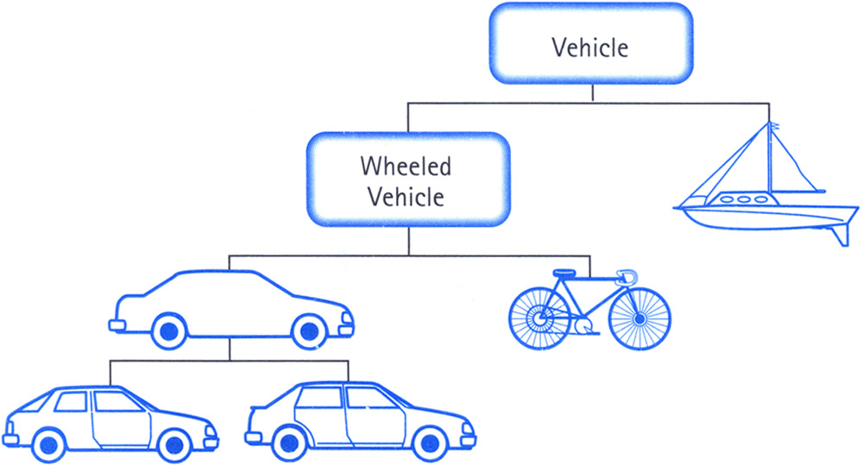
Class Inheritance
Classes can inherit methods and attributes from parent classes but extend into their own class.

Slide 16
Python class statement
class ClassName:
<statement-1>
.
.
.
<statement-N>
class ClassName ( inherits / parent-class ):
<statement-1>
.
.
.
<statement-N>

Slide 17
Example
class BaseAccount:
def __init__(self, name, initial_deposit):
# Initialize the instance attributes
self._name = name
self._acct_no = Account._account_number_seed
Account._account_number_seed += 1
self._balance = initial_deposit
class CheckingAccount(BaseAccount): def __init__(self, name, initial_deposit):
# Use superclass initializer
BaseAccount.__init__(self, name, initial_deposit)
# Alternatively:
# super().__init__(name, initial_deposit)
# Additional initialization
self._type = "Checking"

Slide 18
Accessing the Parent Class
super() gives us access to methods in the parent or "superclass"
Can be called anywhere in our class
Handles passing self to the method
Handles looking up an attribute on a parent class, too.
We can directly call ParentClass.method(self, …)
This is not quite as flexible if our class structure changes.
In general, prefer using super()!
Outside of C88C, things can get complex…
https://docs.python.org/3/library/functions.html#super

Slide 19
Object-Oriented Programming: Evolving The Bank Model

Slide 20
Composing Classes Together
Currently, our BaseAccount stores a lot of data in class attributes…
This suggests we are trying to accomplish an entirely new kind of class, or object
A Bank!
We should extract that these functions into their own class
A bank can now manage:
making accounts
keeping track of account numbers
showing and listing accounts

Slide 21
Live Demo

