Slide 1
SQL

Slide 2
Announcements
All remaining assignments including Ants Due 12/5
All can be submitted as w/a partner
Everyone gets 3 homework + lab drops
HW10, 11, 12 will be largely effort based.
If you get a 4/8, you'll get 8/8
Slip Days basically do not matter. ☺
Ants Updates:
Everyone gets Checkpoint 1 points for submitting the assignment.
Max Score = 41/54 – I'll scale the points
Phase 4 is optional, will become EC of some sort.
No early EC, but can get EC for doing some of Phase 4 + EC

Slide 3
Final Exam Information
Final Exam format is slightly TBD
Will be entirely remote
We will use Zoom proctoring.
I will email everyone a Zoom link early finals week
Will likely be multiple choice + short answer via Gradescope
SQL is in scope, Trees are in scope
These topics will be in less depth than normal.
think conceptual questions, self-checks, environment diagrams, pick the right line of code.
Exam is typically 96 points over 3 hours.
I'll likely design a ~60-point exam (completable in 2 hours) but you'll have 3.
Closed internet, but open hand-written notes

Slide 4
SQL: SELECT Statements

Slide 5
Summary
SQL a declarative programming language on relational tables
largely familiar to you from data8
create, select, where, order, group by, join
Databases are accessed through Applications
e.g., all modern web apps have Database backend
Queries are issued through API
Be careful about app corrupting the database
Data analytics tend to draw database into memory and operate on it as a data structure
e.g., Tables
More in lab

Slide 6
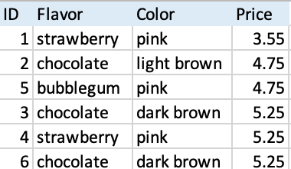
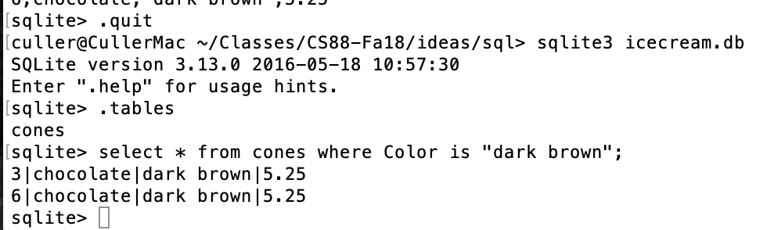
Permanent Data Storage

Slide 7
select
Comma-separated list of column descriptions
Column description is an expression, optionally followed by as and a column name
Selecting literals creates a one-row table
union of select statements is a table containing the union of the rows
select [expression] as [name], [expression] as [name]; . . .
select "strawberry" as Flavor, "pink" as Color, 3.55 as Price;
select "strawberry" as Flavor, "pink" as Color, 3.55 as Price union
select "chocolate","light brown", 4.75 union
select "chocolate","dark brown", 5.25 union
select "strawberry","pink",5.25 union
select "bubblegum","pink",4.75;

Slide 8
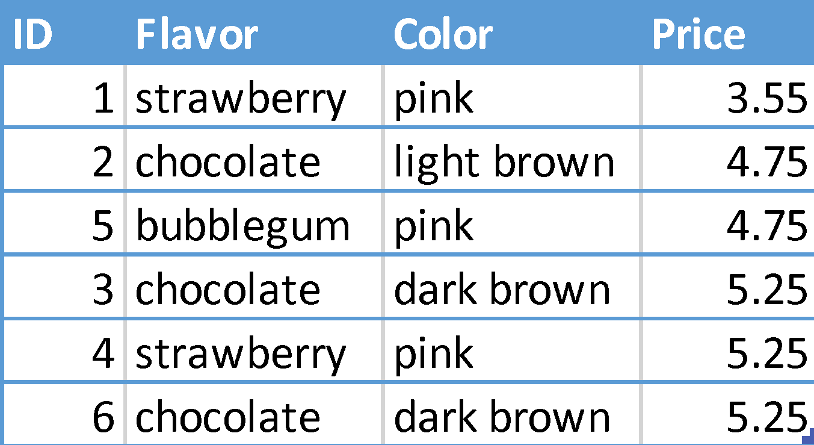
Projecting existing tables
Input table specified by from clause
Subset of rows selected using a where clause
Ordering of the selected rows declared using an order by clause
SELECT [columns] FROM [table] WHERE [condition] ORDER BY [order];
SELECT * FROM cones ORDER BY Price;

Slide 9
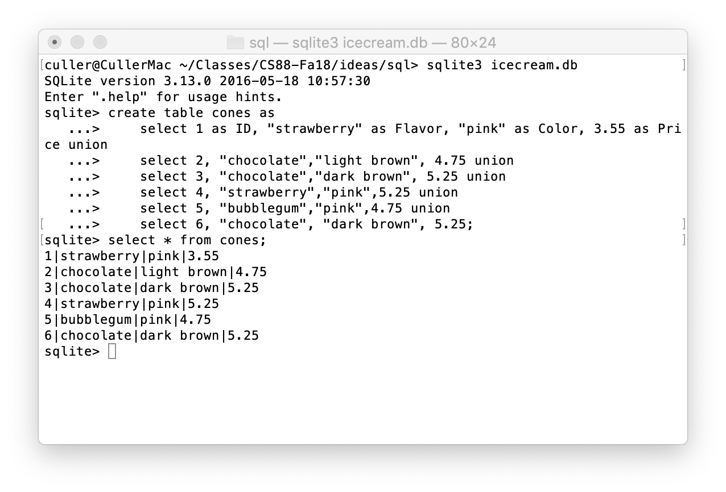
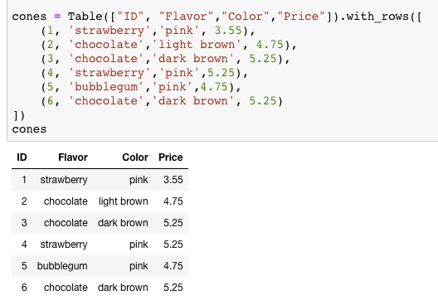
SELECT

Slide 10
SQL: Filtering Queries

Slide 11
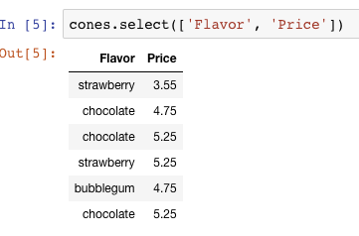
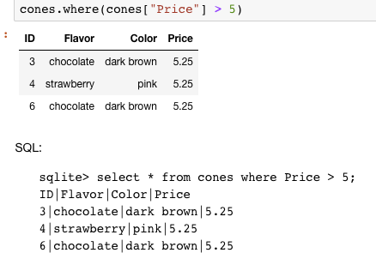
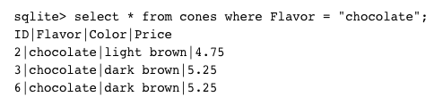
Filtering rows - WHERE
Set of Table records (rows) that satisfy a condition
SELECT [columns] FROM [table] WHERE [condition] [ORDER BY order];

Slide 12
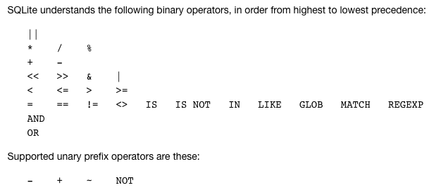
SQL Operators for predicates
use the WHERE clause in the SQL statements such as SELECT, UPDATE and DELETE to filter rows that do not meet a specified condition

Slide 13
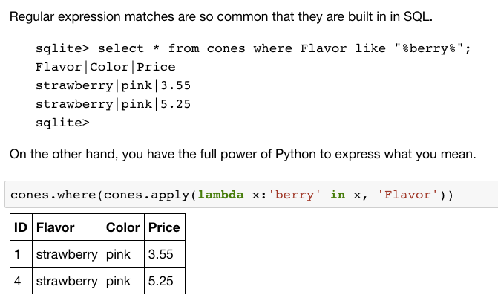
Approximate Matching …

Slide 14
SQL: CREATE and INSERT and UPDATE

Slide 15
CREATE TABLE
SQL often used interactively
Result of select displayed to the user, but not stored
Can create a table in many ways
Often may just supply a list of columns without data.
Create table statement gives the result a name
Like a variable, but for a permanent object
CREATE TABLE [name] AS [select statement];

Slide 16
SQL: creating a named table
CREATE TABLE cones AS
select 1 as ID, "strawberry" as Flavor, "pink" as Color, 3.55 as Price union
select 2, "chocolate", "light brown", 4.75 union
select 3, "chocolate", "dark brown", 5.25 union
select 4, "strawberry", "pink",5.25 union
select 5, "bubblegum", "pink",4.75 union
select 6, "chocolate", "dark brown", 5.25;
Notice how column names are introduced and implicit later on.

Slide 17
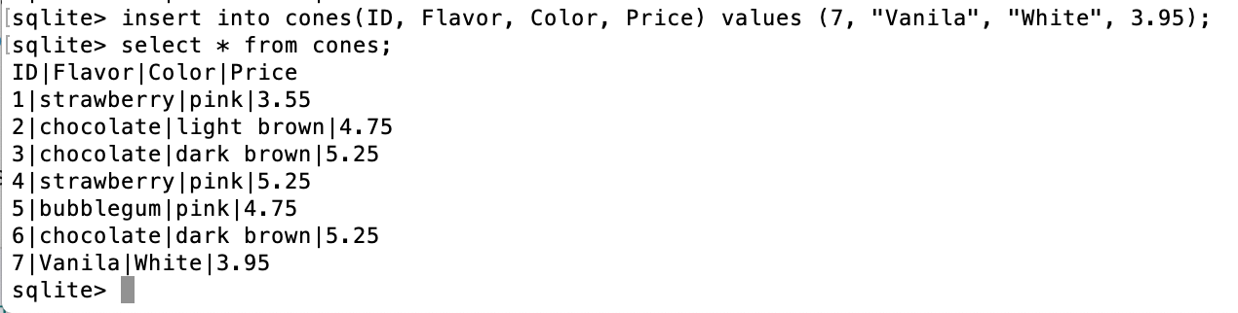
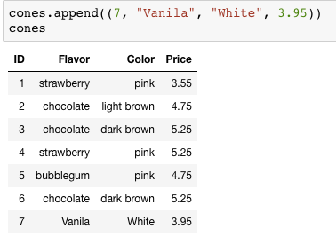
Inserting new records (rows)
INSERT INTO table(column1, column2,...)
VALUES (value1, value2,...);
A database table is typically a shared, durable repository shared by multiple applications

Slide 18
UPDATING new records (rows)
UPDATE table SET column1 = value1, column2 = value2 [WHERE condition];
If you don’t specify a WHERE, you’ll update all rows!

Slide 19
SQL: Aggregations

Slide 20
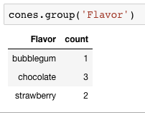
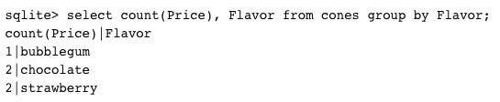
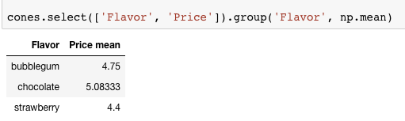
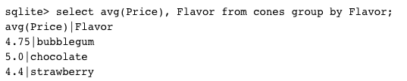
Groupinng and Aggregatations
The GROUP BY clause is used to group rows returned by SELECT statement into a set of summary rows or groups based on values of columns or expressions.
Apply an aggregate function, such as SUM, AVG, MIN, MAX or COUNT, to each group to output the summary information.

Slide 21
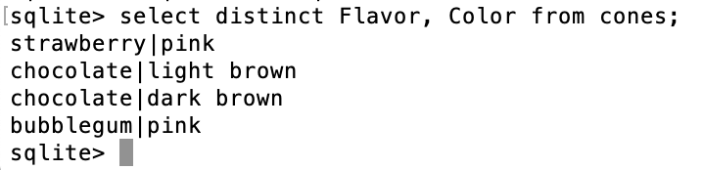
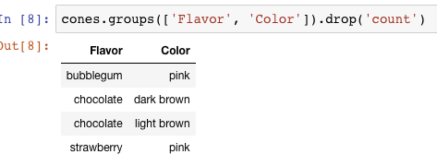

UNIQUE / Distinct values
select DISTINCT [columns] from [table] where [condition] order by [order] ;

Slide 22
SQL: Joins

Slide 23
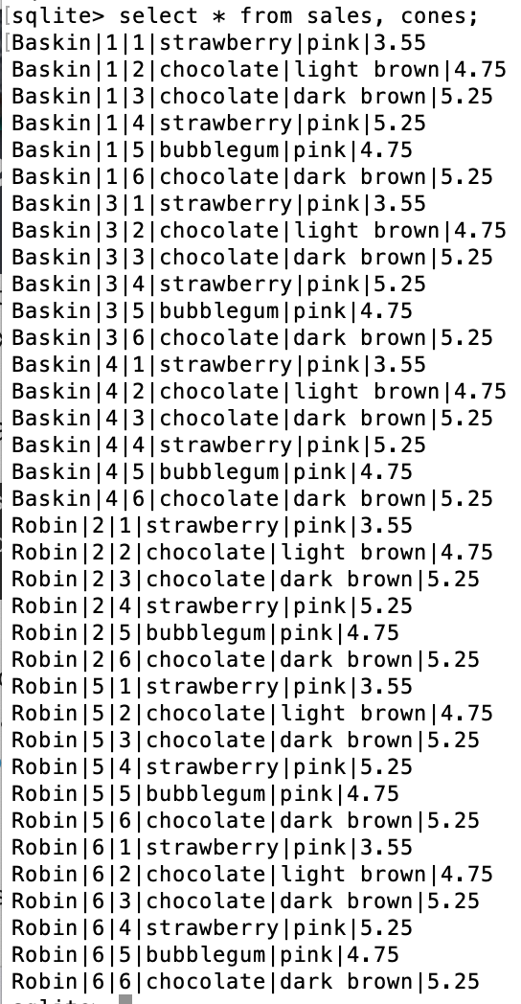
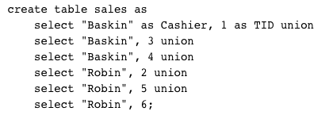
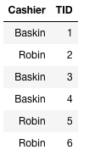
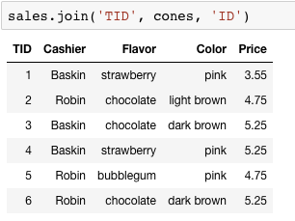
Joining tables
Two tables are joined by a comma to yield all combinations of a row from each
select * from sales, cones;

Slide 24
Inner Join
SELECT * FROM sales, cones WHERE cone_id =cones.id;
When column names conflict we write: table_name.column_name in a query.
sqlite> SELECT * FROM cones, sales WHERE cone_id=cones.id;
Id|Flavor|Color|Price|Cashier|id|cone_id
1|strawberry|pink|3.55|Baskin|3|1
1|strawberry|pink|3.55|Robin|6|1
2|chocolate|light brown|4.75|Baskin|1|2
2|chocolate|light brown|4.75|Baskin|4|2
2|chocolate|light brown|4.75|Robin|5|2
3|chocolate|dark brown|5.25|Robin|2|3

Slide 25
Putting It All Together:
Which of our cashiers sold the highest value of ice cream?
First we need to find which cones were sold by whom, then we SUM() the results!
sqlite> SELECT Cashier, SUM(Price) as 'Total Sold' FROM sales, cones WHERE sales.cone_id = cones.id GROUP BY Cashier;
Cashier|Total Sold
Baskin|13.3
Robin|13.8

Slide 26
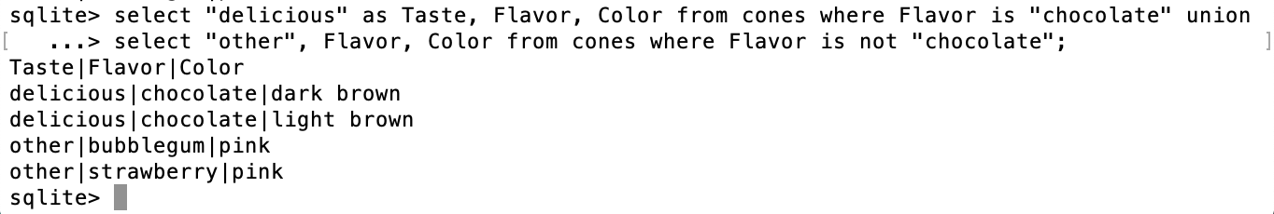
SQL: using named tables - FROM
SELECT "delicious" as Taste, Flavor, Color FROM cones
WHERE Flavor is "chocolate" UNION
SELECT "also tasty", Flavor, Color FROM cones
WHERE Flavor is not "chocolate";

Slide 27
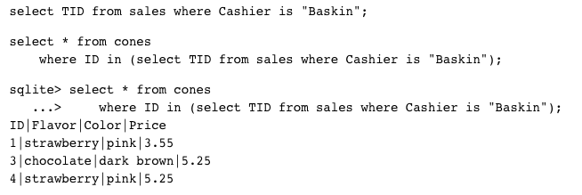
Queries within queries
Any place that a table is named within a select statement, a table could be computed
As a sub-query

Slide 28
Summary
SELECT <col spec> FROM <table spec> WHERE <cond spec>
GROUP BY <group spec> ORDER BY <order spec> ;
INSERT INTO table(column1, column2,...)
VALUES (value1, value2,...);
CREATE TABLE name ( <columns> ) ;
CREATE TABLE name AS <select statement> ;

