Slide 1
Programming Paradigms

Slide 2
Announcements
Please check Ed / Class calendar for new deadlines
No labs, OH, tutoring sessions
CS Mentors is still happening.

Slide 3
Programming Paradigms
Paradigm (Merriam Webster): a typical example or pattern of something; a model. Example: "there is a new paradigm for public art in this country"
Programming Paradigm (Joe Turner, Clemson University): “A programming paradigm is a general approach, orientation, or philosophy of programming that can be used when implementing a program.” You might call this a "style"
Example, three very different approaches to squaring list:
map(lambda x: x*x, range(5))
[ x * x for x in range(5) ]
range(5).square_nums() # Only theoretically

Slide 4
Why?
Understanding the paradigm helps you understand the intent of the programmer
Pick the right tool for the job!
Most programs written today are multi-paradigm
They mix and match the style

Slide 5
Word of Warning
There is no universally agreed upon taxonomy of human programming styles.
One possible list:
Imperative
Functional
Array-based
Object oriented
Declarative
These terms are a bit fluid, and as you’ll see if you read more on wikipedia, there is substantial disagreement about these terms.

Slide 6
Programming Paradigms
Example, three very different approaches to squaring list:
Functional: map(lambda x: x*x, [1, 2, 3])
Array-based: [1, 2, 3] * [1, 2, 3] → [1, 4, 9] # Not Python!
Imperative:
def square(nums):
result = []
for num in nums:
result.append(num * num)
return result

Slide 7
The Imperative Programming Paradigm
An imperative program provides a sequence of steps.
Like following a recipe.
Assignment is allowed (can set variables).
Mutation is allowed (can change variables).
Example (acronym):
def acronym_i(words):
result = ''
words = words.split(' ')
for word in words:
if len(word) > 4:
result += word[0]
return result

Slide 8
The Imperative Programming Paradigm
An imperative program provides a sequence of steps.
Like following a recipe.
Assignment is allowed (can set variables).
Mutation is allowed (can change variables).
Example (acronym):

Slide 9
The Functional Programming Paradigm
In functional programming, computation is thought of in terms of the evaluation of functions.
No state (e.g. variable assignments).
No mutation (e.g. changing variable values).
No side effects when functions execute.
def acronym_f(words):
return reduce(add,
map(lambda w: w[0],
filter(lambda w: len(w) > 3,
words.split(' '))))

Slide 10
Imperative vs. Functional
Can argue that functional is a subset of imperative.
Functional programming is still a series of steps.
Just need to avoid state and think of computation as functions.
Programs in the functional paradigm:
More often only one obvious way to do something.
Programming feels more like solving puzzles.
Solutions can seem like magic (especially to imperative programmers).
Tend to be shorter.
Tend to be easier to debug (no need to track variables / side effects).
Tend to parallelize better (can split work on multiple computers).
Example: Each computer can do 1/8th of a “map” operation.
Are growing in popularity.

Slide 11
A Hybrid Approach
These paradigms are not official rules. Just attempts to taxonomize approaches taken by humans.
Code below is sorta functional, sorta imperative.
Utilizes state for clarity. Many program this way. You might not.
def acronym_h(words):
words = words.split(' ')
long = filter(lambda w: len(w) > 4, words)
letters = maps(lambda w: w[0], long)
return ''.join(letters)

Slide 12
Discussion and Debate
Which of these do you like best?
Less to keep track of.
def acronym_f(words):
return reduce(add,
map(lambda w: w[0],
filter(lambda w: len(w) > 3,
words.split(' '))))
def acronym_i(words):
result = ''
words = words.split(' ')
for word in words:
if len(word) > 4:
result += word[0]
return result
Very small steps to reason about. Seems "natural", but lots of code
Easy to come back and read it later.
def acronym_h(words):
words = words.split(' ')
long = filter(lambda w: len(w) > 4, words)
letters = maps(lambda w: w[0], long)
return ''.join(letters)

Slide 13
Array-Based Programming!
Unfortunately not something we can easily demo in Python.
Treats arrays a "first class" objects – not just containers:
Mathematical Operations correspond to "Pairwise" computations: (These are not Python!)
[1, 2, 3] * [1, 2, 3] == [1, 4, 9]
[1, 2, 3] + [1, 2, 3] == [2, 4, 6]
Very common in data science, engineering!
R (STAT 134), MATALAB, Julia, APL

Slide 14
The Object Based Programming Paradigm
In object programming, we organize our thinking around objects, each containing its own data, and each with its own procedures that can be invoked.
We've had plenty of practice here!
OOP provides many tools!
But also leaves many import questions open:
Should functions be mutalbe or immutable?
Notes:
https://www.pinclipart.com/pindetail/mwxoJT_bean-wizard-alternate-colors-clipart/

Slide 15
Object Based Programming
There is a LOT more than what we see in CS88
Rich model for composing classes together
Can easily be overused.
In Python "everything is an object"
Global functions like len() correspond to "magic" methods on objects, e.g. __len__
Notes:
https://www.pinclipart.com/pindetail/mwxoJT_bean-wizard-alternate-colors-clipart/

Slide 16
Declarative Programming
In declarative programming, we express what we want, without specifying how. A program is simply a description of the result we want.
Can be a very different thought process!
Incredibly useful, but not necessarily best for all types of problems.

Slide 17
The Web: HTML
Web pages are built with a language called HTML.
Programmers specific what content should be on the page, and where.
The browser lays out the content on each device in the right spot for each screen size, etc.
A partial section of the CS88 Website:
<div id="content" class="container">
<div class="page-header">
<h1><span class="content-title-brand">CS 88</span>:
Computational Structures in Data Science
<div class="small">Fall 2022</div>
<div class="small">Instructor: Michael Ball</div>
</h1>
<h3>T &amp; Th 1pm - 2pm PT 105 Stanley</h3> </div> <section><h2>Announcements</h2>…

Slide 18
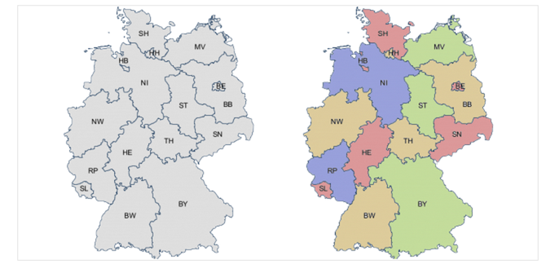
Declarative Programming
In declarative programming, we express what we want, without specifying how. A program is simply a description of the result we want.
Example: coloring a map of Germany using the Prolog language:

Slide 19


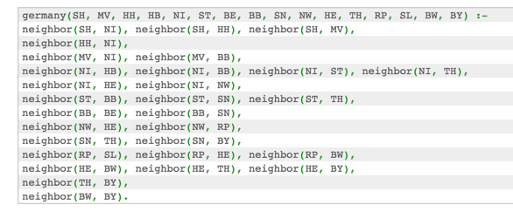
Prolog Example (From Bernardo Pires)
Tell Prolog that colors exist: Tell Prolog that same colors can’t touch:
Tell Prolog all the borders:
Ask Prolog for answer:

Slide 20

Declarative Programming
In declarative programming, we express what we want, without specifying how. A program is simply a description of the result we want.
Another example, coloring a map of Germany using the Prolog language:

Slide 21
Declarative Programming
Each declarative language has only a limited number of tasks for which you can specify “what”, and not “how”, e.g.
Prolog: Logic.
SQL: Queries from a database.
Pandas: Data manipulation operations like aggregation, filtering, joining, etc.
Very common operations in Data 8 and Data 100.
Pandas is a library for Python. You'll use it in Data 100!

Slide 22
Declarative Programming In Data 8
cones.group('Flavor')
DataScience module figures out the grouping
table.where(label, conditions)
Can combine these simpler expressions together for more complex questions

Slide 23
Why SQL?
SQL is a declarative programming language for accessing and modifying data in a relational database.
It is an entirely new way of thinking (“new” in 1970, and new to you now!) that specifies what should happen, but not how it should happen.
Python is a multi-paradigm language, but we haven't yet tried declarative programming.

Slide 24
What is SQL?
A declarative language
Described what to compute
Query processor (interpreter) chooses which of many equivalent query plans to execute to perform the SQL statements
ANSI and ISO standard, but many variants
CS88's SQL will work on nearly all relational databases—databases that use tables. [We'll revisit next lecture!]
SELECT statement creates a new table, either from scratch or by projecting a table
CREATE TABLE statement gives a global name to a table
Lots of other statements
analyze, delete, explain, insert, replace, update, …

Slide 25
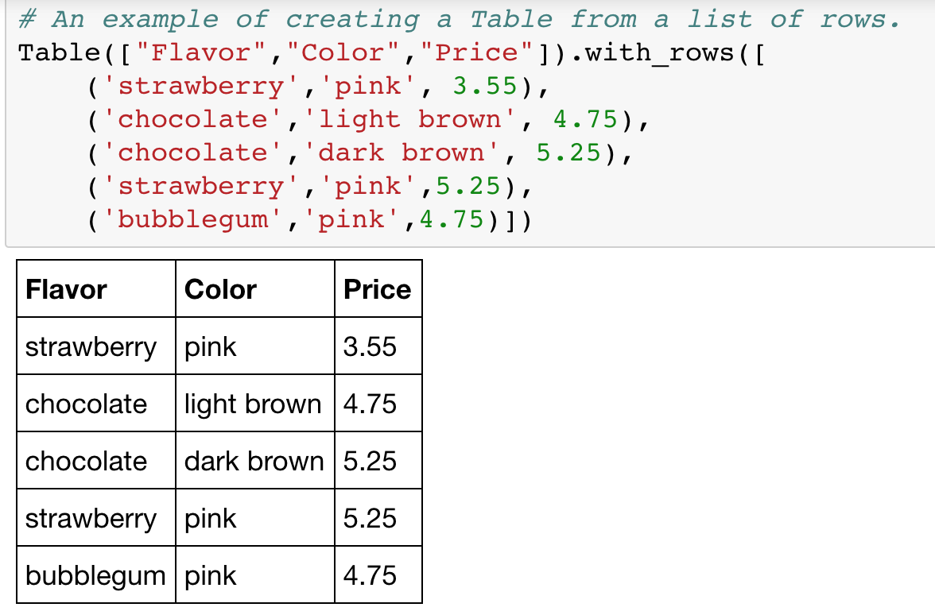
SQL: Describe The Shape of the result!

Slide 26
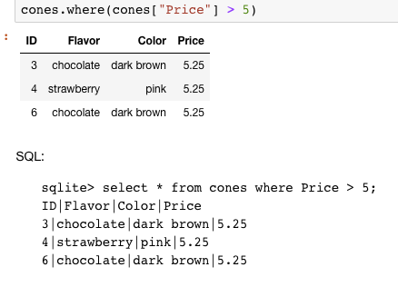
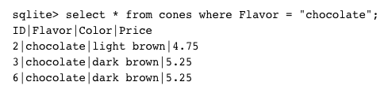
What if I want a table with just a few rows?
Here the `where()` in Python is using the datascience module.

Slide 27
Summary
Paradigms are styles, guidelines for how to approach a program
Each is equally capable, but some are suited best to particular tasks.
Declarative programming gets us to think about the what rather than the how.

