Slide 1
Iterators and Generators

Slide 2
Announcements
We'll see what happens with the strike.
PLEASE Support your GSI's decision!
It is their right to strike and not everyone may make the decision.
Please do so for CS88 and your other courses. ☺
CS88 Lectures will still happen.
I am actually not allowed to cancel class!
I'll do my best to keep things humming along.
but some things will break.
That's OK!
Our GSIs are amazing, they deserve out support!!

Slide 3
Today:
Pick up where we left off!
Iterators – the iter protocol
Getitem protocol
Is an object iterable?
Lazy evaluation with iterators

Slide 4
Review: Why Object-Oriented Design?
Approach creation of a class as a design problem
Meaningful behavior => methods [& attributes]
ADT methodology
What’s private and hidden? vs What’s public?
Design for inheritance
Clean general case as foundation for specialized subclasses
Use it to streamline development
Anticipate exceptional cases and unforeseen problems
try … except
raise / assert

Slide 5
Review: What is a sequence? [Docs]
Sequence is an "ordered set"
list
tuples
ranges
strings
Some common operations:
Slicing syntax: data[1:4]
Membership: 'cs88' in courses
Concatenation: breakfast_foods + lunch_foods + dinner_foods
Count Items: 'cs88'.count('8')

Slide 6
Iterable - an object you can iterate over
iterable: An object capable of yielding its members one at a time.
iterator: An object representing a stream of data.
We have worked with many iterables as if they were sequences

Slide 7
Functions that return iterables
map
filter
zip
These objects are not sequences.
They are generators, or iterables. A "stream" of data we can iterate over.
Why?
Can't directly slice into them.
Don't know their length
If we want to see all the elements at once, we need to explicitly call list() or tuple() on them

Slide 8
Using a Generator
Calling list() works, but it builds the result in one go.
This loses the benefits when we have large data!
Generators allow us to successively generate (get it?) the next result!
data = map(lambda x: x*x, range(5))
# Iterate with for loops
for point in data:
print(point)
data = map(lambda x: x*x, range(5))
next(data) # returns 0
next(data) # returns 1 …
next(data) # eventually raises StopIteration error

Slide 9
Generators: turning iteration into an iterable
Generator functions use iteration (for loops, while loops) and the yield keyword
Generator functions have no return statement, but they don’t return None
They implicitly return a generator object
Generator objects are just iterators
def squares(n):
for i in range(n):
yield (i*i)

Slide 10
Nest iteration
def all_pairs(x):
for item1 in x:
for item2 in x:
yield(item1, item2)

Slide 11
Iterables
Demo

Slide 12
Next element in generator iterable
Iterables work because they have some "magic methods" on them. We saw magic methods when we learned about classes,
e.g., __init__, __repr__ and __str__.
The first one we see for iterables is __next__
iter() – transforms a sequence into an iterator
list_iter = iter([1, 2, 3, 4])
next(list_iter)

Slide 13
Iterators: The iter protocol
In order to be iterable, a class must implement the iter protocol
The iterator objects themselves are required to support the following two methods, which together form the iterator protocol:
__iter__() : Return the iterator object itself. This is required to allow both containers and iterators to be used with the for and in statements.
This method returns an iterator object (which can be self)
__next__() : Return the next item from the container. If there are no further items, raise the StopIteration exception.
Classes get to define how they are iterated over by defining these methods
containers (objects like lists, tuples, etc) typically define a Container class and a separate ContainterIterator class.

Slide 14
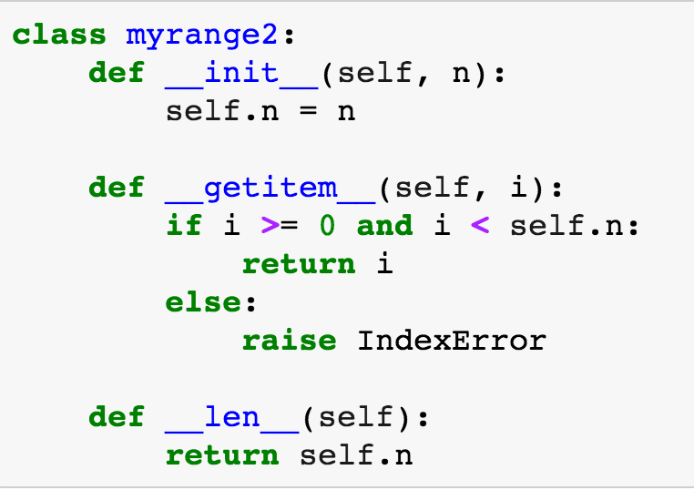
Get Item protocol – Build a Sequene
Another way an object can behave like a sequence is indexing: Using square brackets “[ ]” to access specific items in an object.
Defined by special method: __getitem__(self, i)
Method returns the item at a given index

Slide 15
Determining if an object is iterable
from collections.abc import Iterable
isinstance([1,2,3], Iterable)
This is more general than checking for any list of particular type, e.g., list, tuple, string...

Slide 16
What can we do now?
Build our own for-loop like functions!

Slide 17
What's the Big Picture?
We have new tools for building data structures that behave sequences
We can handle "infinite" streams of data.
We can build our own for loops, perhaps custom for loops.

Slide 18
If Extra Time – What happens when we yield?

