Slide 1
HOFs & Environment Diagrams
Notes:
1

Slide 2
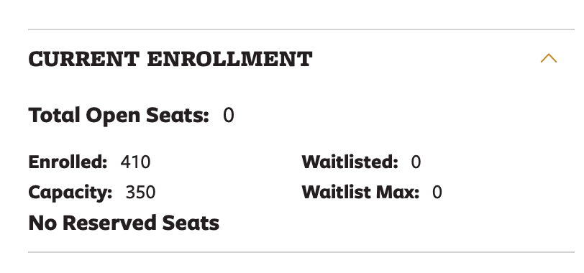
Announcements
The weeks-long saga is over!
Early next week:
TWO new sections added
Will send out a form for transferring work from 61A
Will give extensions for Labs 1, 2, 3 and Homework 1, 2
if I don't respond to your email about enrollment, I'm sorry.

Slide 3
HOFs and Lists
Notes:
3

Slide 4
Functional List Operations
Goal: Transform a list, and return a new result
We'll use 3 functions that are hallmarks of functional programming
Each of these takes in a function and a sequence
Function Name | Action | Input arguments | Input Fn. Returns | Output List
map | Transform every item | 1 argument (each item) | "Anything", a new item | List of the same length, but possibly new values
filter | Return a list with fewer items | 1 argument (each item) | A Boolean | List with possibly fewer items, but values are the same
reduce | "Combine" items together | 2 arguments (current item, and the previous result) | Type should match the type each item | Usually a "single" item

Slide 5
Filter and Non-Boolean Functions
>>> list(filter(add_2, range(10)))
[0, 1, 2, 3, 4, 5, 6, 7, 8, 9]
>>> if 0:
... print("0 is a true value")
... else:
... print("0 is a false value")
...
0 is a false value
Why is 0 in the output of 0ur filter?

Slide 6
Filter and Non-Boolean Functions
>>> [ x for x in range(10) if add_2(x) ]
Why is 0 in the output of 0ur filter?
Filter calls our function, but always returns the original value!

Slide 7
Lists & Higher Order Functions Reduce
Notes:
7

Slide 8
Learning Objectives
Learn three new common Higher Order Functions:
map, filter, reduce
These each apply a function to a sequence (list) of data
Reduce: “Combines” items together, probably doesn’t return a list.
Input: A 2 item function and a sequence
A single value

Slide 9
REDUCE
reduce(function, list_of_inputs)
Successively combine items of our sequence
• function: add(), takes 2 inputs gives us 1 value.
Inputs (Domain): • Function, with 2 inputs
• Sequence Output (Range):
• An item, the type is the output of our function.
Note: We must import reduce from functools!
def reduce(function, sequence):
result = function(sequence[0], sequence[1])
for index in range(2, len(sequence)):
result = function(result, sequence[index])
return result

Slide 10
Lists & Higher Order Functions Acronym
Notes:
10

Slide 11
Today’s Task: Acronym
Input: "The University of California at Berkeley"
Output: "UCB"
def acronym(sentence):
"""YOUR CODE HERE"""
P.S. Pedantry alert: This is really an initialism but that's rather annoying to say and type. ☺ (However, the code we write is the same, the difference is in how you pronounce the result.) The more you know!

Slide 12
Today’s Task: Acronym
def acronym(sentence):
"""
>>> acronym("The University of California at Berkeley")
"UCB"
"""
words = sentence.split()
return reduce(add, map(first_letter, filter(long_word, words)))
P.S. Pedantry alert: This is really an initialism but that's rather annoying to say and type. ☺ (However, the code we write is the same, the difference is in how you pronounce the result.) The more you know!

Slide 13
Functional List Operations
Goal: Transform a list, and return a new result
We'll use 3 functions that are hallmarks of functional programming
Each of these takes in a function and a sequence
Function Name | Action | Input arguments | Input Fn. Returns | Output List
map | Transform every item | 1 argument (each item) | "Anything", a new item | List of the same length, but possibly new values
filter | Return a list with fewer items | 1 argument (each item) | A Boolean | List with possibly fewer items, but values are the same
reduce | "Combine" items together | 2 arguments (current item, and the previous result) | Type should match the type each item | Usually a "single" item

Slide 14
Environment Diagrams
Notes:
14

Slide 15
Python Tutor Examples: compose
def make_adder(n):
def adder(k):
return k + n
return adder
add_2 = make_adder(2)
add_3 = make_adder(3)
x = add_2(5)
y = add_3(x)

Slide 16
Environment Diagrams
Organizational tools that help you understand code
Terminology:
Frame: keeps track of variable-to-value bindings, each function call has a frame
Global Frame: global for short, the starting frame of all python programs, doesn’t correspond to a specific function
Parent Frame: The frame of where a function is defined (default parent frame is global)
Frame number: What we use to keep track of frames, f1, f2, f3, etc
Variable vs Value: x = 1. x is the variable, 1 is the value

Slide 17
Environment Diagrams Reminders
Always draw the global frame first
When evaluating assignments (lines with single equal), always evaluate right side first
When you CALL a function MAKE A NEW FRAME!
When assigning a primitive expression (number, boolean, string) write the value in the box
When assigning anything else (lists, functions, etc.), draw an arrow to the value
When calling a function, name the frame with the intrinsic name – the name of the function that variable points to
The parent frame of a function is the frame in which it was defined in (default parent frame is global)
If the value for a variable doesn’t exist in the current frame, search in the parent frame

Slide 18
Demo
Example 1:
Primitives and Functions: Environment Diagram Python Tutor:
Example 2:
make_adder Higher Order Function: Environment Diagram Python Tutor Link
Example 3:
Compose Python Tutor Link

Slide 19
Example 1
a = "chipotle"
b = 5 > 3
c = 8
def foo(c):
return c - 5
def bar():
if b:
a = "taco bell"
result1 = foo(10)
result2 = bar()

Slide 20
Example 2
def make_adder(n):
def adder(k):
return k + n
return adder
n = 10
add_2 = make_adder(2)
x = add_2(5)

Slide 21
Python Tutor Examples
add_2 = make_adder(2)
add_3 = make_adder(3)
x = add_2(2)
def compose(f, g):
def h(x):
return f(g(x))
return h
add_5 = compose(add_2, add_3)
z = add_5(x)

Slide 22
Environment Diagram Tips / Links
NEVER draw an arrow from one variable to another.
Useful Resources:
http://markmiyashita.com/cs61a/environment_diagrams/rules_of_environment_diagrams/
http://albertwu.org/cs61a/notes/environments.html

