Slide 1
Lambdas Environments Dictionaries
Notes:
1

Slide 2
Computing In the News: Dark Patterns
FTC Report Shows Rise in Sophisticated Dark Patterns Designed to Trick and Trap Consumers 9/15/2022 (See also darkpatterns.org)
Tactics Include Disguised Ads, Difficult-to-Cancel Subscriptions, Buried Terms, and Tricks to Obtain Data
The Federal Trade Commission released a report today showing how companies are increasingly using sophisticated design practices known as “dark patterns” that can trick or manipulate consumers into buying products or services or giving up their privacy. The dark pattern tactics detailed in the report include disguising ads to look like independent content, making it difficult for consumers to cancel subscriptions or charges, burying key terms or junk fees, and tricking consumers into sharing their data. The report highlighted the FTC’s efforts to combat the use of dark patterns in the marketplace and reiterated the agency’s commitment to taking action against tactics designed to trick and trap consumers.

Slide 3
Announcements
Late Adds / Transfers
Form out in a day or two
Schedule Updates + Changes
Likely add a Friday afternoon lab
Will likely add Tues or Weds afternoon
A couple TAs times will shift
Office Hours may move

Slide 4
Lambda Expressions
Notes:
4

Slide 5
Learning Objectives
Lambda are anonymous functions, which use expressions
Don’t use return, lambdas always return the value of the expression.
They are typically short and concise
They don’t have an “intrinsic” name when using an environment diagram.
Their name is the character 𝜆

Slide 6
lambda
Function expression
“anonymous” function creation
Expression, not a statement, no return or any other statement
lambda <arg or arg_tuple> : <expression using args>
add_one = lambda v : v + 1
def add_one(v):
return v + 1

Slide 7
Lambdas
>>> def inc_maker(i):
... return lambda x: x+i
...
>>> inc_maker(3)
<function inc_maker.<locals>.<lambda> at 0x10073c510>
>>> inc_maker(3)(4)
7
>>> map(inc_maker(3), [1,2,3,4])
<map object at 0x1020950b8>
>>> list(map(inc_maker(3), [1,2,3,4]))
[4, 5, 6, 7]
>>>

Slide 8
Lambda with HOFs
A function that returns (makes) a function
def leq_maker(c):
return lambda val: val <= c
>>> leq_maker(3)
<function leq_maker.<locals>.<lambda> at 0x1019d8c80>
>>> leq_maker(3)(4)
False
>>> filter(leq_maker(3), [0,1,2,3,4,5,6,7])
[0, 1, 2, 3]

Slide 9
Lambda Examples
>>> sorted([1,2,3,4,5], lambda x: x)
[1, 2, 3, 4, 5]
>>> sorted([1,2,3,4,5], lambda x: -x)
[5, 4, 3, 2, 1]
>>> sorted([(2, "hi"), (1, "how"), (5, "goes"), (7, "I")],
lambda x:x[0])
[(1, 'how'), (2, 'hi'), (5, 'goes'), (7, 'I')]
>>> sorted([(2, "hi"), (1, "how"), (5, "goes"), (7, "I")],
lambda x:x[1])
[(7, 'I'), (5, 'goes'), (2, 'hi'), (1, 'how')]
>>> sorted([(2,"hi"),(1,"how"),(5,"goes"),(7,"I")],
lambda x: len(x[1]))
[(7, 'I'), (2, 'hi'), (1, 'how'), (5, 'goes')]

Slide 10
Environment Diagrams
Notes:
10

Slide 11
Python Tutor Examples: compose
def make_adder(n):
def adder(k):
return k + n
return adder
add_2 = make_adder(2)
add_3 = make_adder(3)
x = add_2(5)
y = add_3(x)

Slide 12
Environment Diagrams
Organizational tools that help you understand code
Terminology:
Frame: keeps track of variable-to-value bindings, each function call has a frame
Global Frame: global for short, the starting frame of all python programs, doesn’t correspond to a specific function
Parent Frame: The frame of where a function is defined (default parent frame is global)
Frame number: What we use to keep track of frames, f1, f2, f3, etc
Variable vs Value: x = 1. x is the variable, 1 is the value

Slide 13
Environment Diagrams Reminders
Always draw the global frame first
When evaluating assignments (lines with single equal), always evaluate right side first
When you CALL a function MAKE A NEW FRAME!
When assigning a primitive expression (number, boolean, string) write the value in the box
When assigning anything else (lists, functions, etc.), draw an arrow to the value
When calling a function, name the frame with the intrinsic name – the name of the function that variable points to
The parent frame of a function is the frame in which it was defined in (default parent frame is global)
If the value for a variable doesn’t exist in the current frame, search in the parent frame

Slide 14
Demo
Example 1:
Primitives and Functions: Environment Diagram Python Tutor:
Example 2:
make_adder Higher Order Function: Environment Diagram Python Tutor Link
Example 3:
Compose Python Tutor Link

Slide 15
Example 1
a = "chipotle"
b = 5 > 3
c = 8
def foo(c):
return c - 5
def bar():
if b:
a = "taco bell"
result1 = foo(10)
result2 = bar()

Slide 16
Example 2
def make_adder(n):
def adder(k):
return k + n
return adder
n = 10
add_2 = make_adder(2)
x = add_2(5)

Slide 17
Python Tutor Examples
add_2 = make_adder(2)
add_3 = make_adder(3)
x = add_2(2)
def compose(f, g):
def h(x):
return f(g(x))
return h
add_5 = compose(add_2, add_3)
z = add_5(x)

Slide 18
Environment Diagram Tips / Links
NEVER draw an arrow from one variable to another.
Useful Resources:
http://markmiyashita.com/cs61a/environment_diagrams/rules_of_environment_diagrams/
http://albertwu.org/cs61a/notes/environments.html

Slide 19
Dictionaries
Notes:
19

Slide 20
Learning Objectives
Dictionaries are a new type in Python
Lists let us index a value by a number, or position.
Dictionaries let us index data by other kinds of data.

Slide 21
Dictionaries
Constructors:
dict( <list of 2-tuples> )
dict( <key>=<val>, ...) # like kwargs
{ <key exp>:<val exp>, … }
{ <key>:<val> for <iteration expression> }
>>> {x:y for x,y in zip(["a","b"],[1,2])}
{'a': 1, 'b': 2}
Selectors: <dict> [ <key> ]
<dict>.keys(), .items(), .values()
<dict>.get(key [, default] )
Operations:
Key in, not in, len, min, max
<dict>[ <key> ] = <val>

Slide 22
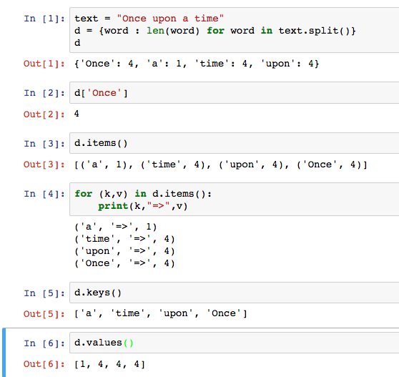
Dictionary Example

Slide 23
Dictionary Example

Slide 24
Bonus / Review
Left over slides we didn’t get to.

Slide 25
Three super important HOFS
list(map(function_to_apply, list_of_inputs))
Applies function to each element of the list
list(filter(condition, list_of_inputs))
Returns a list of elements for which the condition is true
reduce(function, list_of_inputs)
Applies the function, combining items of the list into a "single" value.

Slide 26
What does this do?
list(map(capitalize, ['michael', 'Alex', 'Srinath', 'julia']
)) Assume capitalize('michael') == 'Michael'
A) ['michael', 'Alex', 'Srinath', 'julia']
B) ['Michael', 'Alex', 'Srinath', 'Julia']
C) []
D) Error
E) I'm lost.
02/10/2020
UCB CS88 Fa20 L6
26

Slide 27
What does this do?
list(filter(return_false, range(100)
)) Assume return_false(42) == False
A) range(0, 100) # A standard range object
B) [0, 1, 2, … 96, 97, 98, 99]
C) [ ]
D) Error
E) I'm lost.
02/10/2020
UCB CS88 Fa20 L6
27

