Slide 1
Lecture: Mutable Data

Slide 2
NOTES FOR NEXT TIME
Move Sooner
Briefly mention dictionaries
Give more examples of basic lists in Python Tutor

Slide 3
Announcements
Midterm Scores out on the Weekend / Monday
Ants project coming out soon.
Puts OOP into practice!
Next few weeks, some big ideas in CS!
Today: Solidify some understandings of data structures
Next up: Efficiency
Soon: Linked-Lists and Trees (great 61B prep!)
End: SQL. Foundational for Data Science

Slide 4
Mutability: Lists

Slide 5
Learning Objectives
Distinguish between when a function mutates data, or returns a new object
Many Python "default" functions return new objects
Understand modifying objects in place
Python provides “is” and “==” for checking if items are the same, in different ways

Slide 6
Objects
An object is a bundle of data and behavior.
A type of object is called a class.
Every value in Python is an object.
string, list, int, tuple, et
All objects have attributes
Objects often have associated methods
Objects have a value (or values)
Mutable: We can change the object after it has been created
Immutable: We cannot change the object.
Objects have an identity, a reference to that object.

Slide 7
Immutable Object: string
course = 'CS88'
What kind of object is it?
type(course)
What data is inside it?
course[0]
course[2:]
What methods can we call?
course.upper()
course.lower()
None of these methods modify our original string.

Slide 8
Dictionaries are Mutable, too
Immutable – the value of the object cannot be changed
integers, floats, booleans
strings, tuples
Mutable – the value of the object can change
Lists
Dictionaries
>>> adict = {'a':1, 'b':2}
>>> adict
{'b': 2, 'a': 1}
>>> adict['b']
2
>>> adict['b'] = 42
>>> adict['c'] = 'elephant'
>>> adict
{'b': 42, 'c': 'elephant', 'a': 1}
>>> alist = [1,2,3,4]
>>> alist
[1, 2, 3, 4]
>>> alist[2]
3
>>> alist[2] = 'elephant'
>>> alist
[1, 2, 'elephant', 4]

Slide 9
Dictionaries – by example
Constructors:
dict( hi=32, lo=17)
dict([('hi',212),('lo',32),(17,3)])
{'x':1, 'y':2, 3:4}
{wd:len(wd) for wd in "The quick brown fox".split()}
Selectors:
water['lo']
<dict>.keys(), .items(), .values()
<dict>.get(key [, default] )
Operations:
in, not in, len, min, max
'lo' in water
Mutators
water['lo' ] = 33

Slide 10
Immutability vs Mutability
An immutable value is unchanging once created.
Immutable types (that we've covered): int, float, string, tuple
a_string = "Hi y'all"
a_string[1] = "I" # ERROR
a_string += ", how you doing?"
an_int = 20
an_int += 2
A mutable value can change in value throughout the course of computation. All names that refer to the same object are affected by a mutation.
Mutable types (that we've covered): list, dict
grades = [90, 70, 85]
grades_copy = grades
grades[1] = 100 # grades_copy changes too!
words = {"agua": "water"}
words["pavo"] = "turkey"

Slide 11
From value to storage …
A variable assigned a compound value (object) is a reference to that object.
Mutable objects can be changed but the variable(s) still refer to it
x is still the same object, but it's values have changed.
x = [1, 2, 3]
y = 6
x[1] = y
x[1]
frame
1
•
2
6
•
3
•
x:
•
y:
6
…

Slide 12
Mutating Lists: Example functions of the list class
append() adds a single element to a list:
s = [2, 3]
t = [5, 6]
s.append(4)
s.append(t)
t = 0
Try in PythonTutor.
extend() adds all the elements in one list to a list:
s = [2, 3]
t = [5, 6]
s.extend(4) # 🚫 Error: 4 is not an iterable!
s.extend(t)
t = 0
Try in PythonTutor. (After deleting the bad line)

Slide 13
Mutating Lists -- More Functions!
list += [x, y, z] # just like extend.
You need to be careful with this one! It modifies the list.
pop() removes and returns the last element:
s = [2, 3]
t = [5, 6]
t = s.pop()
Try in PythonTutor.
remove() removes the first element equal to the argument:
s = [6, 2, 4, 8, 4]
s.remove(4)
Try in PythonTutor.

Slide 14
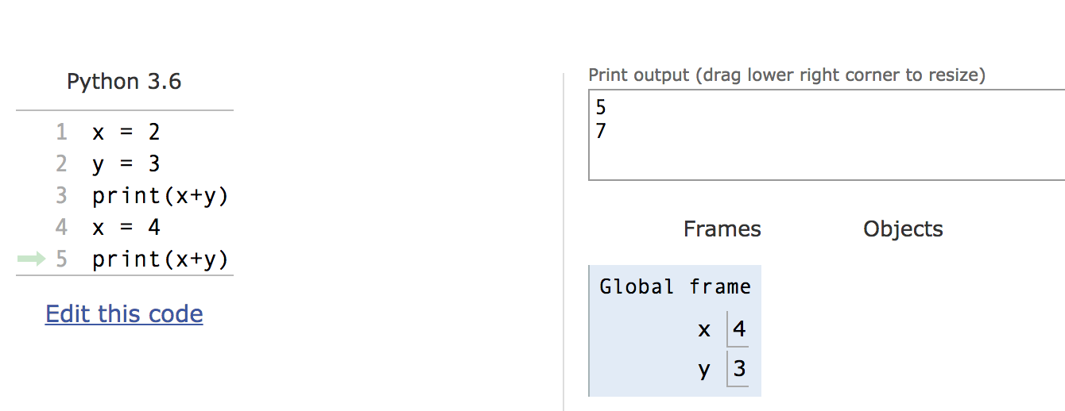
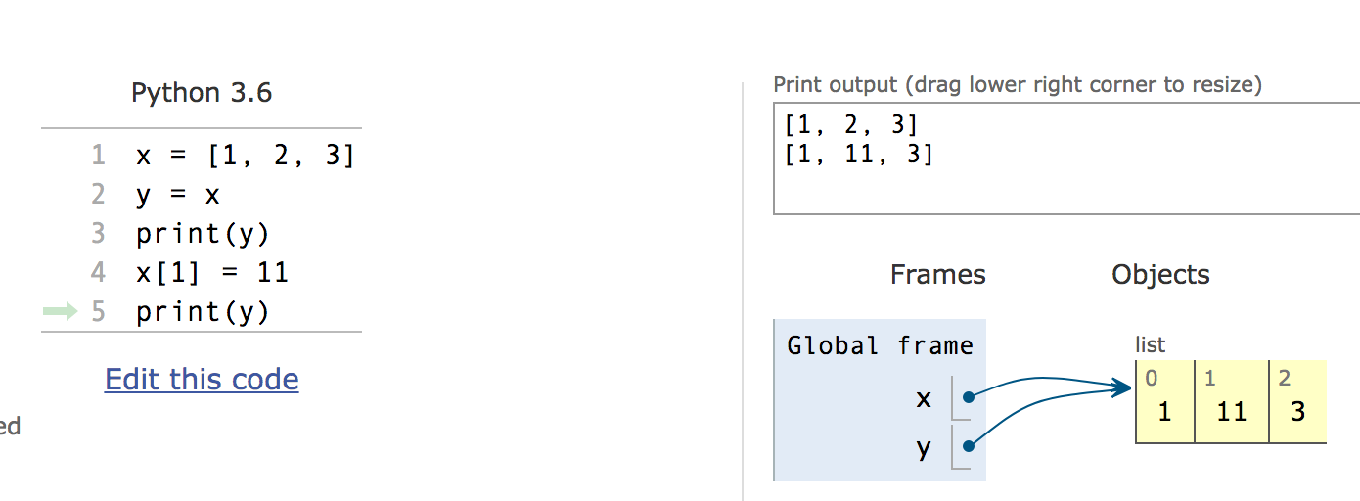
Mutation makes sharing visible

Slide 15
Mutables Inside Immutables
Mutable objects can "live" inside immutable objects!
An immutable sequence may still change if it contains a mutable value as an element.
Be very careful, and probably don't do this!
t = (1, [2, 3])
t[1][0] = 99
t[1][1] = "Problems"
Try in PythonTutor

Slide 16
Copies, 'is' and '=='
>>> alist = [1, 2, 3, 4]
>>> alist == [1, 2, 3, 4] # Equal values?
True
>>> alist is [1, 2, 3, 4] # same object?
False
>>> blist = alist # assignment refers
>>> alist is blist # to same object
True
>>> blist = list(alist) # type constructors copy
>>> blist is alist
False
>>> blist = alist[ : ] # so does slicing
>>> blist is alist
False
>>> blist
[1, 2, 3, 4]
>>>

Slide 17
Equality vs Identity
list1 = [1,2,3]
list2 = [1,2,3]
Equality: exp0 == exp1 evaluates to True if both exp0 and exp1 evaluate to objects containing equal values (Each object can define what == means)
list1 == list2 # True
Identity: exp0 is exp1 evaluates to True if both exp0 and exp1 evaluate to the same object
Identical objects always have equal values.
list1 is list2 # False
Try in PythonTutor.

Slide 18
What is the meaning of 'is'?
is in Python means two items have the exact same identity
Thus, a is b implies a == b
Each object has a function id() which returns its "address"
We won't get into what this means, but it's essentially an internal "locator" for that data in memory.
Think this is tricky? cool? amazing?
Take CS61C (Architecture) and CS164 (Programming Languages)

Slide 19
Passing Data Into Functions

Slide 20
Learning Objectives
Passing in a mutable object in a function in Python lets you modify that object
Immutable objects don't change when passed in as an argument
Making a new name doesn't affect the value outside the function
Modifying mutable data does modify the values in the parent frame.

Slide 21
Mutating Input Data
Functions can mutate objects passed in as an argument
Declaring a new variable with the same name as an argument only exists within the scope of our function
You can think of this as creating a new name, in the same way as redefining a variable.
This will not modify the data outside the function, even for mutable objects.
BUT
We can still directly modify the object passed in…even though it was created in some other frame or environment.
We directly call methods on that object.
View Python Tutor

Slide 22
Python Gotcha's: a += b and a = a + b
Sometimes similar looking operations have very different results!
Why?
= always binds (or rebinds) a value to a name.
+= maps to the special method, e.g. __iadd__
def add_data_to_obj(obj, data):
print(obj)
obj += data
print(obj)
return obj
def new_obj_with_data(obj, data):
print(obj)
obj = obj + data
print(obj)
return obj

Slide 23
Mutable Functions

Slide 24
Learning Objectives
Remember: Each function gets its own new frame
Inner functions can access data in the parent environment
Use an inner function along with a mutable data type to capture changes

Slide 25
Functions with Changing State
Goal: Use a function to repeatedly withdraw from a bank account that starts with $100.
Build our account: withdraw = make_withdraw_account(100)
First call to the function:
withdraw(25) # 75
Second call to the function:
withdraw(25) # 50
Third call to the function:
withdraw(60) # 'Insufficient funds'

Slide 26
How Do We Implement Bank Accounts?
A mutable value in the parent frame can maintain the local state for a function.
def make_withdraw_account(initial):
balance = [initial]
def withdraw(amount):
if balance[0] - amount < 0:
return 'Insufficient funds'
balance[0] -= amount
return balance[0]
return withdraw
View in PythonTutor

Slide 27
Implementing Bank Accounts
A mutable value in the parent frame can maintain the local state for a function.
def make_withdraw_account(initial):
balance = [initial]
def withdraw(amount):
if balance[0] - amount < 0:
return 'Insufficient funds'
balance[0] -= amount
return balance[0]
return withdraw
View in PythonTutor

Slide 28
Creating mutating ‘functions’
Pure functions have referential transparency
c = greet() + name() is “referentially transparent” if we can replace that expression with the value
e.g c = “Hello, CS 88”
Result value depends only on the inputs
Same inputs, same result value
Functions that use global variables are not pure
Non-pure functions can be “mutating”, and rely on some state

Slide 29
global and nonlocal allow us to modify parent frames.
>>> counter = 0
>>> def count_fun():
... global counter
... counter += 1
... return counter
...
>>> count_fun()
1
>>> count_fun()
2
>>> def make_counter():
... counter = 0
... def counts():
... nonlocal counter
... counter +=1
... return counter
... return counts
...
>>> count_fun = make_counter()
>>> count_fun()
1
>>> count_fun()
2
>>> another_one = make_counter()
>>> another_one()
1
>>> count_fun()
3
How do I make a second counter?

Slide 30
Are these ‘mutations’ of seq?
def sum(seq):
psum = 0
for x in seq:
psum = psum + x
return psum
def reverse(seq):
rev = []
for x in seq:
rev = [x] + rev
return rev
A) Yes, both B) Only sum C) Only reverse D) None of them
Solution: D) No change of seq

Slide 31
Creating mutable objects
Follow the ADT methodology, enclosing state within the abstraction

Slide 32
Useless bank account
def account(name, initial_deposit):
return (name, initial_deposit)
def account_name(acct):
return acct[0]
def account_balance(acct):
return acct[1]
def deposit(acct, amount):
return (acct[0], acct[1]+amount)
def withdraw(acct, amount):
return (acct[0], acct[1]-amount)
>>> my_acct = account('David Culler', 175)
>>> my_acct
('David Culler', 175)
>>> deposit(my_acct, 35)
('David Culler', 210)
>>> account_balance(my_acct)
175

Slide 33
Bank account using dict
def account(name, initial_deposit):
return {'Name' : name, 'Number': 0,
'Balance' : initial_deposit}
def account_name(acct):
return acct['Name']
def account_balance(acct):
return acct['Balance']
def deposit(acct, amount):
acct['Balance'] += amount
return acct['Balance']
def withdraw(acct, amount):
acct['Balance'] -= amount
return acct['Balance']
>>> my_acct = account('David Culler', 93)
>>> account_balance(my_acct)
93
>>> deposit(my_acct, 100)
193
>>> account_balance(my_acct)
193
>>> withdraw(my_acct, 10)
183
>>> account_balance(my_acct)
183
>>> your_acct = account("Fred Jones",0)
>>> deposit(your_acct, 75)
75
>>> account_balance(my_acct)
183

Slide 34
State for a class of objects
account_number_seed = 1000
def account(name, initial_deposit):
global account_number_seed
account_number_seed += 1
return {'Name' : name, 'Number': account_number_seed,
'Balance' : initial_deposit}
def account_name(acct):
return acct['Name']
def account_balance(acct):
return acct['Balance']
def account_number(acct):
return acct['Number']
def deposit(acct, amount):
acct['Balance'] += amount
return acct['Balance']
def withdraw(acct, amount):
acct['Balance'] -= amount
return acct['Balance']
>>> my_acct = account('David Culler', 100)
>>> my_acct
{'Name': 'David Culler', 'Balance': 100, 'Number': 1001}
>>> account_number(my_acct)
1001
>>> your_acct = account("Fred Jones", 475)
>>> account_number(your_acct)
1002
>>>

Slide 35
Hiding the object inside
account_number_seed = 1000
accounts = []
def account(name, initial_deposit):
global account_number_seed
global accounts
account_number_seed += 1
new_account = {'Name' : name, 'Number': account_number_seed,
'Balance' : initial_deposit}
accounts.append(new_account)
return len(accounts)-1
def account_name(acct):
return accounts[acct]['Name’]
. . .
def deposit(acct, amount):
account = accounts[acct]
account['Balance'] += amount
return account['Balance']
def account_by_number(number):
for account, index in zip(accounts,range(len(accounts))):
if account['Number'] == number:
return index
return -1

Slide 36
Hiding the object inside
>>> my_acct = account('David Culler', 100)
>>> my_acct
0
>>> account_number(my_acct)
1001
>>> your_acct = account("Fred Jones", 475)
>>> accounts
[{'Name': 'David Culler', 'Balance': 100, 'Number': 1001}, {'Name': 'Fred Jones', 'Balance': 475, 'Number': 1002}]
>>> account_by_number(1001)
0
>>> account_name(account_by_number(1001))
'David Culler’
>>> your_acct
1
>>> account_name(your_acct)
'Fred Jones'
>>>

Slide 37
A better way …
account_number_seed = 1000
accounts = []
def account(name, initial_deposit):
global account_number_seed
global accounts
account_number_seed += 1
new_account = {'Name' : name, 'Number': account_number_seed,
'Balance' : initial_deposit}
accounts.append(new_account)
return account_number_seed
def _get_account(number):
for account in accounts:
if account['Number'] == number:
return account
return None
def account_name(acct):
return _get_account(acct)['Name']
. . .

Slide 38
A better way …
account_number_seed = 1000
accounts = []
def account(name, initial_deposit):
global account_number_seed
global accounts
account_number_seed += 1
new_account = {'Name' : name, 'Number': account_number_seed,
'Balance' : initial_deposit}
accounts.append(new_account)
return account_number_seed
def _get_account(number):
for account in accounts:
if account['Number'] == number:
return account
return None
def account_name(acct):
return _get_account(acct)['Name']
. . .
>>> my_acct = account('David Culler', 100)
>>> your_acct = account("Fred Jones", 475)
>>> nother_acct = account("Wilma Flintstone", 999)
>>> account_name(your_acct)
'Fred Jones'
>>> remove_account(my_acct)
>>> account_name(your_acct)
'Fred Jones’
>>> your_acct
1002

