Slide 1
Databases & SQL

Slide 2
Announcements

Slide 3
Databases & SQL

Slide 4
Why SQL? (Review)
SQL is a declarative programming language for accessing and modifying data in a relational database.
It is an entirely new way of thinking (“new” in 1970, and new to you now!) that specifies what should happen, but not how it should happen.
One of a few major programming paradigms
Imperative/Procedural
Object Oriented
Functional
Declarative
Python is a multi-paradigm language, but we haven't yet tried declarative programming.

Slide 5
What is SQL?
A declarative language
Described what to compute
Imperative languages, like python, describe how to compute it
Query processor (interpreter) chooses which of many equivalent query plans to execute to perform the SQL statements
ANSI and ISO standard, but many variants
CS88's SQL will work on nearly all relational databases—databases that use tables.
SELECT statement creates a new table, either from scratch or by projecting a table
CREATE TABLE statement gives a global name to a table
Lots of other statements
analyze, delete, explain, insert, replace, update, …

Slide 6
Why Databases?
• Data lives in files: website access logs, in images, in CSVs and so on…
• Useful, but hard to access, aggregate and compute results with.
• Databases provide a mechanism to store vast amounts of data in an organized manner.
• The (often) rely on ”tables” as an abstraction.
• There are other kinds of databases, that store “documents” or other forms of data.
• Databases is the topic of CS186
• Elsewhere: Data, it's storage and accessing it are critical to data science.

Slide 7
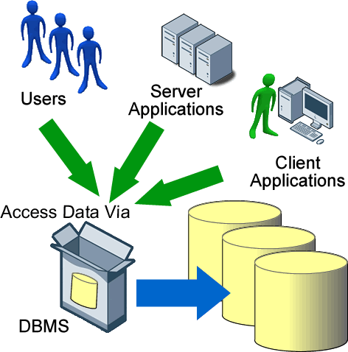
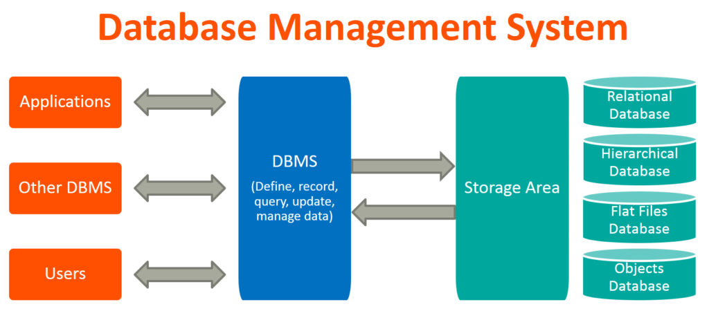
Database Management Systems

Slide 8
Applications Issue Queries to a Database
User
Application
Classes & Objects
Database Query Processor,
i.e., Interpreter
Response
Tables
Python Interpreter
SQL query
The SQL language is represented in query strings delivered to a DB backend.
Use the techniques learned here to build clean abstractions.
You have already learned the relational operators!

Slide 9


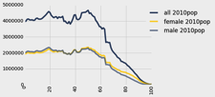
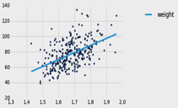
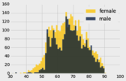
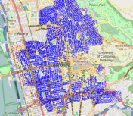
Data 8 Tables
ordered collection of labeled columns of anything
label
select, where, take, drop, group
dict, record,tuple
pivot, pivot_bin
values
split
join
Numpy array
T[‘label’]
A single, simple, powerful data structure for all
Inspired by Excel, SQL, R, Pandas, Numpy, …

Slide 10
Database Management Systems
DBMS are persistent tables with powerful relational operators
Important, heavily used, interesting!
A table is a collection of records, which are rows that have a value for each column
Structure Query Language (SQL) is a declarative programming language describing operations on tables
column has a name and a type
row has a value for each column
Name | Latitude | Longitude
Berkeley | 38 | 122
Cambridge | 42 | 71
Minneapolis | 45 | 93
table has columns and rows

Slide 11
Interacting With A Database

Slide 12
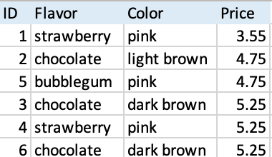
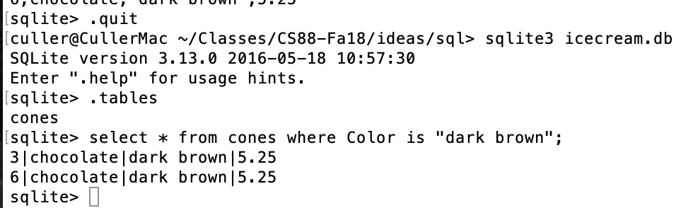
Permanent Data Storage

Slide 13
sqlite3 [Python Docs] [SQLite Docs]
Pronounced "sequel lite"
sqlite3 is a Python module which connects to a very popular database!
This is the first time you write code that really interacts with data on your computer!
There's some "boilerplate" setup here, but it's not too bad…
It's lightweight, fast, and works on most computers natively
But sqlite is not setup for web applications – you may encounter other database systems like PostgreSQL
A database is a .db file, which contains all of your data in an efficient form.
Many people connect to sqlite through a Program like Python OR through the sqlite interpreter.

Slide 14
Connecting To a Database (Python 3)
DB_FILENAME = '23-Databases_and_SQL.db' import sqlite3
# Talking to the database happens through a "connection"
con = sqlite3.connect(DB_FILENAME)
# A cursor is the object we use to execute a query.
cur = con.cursor() # This returns an iterator!
result = cur.execute("YOUR QUERY")
for row in result:
print(result) # This is a Tuple! # Save (commit) the changes
con.commit() # We can also close the connection if we are done with it.
# Just be sure any changes have been committed or they will be lost.
con.close()

Slide 15
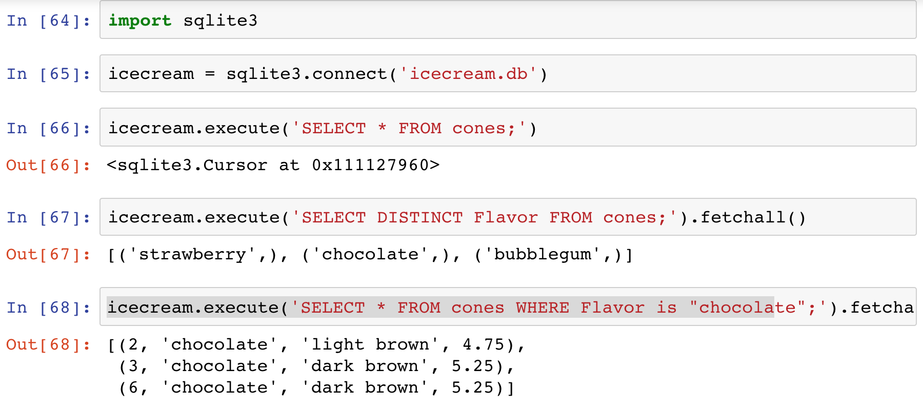
SQLite python API – In a Notebook.

Slide 16
The sqlite console
Interactive console used via the Terminal!
Everything is saved automaticaly. BEWARE!
👉 sqlite3 23-Databases_and_SQL.db
SQLite version 3.37.0 2021-12-09 01:34:53
Enter ".help" for usage hints.
sqlite> .help
.echo on|off Turn command echo on or off
.exit ?CODE? Exit this program with return-code CODE
.headers on|off Turn display of headers on or off
.help ?-all? ?PATTERN? Show help text for PATTERN
.quit Exit this program
.show Show the current values for various settings
.tables ?TABLE? List names of tables matching LIKE pattern TABLE
.trace ?OPTIONS? Output each SQL statement as it is run
sqlite> .tables
cones sales
sqlite>
There are many more commands than the ones shown here!, but these can be neat!

Slide 17
Introduction to SQL

Slide 18
Why SQL?
SQL is a declarative programming language for accessing and modifying data in a relational database.
It is an entirely new way of thinking (“new” in 1970, and new to you now!) that specifies what should happen, but not how it should happen.
One of a few major programming paradigms
Imperative/Procedural
Object Oriented
Functional
Declarative
Python is a multi-paradigm language, but we haven't yet tried declarative programming.

Slide 19
What is SQL?
A declarative language
Described what to compute
Imperative languages, like python, describe how to compute it
Query processor (interpreter) chooses which of many equivalent query plans to execute to perform the SQL statements
ANSI and ISO standard, but many variants
CS88's SQL will work on nearly all relational databases—databases that use tables.
SELECT statement creates a new table, either from scratch or by projecting a table
CREATE TABLE statement gives a global name to a table
Lots of other statements
analyze, delete, explain, insert, replace, update, …

Slide 20
SQL example
SQL statements create tables
Give it a try with sqlite3 or code.cs61a.org
Each statement ends with ‘;’
cs88$ sqlite3
SQLite version 3.9.2 2015-11-02 18:31:45
Enter ".help" for usage hints.
Connected to a transient in-memory database.
Use ".open FILENAME" to reopen on a persistent database.
sqlite> select 38 as latitude, 122 as longitude, "Berkeley" as name;
38|122|Berkeley
sqlite>

Slide 21
SQL Basics
SQL Keywords are case-insensitive
e.g. SELECT and select do the same thing
I try to capitalize them to make it clear what's-what.
The order of SQL keywords matters
e.g. SELECT ... FROM … WHERE …
Every statement ends in a ;
Whitespace doesn't matter
But indentations and newlines help make queries readable!
Despite being a standard, differences do exist between databases. We use sqlite3.

Slide 22
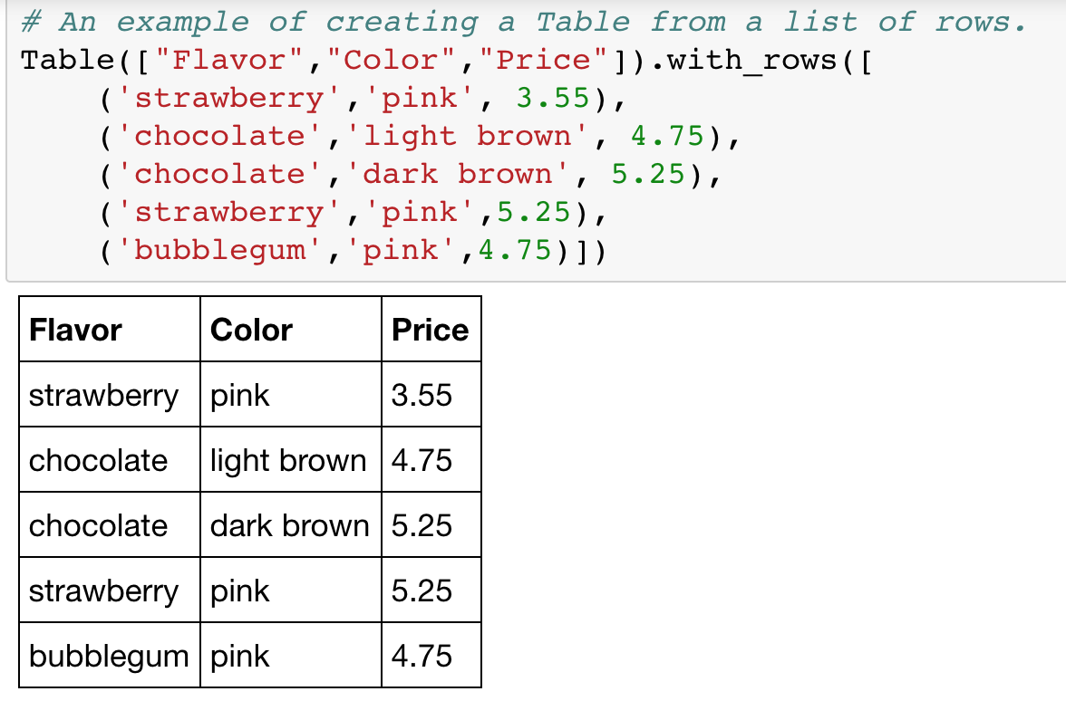

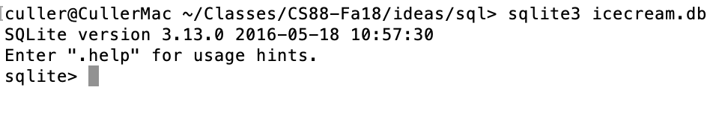
A Running example from Data 8 Lec 10

Slide 23
SELECT
Comma-separated list of column descriptions
Column description is an expression, optionally followed by as and a column name
Selecting literals creates a one-row table
union of select statements is a table containing the union of the rows
select [expression] as [name], [expression] as [name]; . . .
select "strawberry" as Flavor, "pink" as Color, 3.55 as Price;
select "strawberry" as Flavor, "pink" as Color, 3.55 as Price union
select "chocolate","light brown", 4.75 union
select "chocolate","dark brown", 5.25 union
select "strawberry","pink",5.25 union
select "bubblegum","pink",4.75;

Slide 24
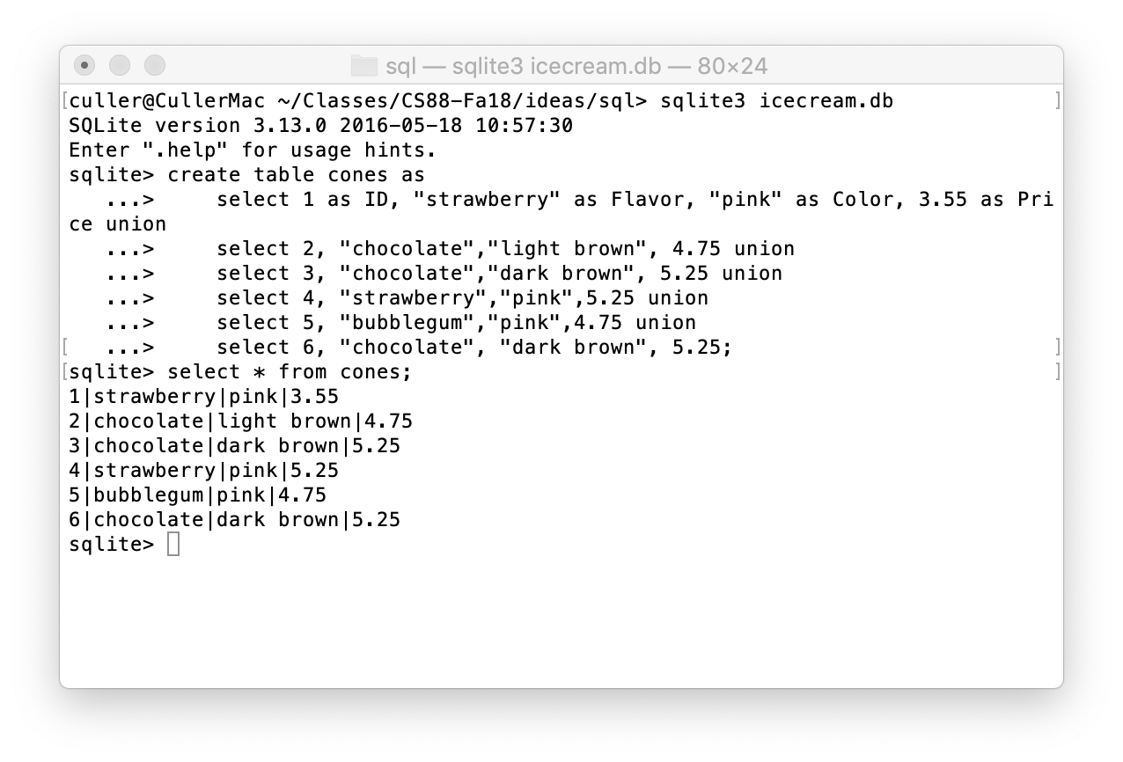
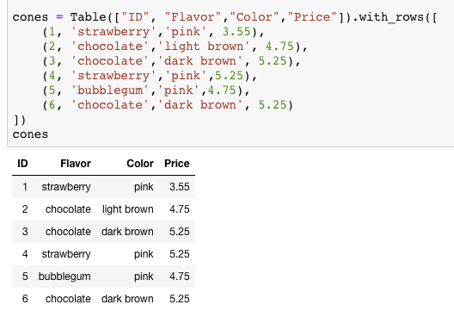
Select …

Slide 25
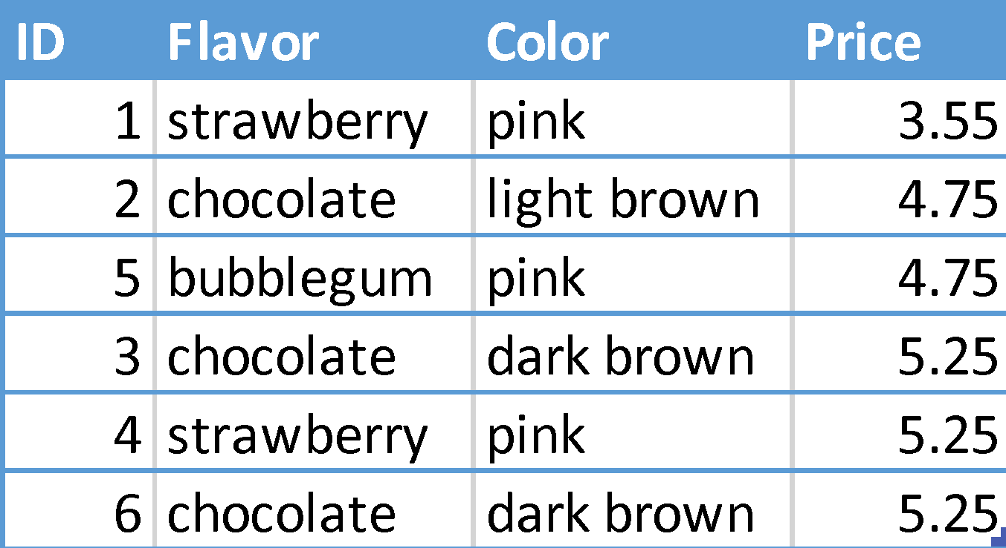
Projecting existing tables
Input table specified by from clause
Subset of rows selected using a where clause
Ordering of the selected rows declared using an order by clause
select [columns] from [table] where [condition] order by [order] ;
select * from cones order by Price;

Slide 26
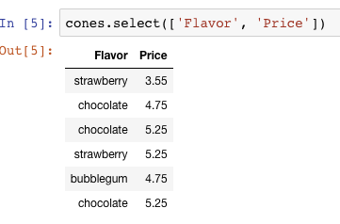
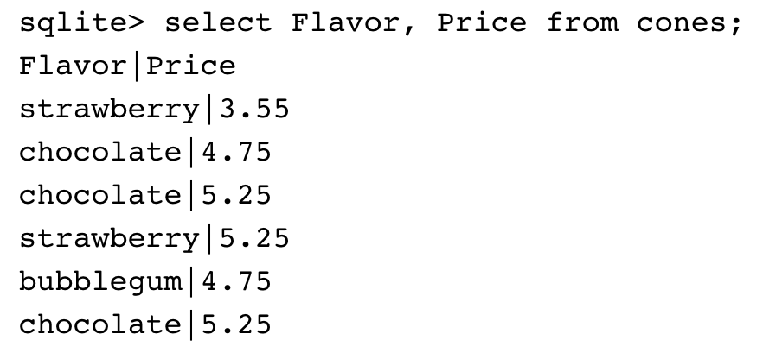
Projection
A “projection” is a view of a table, it doesn’t alter the state of the table.

Slide 27
Filtering in SQL

Slide 28
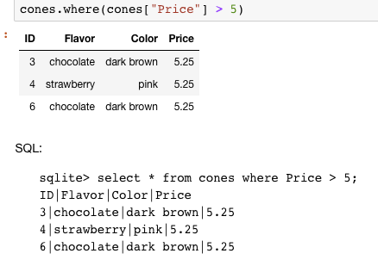
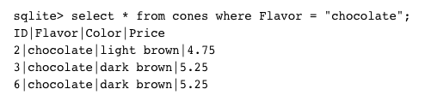
Filtering rows - where
Set of Table records (rows) that satisfy a condition
select [columns] from [table] where [condition] order by [order] ;

Slide 29
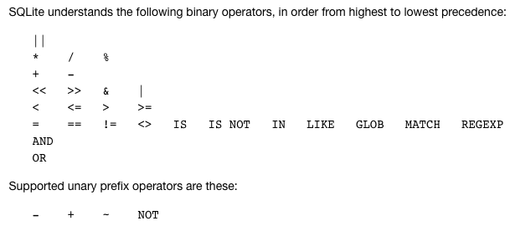
SQL Operators for predicate
use the WHERE clause in the SQL statements such as SELECT, UPDATE and DELETE to filter rows that do not meet a specified condition

Slide 30
Summary
SQL a declarative programming language on relational tables
largely familiar to you from data8
create, select, where, order, group by, join
Databases are accessed through Applications
e.g., all modern web apps have Database backend
Queries are issued through API
Be careful about app corrupting the database
Data analytics tend to draw database into memory and operate on it as a data structure
e.g., Tables
More in lab

Slide 31
create table
SQL often used interactively
Result of select displayed to the user, but not stored
Create table statement gives the result a name
Like a variable, but for a permanent object
create table [name] as [select statement];

Slide 32
SQL: creating a named table
create table cones as
select 1 as ID, "strawberry" as Flavor, "pink" as Color, 3.55 as Price union
select 2, "chocolate","light brown", 4.75 union
select 3, "chocolate","dark brown", 5.25 union
select 4, "strawberry","pink",5.25 union
select 5, "bubblegum","pink",4.75 union
select 6, "chocolate", "dark brown", 5.25;
Notice how column names are introduced and implicit later on.

Slide 33
Summary – Part 1
SELECT <col spec> FROM <table spec> WHERE <cond spec>
GROUP BY <group spec> ORDER BY <order spec> ;
INSERT INTO table(column1, column2,...)
VALUES (value1, value2,...);
CREATE TABLE name ( <columns> ) ;
CREATE TABLE name AS <select statement> ;
DROP TABLE name ;

Slide 34
Summary
SQL a declarative programming language on relational tables
largely familiar to you from data8
create, select, where, order, group by, join
Databases are accessed through Applications
e.g., all modern web apps have Database backend
Queries are issued through API
Be careful about app corrupting the database
Data analytics tend to draw database into memory and operate on it as a data structure
e.g., Tables
More in lab

