Slide 1
SQL

Slide 2
Announcements
Ants Project due Weds!
Bonus point for submitting by Tuesday night
Be on the lookout for a final survey
Extra credit for everyone if enough people submit. (TBD on numbers, points)
Final Exam logistics out soon, but just like the midterm.
Tuesday 8AM! (Sorry!)

Slide 3
SQL: SELECT Statements

Slide 4
Summary
SQL a declarative programming language on relational tables
largely familiar to you from data8
create, select, where, order, group by, join
Databases are accessed through Applications
e.g., all modern web apps have Database backend
Queries are issued through API
Be careful about app corrupting the database
Data analytics tend to draw database into memory and operate on it as a data structure
e.g., Tables
More in lab

Slide 5
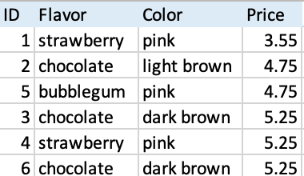
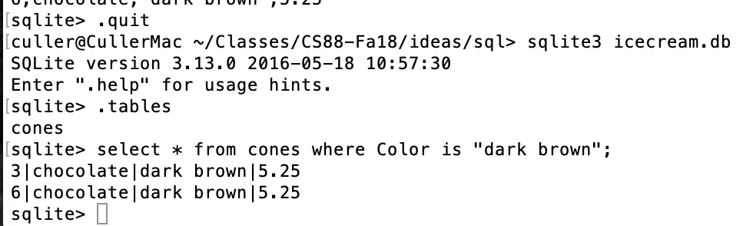
Permanent Data Storage

Slide 6
select
Comma-separated list of column descriptions
Column description is an expression, optionally followed by as and a column name
Selecting literals creates a one-row table
union of select statements is a table containing the union of the rows
select [expression] as [name], [expression] as [name]; . . .
select "strawberry" as Flavor, "pink" as Color, 3.55 as Price;
select "strawberry" as Flavor, "pink" as Color, 3.55 as Price union
select "chocolate","light brown", 4.75 union
select "chocolate","dark brown", 5.25 union
select "strawberry","pink",5.25 union
select "bubblegum","pink",4.75;

Slide 7
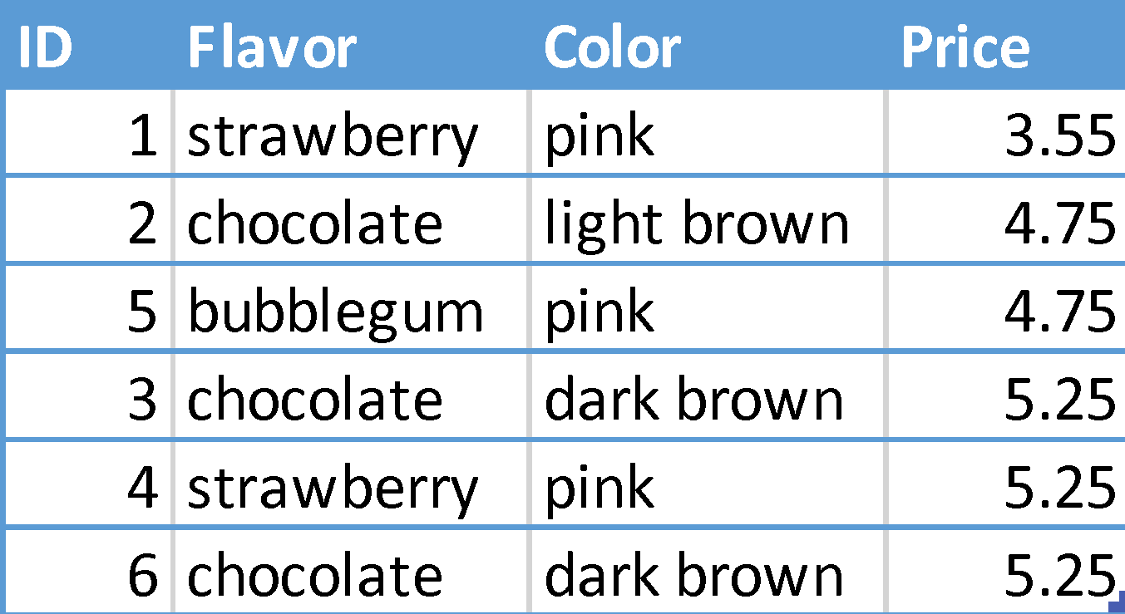
Projecting existing tables
Input table specified by from clause
Subset of rows selected using a where clause
Ordering of the selected rows declared using an order by clause
SELECT [columns] FROM [table] WHERE [condition] ORDER BY [order];
SELECT * FROM cones ORDER BY Price;

Slide 8
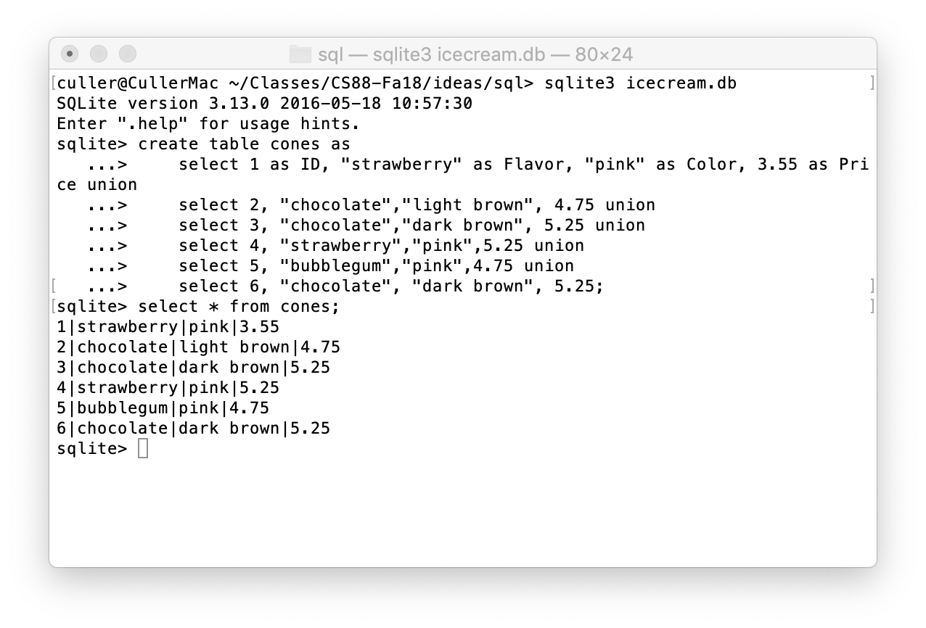
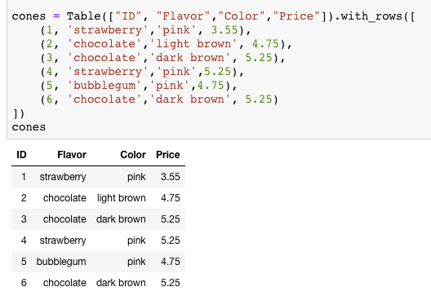
SELECT

Slide 9
SQL: Filtering Queries

Slide 10
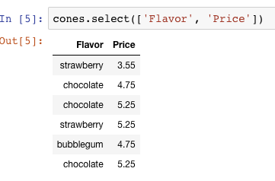
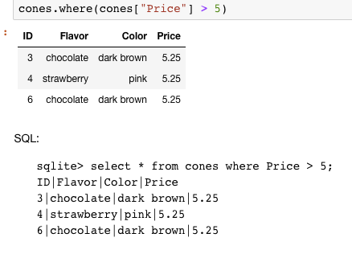
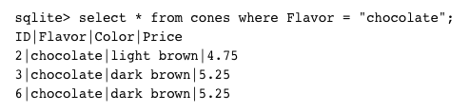
Filtering rows - WHERE
Set of Table records (rows) that satisfy a condition
SELECT [columns] FROM [table] WHERE [condition] [ORDER BY order];

Slide 11
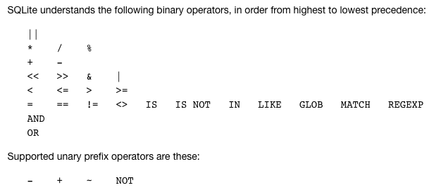
SQL Operators for predicates
use the WHERE clause in the SQL statements such as SELECT, UPDATE and DELETE to filter rows that do not meet a specified condition

Slide 12
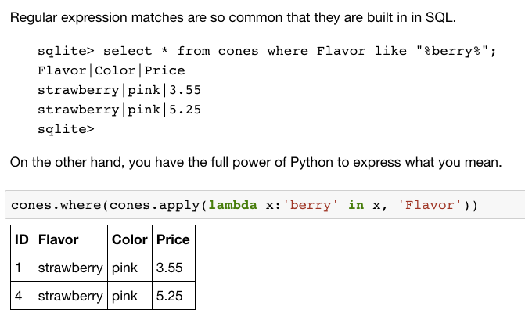
Approximate Matching …

Slide 13
SQL: CREATE and INSERT and UPDATE

Slide 14
CREATE TABLE
SQL often used interactively
Result of select displayed to the user, but not stored
Can create a table in many ways
Often may just supply a list of columns without data.
Create table statement gives the result a name
Like a variable, but for a permanent object
CREATE TABLE [name] AS [select statement];

Slide 15
SQL: creating a named table
CREATE TABLE cones AS
select 1 as ID, "strawberry" as Flavor, "pink" as Color, 3.55 as Price union
select 2, "chocolate", "light brown", 4.75 union
select 3, "chocolate", "dark brown", 5.25 union
select 4, "strawberry", "pink",5.25 union
select 5, "bubblegum", "pink",4.75 union
select 6, "chocolate", "dark brown", 5.25;
Notice how column names are introduced and implicit later on.

Slide 16
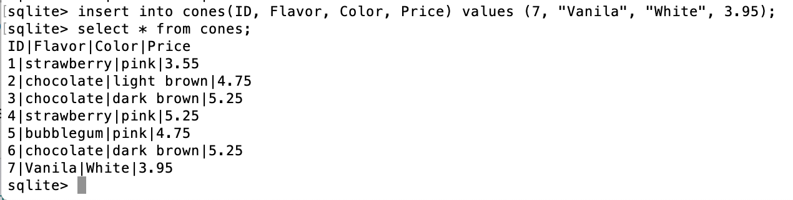
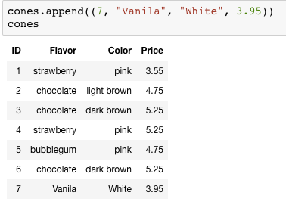
Inserting new records (rows)
INSERT INTO table(column1, column2,...)
VALUES (value1, value2,...);
A database table is typically a shared, durable repository shared by multiple applications

Slide 17
UPDATING new records (rows)
UPDATE table SET column1 = value1, column2 = value2 [WHERE condition];
If you don’t specify a WHERE, you’ll update all rows!

Slide 18
SQL: Aggregations

Slide 19
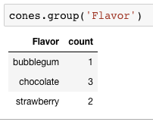
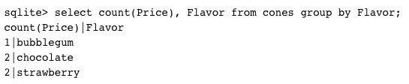
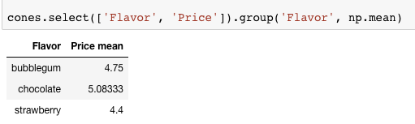
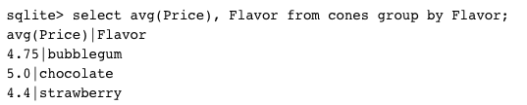
Groupinng and Aggregatations
The GROUP BY clause is used to group rows returned by SELECT statement into a set of summary rows or groups based on values of columns or expressions.
Apply an aggregate function, such as SUM, AVG, MIN, MAX or COUNT, to each group to output the summary information.

Slide 20
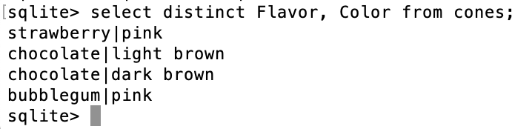
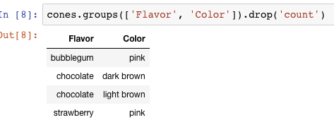

UNIQUE / Distinct values
select DISTINCT [columns] from [table] where [condition] order by [order] ;

Slide 21
SQL: Joins

Slide 22
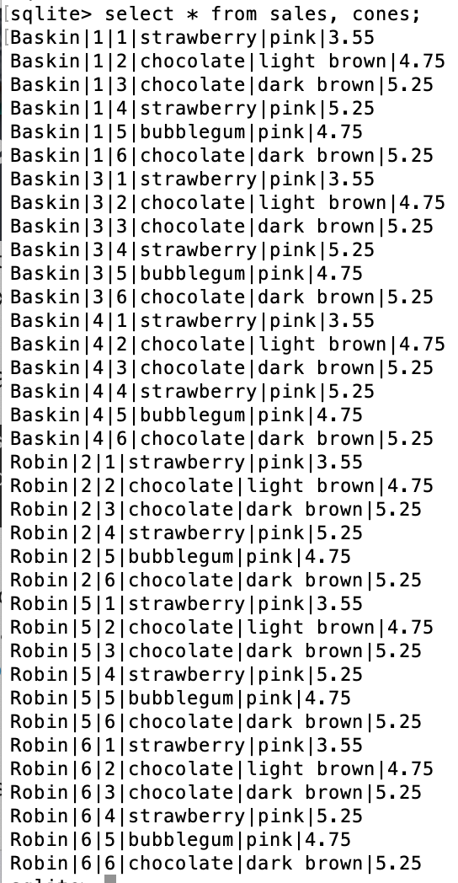
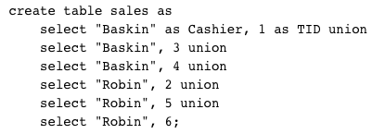
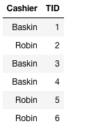
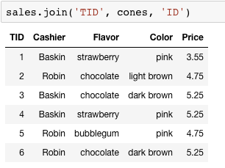
Joining tables
Two tables are joined by a comma to yield all combinations of a row from each
select * from sales, cones;

Slide 23
Inner Join
SELECT * FROM sales, cones WHERE cone_id =cones.id;
When column names conflict we write: table_name.column_name in a query.
sqlite> SELECT * FROM cones, sales WHERE cone_id=cones.id;
Id|Flavor|Color|Price|Cashier|id|cone_id
1|strawberry|pink|3.55|Baskin|3|1
1|strawberry|pink|3.55|Robin|6|1
2|chocolate|light brown|4.75|Baskin|1|2
2|chocolate|light brown|4.75|Baskin|4|2
2|chocolate|light brown|4.75|Robin|5|2
3|chocolate|dark brown|5.25|Robin|2|3

Slide 24
Putting It All Together:
Which of our cashiers sold the highest value of ice cream?
First we need to find which cones were sold by whom, then we SUM() the results!
sqlite> SELECT Cashier, SUM(Price) as 'Total Sold' FROM sales, cones WHERE sales.cone_id = cones.id GROUP BY Cashier;
Cashier|Total Sold
Baskin|13.3
Robin|13.8

Slide 25
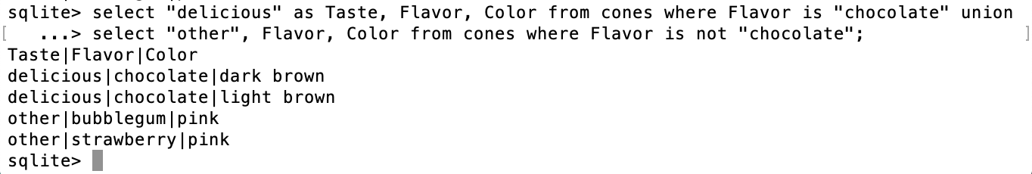
SQL: using named tables - FROM
SELECT "delicious" as Taste, Flavor, Color FROM cones
WHERE Flavor is "chocolate" UNION
SELECT "also tasty", Flavor, Color FROM cones
WHERE Flavor is not "chocolate";

Slide 26
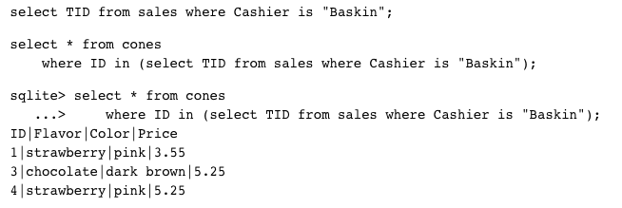
Queries within queries
Any place that a table is named within a select statement, a table could be computed
As a sub-query

Slide 27
Summary
SELECT <col spec> FROM <table spec> WHERE <cond spec>
GROUP BY <group spec> ORDER BY <order spec> ;
INSERT INTO table(column1, column2,...)
VALUES (value1, value2,...);
CREATE TABLE name ( <columns> ) ;
CREATE TABLE name AS <select statement> ;

