Slide 1
Iterators and Generators (Part 2)

Slide 2
Today:
Pick up where we left off!
Iterators – the iter protocol
Getitem protocol
Is an object iterable?
Lazy evaluation with iterators

Slide 3
Generator Functions

Slide 4
Terminology [Docs]
generator
A function which returns a generator iterator. It looks like a normal function except that it contains yield expressions for producing a series of values usable in a for-loop or that can be retrieved one at a time with the next() function.
generator iterator
An object created by a generator function.

Slide 5
Generators: turning iteration into an iterable
Generator functions use the yield keyword
Generator functions have no return statement, but they don’t return None
They implicitly return a generator object
Generator objects are just iterators
def squares(n):
for i in range(n):
yield (i*i)

Slide 6
Spongebob Case
def spongebob_case(text):
caps = True
for letter in text:
if caps:
yield letter.upper()
else:
yield letter.lower()
caps = not caps
Generate one letter at a time.
Explore how caps changes with each iteration.

Slide 7
Nest iteration
def all_pairs(x):
for item1 in x:
for item2 in x:
yield(item1, item2)

Slide 8
Order of Execution
Our generator function executes until we hit yield
Once we hit yield, execution is paused
Explore this with print statements

Slide 9
Iterators

Slide 10
What's an Iterator? [Docs]
iterator
An object representing a stream of data. Repeated calls to the iterator’s __next__() method (or passing it to the built-in function next()) return successive items in the stream. When no more data are available a StopIteration exception is raised instead.
iterable
An object capable of returning its members one at a time. Examples of include all sequence types and objects of any classes you define with an __iter__() method or with a __getitem__() method that implements sequence semantics.

Slide 11
Next element in generator iterable
Iterables work because they implement some "magic methods" on them. We saw magic methods when we learned about classes,
e.g., __init__, __repr__ and __str__.
The first one we see for iterables is __next__
iter() – transforms a sequence into an iterator
Usually this is not necessary, but can be useful.

Slide 12
Iterators: The iter protocol [Docs]
In order to be iterable, a class must implement the iter protocol
The iterator objects themselves are required to support the following two methods, which together form the iterator protocol:
__iter__: Return the iterator object itself. This is required to allow both containers and iterators to be used with the for and in statements.
This method returns an iterator object (which can be self)
__next__ : Return the next item from the container. If there are no further items, raise the StopIteration exception.

Slide 13
The Iter Protocol In Practice
Classes get to define how they are iterated over by defining these methods
containers (objects like lists, tuples, etc) typically define a Container class and a separate ContainterIterator class.
Lists, Ranges, etc are not directly iterators
We cannot call next() on them.
We can all iter(list), iter(range), etc if needed.
However, they implement an __iter__ method, and list_iterator, range_iterator class, etc.

Slide 14
Iterables
Demo

Slide 15
Building a Range Iterator

Slide 16
Making a Range Iterator
What does a range need?
Start value
Stop
(We'll ignore step sizes)
keep track of the current value
An __iter__ method
A __next__ method

Slide 17
Example
class myrange:
def __init__(self, n):
self.i = 0
self.n = n
def __iter__(self):
return self
def __next__(self):
if self.i < self.n:
current = self.i
self.i += 1
return current
else:
raise StopIteration()

Slide 18
The GetItem Protocol

Slide 19
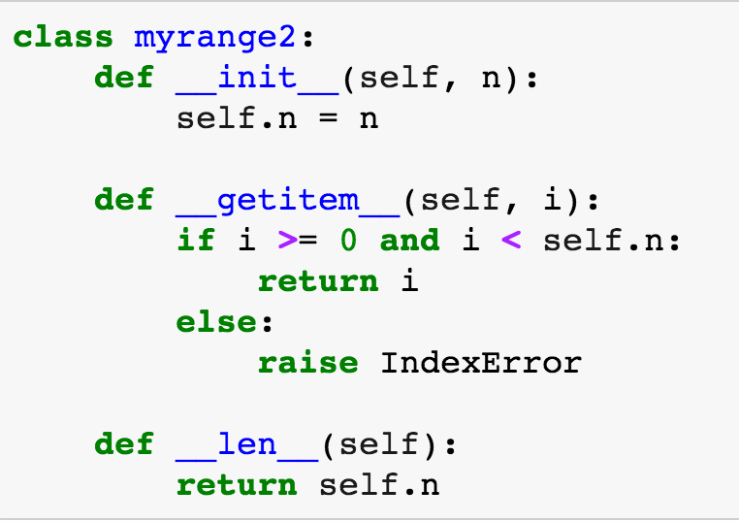
Get Item protocol – Build a Sequene
Another way an object can behave like a sequence is indexing: Using square brackets “[ ]” to access specific items in an object.
Defined by special method: __getitem__(self, i)
Method returns the item at a given index

Slide 20
Get Item Protocol
When __iter__ isn't defined, check if __getitem__ exists
__getitem__ must accept integers as indices
Start at 0
Continue iterating until IndexError is raised
This is an older way of making iterators.
Why two ways?
Languages evolve over time!
There's often more than one valid design.

Slide 21
Get Item Protocol [Docs]
class myrange2:
def __init__(self, n):
self.n = n
def __getitem__(self, i):
if i >= 0 and i < self.n:
return i
else:
raise IndexError
def __len__(self):
return self.n

Slide 22
Iterators and Generators Review

Slide 23
Terms and Tools
Iterators: Objects which we can use in a for loop
Anything that can be looped over!
Sometimes they’re lazy, sometimes not!
Generators: A shorthand way to make an iterator that uses yield
a function that uses yield is a generator function
a generator function returns a generator object
Generators do not use return
Sequences: A particular type of iterable
They know they’re length, support slicing
Are not lazy

Slide 24
What's the Big Picture?
We have new tools for building data structures that behave sequences
We can handle "infinite" streams of data.
We can build our own for loops, perhaps custom for loops.

Slide 25
What can we do now?
Build our own for-loop like functions!
Python doesn't let us extend built in keywords
So we can make a function like doFor(sequence, action)
Is the sequence already an iterator? → Use next()
Can we call iter(sequence)? → Use next()
Can we call sequence[0]? → Use Indexing
Now we can get items
We can call fn(some_item) until:
We catch StopIteration or IndexError
Other Errors we should probably not address

Slide 27
Type Checking

Slide 28
Determining if an object is iterable
from collections.abc import Iterable
isinstance([1,2,3], Iterable)
This is more general than checking for any list of particular type, e.g., list, tuple, string...

