Slide 1
Object-Oriented Programming

Slide 2
Announcements
Midterm Thurs 3/14
We will be sending seating assignments out early next week
If you have a conflict email us ASAP – should have already filled out the form
cs88@berkeley.edu (Please don't email just me. I love to help, but can't get to 500 emails)
Review sessions posted on Ed.
Will be updating Lab/HW schedule to give you a chance to study.

Slide 3
Object-Oriented Programming

Slide 4
Learning Objectives
Learn how to make a class in Python
class keyword
__init__ method
self

Slide 5
Object-Oriented Programming (OOP)
Objects as data structures
With methods you ask of them
These are the behaviors
With local state, to remember
These are the attributes
Classes & Instances
Instance an example of class
E.g., Fluffy is instance of Dog
Inheritance saves code
Hierarchical classes
e.g., a Tesla is a special case of an Electric Vehicle, which is a special cade of a car
Other Examples (though not pure)
Java (CS61B), C++
www3.ntu.edu.sg/home/ehchua/programming/java/images/OOP-Objects.gif

Slide 6

Object-Oriented Programming is About Design
"In my version of computational thinking, I imagine an abstract machine with just the data types and operations that I want. If this machine existed, then I could write the program I want.
But it doesn’t. Instead I have introduced a bunch of subproblems — the data types and operations — and I need to figure out how to implement them. I do this over and over until I’m working with a real machine or a real programming language. That’s the art of design."
— Barbara Liskov,
Turing Award Winner, UC Berkeley '61.
Full interview

Slide 7
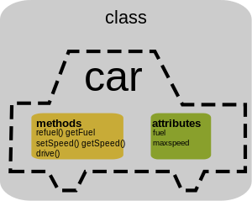
Classes
Consist of data and behavior, bundled together to create abstractions
Abstract Data Types use functions to create abstractions
Classes define a new type in a programming language
They make the "abstract" data type concrete.
A class has
attributes (variables)
methods (functions)
that define its behavior.

Slide 8
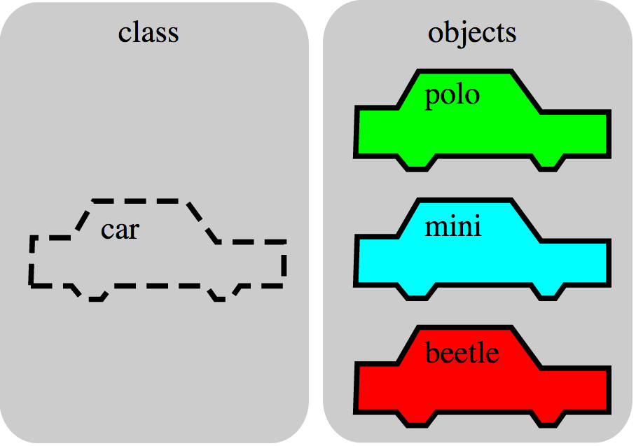
Objects
An object is the instance of a class.

Slide 9
Objects
Objects are concrete instances of classes in memory.
They have state
mutable vs immutable (lists vs tuples)
Methods are functions that belong to an object
Objects do a collection of related things
In Python, everything is an object
All objects have attributes
Manipulation happens through methods

Slide 10
Python class statement
class ClassName:
def __init__(self):
<initialization steps>
.
.
.
<statement-N>
# Coming Next Week:
class ClassName ( inherits ):
<statement-1>
.
.
.
<statement-N>

Slide 11
From ADTs to Classes
An ADT is an abstract representation of a type of Data.
def points(x, y) # our point ADT
return { 'x': x, 'y': y}
class Point:
def __init__(self, x, y):
self.x = x
self.y = y
def subtract(self, other):
return Point(self.x - other.x, self.y - other.y)

Slide 12
From ADTs to Classes (Usage)
>>> origin = point(0, 0) # Using the ADT
>>> type(origin)
<class 'dict'>
>>> origin
{'x': 0, 'y': 0}
>>> my_house = Point(5, 5) # Using the class
>>> my_house.x
5
>>> type(my_house)
<class '__main__.Point'>
>>> my_house
<__main__.Point object at 0x104fdc710>

Slide 13
Example: Account
class BaseAccount:
def __init__(self, name, initial_deposit):
self.name = name
self.balance = initial_deposit
def account_name(self):
return self.name
def balance(self):
return self.balance
def withdraw(self, amount):
self.balance -= amount
return self.balance
attributes
new namespace
The object
dot
methods

Slide 14
Creating an object, invoking a method
The Class Constructor
my_acct = BaseAccount("John Doe", 93)
my_acct.withdraw(42)
dot

Slide 15
Special Initialization Method
class BaseAccount:
def __init__(self, name, initial_deposit):
self.name = name
self.balance = initial_deposit
def account_name(self):
return self.name
def balance(self):
return self.balance
def withdraw(self, amount):
self.balance -= amount
return self.balance
return None

Slide 16
More on Attributes
Attributes of an object accessible with ‘dot’ notation
obj.attr
You can distinguish between ”public” and “private” data.
Used to clarify to programmers how you class should be used.
In Python an _ prefix means “this thing is private”
_foo and __foo do different things inside a class.
More for the curious.
Class variables vs Instance variables:
Class variable set for all instances at once
Instance variables per instance value

Slide 17
Example
class BaseAccount:
def __init__(self, name, initial_deposit):
self.name = name
self.balance = initial_deposit
def name(self):
return self.name
def balance(self):
return self.balance
def withdraw(self, amount):
self.balance -= amount
return self.balance

Slide 18
Example: Suggested “private” attributes
class BaseAccount:
def __init__(self, name, initial_deposit):
self._name = name
self._balance = initial_deposit
def name(self):
return self._name
def balance(self):
return self._balance
def withdraw(self, amount):
self._balance -= amount
return self._balance

Slide 19
Example: class attribute
class BaseAccount:
account_number_seed = 1000
def __init__(self, name, initial_deposit):
self._name = name
self._balance = initial_deposit
self._acct_no = BaseAccount.account_number_seed
BaseAccount.account_number_seed += 1
def name(self):
return self._name
def balance(self):
return self._balance
def withdraw(self, amount):
self._balance -= amount
return self._balance

Slide 20
More class attributes
class BaseAccount:
account_number_seed = 1000
accounts = []
def __init__(self, name, initial_deposit):
self._name = name
self._balance = initial_deposit
self._acct_no = BaseAccount.account_number_seed
BaseAccount.account_number_seed += 1
BaseAccount.accounts.append(self)
def name(self):
...
def show_accounts():
for account in BaseAccount.accounts:
print(account.name(),
account.account_no(),account.balance())

Slide 21
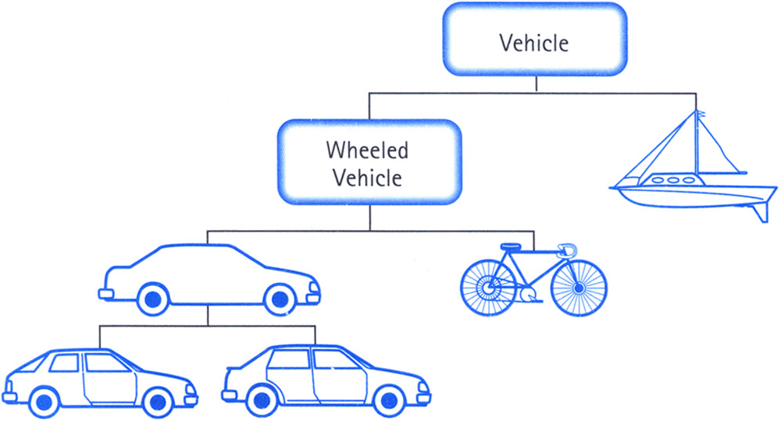
Class Inheritance
Classes can inherit methods and attributes from parent classes but extend into their own class.

Slide 22
Inheritance
Define a class as a specialization of an existing class
Inherent its attributes, methods (behaviors)
Add additional ones
Redefine (specialize) existing ones
Ones in superclass still accessible in its namespace

Slide 23
Review: Bank account using dictionary
account_number_seed = 1000
def account(name, initial_deposit):
global account_number_seed
account_number_seed += 1
return {'Name' : name, 'Number': account_number_seed,
'Balance' : initial_deposit}
def account_name(acct):
return acct['Name']
def account_balance(acct):
return acct['Balance']
def account_number(acct):
return acct['Number']
def deposit(acct, amount):
acct['Balance'] += amount
return acct['Balance']
def withdraw(acct, amount):
acct['Balance'] -= amount
return acct['Balance']
>>> my_acct = account('David Culler', 100)
>>> my_acct
{'Name': ’John Doe', 'Balance': 100, 'Number': 1001}
>>> account_number(my_acct)
1001
>>> your_acct = account("Fred Jones", 475)
>>> account_number(your_acct)
1002
>>>

Slide 24
Example
class Account(BaseAccount):
def deposit(self, amount):
self._balance += amount
return self._balance

Slide 25
More special methods
class Account(BaseAccount):
def deposit(self, amount):
self._balance += amount
return self._balance
def __repr__(self):
return '< ' + str(self._acct_no) +
'[' + str(self._name) + '] >'
def __str__(self):
return 'Account: ' + str(self._acct_no) +
'[' + str(self._name) + ']'
def show_accounts():
for account in BaseAccount.accounts:
print(account)
Goal: unambiguous
Goal: readable

Slide 26
Classes using classes
class Bank:
accounts = []
def add_account(self, name, account_type,
initial_deposit):
assert (account_type == 'savings') or
(account_type == 'checking'), "Bad Account type"
assert initial_deposit > 0, "Bad deposit"
new_account = Account(name, account_type,
initial_deposit)
Bank.accounts.append(new_account)
def show_accounts(self):
for account in Bank.accounts:
print(account)

