Slide 1
Object-Oriented Programming: Part 2, Inheritance

Slide 2
Announcements
Midterm Thursday!
Seating announcements sent out.
https://go.c88c.org/seating to login in and see your seat.
Reminders: 5 hand-written pages.
Please write names and hand them in with your exam.

Slide 3
Reviewing Our Account

Slide 4
Example: Suggested “private” attributes
class BaseAccount:
def __init__(self, name, initial_deposit):
self._name = name
self._balance = initial_deposit
def name(self):
return self._name
def balance(self):
return self._balance
def withdraw(self, amount):
self._balance -= amount
return self._balance

Slide 5
Python's Instance Attributes
self.attribute_name = x
Sets up an attribute which can be modified by anyone
self._attribute_name = x
Sets up an attribute which is suggested that is "internal only"
e.g. my_instance._attribue_name = y will work, but should look wrong.
Internally, self._attribute_name = y is OK.
self.__attribute_name = x
Sets up an attribute which is private
e.g. my_instance.__attribue_name = y will error!
Internally, self.__attribute_name = y is OK.

Slide 6
Object-Oriented Programming: Part 2, Inheritance

Slide 7
Class Attributes: Keeping Track of Our Instances?
Problem:
We can make many accounts… they all live in memory.
But how do we know what all of our accounts are?
How could we create an account number which is always increasing?
Solution:
A class in Python can manage data shared across all instances
We call these class attributes which are distinguished from instance attributes

Slide 8
Classes Can Have Attributes Too!
Class attributes (as opposed to instance attributes) belong to the class itself, instead of each object
This means there is one value which is shared for all of the class's objects
Be Careful!
It's easy to overdo class attributes
Methods that rely only on class attributes are called class methods
Python has some special features we won't use, but are useful
Declaring a method as belonging to a class, not an instance.

Slide 9
Example: class attribute
class BaseAccount:
account_number_seed = 1000
def __init__(self, name, initial_deposit):
self._name = name
self._balance = initial_deposit
self._acct_no = BaseAccount.account_number_seed
BaseAccount.account_number_seed += 1
def name(self):
return self._name
def balance(self):
return self._balance
def withdraw(self, amount):
self._balance -= amount
return self._balance

Slide 10
More class attributes
class BaseAccount:
account_number_seed = 1000
accounts = []
def __init__(self, name, initial_deposit):
self._name = name
self._balance = initial_deposit
self._acct_no = BaseAccount.account_number_seed
BaseAccount.account_number_seed += 1
BaseAccount.accounts.append(self)
def name(self):
...
def show_accounts():
for account in BaseAccount.accounts:
print(account.name(),
account.account_no(),account.balance())

Slide 11
Are There Better Approaches?
BEWARE! Class attributes are useful but can get confusing.
Perhaps what want is a Bank() class
The bank would have a create_account() method
Each Bank() would have its own accounts list, as a set of instance variables.
class Bank():
def __init___(self): self.account_no_seed = 1000
self.accounts = []
def create_account(self, name, balance):
acct = BaseAccount(name, balance, self.account_no_seed)
self.accounts.append(acct)
self.account_no_seed += 1

Slide 12
Object-Oriented Programming: "Magic" Methods

Slide 13
Learning Objectives
Python's Special Methods define built-in properties
__init__ # Called when making a new instance
__sub__ # Maps to the - operator
__str__ # Called when we call print()
__repr__ # Called in the interpreter

Slide 14
Special Initialization Method
__init__ is called automatically when we write: my_account = BaseAccount('me', 0)
class BaseAccount:
def __init__(self, name, initial_deposit):
self.name = name
self.balance = initial_deposit
def account_name(self):
return self.name
def account_balance(self):
return self.balance
def withdraw(self, amount):
self.balance -= amount
return self.balance
return None

Slide 15
More special methods
class BaseAccount:
… (init, etc removed)
def deposit(self, amount):
self._balance += amount
return self._balance
def __repr__(self):
return '< ' + str(self._acct_no) +
'[' + str(self._name) + '] >'
def __str__(self):
return 'Account: ' + str(self._acct_no) +
'[' + str(self._name) + ']'
def show_accounts():
for account in BaseAccount.accounts:
print(account)
Goal: unambiguous
Goal: readable

Slide 16
More Magic Methods
We will not go through an exhaustive list!
Magic Methods start and end with "double underscores" __
They map to built-in functionality in Python. Many are logical names:
__init__ → Class Constructor
__add__ → + operator
__sub__ → - operator
__getitem__ → [] operator
__repr__ and __str__ → control output
A longer list for the curious:
https://docs.python.org/3/reference/datamodel.html

Slide 17
Live Demo

Slide 18
Object-Oriented Programming: Inheritance

Slide 19
Learning Objectives
Inheritance allows classes to reuse methods and attributes from a parent class.
super() is a new method in Python
Subclasses or child classes are distinct from on another, but share properties of the parent.

Slide 20
Inheritance
Define a class as a specialization of an existing class
Inherent its attributes, methods (behaviors)
Add additional ones
Redefine (specialize) existing ones
Ones in superclass still accessible in its namespace

Slide 21
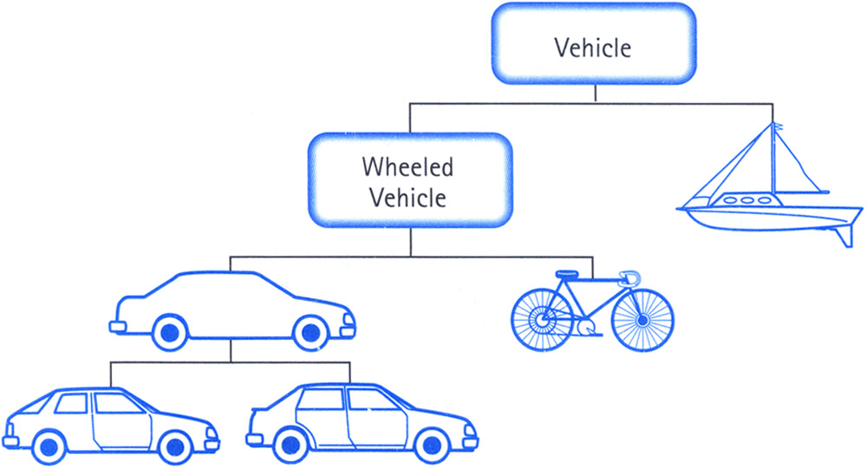
Class Inheritance
Classes can inherit methods and attributes from parent classes but extend into their own class.

Slide 22
Python class statement
class ClassName:
<statement-1>
.
.
.
<statement-N>
class ClassName ( inherits / parent-class ):
<statement-1>
.
.
.
<statement-N>

Slide 23
Example
class BaseAccount:
def __init__(self, name, initial_deposit):
# Initialize the instance attributes
self._name = name
self._acct_no = Account._account_number_seed
Account._account_number_seed += 1
self._balance = initial_deposit
class CheckingAccount(BaseAccount): def __init__(self, name, initial_deposit):
# Use superclass initializer
BaseAccount.__init__(self, name, initial_deposit)
# Alternatively:
# super().__init__(name, initial_deposit)
# Additional initialization
self._type = "Checking"

Slide 24
Accessing the Parent Class
super() binds methods in the parent or "superclass" to the current instance
Can be called anywhere in our class
Handles passing self to the method
Handles looking up an attribute on a parent class, too.
We can directly call ParentClass.method(self, …)
This is not quite as flexible if our class structure changes.
In general, prefer using super()!
Outside of C88C, things can get complex…
https://docs.python.org/3/library/functions.html#super

Slide 25
Object-Oriented Programming: Evolving The Bank Model

Slide 26
Composing Classes Together
Currently, our BaseAccount stores a lot of data in class attributes…
This suggests we are trying to accomplish an entirely new kind of class, or object
A Bank!
We should extract that these functions into their own class
A bank can now manage:
making accounts
keeping track of account numbers
showing and listing accounts

Slide 27
Live Demo

