Slide 1
Programming Paradigms

Slide 2
Announcements
Ants out this week. ☺
Checkpoint, 4 points (like maps) in 1.5 weeks

Slide 3
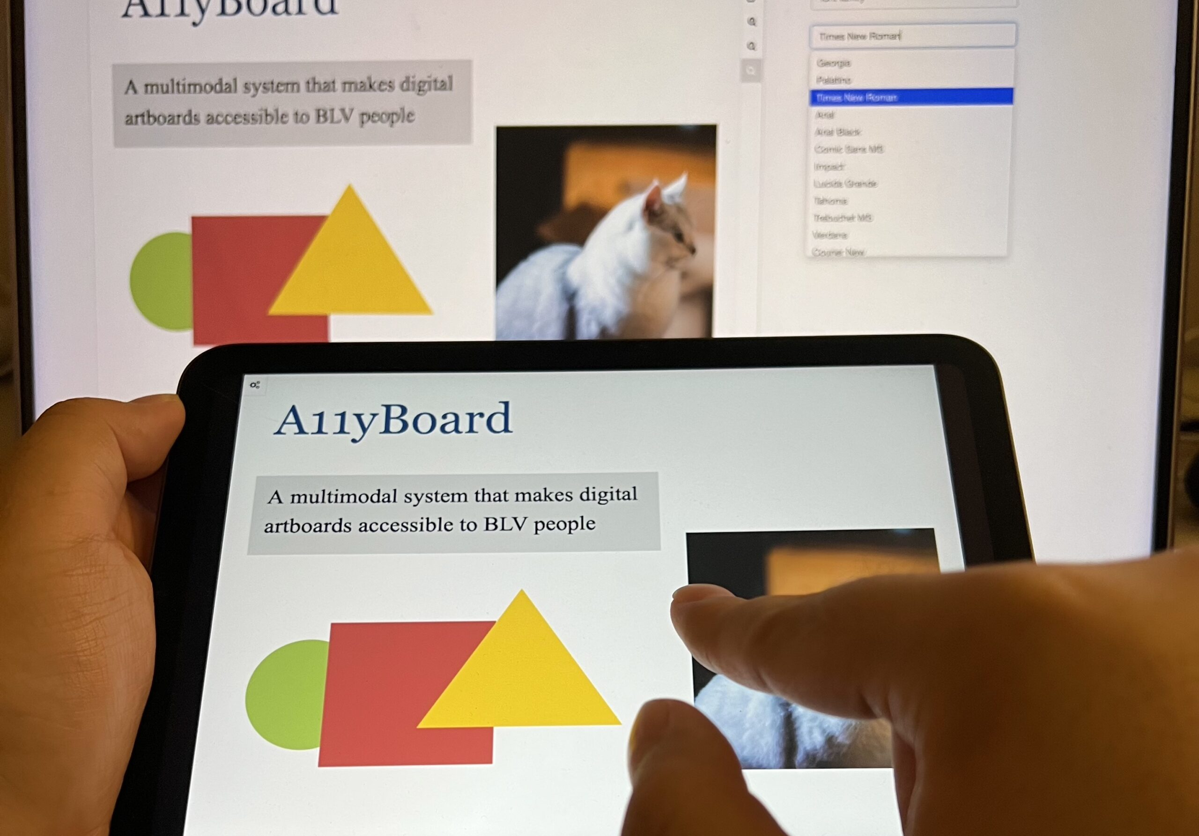
October 30, 2023
A Google Slides extension can make presentation software more accessible for blind users
Screen readers, which convert digital text to audio, can make computers more accessible to many disabled users — including those who are blind, low vision or dyslexic. Yet slideshow software, such as Microsoft PowerPoint and Google Slides, isn’t designed to make screen reader output coherent. Such programs typically rely on Z-order — which follows the way objects are layered on a slide — when a screen reader navigates through the contents. Since the Z-order doesn’t adequately convey how a slide is laid out in two-dimensional space, slideshow software can be inaccessible to people with disabilities.
https://www.washington.edu/news/2023/10/30/a11yboard-google-slides-powerpoint-accessible-blind-users
A team led by researchers at the University of Washington has created A11yBoard for Google Slides, a browser extension and phone or tablet app that allows blind users to navigate through complex slide layouts, objects, images and text. Here, a user demonstrates the touchscreen interface. University of Washington

Slide 4
Programming Paradigms
Paradigm (Merriam Webster): a typical example or pattern of something; a model. Example: "there is a new paradigm for public art in this country"
Programming Paradigm (Joe Turner, Clemson University): “A programming paradigm is a general approach, orientation, or philosophy of programming that can be used when implementing a program.” You might call this a "style"

Slide 5
Examples of Paradigms
Example, three very different approaches to squaring list:
map(lambda x: x*x, range(5))
[ x * x for x in range(5) ]
range(5).square_nums() # Only theoretically, e.g assume `def square_nums(self)` exists.

Slide 6
Why?
Understanding the paradigm helps you understand the intent of the programmer
Pick the right tool for the job!
Most programs written today are multi-paradigm
They mix and match the style

Slide 7
Word of Warning
There is no universally agreed upon taxonomy of human programming styles.
One possible list:
Imperative
Functional
Array-based
Object oriented
Declarative
These terms are a bit fluid, and as you’ll see if you read more on wikipedia, there is substantial disagreement about these terms.

Slide 8
Programming Paradigms
Example, three very different approaches to squaring list:
Functional: map(lambda x: x*x, [1, 2, 3])
Array-based: np.array([1,2,3]) * np.array([1,2,3]) np.array([1,2,3]) ** 2
Imperative:
def square(nums):
result = []
for num in nums:
result.append(num * num)
return result

Slide 9
The Imperative Programming Paradigm
An imperative program provides a sequence of steps.
Like following a recipe.
Assignment is allowed (can set variables).
Mutation is allowed (can change variables).
Example (acronym):
def acronym_i(words):
result = ''
words = words.split(' ')
for word in words:
if len(word) > 4:
result += word[0]
return result

Slide 10
The Functional Programming Paradigm
In functional programming, computation is thought of in terms of the evaluation of functions.
No state (e.g. variable assignments).
No mutation (e.g. changing variable values).
No side effects when functions execute.
def acronym_f(words):
return reduce(add,
map(lambda w: w[0],
filter(lambda w: len(w) > 3,
words.split(' '))))

Slide 11
Imperative vs. Functional
Can argue that functional is a subset of imperative.
Functional programming is still a series of steps.
“Just” need to avoid state and think of computation as functions.
Functional Programs:
More often fewer clear /correct ways to do something.
Programming feels more like solving puzzles.
Solutions can seem like magic (especially to imperative programmers).

Slide 12
Why do we push functional programming?
Tend to be shorter.
Tend to be easier to debug (no need to track variables / side effects).
Tend to parallelize better (can split work on multiple computers).
Example: Each computer can do 1/8th of a “map” operation.
Reducing mutations makes computation easier to scale
Hugely prevalent in AI fields.
Growing in popularity.
Explosion of ideas in new programming languages
“old” ideas are becoming new/popular

Slide 13
A Hybrid Approach
Paradigms are not official rules. Just attempts to taxonomize approaches taken by humans.
Code below is sorta functional, sorta imperative.
Utilizes state for clarity. Many program this way. You might not.
def acronym_h(words):
words = words.split(' ')
long = filter(lambda w: len(w) > 4, words)
letters = maps(lambda w: w[0], long)
return ''.join(letters)

Slide 14
Discussion and Debate
Which of these do you like best?
Imperative Very small steps to reason about. Seems "natural", but lots of code
Functional: Less to keep track of. Fewer variables, lines
def acronym_f(words):
return reduce(add,
map(lambda w: w[0],
filter(lambda w: len(w) > 3,
words.split(' '))))
def acronym_i(words):
result = ''
words = words.split(' ')
for word in words:
if len(word) > 4:
result += word[0]
return result
Hybrid: Some functional, but uses variables, soom OOP!
def acronym_h(words):
words = words.split(' ')
long = filter(lambda w: len(w) > 3, words)
letters = maps(lambda w: w[0], long)
return ''.join(letters)

Slide 15
Array-Based Programming!
Not something we can easily demo in native Python.
Treats arrays a "first class" objects – not just containers:
Mathematical Operations correspond to "Pairwise" computations:
np.array([1,2,3]) * np.array([1,2,3])
np.array([1,2,3]) + np.array([1,2,3]) == [2, 4, 6] → array([ True, True, True])
Note! Even == is now an array operation. Good? Bad? Just different!
Very common in data science, engineering!
R (STAT 134), MATALAB, Julia, APL

Slide 16
The Object Based Programming Paradigm
In object programming, we organize our thinking around objects, each containing its own data, and each with its own procedures that can be invoked.
We've had plenty of practice here!
OOP provides many tools!
But also leaves many import questions open:
Should functions be mutable or immutable?
How much inheritance is the right amount?
Notes:
https://www.pinclipart.com/pindetail/mwxoJT_bean-wizard-alternate-colors-clipart/

Slide 17
Object-Oriented Programming
There is a LOT more than what we see in C88C
Rich model for composing classes together
Python allows you to inherit from multiple classes at once
Can easily be overused.
Explored in depth in CS61B
In Python "everything is an object”
You benefit from OOP ideas even when you don’t realize.
Global functions like len() delegate to "magic" methods on objects, e.g. __len__
Notes:
https://www.pinclipart.com/pindetail/mwxoJT_bean-wizard-alternate-colors-clipart/

Slide 18
Declarative Programming
In declarative programming, we express what we want, without specifying how. A program is simply a description of the result we want.
Can be a very different thought process!
Incredibly useful, but not necessarily best for all types of problems.

Slide 19
The Web: HTML
Web pages are built with a language called HTML.
Programmers specific what content should be on the page, and where.
The browser lays out the content on each device in the right spot for each screen size, etc.
A partial section of the CS88 Website:
<div id="content" class="container">
<div class="page-header">
<h1><span class="content-title-brand">CS 88</span>:
Computational Structures in Data Science
<div class="small">Fall 2023</div>
<div class="small">Instructor: Michael Ball</div>
</h1>
</div> <section><h2>Announcements</h2>…

Slide 20
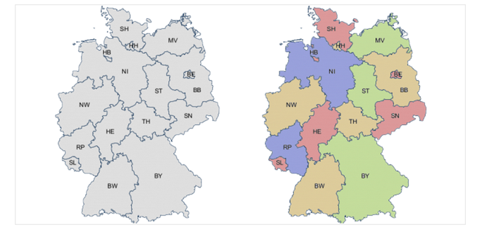
Declarative Programming
In declarative programming, we express what we want, without specifying how. A program is simply a description of the result we want.
Example: coloring a map of Germany using the Prolog language:

Slide 21


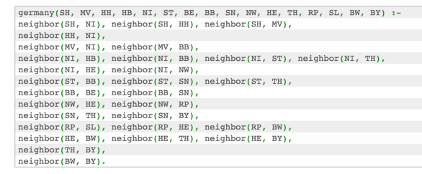
Prolog Example (From Bernardo Pires)
Tell Prolog that colors exist: Tell Prolog that same colors can’t touch:
Tell Prolog all the borders:
Ask Prolog for answer:

Slide 22

Declarative Programming → Results
Result is a list of states and color pairs

Slide 23
Declarative Programming
Each declarative language has only a limited number of tasks for which you can specify “what”, and not “how”, e.g.
Prolog: Logic.
SQL: Queries from a database.
Pandas and datascience modules: Data manipulation operations like aggregation, filtering, joining, etc.
Very common operations in Data 8 and Data 100.
While the syntax of Pandas is odd, the ideas will build upon Data 8.

Slide 24
Declarative Programming In Data 8
cones.group('Flavor')
datascience module figures out the grouping
table.where(label, conditions)
Can combine these simpler expressions together for more complex questions

Slide 25
Declarative or Object-Oriented?
Both!
Tables (in Data 8, Pandas, etc) are Python objects
There is a class Table with a def columns(self) method
However, the interface is often declarative.
You describe what the output should look like

Slide 26
Why SQL?
SQL is a declarative programming language for accessing and modifying data in a relational database.
It is an entirely new way of thinking (“new” in 1970, and new to you now!) that specifies what should happen, but not how it should happen.
Python is a multi-paradigm language, but we haven't yet tried declarative programming.

Slide 27
What is SQL?
A declarative language
Described what to compute
Query processor (interpreter) chooses which of many equivalent query plans to execute to perform the SQL statements
ANSI and ISO standard, but many variants
CS88's SQL will work on nearly all relational databases—databases that use tables.

Slide 28
What is SQL?
SELECT statement creates a new table, either from scratch or by projecting a table
INSERT adds to a table, UPDATE changes data.
CREATE TABLE statement gives a global name to a table
Lots of other statements
ANALYZE, DELETE, EXPLAIN, …

Slide 29
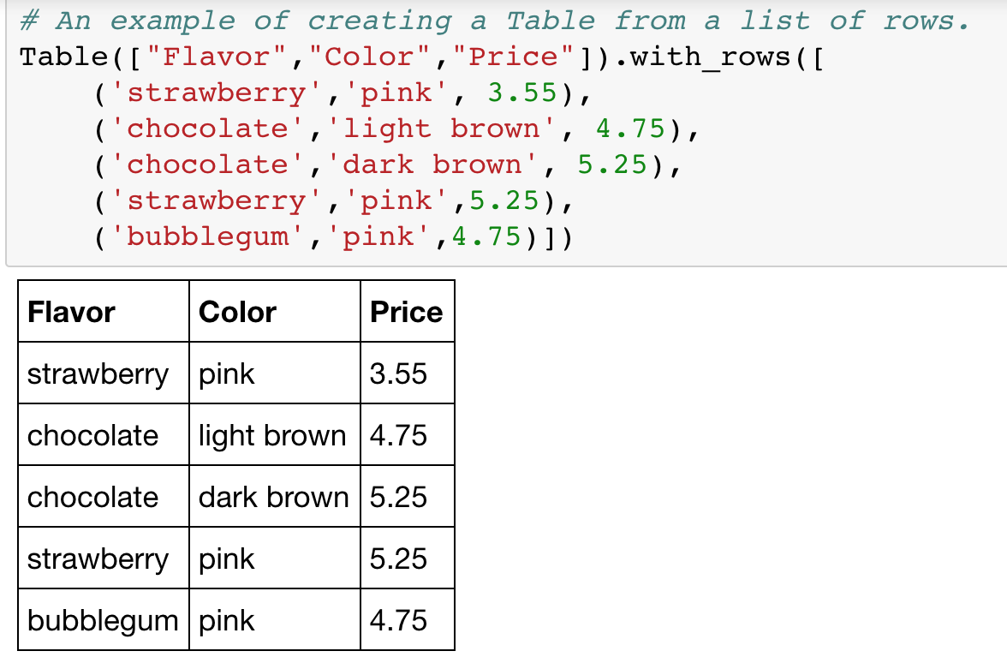
SQL: Describe The Shape of the result!

Slide 30
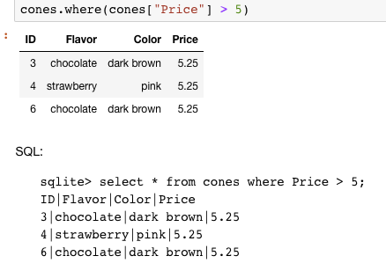
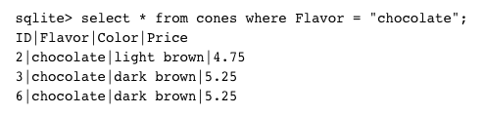
What if I want a table with just a few rows?
Here the `where()` in Python is using the datascience module.

Slide 31
Summary
Paradigms are styles, guidelines for how to approach a program
Each is equally capable, but some are suited best to particular tasks.
Declarative programming gets us to think about the what rather than the how.
Almost no programs are purely single-paradigm

