Slide 1
Iterators and Generators

Slide 2
Announcements
Ants out!
Check out Review & Exam Prep Sections
times have moved a bit due to low attendance
Reminder: No class/OH/reviews on Friday
(random) Cool YouTube Video
https://www.youtube.com/watch?v=nmgFG7PUHfo
Signal Processing / History / Algorithmic Complexity

Slide 3
Today & Next Lecture
Sequences vs Iterables
Using iterators without generating all the data
Magic methods
__next__
__iter__
Generator concept
Generating an iterator from iteration with yield
Iterators – the iter protocol
__getitem__ protocol
Is an object iterable?
Lazy evaluation with iterators

Slide 4
Iterators & Genators

Slide 5
Why?
Iterators and similar patterns exist in many languages
We'll see more examples when we work with SQL
Often times, with large data we can't compute a result immediately.
What if we have infinite data?
A template for iteration makes solving (some) problems easy.

Slide 6
Review: Why Object-Oriented Design?
Approach creation of a class as a design problem
Meaningful behavior => methods [& attributes]
ADT methodology
What’s private and hidden? vs What’s public?
Design for composition:
Use consistent patterns to solve problems more easily.
Anticipate exceptional cases and unforeseen problems
try … catch
raise / assert

Slide 7
Review: What is a sequence? [Docs]
Sequence is an "ordered set"
list
tuples
ranges
strings
Some common operations:
Slicing syntax: data[1:3]
Membership: 'cs88' in courses
Concatenation: breakfast_foods + lunch_foods + dinner_foods
Count Items: 'cs88'.count('8')

Slide 8
Iterable - an object you can iterate over
iterable: An object capable of yielding its members one at a time.
iterator: An object representing a stream of data.
We have worked with many iterables as sequences
i.e. We haven't yet cared about the more generic forms.

Slide 9
Functions that return iterables
map, filter, zip
These objects are not sequences.
They are iterables. A "stream" of data we can iterate over.
Why?
Can't directly slice into them.
Don't know their length
If we want to see all the elements at once, we need to explicitly collect them, by using list() or tuple()

Slide 10
Using an iterator
data = map(lambda x: x*x, range(5))
# Iterate with for loops
for num in data:
print(num)
data = map(lambda x: x*x, range(5))
next(data) # returns 0
next(data) # returns 1 …
next(data) # eventually raises StopIteration error

Slide 11
How do for, list, tuple Work?
Python's built in tools use the iterator pattern to work!
for internally calls next() repeatedly
list() internally calls repeatedly
They handle the stop condition, adding to a list, etc.

Slide 12
Demo

Slide 13
Generator Expressions

Slide 14
Generator Expressions
We've used them as list comprehensions
Generator Expressions return iterators
access items by calling next()
An expression which computes its values on demand
Can be used in place of many sequences, like in for loops, map, etc.
>>> nums = (x * x for x in range(20))
>>> next(nums)
0
>>> next(nums)
1

Slide 15
Generator Expressions and Generators
Calling list() works, but it builds the result in one go.
This loses the benefits when we have large data!
Generator Expressions are a short-hand to make iterators
Generators allow us to successively generate (get it?) the next result!

Slide 16
Generator Functions

Slide 17
Terminology [Docs]
generator
A function which returns a generator iterator. It looks like a normal function except that it contains yield expressions for producing a series of values usable in a for-loop or that can be retrieved one at a time with the next() function.
generator iterator
An object created by a generator function.

Slide 18
Generators: turning iteration into an iterable
Generator functions use the yield keyword
Generator functions have no return statement, but they don’t return None
They implicitly return a generator object
Generator objects are just iterators
def squares(n):
for i in range(n):
yield (i*i)

Slide 19
Spongebob Case
def spongebob_case(text):
caps = True
for letter in text:
if caps:
yield letter.upper()
else:
yield letter.lower()
caps = not caps
Generate one letter at a time.
Explore how caps changes with each iteration.

Slide 20
Nest iteration
def all_pairs(x):
for item1 in x:
for item2 in x:
yield(item1, item2)

Slide 21
Order of Execution
Our generator function executes until we hit yield
Once we hit yield, execution is paused
Explore this with print statements

Slide 22
Iterators

Slide 23
What's an Iterator? [Docs]
iterator
An object representing a stream of data. Repeated calls to the iterator’s __next__() method (or passing it to the built-in function next()) return successive items in the stream. When no more data are available a StopIteration exception is raised instead.
iterable
An object capable of returning its members one at a time. Examples of include all sequence types and objects of any classes you define with an __iter__() method or with a __getitem__() method that implements sequence semantics.

Slide 24
Next element in generator iterable
Iterables work because they implement some "magic methods" on them. We saw magic methods when we learned about classes,
e.g., __init__, __repr__ and __str__.
The first one we see for iterables is __next__
iter() – transforms a sequence into an iterator
Usually this is not necessary, but can be useful.

Slide 25
Iterators: The iter protocol [Docs]
In order to be iterable, a class must implement the iter protocol
The iterator objects themselves are required to support the following two methods, which together form the iterator protocol:
__iter__: Return the iterator object itself. This is required to allow both containers and iterators to be used with the for and in statements.
This method returns an iterator object (which can be self)
__next__ : Return the next item from the container. If there are no further items, raise the StopIteration exception.

Slide 26
The Iter Protocol In Practice
Classes get to define how they are iterated over by defining these methods
containers (objects like lists, tuples, etc) typically define a Container class and a separate ContainterIterator class.
Lists, Ranges, etc are not directly iterators
We cannot call next() on them.
However, they implement an __iter__ method, and list_iterator, range_iterator class, etc.

Slide 27
Iterables
Demo

Slide 28
Building a Range Iterator

Slide 29
Making a Range Iterator
What does a range need?
Start value
Stop
(We'll ignore step sizes)
keep track of the current value
An __iter__ method
A __next__ method

Slide 30
Example
class myrange:
def __init__(self, n):
self.i = 0
self.n = n
def __iter__(self):
return self
def __next__(self):
if self.i < self.n:
current = self.i
self.i += 1
return current
else:
raise StopIteration()

Slide 31
The GetItem Protocol

Slide 32
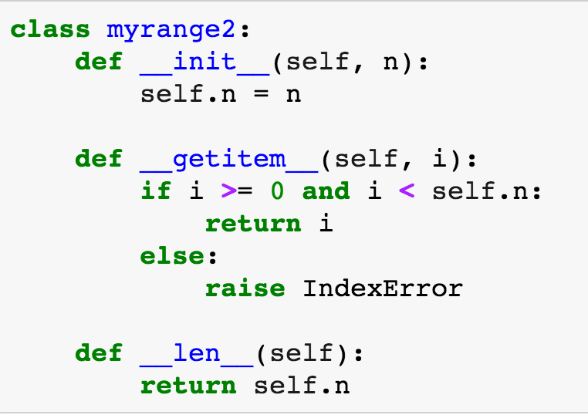
Get Item protocol
Another way an object can behave like a sequence is indexing: Using square brackets “[ ]” to access specific items in an object.
Defined by special method: __getitem__(self, i)
Method returns the item at a given index

Slide 33
Iterators and Generators Review

Slide 34
Terms and Tools
Iterators: Objects which we can use in a for loop
Anything that can be looped over!
Sometimes they’re lazy, sometimes not!
Generators: A shorthand way to make an iterator that uses yield
a function that uses yield is a generator function
a generator function returns a generator object
Generators do not use return
Sequences: A particular type of iterable
They know they’re length, support slicing
Are not lazy

Slide 36
Type Checking

Slide 37
Determining if an object is iterable
from collections.abc import Iterable
isinstance([1,2,3], Iterable)
This is more general than checking for any list of particular type, e.g., list, tuple, string...

