Slide 1
Lecture 4: Sequences and for Loops
Notes:
1

Slide 2
Announcements
Concurrent Enrollment / BGA Students:
- Working on expanding the class, should happen next week
Lab Autograders:
You only need 2/4 for full credit.
Please do the welcome survey

Slide 3
Assignments And Extensions
Everyone gets 9 slip days – use them!
https://go.c88c.org/extensions
For exceptional circumstances.
Please don't request for < 3 days.
Don't request for Lab 0
If you've joined late, please request extensions if necessary
https://go.c88c.org/chat
https://c88c.org/fa22 -- previous slides

Slide 4
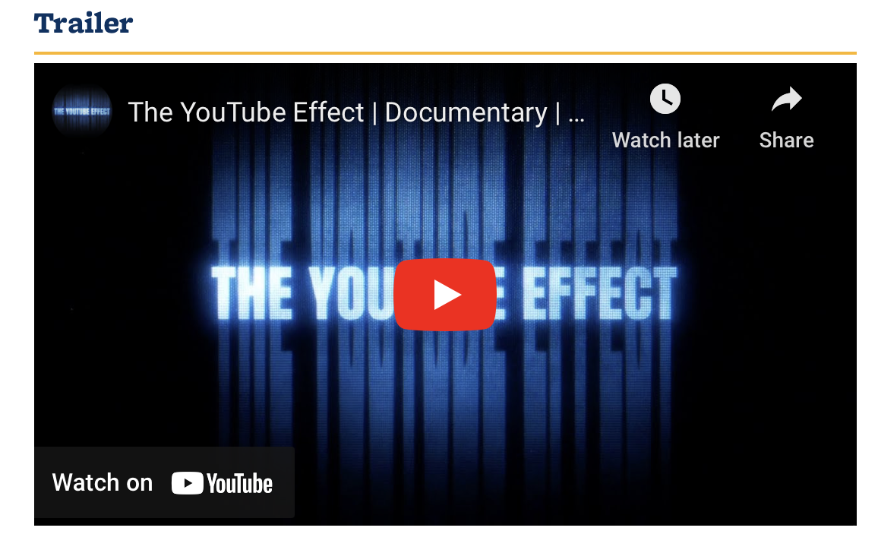
CITN: “The YouTube Effect” Screening & Panel Discussion
Thurs, September 14, 2023
2:00 pm to 5:00 pm
Banatao Auditorium, Sutardja Dai Hall, UC Berkeley
SPONSORED BY THE SCHOOL OF INFORMATION AND THE CITRIS POLICY LAB
Join us for a screening of the new film The YouTube Effect, followed by a panel discussion with the filmmaker, Alex Winter, and a panel of Berkeley experts.
About the Film
The YouTube Effect, a documentary by Alex Winter, had its world premiere at the Tribeca Festival. The film takes viewers on a timely and gripping journey inside the cloistered world of YouTube and parent Google.
The film, presented by Olive Hill Media and produced by Valhalla Entertainment, Trouper Productions and Zipper Bros., investigates YouTube’s rise from humble beginnings in the attic of a pizzeria to its explosion onto the world stage, becoming the largest media platform in history and sparking a cultural revolution, while creating massive controversy in the age of disinformation.
Watch Trailer (on YouTube!)

Slide 5
for Loops
Notes:
5

Slide 6
Learning Objectives: Using Lists in Practice
for Loops are a ”generic” way to iterate over data.
Compare a for loop and a while loop.
Learn to use range()
Use a string as a sequence of letters

Slide 7
REVIEW: while statement – iteration control
Repeat a block of statements until a predicate expression is satisfied
<initialization statements>
while <predicate expression>:
<body statements>
<rest of the program>
# Equivalent to a for loop:
text = "Hello, C88C!"
index = 0
while index < len(text):
letter = text[index]
print(letter)
index += 1

Slide 8
for Statement – Iteration Control
Repeat a block of statements for a structured sequence of variable bindings
<initialization statements>
for <variables> in <sequence expression>:
<body statements>
<rest of the program>

Slide 9
Live Coding Demo
text = "Hello, C88C!"
index = 0
while index < len(text):
letter = text[index]
print(letter)
index += 1
for letter in text:
print(letter)

Slide 10
Live Coding Demo
index = 0
while index < 10:
print(index)
index += 1
for index in range(0, 10):
print(index)

Slide 11
Sequences
Notes:
11

Slide 12
<sequence expression> — What's that?
Sequences are a type of data that can broken down into smaller parts.
Common sequences:
range() – gimme all the numbers
strings
lists (next!)
We'll start with two basic facts:
range(10) is the numbers 0 to 9, or range(0, 10)
[] means "indexing" an item in a sequence.
"Hello"[0] == "H"

Slide 13
Live Coding Demo

Slide 14
Learning Objectives
Lists are a type of sequence
There are many types of sequences in Python.
range
string
tuples
Sequences all share some common properties.

Slide 15
Sequences
The term sequence refers generally to a data structure consisting of an indexed collection of values, which we’ll generally call elements.
That is, there is a first, second, third value (which CS types call #0, #1, #2, etc.)
A sequence may be finite (with a length) or infinite.
It may be mutable (elements can change) or immutable.
It may be indexable: its elements may be accessed via selection by their indices.
It may be iterable: its values may be accessed sequentially from first to last.

Slide 16
range
range() is a built in Python tool that generates a sequence of numbers.
It does not return a list unless we explicitly ask for one.
It has many options: start, stop, and step.
Range is lazy! It can be iterated over, but doesn’t compute all its values at once.
We’ll revisit this later.
GOTCHA: Range is exclusive in the last value!
range(10) is a sequence on 10 numbers from 0 to 9.
https://docs.python.org/3.7/library/stdtypes.html?highlight=range#range

Slide 17
Lists
Notes:
17

Slide 18
Learning Objectives
Lists are a new data type in Python.
Lists can store any kind of data and be any length.
We start counting items of lists at 0.
Lists are mutable. We can change their data!

Slide 19
Lists
A structure in Python that can hold many elements
Also referred to an an “array” in other programming languages.
Lists are used to group similar items together.
A “contact list”, a “list of courses”, a “to do list”
Python lists are really flexible!
Can contain any type of data
Can mix and match types!
Can add and delete items

Slide 20
Types We’ve Learned So Far
Each type of data has a specific set of functions (methods) you can apply to them, and certain properties you can access.
int / Integers
1, -1, 0, …
float (“decimal numbers”)
1.0, 3.14159, 20.0
string
"Hello, CS88"
function
max(), min(), print(), your own functions!
list
['CS88', 'DATA8', 'POLSCI2', 'PHILR1B’]

Slide 21
List Operations [Python Docs!]
[] ”square brackets”: Used to access items in a list. We start at 0!
len(): The number of items in a list
+: We can add lists together
min(), max(): Functions that take in a list and return some info.
Converting between types: Strings and Lists:
<string>.split(<separator>) → List of strings
'I am taking CS88.'.split(' ')
<string>.join(<list>) → String, with the items of a list joined together.
' '.join(['I', 'am', 'taking', 'C88C.'])
Lots more interesting tools!

Slide 22
Selecting Elements From a List (A Reference, Don't Memorize Yet!)
• Selection refers to extracting elements by their index.
• Slicing refers to extracting subsequences.
• These work uniformly across sequence types.
L = [2,0,9,10,11]
S = "Hello, world!"
L[2]== 9
L[-1] == L[len(t)-1] == 11
S[1] == "e" # Each element of a string is a one-element string.
L[1:4] == (L[1], L[2], L[3]) == (0, 9, 10)
S[1:2] == S[1] == "e"
S[0:5] == "Hello", S[0:5:2] == "Hlo", S[4::-1] == "olleH"

Slide 23
Rules of Indexing & Slicing
We start counting from 0.
You will mess this up. We all do. It's ok.
There's lots of bad dad jokes about this. ☺
Python provides flexibility, but can be confusing.
[0] means the first item
[-1] means the last item, [-2] 2nd to last, and so on
Slicing: The last value is exclusive!
[:stop], e.g. my_list[:5] # items 0-4
[start:stop], e.g. my_list[2:5] # items 2,3,4
[start:stop:step] e.g. my_list[0:8:2] # items 0,2,4,6

Slide 24
Demo

Slide 25
List Comprehensions
Notes:
25

Slide 26
Learning Objectives
List comprehensions let us build lists "inline".
List comprehensions are an expression that returns a list.
We can easily “filter” the list using a conditional expression, i.e. if

Slide 27
Data-driven iteration
describe an expression to perform on each item in a sequence
let the data dictate the control
In some ways, nothing more than a concise for loop.
[ <expr with loop var> for <loop var> in <sequence expr > ]
[ <expr with loop var> for <loop var> in <sequence expr > if <conditional expression with loop var> ]

Slide 28
Control Structures Review
The result of list(range(0,10)) is… A) [0, 1, 2, 3, 4, 5, 6, 7, 8, 9] B) [0, 1, 2, 3, 4, 5, 6, 7, 8, 9, 10] C) [1, 2, 3, 4, 5, 6, 7, 8, 9, 10] D) [1, 2, 3, 4, 5, 6, 7, 8, 9] E) an error
Solution: A) list(range(m,n)) creates a list with elements from m to n-1.

Slide 29
iClicker Question
What is the value of thing after running:
thing = [ print('I like '+ course) for course in courses ]
Nothing
[ “I like CS88”, “I like DATA8”, … ]
[]
[ None, None, None, None ]
Error

Slide 30
iClicker Question
>>> uni = ‘The University of California at Berkeley’
>>> words = uni.split(‘ ‘)
>>> thing = [ w[0] for w in words ] A) [] B) [‘The’, ’University’, ‘of’, ‘California’, ‘at’, ‘Berkeley’ ] C) ‘TUoCaB’ D) [ ‘T’, ‘U’, ‘o’, ‘C’, ‘a’, ‘B’ ] E) Error
Solution: D)

Slide 31
Control Structures Review
The result of [i for i in range(3,9) if i % 2 == 1] is…
A) [3, 4, 5, 6, 7, 8, 9] B) [3, 4, 5, 6, 7, 8] C) [1, 3, 5, 7, 9] D) [3, 5, 7, 9] E) [3, 5, 7]
Solution: E) [3, 5, 7]

Slide 32
Additional Types
ranges
A function, but is also its own type
range(0, 10)
A “sequence”.
tuple / A list you cannot change.
('CS88', 'DATA8', 'POLSCI2', 'PHILR1B’)
More sequence types:
map
filter

Slide 33
Example “Acronym”
“The University of California at Berkeley” → “UCB"

Slide 34
Three super important HOFS (Wait for lab)
* For the builtin filter/map, you need to then call list on it to get a list. If we define our own, we do not need to call list
list(map(function_to_apply, list_of_inputs))
Applies function to each element of the list
list(filter(condition, list_of_inputs))
Returns a list of elements for which the condition is true
reduce(function, list_of_inputs)
Reduces the list to a result, given the function
09/23/19
UCB CS88 Fa19 L3
34

